Slide 1
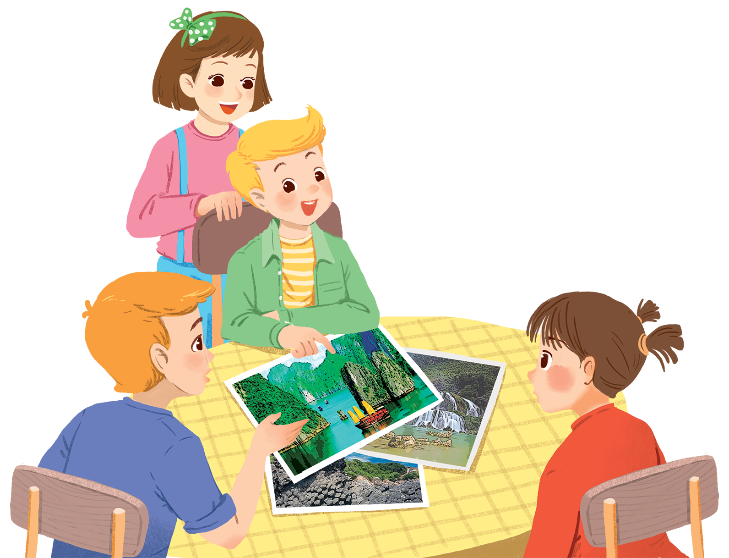
      UNIT 5: NATURAL WONDERS OF VIETNAM
      LESSON 2: A CLOSER LOOK 1
English 6

Slide 2


Vocabulary
1
Write a word under each picture. Practise saying the words.
2
Complete the following sentences. Use the words in 1.
3
Now put the items in order of usefulness. Number 1 is the most useful, number 6 is the least useful on holiday.
Pronunciation
/t/ and /d/
4
Listen and repeat the words.
5
Listen and repeat. Pay attention to the bold-typed parts of the words.

Slide 3
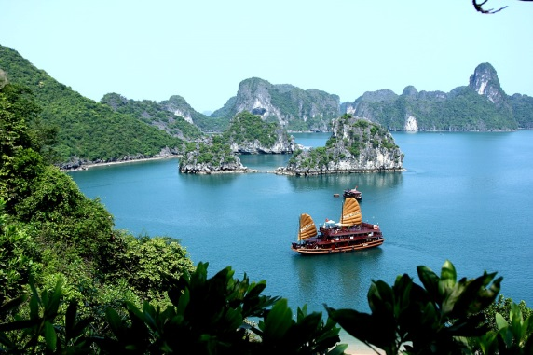
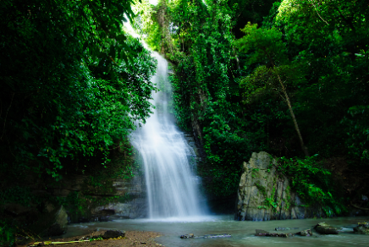
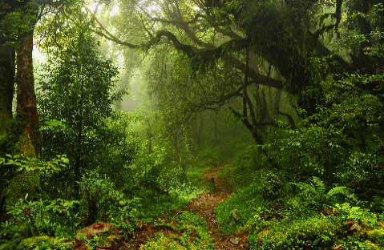
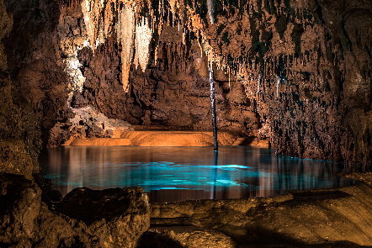
Forest
Bay
Cav e
1
2
3
Waterfall
4
Natural Wonder
5
6
7
8
There is ONE match - Vietnam Natural Wonder

Slide 4


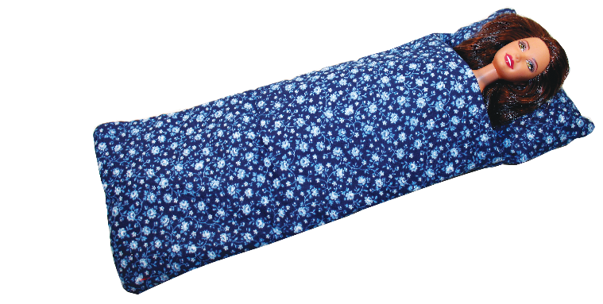
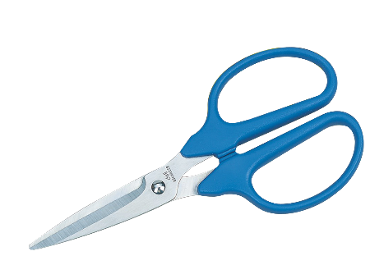
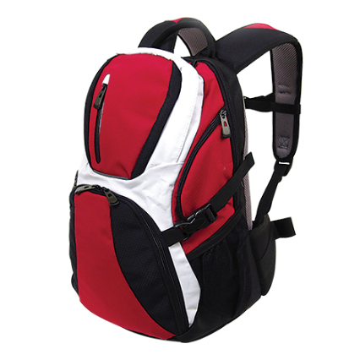

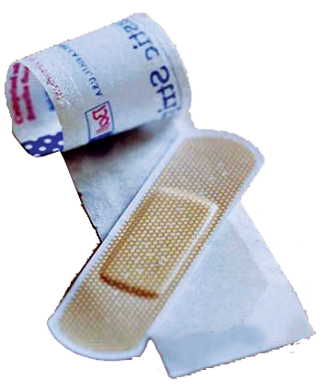
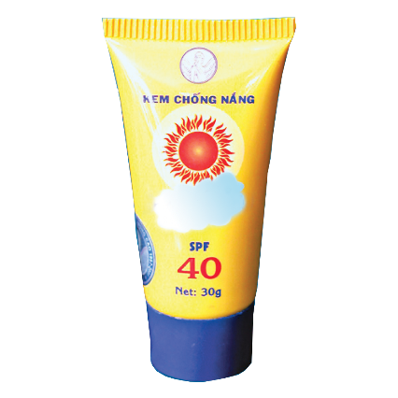
U5 L2
Vocabulary
‘plaster (n)
băng, gạc y tế
‘sleeping bag (n)
túi ngủ
‘backpack (n)
ba lô
‘compass (n)
la bàn
sun cream (n)
kem chống nắng
‘scissors (n)
cái kéo

Slide 5
Rub out and remember
plaster (n)
băng, gạc y tế
sleeping bag (n)
túi ngủ
backpack (n)
ba lô
compass (n)
la bàn
sun cream (n)
kem chống nắng
scissors (n)
cái kéo

Slide 6
Vocabulary

Slide 7
1
Write a word under each picture.
Practise saying the words.
plaster
sleeping bag
backpack
compass
suncream
scissors
1. plaster
2. suncream
3. sleeping bag
1.
2.
3.
4. scissors
5. backpack
6. compass
4.
5.
6.

Slide 8
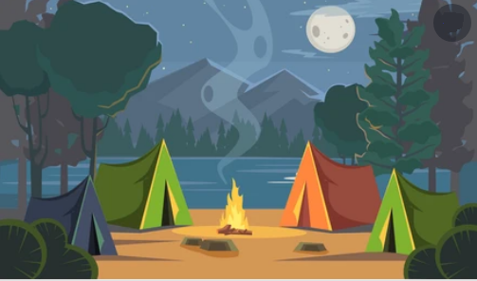

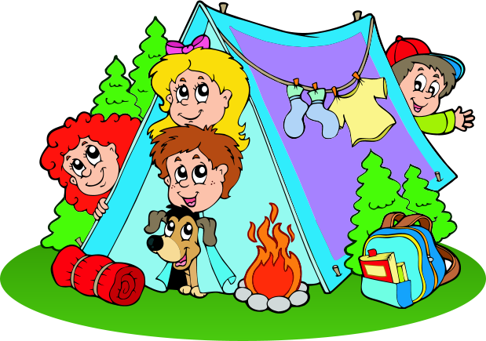

Slide 9
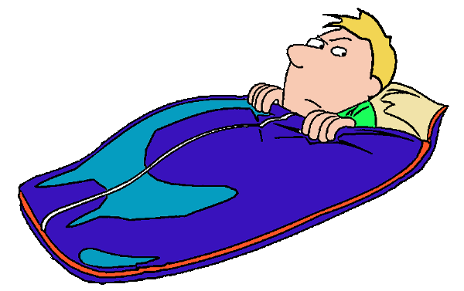

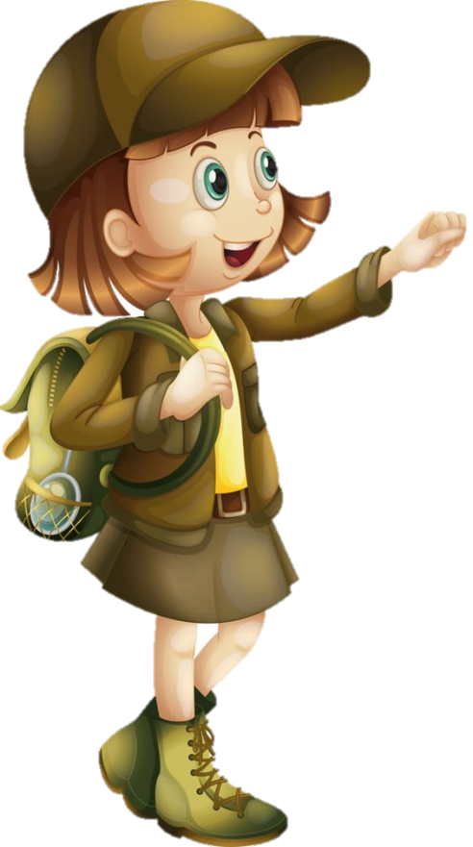

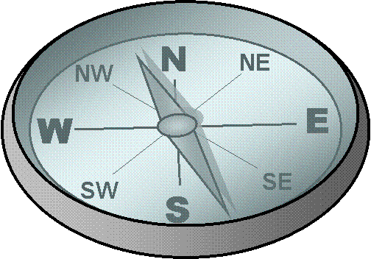

1
1
I should carry a ……….
2
3
4

Slide 10
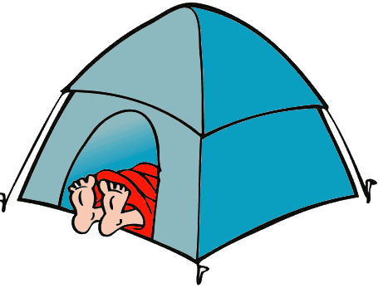
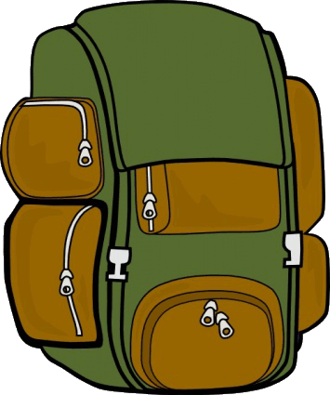
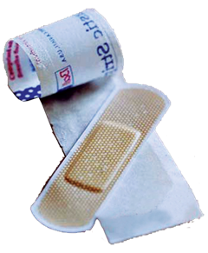

2
1
I should carry a ……….
2
3
4

Slide 11
3
1
I should carry a ……….
2
3
4

Slide 12
4
1
I should carry ……….
2
3
4

Slide 13
5
1
I should carry ……….
2
3
4

Slide 14
6
1
I should carry a ……….
2
3
4

Slide 15
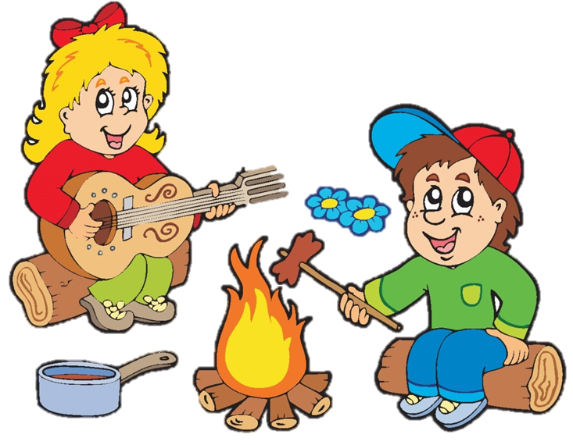
We’re lost. Please give me the ……
compass

Slide 16
It’s so sunny today. I need to put on some ……
sunscream

Slide 17
A ……………..…… is very useful when you go camping overnight.
sleeping bag

Slide 18
I’ve finished packing. All my things are in my ……………..
backback

Slide 19
My foot hurts. I need to put a ………… on my foot.
plaster

Slide 20
2
Complete the following sentences. Use the words in 1.
We’re lost. Please give me the .
1.
compass
suncream
2.
It’s so sunny today. I need to put on some .
sleeping bag
is very useful when you go camping overnight.
3.
A
is very useful when you go camping overnight.
4.
I’ve finished packing. All my things are in my .
backpack
5.
plaster
My foot hurts. I need to put a on my foot.

Slide 21
3
Now put the items in order of usefulness. Number 1 is the most useful, number 6 is the least useful on holiday.
plaster
sleeping bag
backpack
compass
suncream
scissors
1.
backpack
2.
sleeping bag
3.
compass
4.
plaster
5.
suncream
6.
scissors

Slide 22
Pronunciation
/t/ and /d/

Slide 23
4
Listen and repeat the words.
/t/ | /d/
mountain waterfall desert plaster | wonder island guide holiday

Slide 24
5
Listen and repeat. Pay attention to the bold-typed parts of the words.
1.
Where’s my hat?
Oh, it’s on your head.
2.
Where do they stay on their holiday?
3.
I need some meat for my cat.
4.
The Sahara is a very hot desert.
5.
I want to explore the island by boat.

Slide 25

Game: Whispering
Students stand in four lines. The member in the last place will make a sentence containing at least a word and a sound they have learnt; then, whisper the sentence to the next member of the group. They will continue until the member in the first place and this member will say the sentence aloud. The fastest group will win the game. Suggested sentences: I must bring a plaster when going camping. I want to visit a famous desert in the world. He lives in a quiet island.

Slide 26

Homework
  Learn vocabulary and the structure by heart.
  Do exercise in your work book
  Prepare the next lesson: A closer look 2

