Slide 1
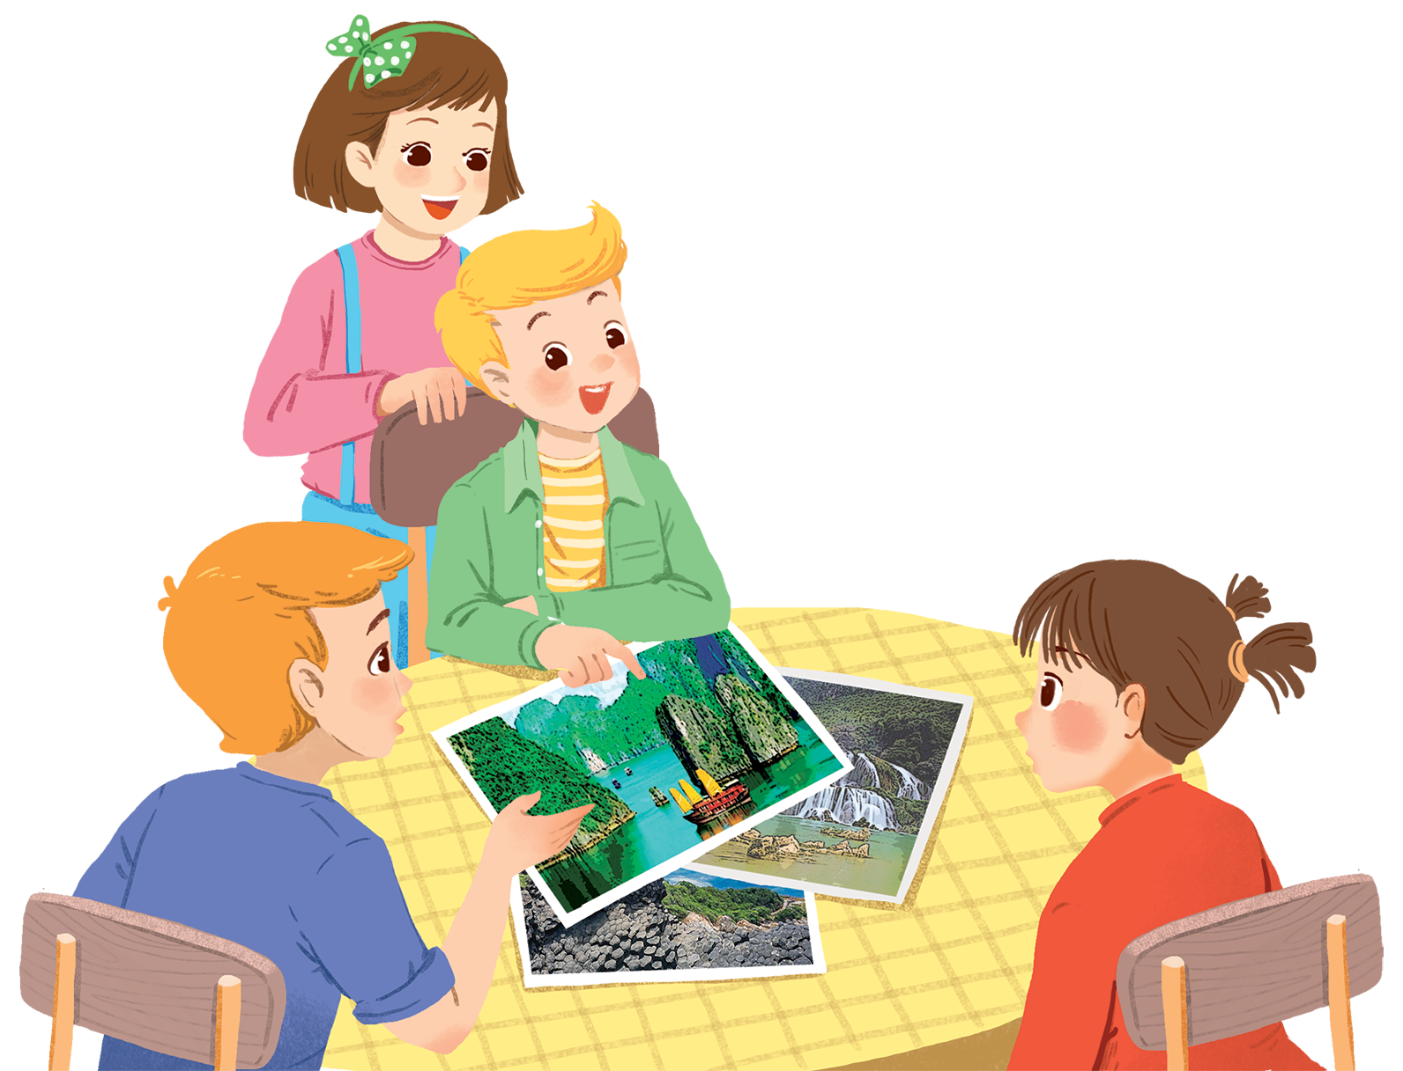
UNIT 5: NATURAL WONDERS OF VIETNAM
LESSON 1: GETTING STARTED
English 6

Slide 2



Geography Club
1
Listen and read.
2
Complete the following sentences with the words from the box.
3
Listen and repeat the words, then label the pictures.
4
Work in groups. Choose the correct answer to each of the questions.

Slide 3


Hidden Picture Game

Slide 4
Instructions
Divide the class into two halves.
One student from the first half calls out an adjective from unit4.
One student from the second half has to give the comparative form of the adjective (1 point), and find out the hidden picture - What is it?

Slide 5
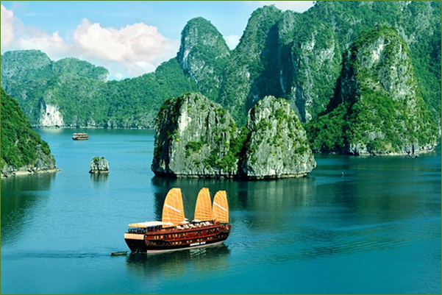
1
2
3
4
5
6
8
7

Slide 6

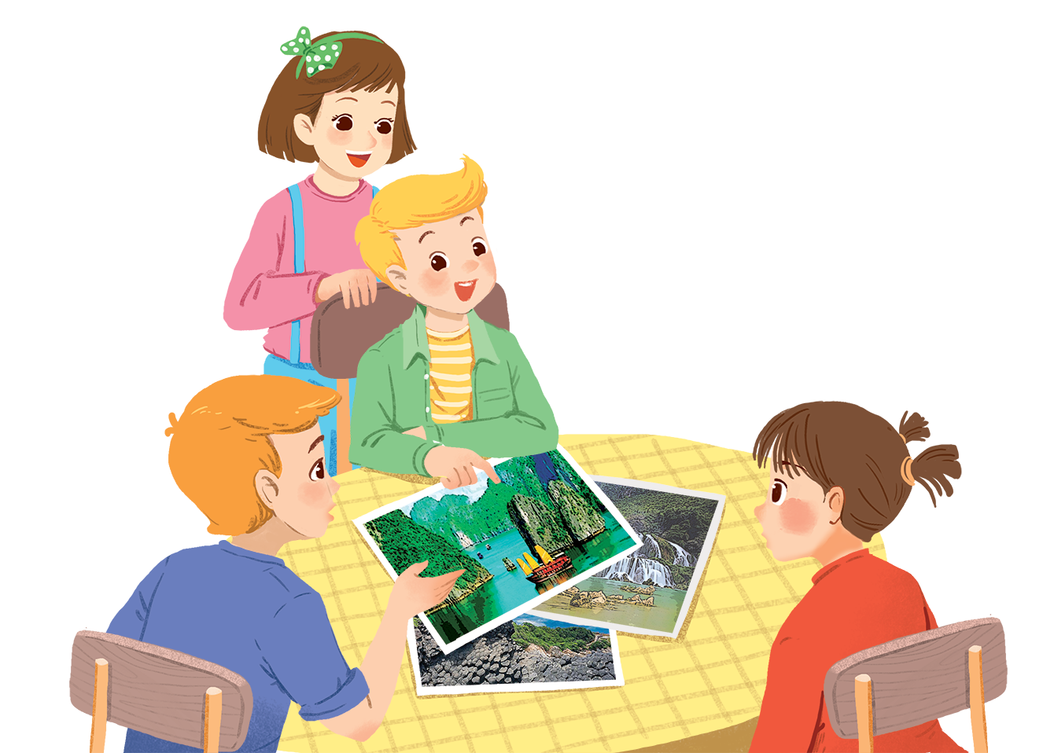
1
Listen and read.
Geopraphy Club
Who are they?
What are they looking at?
What are they talking about?
Notes:
Thiếu tên bài đọc.

Slide 7
Geopraphy Club
Alice: Hello, welcome to our Geography Club.
(Knock at door)
Alice: Come in, Elena. We’re just starting now.
But remember you must always be on time.
Elena: Sure. Sorry.
Alice: Today I’m going to talk about some natural wonders of Viet Nam.
Nick: Great! What’s that in the first picture?
Alice: It’s Ganh Da Dia in Phu Yen.
Elena: Wow. It looks amazing!
Nick: Is picture 2 Ha Long Bay?
Alice: Right. What do you know about it?
Nick: It has many islands.
Alice: Yeah! The scenery is wonderful. This picture shows Tuan Chau, a large island.
Tommy: How about picture 3?
…

Slide 8


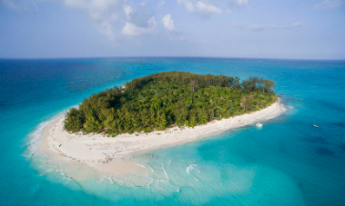
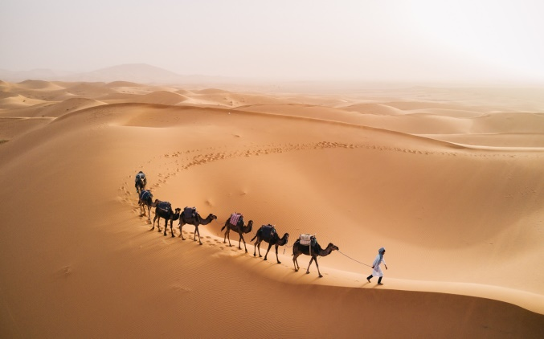
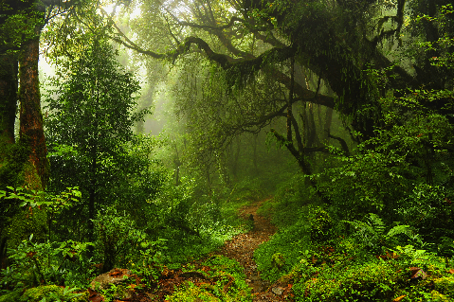
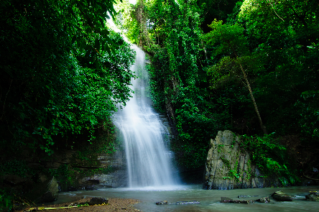
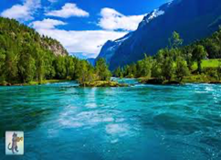
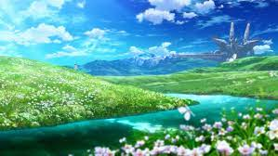
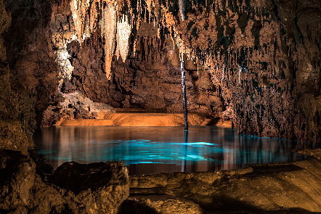
U5 L1
Vocabulary
‘natural ‘wonders (phr)
kì quan thiên nhiên
‘scenery (n)
phong cảnh
‘island (n)
hòn đảo
de‘sert (n)
sa mạc
cave (n)
hang động
‘waterfall (n)
thác nước
‘forest (n)
khu rừng

Slide 9
What and Where
natural
wonders
forest
desert
scenery
island
waterfall
cave

Slide 10
Questions.
1. Who is the leader of Geography Club?
→ Alice
2. What are they talking about?
→ They are talking about some natural wonders of Viet Nam
3. What is Ganh Da Dia ? And where?
→ They are Rocks in Phu Yen
4. Does Ha Long Bay have thousands of big and small
→ Yes, it does.

Slide 11
2
Complete the following sentences with the words from the box.
scenery
amazing
natural
islands
wonders
1.
People didn’t make Ganh Da Dia.
They are rocks.
natural
Ha Long Bay has thousands of big and small .
2.
islands
scenery
3.
Ha Long Bay is charming and the is wonderful.
Ganh Da Dia has rock columns of different shapes and sizes.
4.
amazing
5.
wonders
There are many natural and man-made in Viet Nam.

Slide 12
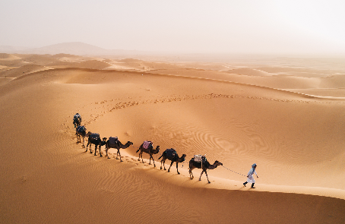
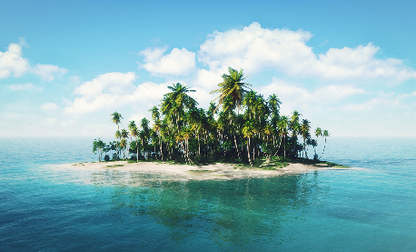
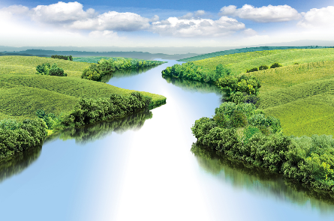
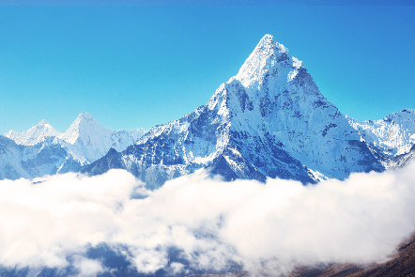
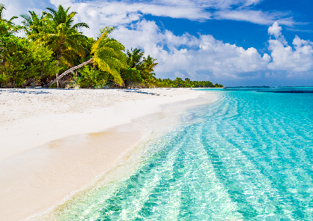
3
Listen and repeat the words, then label the pictures.
1. mountain
3. waterfall
5. cave
7. beach
2. river
4. forest
6. desert
8. island
a.
desert
b.
island
c.
cave
d.
river
e.
waterfall
f.
mountain
g.
forest
h.
beach

Slide 13

Work in groups. Choose the correct answer to each of the questions.
4
1.
Which is an island in Viet Nam?
A.
Con Dao
B.
Son Doong
2.
Where is Mount Fansipan?
A.
In Lao Cai
B.
In Quang Binh
3.
Which of the following is a national park?
A.
Thong Nhat Park
B.
Cat Tien Park
4.
Which of the following wonders is a cave?
A.
Cuc Phuong
B.
Phong Nha
5.
Which waterfall is in Cao Bang?
A.
Giang Dien Waterfall
B.
Ban Gioc Waterfall

Slide 14


Homework
Learn vocabulary and the structure by heart.
Do exercises in your work book
Prepare the next lesson: A closer look 1

