Slide 1
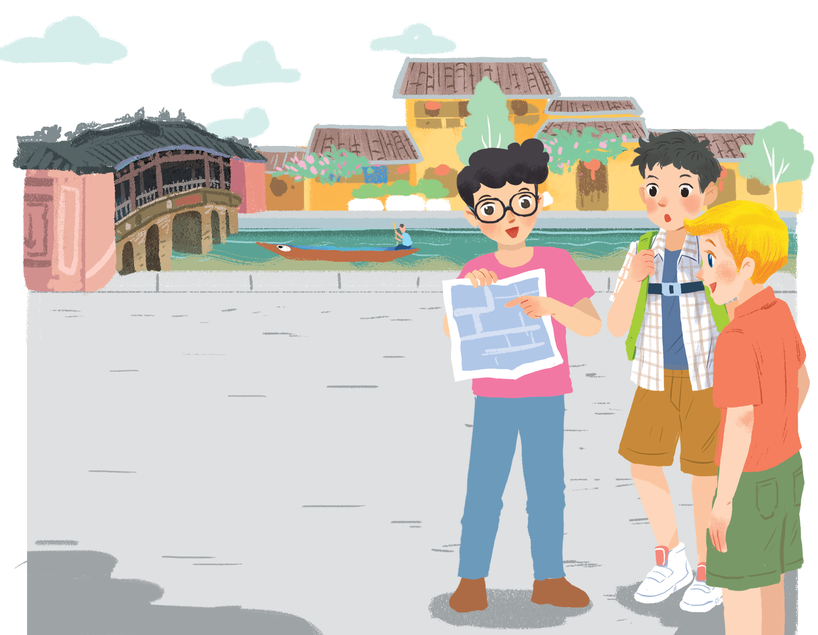
      UNIT 4: MY NEIGHBOURHOOD
      LESSON 7: LOOKING BACK - PROJECT
English 6

Slide 2



Vocabulary
1
Write the name for each picture.
Grammar
2
Put the following adjectives in the correct column.
3
Now write their comparative forms in the table below.
4
Complete the sentences comparing the pictures. Use the comparative forms of the adjectives below.

Slide 3
Vocabulary

Slide 4
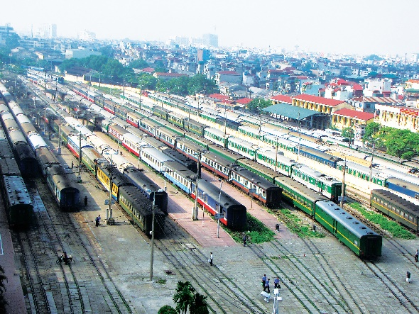
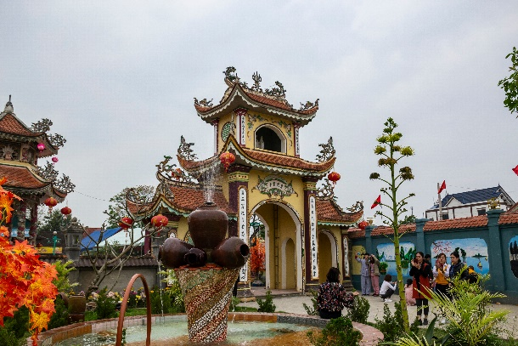
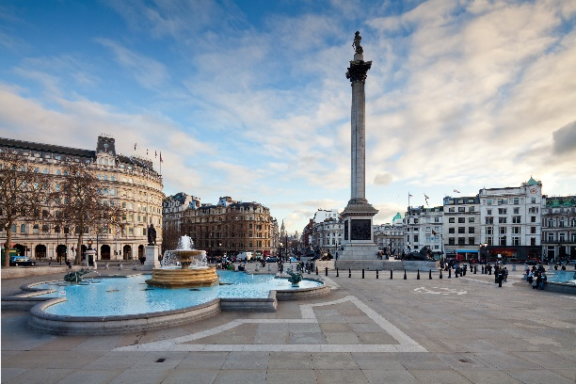
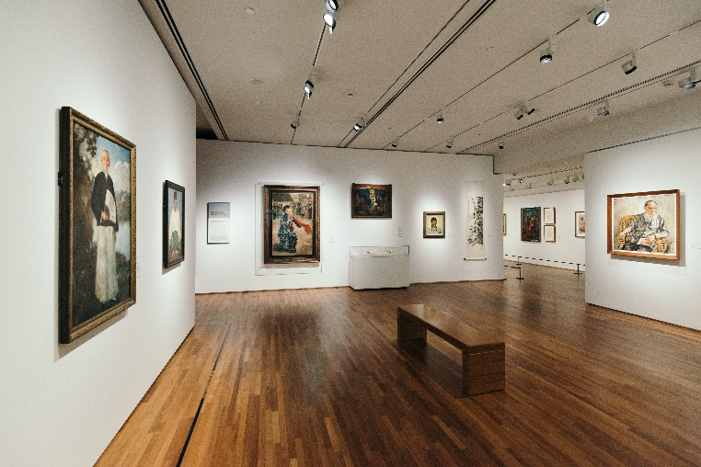
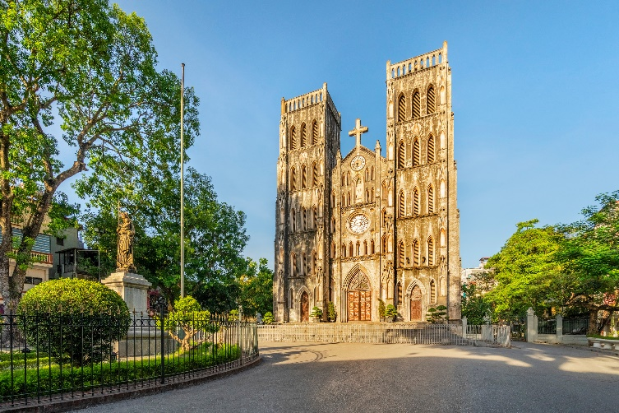
1
Write the name for each picture.
1. temple
1.
2. railway station
2.
3. square
3.
5. cathedral
5.
5. cathedral
5.

Slide 5
Grammar

Slide 6
2
Put the following adjectives in the correct column.
fast
hot
large
expensive
exciting
fast
hot
large
expensive
exciting
heavy
noisy
quiet
beautiful
heavy
noisy
quiet
beautiful
One syllable | Two syllables | Three or more syllables
fast
heavy
expensive
hot
noisy
exciting
large
quiet
beautiful

Slide 7
3
Now write their comparative forms in the table below.
Adjectives | Comparative form
fast | faster
beautiful
noisy
expensive
hot
exciting
quiet
heavy
large
more beautiful
noisier
more expensive
hotter
more exciting
quieter
heavier
larger

Slide 8
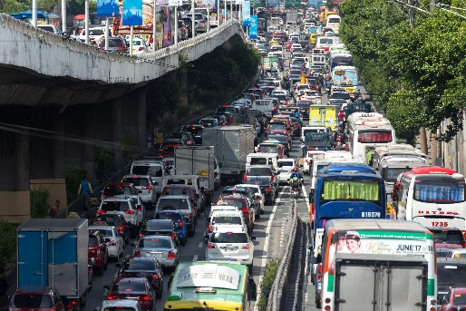
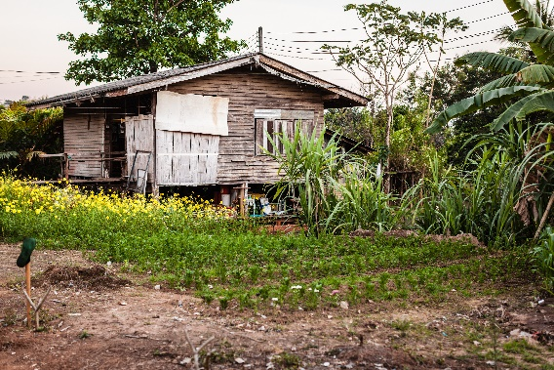
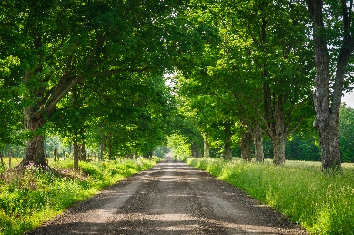
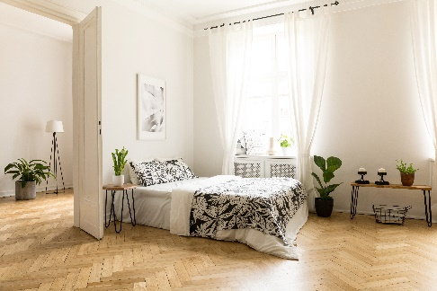
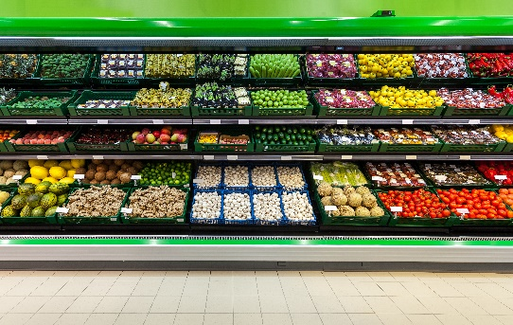
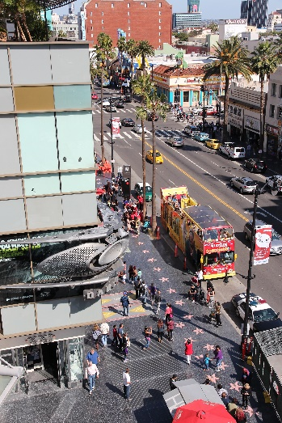
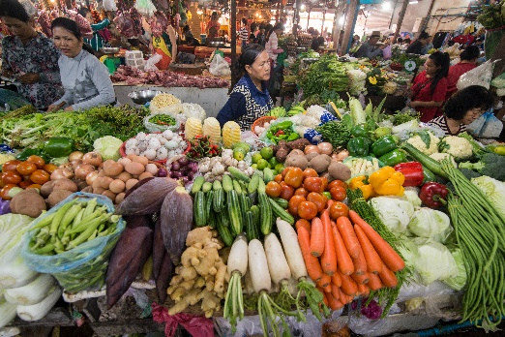
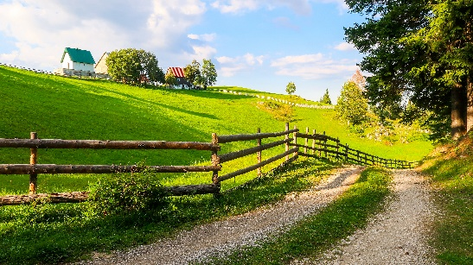
4
Complete the sentences comparing the pictures. Use the comparative forms of the adjectives below.
expensive
noisy
modern
peaceful

Slide 9











Team A
Team B
10
10
10
blue fish
yellow fish
yellow and back fish
orange fish
red fish
colorful fish
green and yellow fish
unlucky
lucky
10

Slide 10
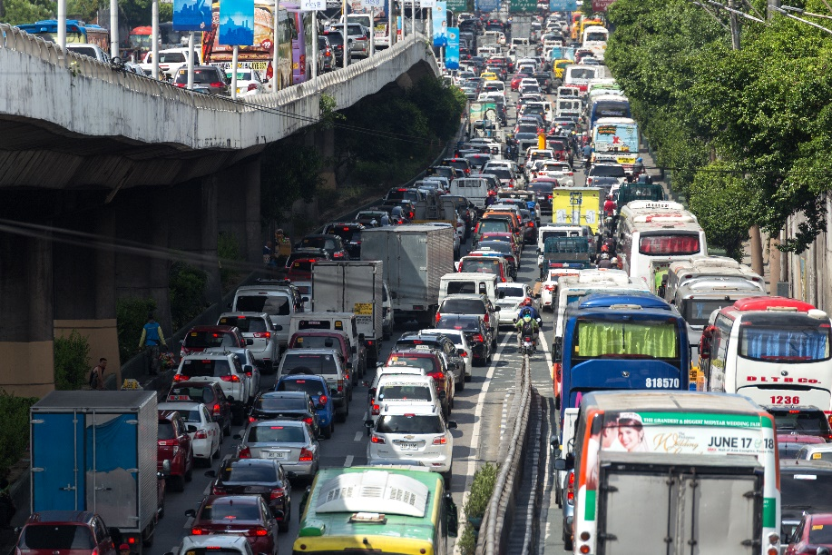


expensive
noisy
modern
peaceful
1. This street is noisier than that one.
1.
This street is than that one.

Slide 11


expensive
noisy
modern
peaceful
2.
2. A city house is more modern than a country house.
A city house is than a country house.

Slide 12
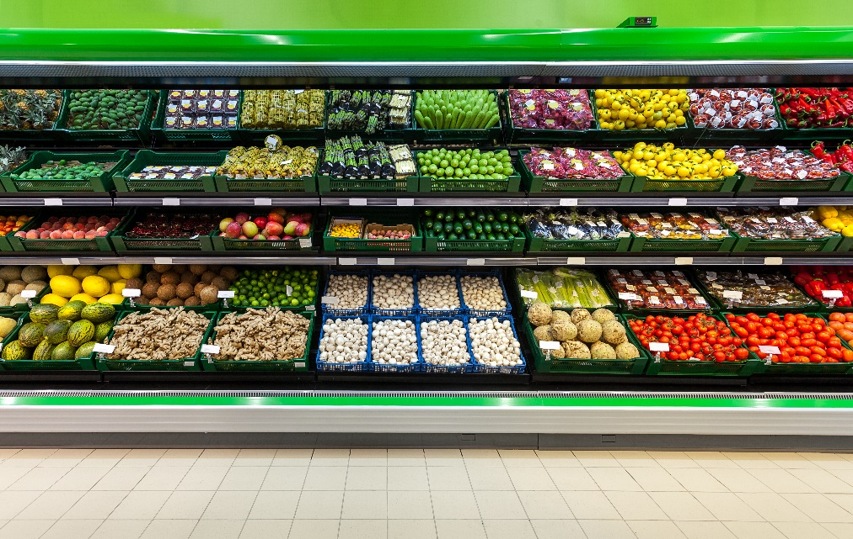

expensive
noisy
modern
peaceful
3.
3. Things at a corner shop are more expensive than things at a village market.
Things at a corner shop are than things at a village market.

Slide 13


expensive
noisy
modern
peaceful
4. Life in the countryside is more peaceful than life
in the city.
4.
Life in the countryside is than life in the city.

Slide 14




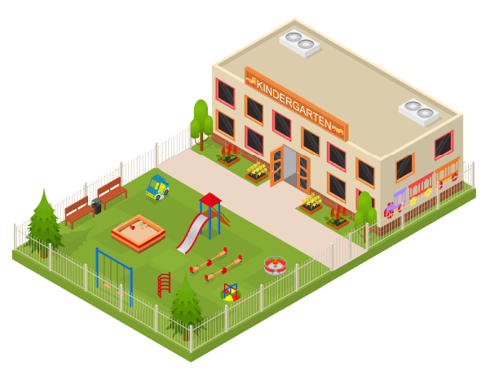
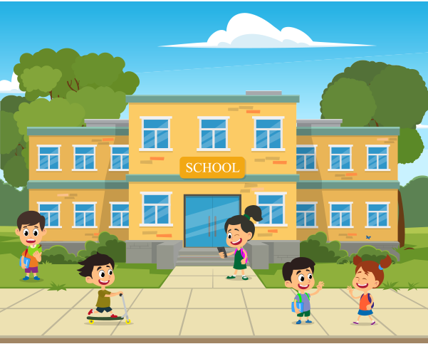
Draw a map of a neighbourhood. Write names of at least five places on your map.

Slide 15

Work in pairs. Take turns to ask for and give directions to the places on the map.

Slide 16
Now I can … |  |  | 
use the words to name places in a neighbourhood.
pronounce the sounds /ɪ/ and /i:/ correctly.
compare two people or things using comparative adjectives.
ask for and give directions.
read about a neighbourhood.
talk about a neighbourhood.
listen about a neighbourhood.
write a paragraph to describe a neighbourhood.

Slide 17

Homework
  Learn vocabulary and the structure by heart.
  Do exercise in your work book
  Prepare the next lesson: Getting Started

