Slide 1
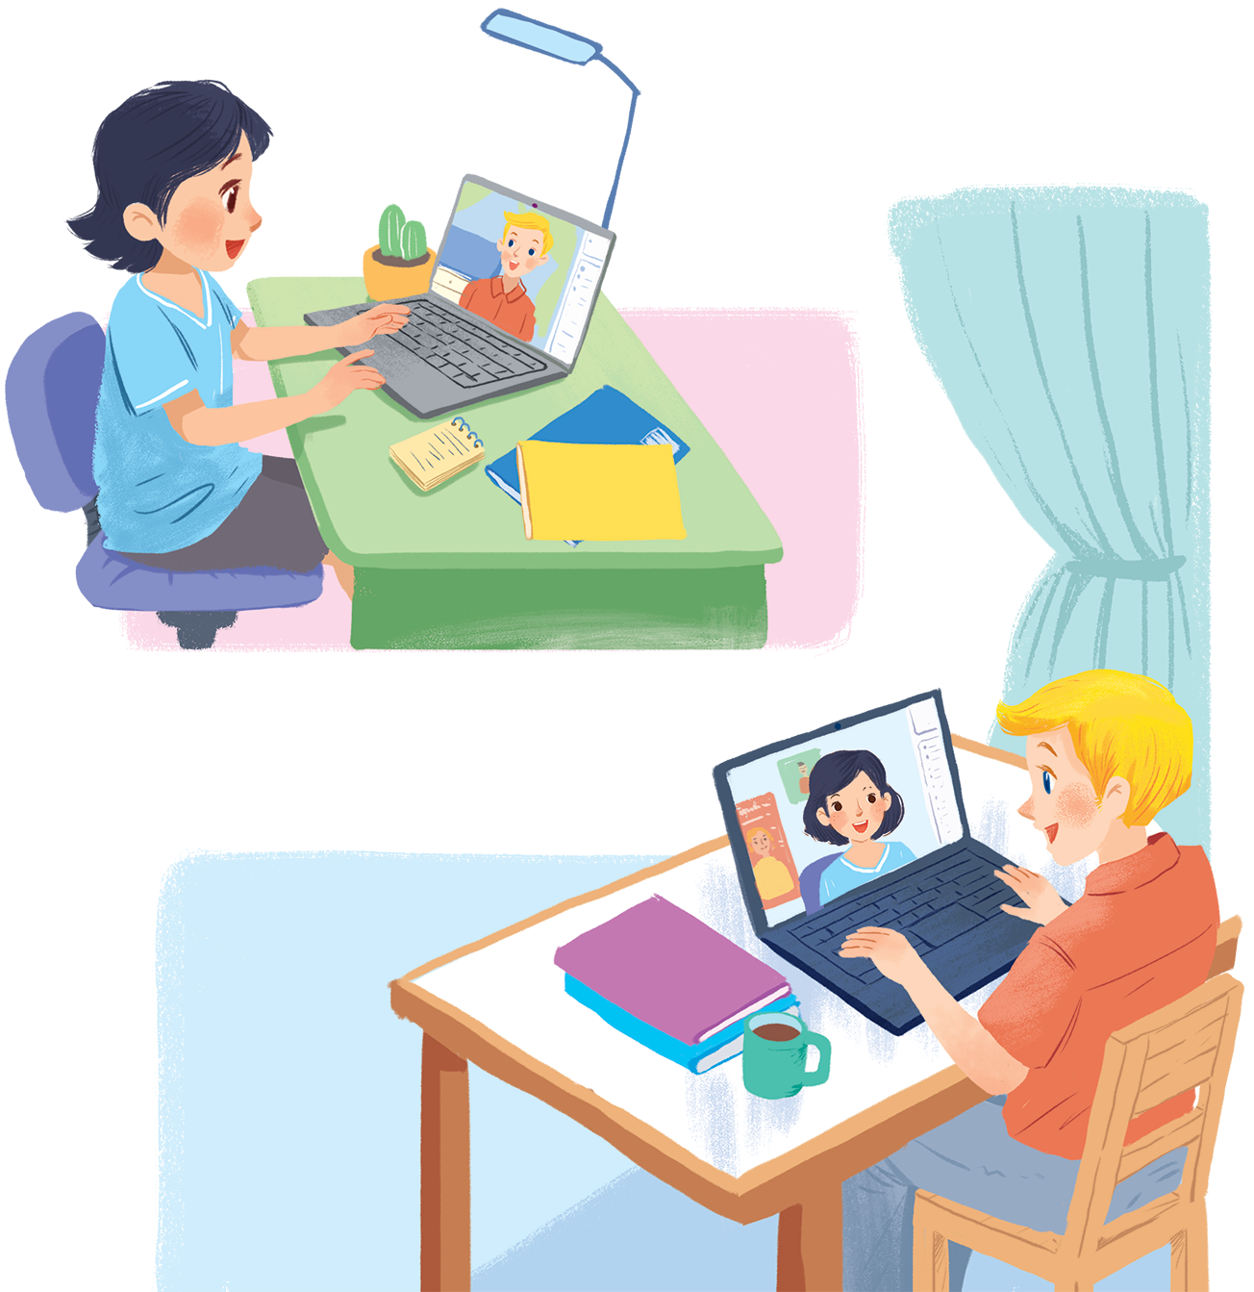
UNIT 2: MY HOUSE
LESSON 5: SKILLS 1
English 6

Slide 2


Reading
1
Look at the text. Answer the questions.
2
Read the text again and answer the questions.
3
Circle the things in the Tiger Room.
Speaking
4
Create a new room for the hotel. Draw a plan for the room.
5
Show your plan to your partner and describe it.

Slide 3
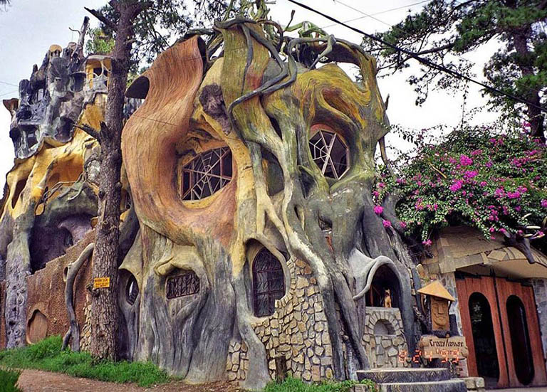


Slide 4
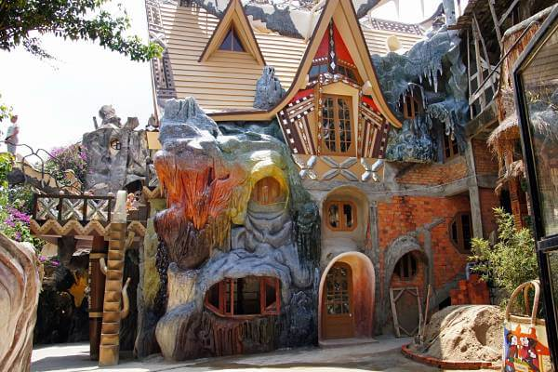
Fist opened in 190, it is still expanding and construction is ongoing to this day

Slide 5
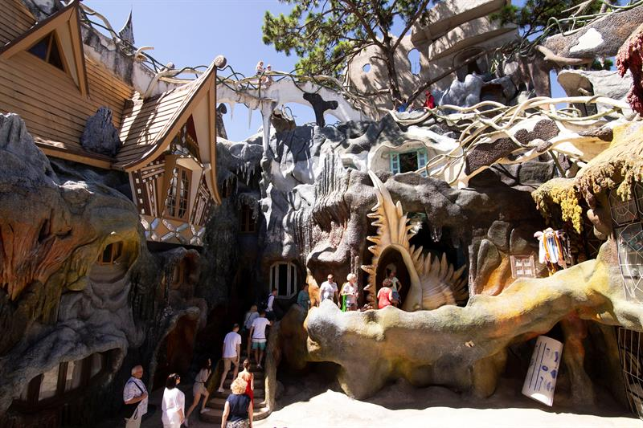
It is also a hotel and
these rooms can be rented

Slide 6
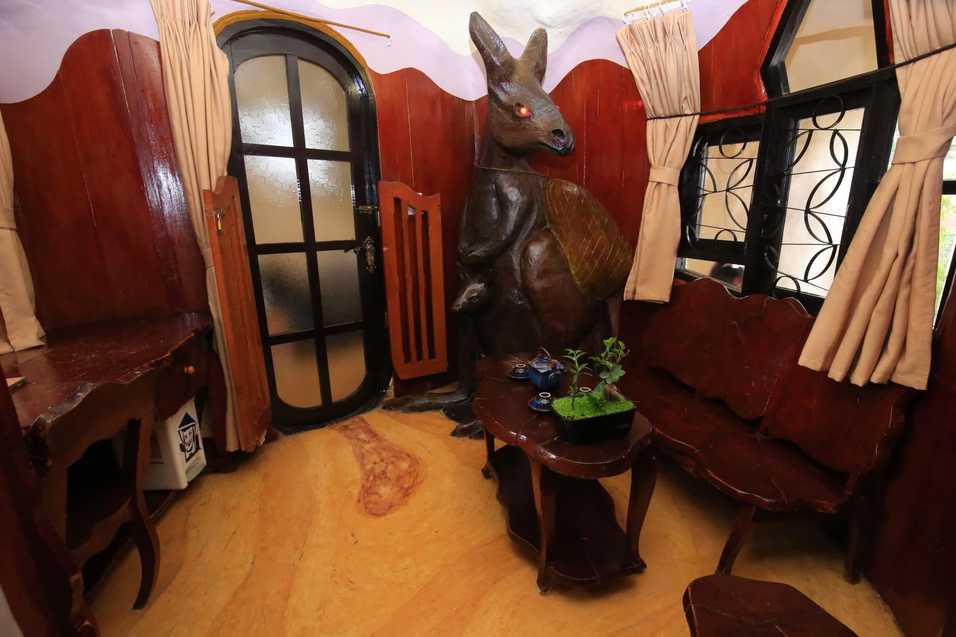
1/10
Kangaroo room – Phòng con chuột túi

Slide 7
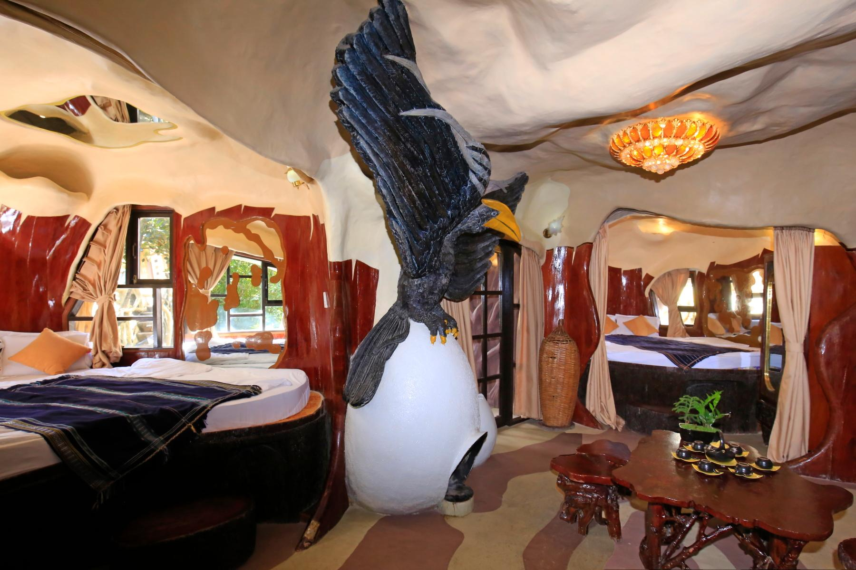
2/10
Eagle room – Phòng con đại bàng

Slide 8
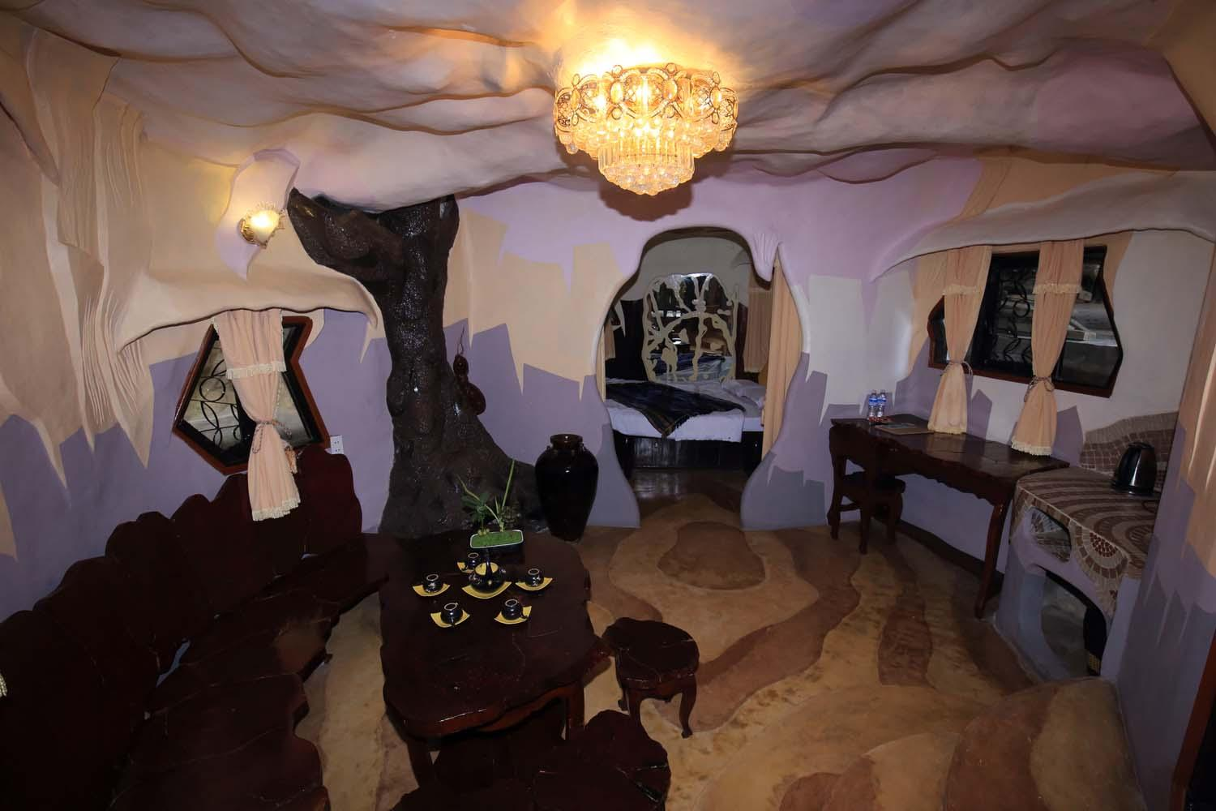
3/10
Ant Room – Phòng con kiến

Slide 9
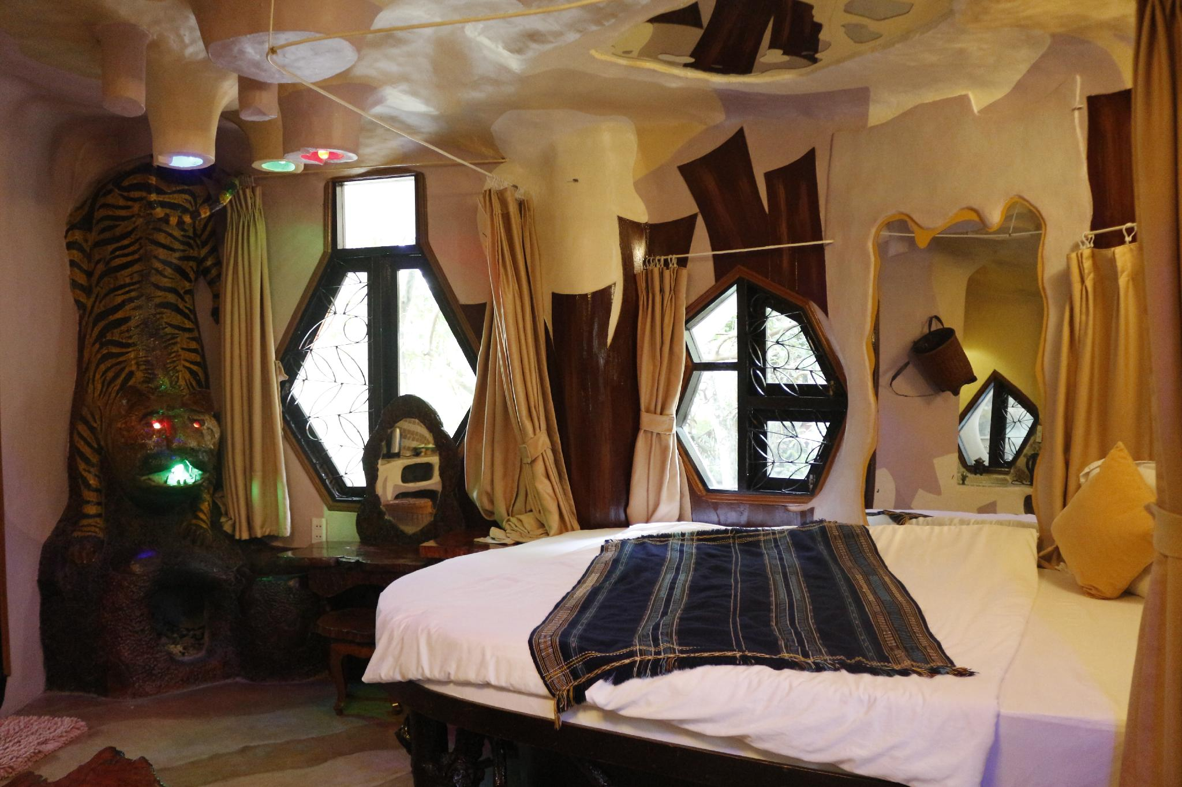
4/10
Tiger Room – Phòng con hổ

Slide 10
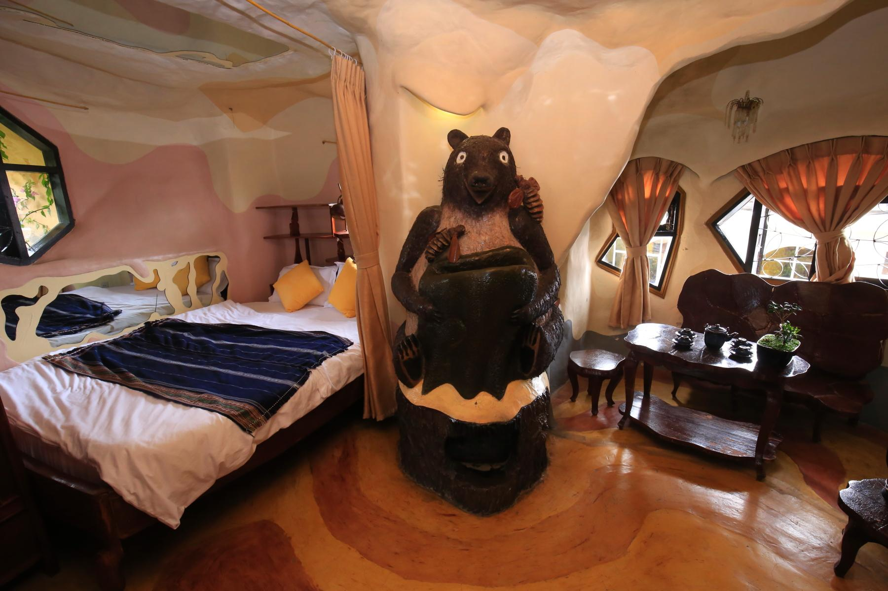
5/10
Bear Room – Phòng con gấu

Slide 11
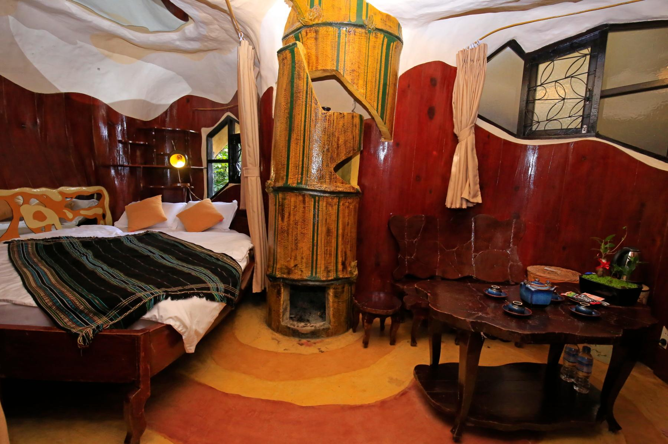
6/10
Bamboo Room – Phòng cây tre

Slide 12
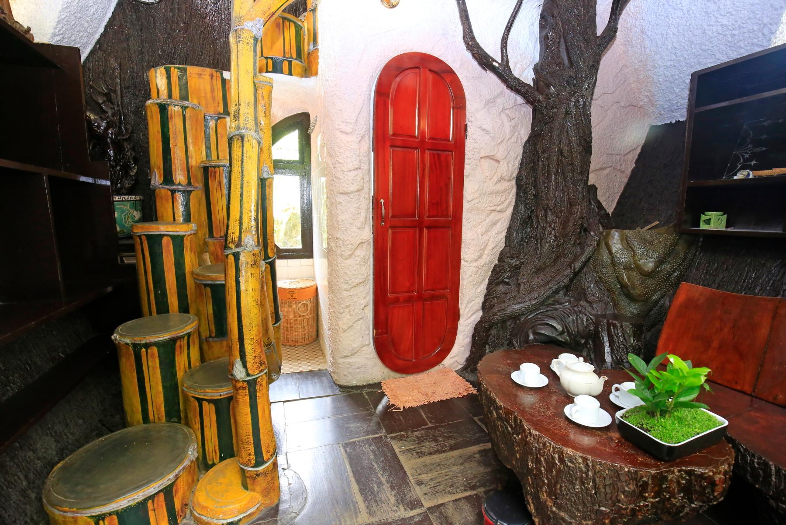
7/10
Honey Moon Room – Phòng tuần trăng mật

Slide 13
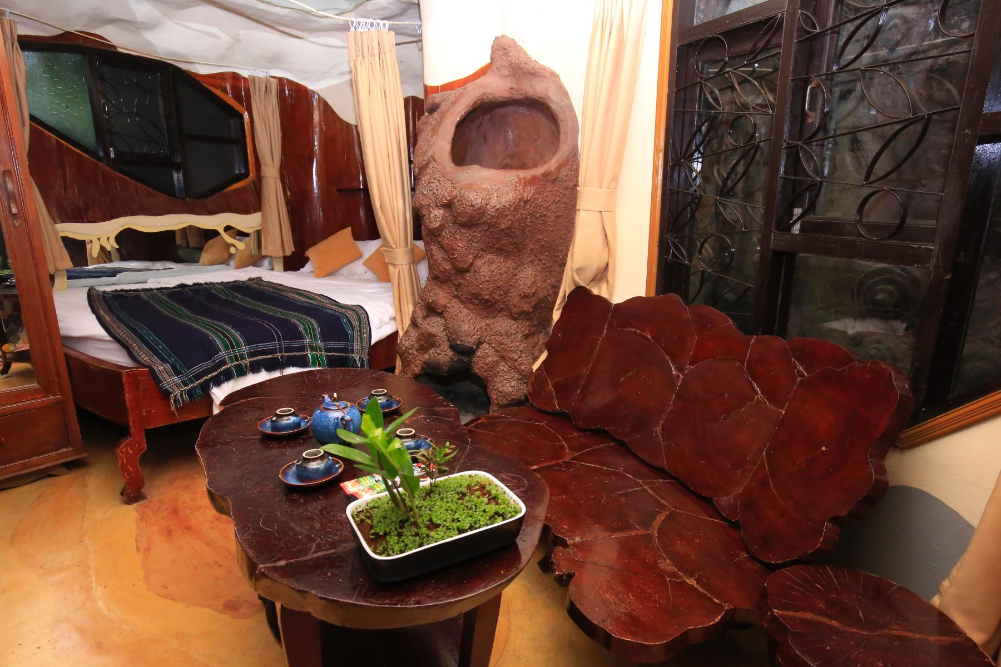
8/10
Termite Room – Phòng tổ mối

Slide 14
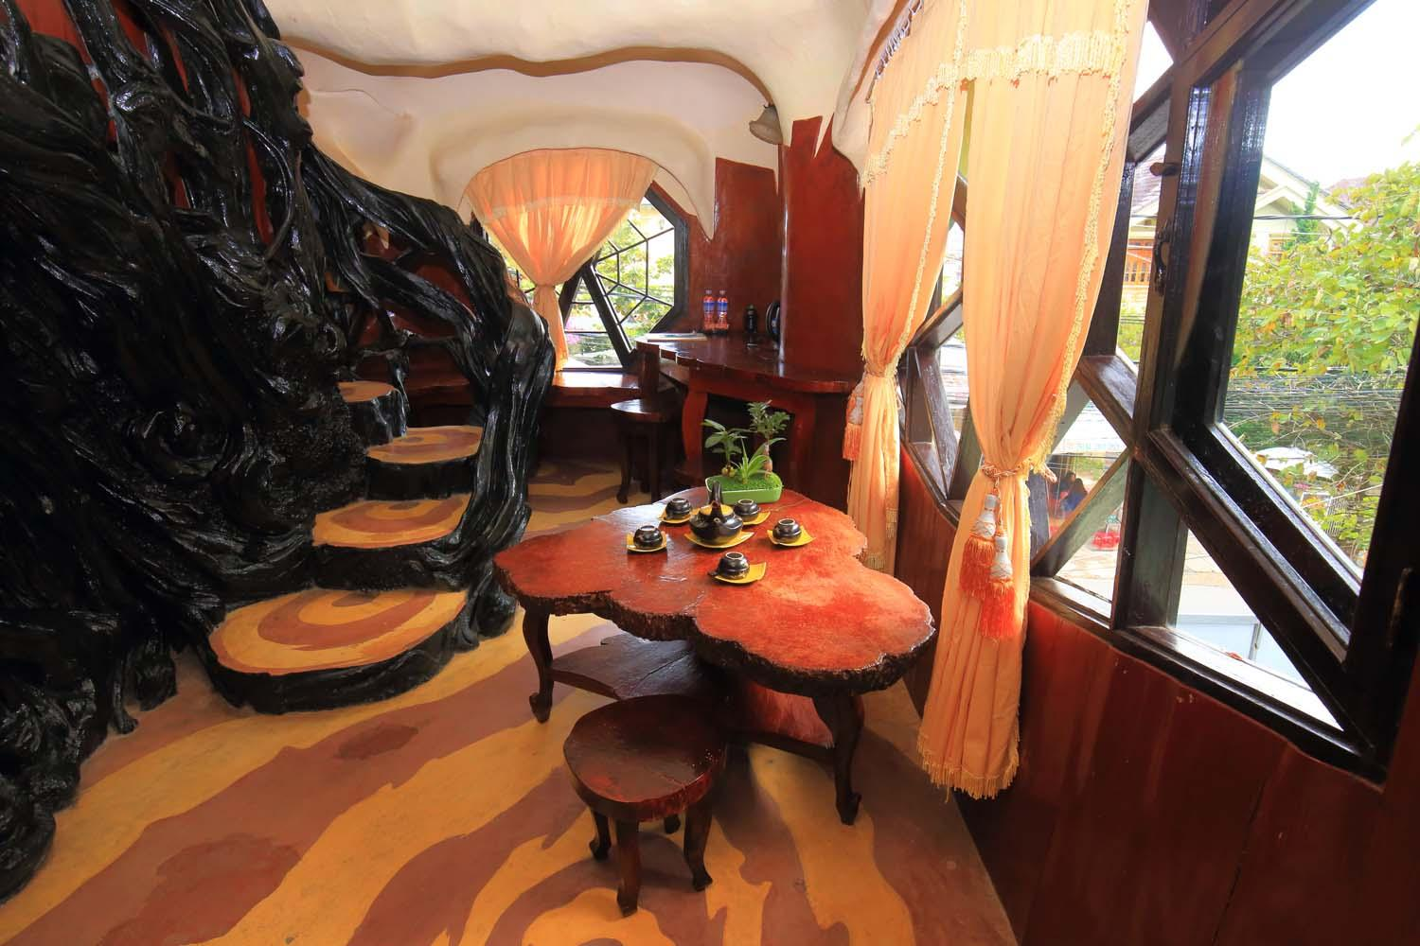
9/10
Pheasant room – Phòng gà lôi

Slide 15
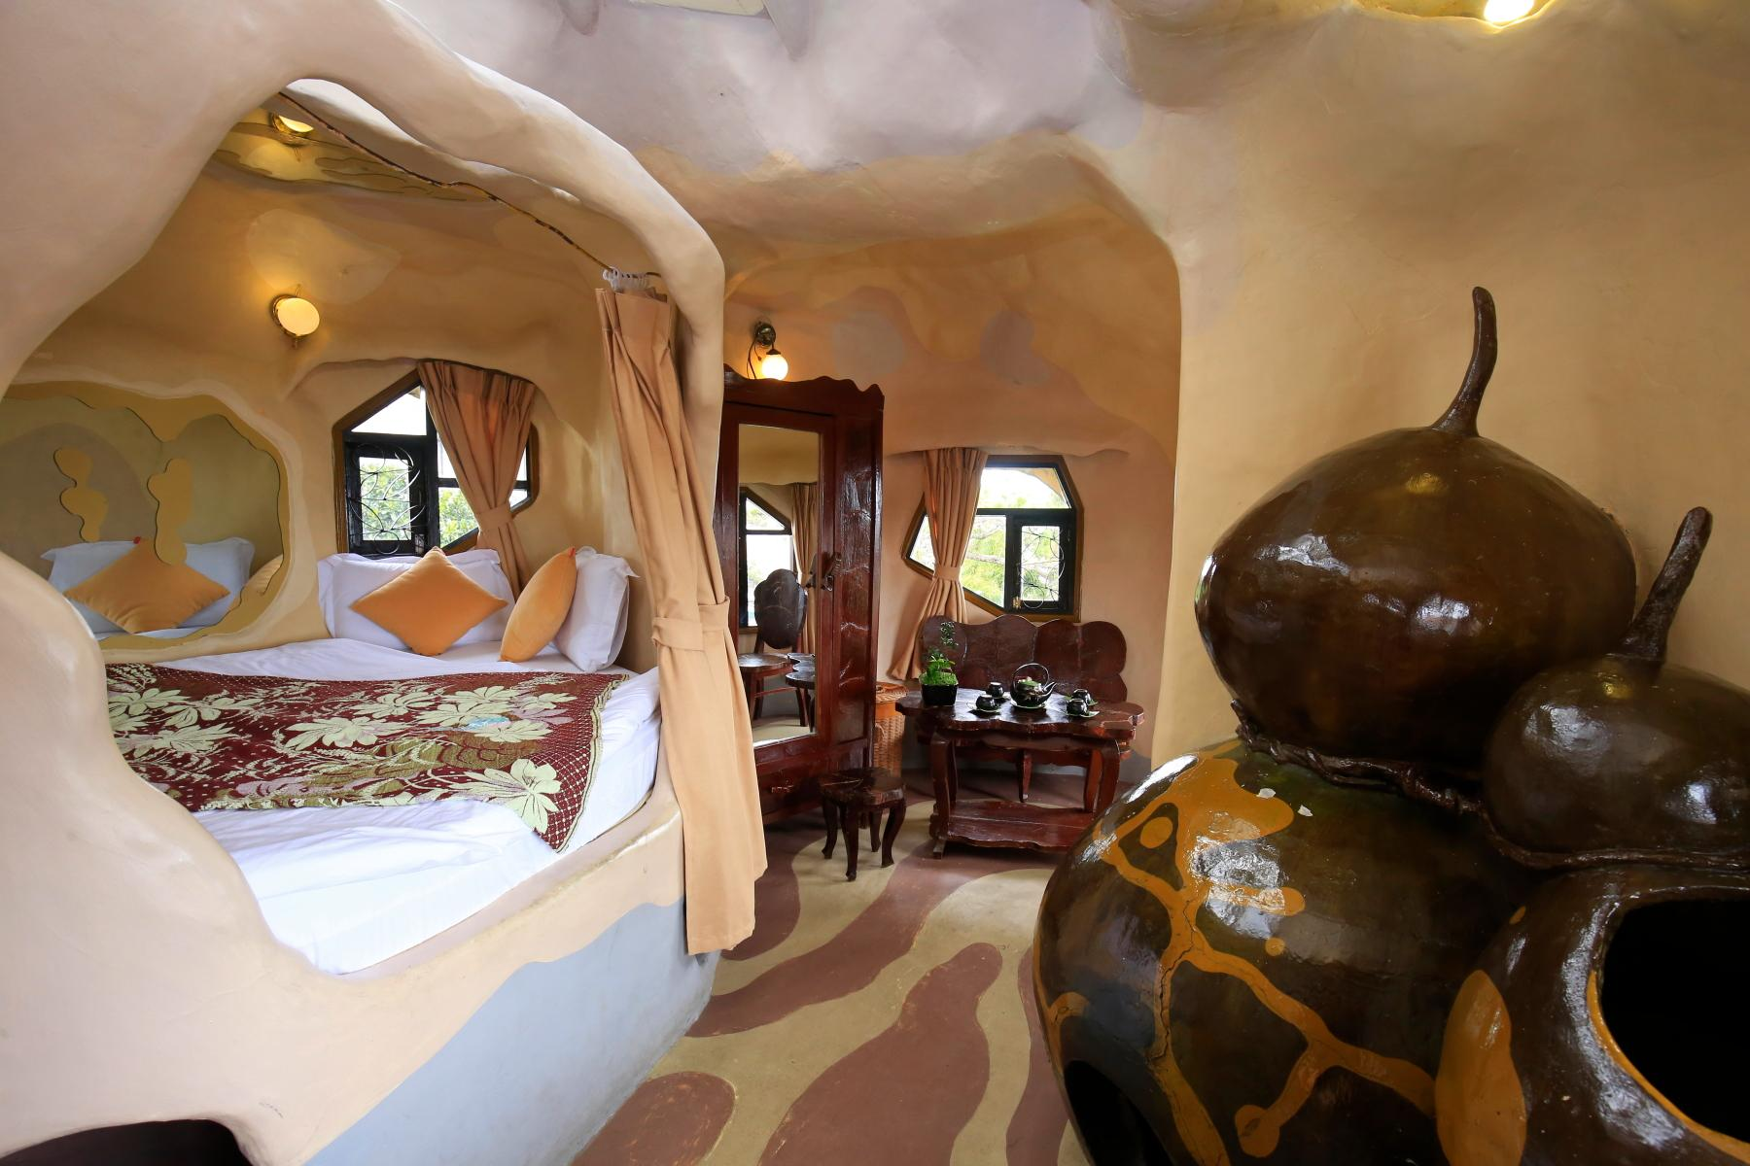
10/10
Gourd Room – Phòng quả bí

Slide 16

Reading

Slide 17


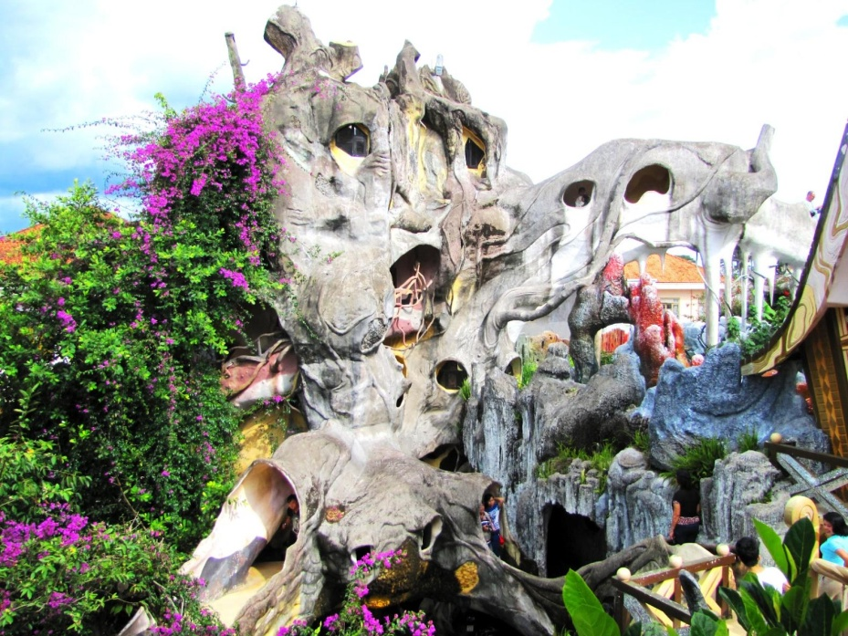
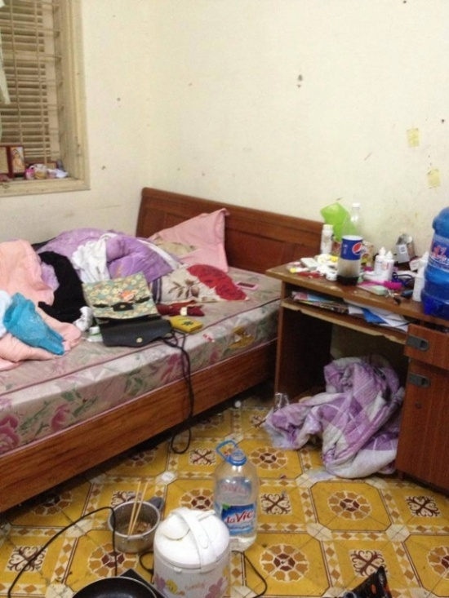
U2 L5
Vocabulary
‘crazy (adj)
kì dị, lạ thường
shape (n)
hình dạng
‘messy (adj)
lộn xộn,bừa bộn

Slide 18
Rub out and remember
crazy (adj)
kì dị, lạ thường
shape (n)
hình dạng
messy (adj)
lộn xộn,bừa bộn

Slide 19
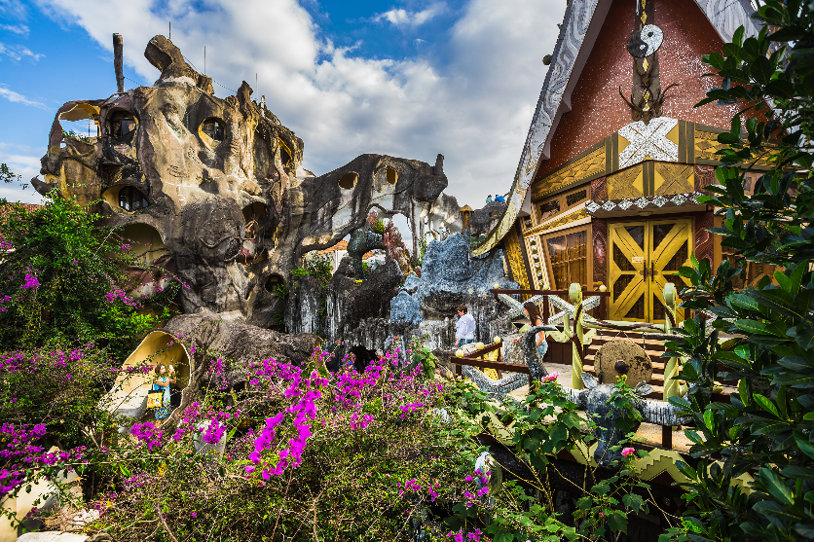
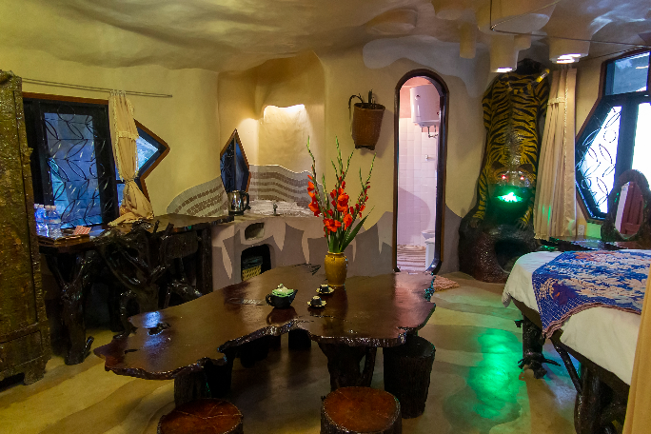

1
Look at the text. Answer the questions.
Reading skill: Predicting
Predicting makes reading easy.
Before reading, look at the pictures, design and title.
Decide what the text is about.
Think about what you know about the topic.

Slide 20



To: phong@webmail.com; mi@webmail.com
Subject: A room at the Crazy House Hotel
Hi Phong and Mi,
How are you? I’m in Da Lat with my parents. We’re staying at the Crazy House Hotel. Wow! It really is crazy. There are ten rooms in the hotel.
There’s a Kangaroo Room, an Eagle Room, and even an Ant Room. I’m staying in the Tiger Room. It’s called the Tiger Room because there’s a big tiger on the wall.
The tiger is between the bathroom door and the window. The bed is next to the window, but the window is a strange shape. I put my bag under the bed. There’s a lamp, a wardrobe and a desk.
You should stay here when you visit Da Lat. It’s great.
See you soon!
Nick

Slide 21
To: phong@webmail.com; mi@webmail.com
Subject: A room at the Crazy House Hotel
Hi Phong and Mi,
How are you? I’m in Da Lat with my parents. We’re staying at the Crazy House Hotel. Wow! It really is crazy. There are ten rooms in the hotel.
There’s a Kangaroo Room, an Eagle Room, and even an Ant Room. I’m staying in the Tiger Room. It’s called the Tiger Room because there’s a big tiger on the wall.
The tiger is between the bathroom door and the window. The bed is next to the window, but the window is a strange shape. I put my bag under the bed. There’s a lamp, a wardrobe and a desk.
You should stay here when you visit Da Lat. It’s great.
See you soon!
Nick
1.
Is it an email or a letter?
2.
What is the text about?
It's an email.
The text is about Nick's room at the Crazy House Hotel.

Slide 22
2
Read the text again and answer the questions.
1.
Who is Nick in Da Lat with?
He's in Da Lat with his parents.
2.
How many rooms are there in the hotel?
There are ten rooms.
3.
Why is the room called the Tiger Room?
Because there's a big tiger on the wall.
4.
Where is Nick’s bag?
It's under the bed.

Slide 23
Circle the things in the Tiger Room.
D
W
L
T
w

Slide 24
3
Circle the things in the Tiger Room.
a window
a wardrobe
a cooker
a cupboard
a shelf
a lamp
a desk
a tiger

Slide 25
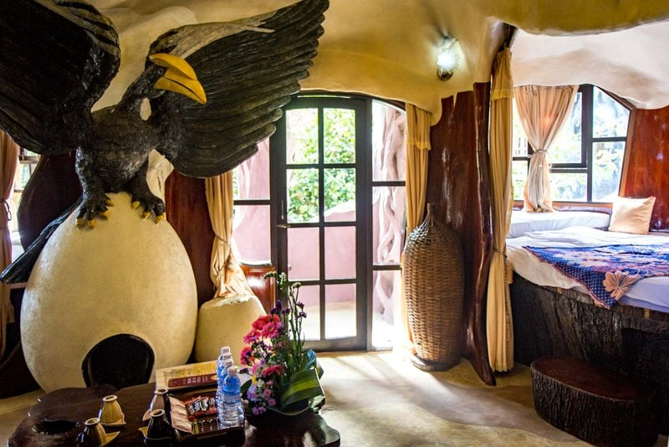
When describing a room in the hotel
Name of the room
Reason for the name
Position of things in the room

Slide 26
Speaking

Slide 27



4
Create a new room for the hotel. Draw a plan for the room.

Slide 28
5
Show your plan to your partner and describe it.
Example:
This is the Shark Room. There’s a big shark at the door. There’s a table and a sofa in the middle of the room ...

Slide 29
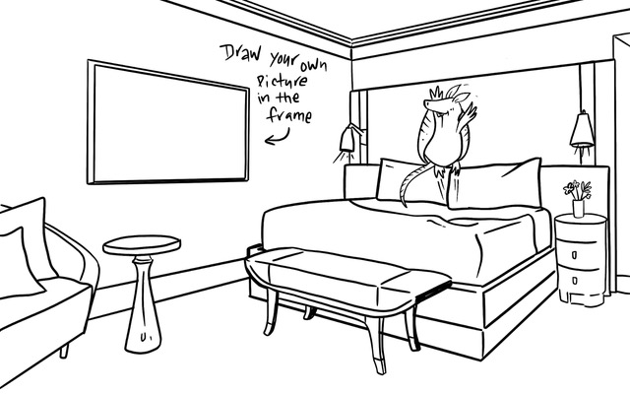

This is the Dolphin Room. There’s a big Dolphin at the door. There’s a table and a sofa in the middle of the room ...

Slide 30

Homework
Redo Exercises.
Do Exercise D1, 2 & 3 (p. 12, 13, 14) - Workbook..
Prepare the next lesson: Skills 2

