Slide 1
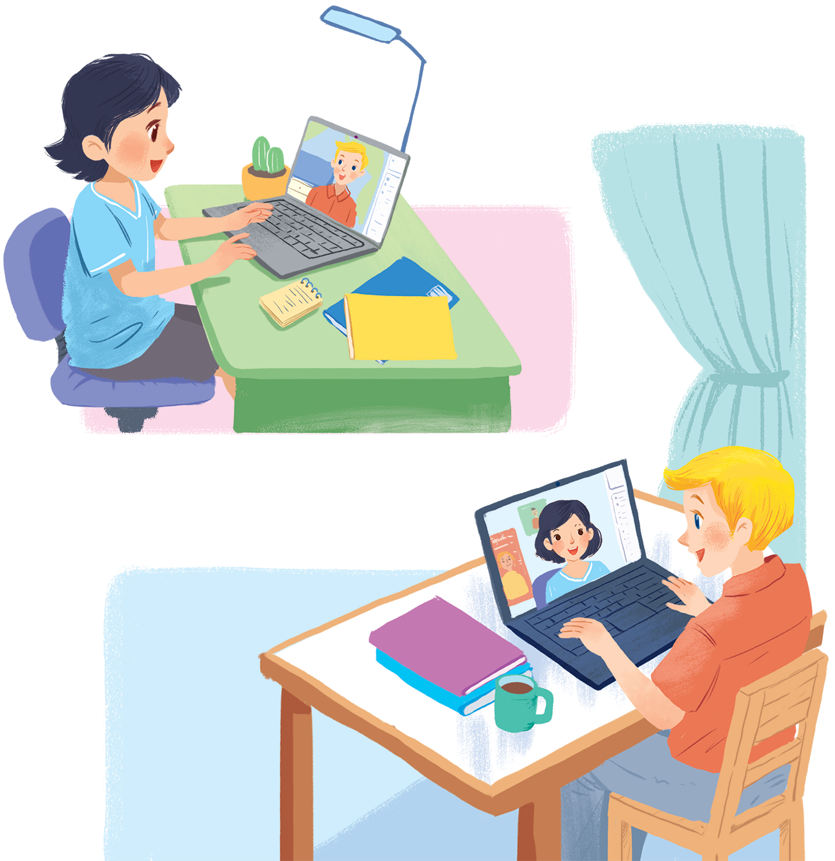
UNIT 2: MY HOUSE
LESSON 4: COMMUNICATION
English 6

Slide 2


Everyday English
Giving suggestions
1
Elena and her mum are discussing how to decorate her bedroom. Listen and read the dialogue. Pay attention to the highlighted sentences.
2
Work in pairs. Make a similar dialogue. Remember to use the structures:
How about + V-ing?
Let’s +V.
Living places
3
Mi tells Nick about her grandparents’ country house. Look at the pictures of her grandparents’ house and complete these sentences.
4
Student A looks at the pictures of Nick’s house on this page. Student B looks at the pictures of Mi’s house on page 25. Ask questions to find the differences between the two houses.
5
Draw a simple picture of your house. Tell your partner about it.

Slide 3

Use ‘There is/ are …’ and the suitable prepositions to make as many sentences as possible in order to describe the room

Slide 4
Everyday English
Giving suggestions

Slide 5

1
Elena and her mum are discussing how to decorate her bedroom. Listen and read the dialogue. Pay attention to the highlighted sentences.
…
Elena: My bedroom isn’t nice.
Mum: How about putting a picture on the wall?
Elena: Great idea, Mum.
Mum: Let’s go to the department store to buy one.
…
Notes:
Slide này không đúng.

Slide 6
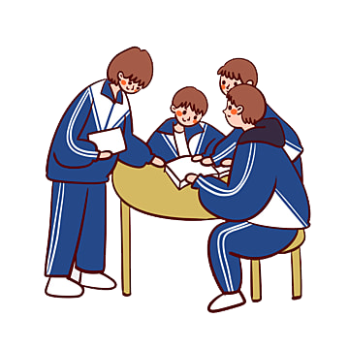
2
Work in pairs. Make a similar dialogue. Remember to use the structures:
How about + V-ing?
Let’s +V.

Slide 7
Living places

Slide 8
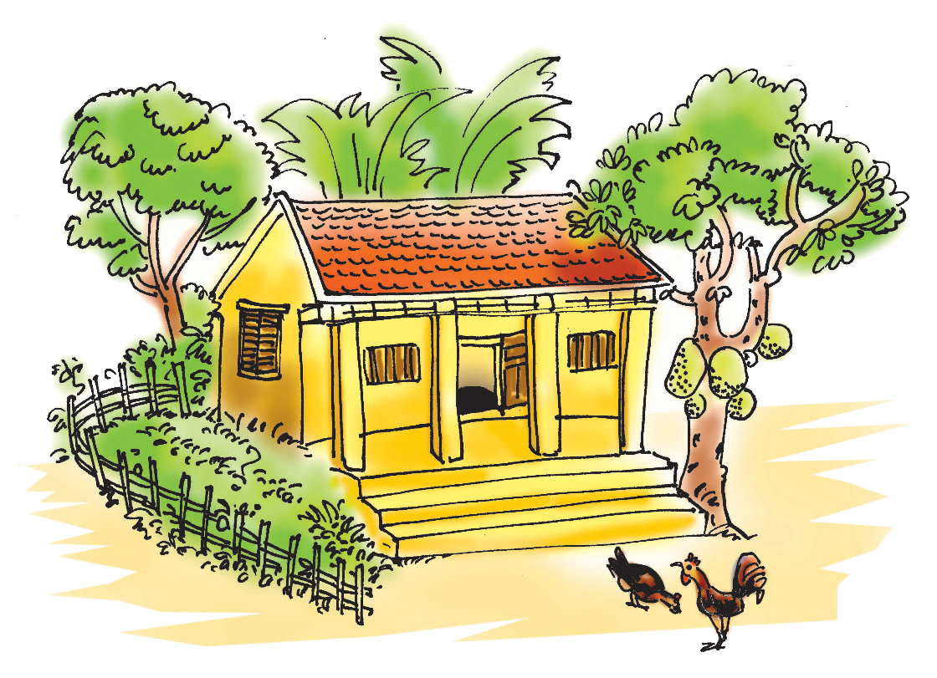
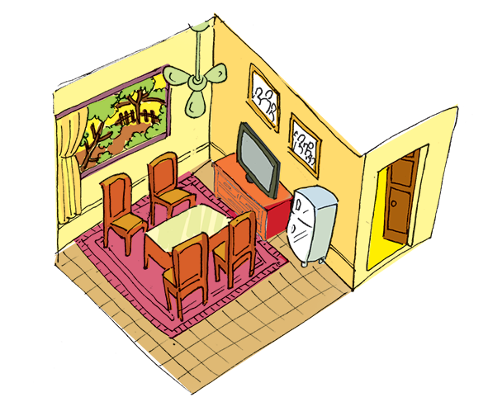
3
Mi tells Nick about her grandparents’ country house. Look at the pictures of her grandparents’ house and complete thesentences.
Notes:
City landmarks phải ở trên mục 3

Slide 9

country
1.
My grandparents live in a house in Nam Dinh.
2.
are
There four rooms in the house and big garden.
3.
is
I like the living room. There a big window in this room.
There are four and a table in the middle of the room.
4.
chairs
on
5.
There are two family photos the wall.

Slide 10
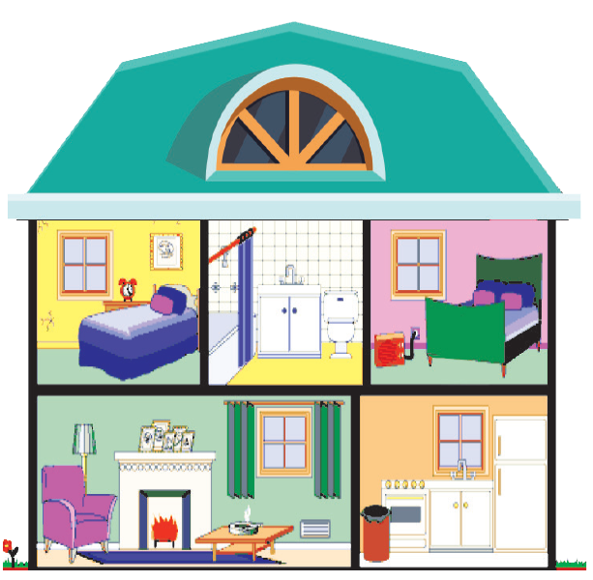

4
Student A looks at the pictures of Nick’s house on this page. Student B looks at the pictures of Mi’s house on page 25. Ask questions to find the differences between the two houses.

Slide 11
Nick lives in a country house.
Example:
A: Where does Mi Live?
B: She lives in a town house.
A: How many rooms are there in Mi’s house?
B: There are six rooms.

Slide 12




5
Draw a simple picture of your house.
Tell your partner about it.
This is my house . It is a small house in the country. There are 5 rooms in my house such as living room, bathroom, dining room, my room and my parent’s room. There is a sofa, a coffee table and two stools in the living room. There are six chairs and a table, and a fridge in the dining room. The kitchen is big and fully equipped. There is a bed , a table, a chair and a bookshelf in the bedroom. There is a sink and a toilet in the bathroom….. I love my house..

Slide 13
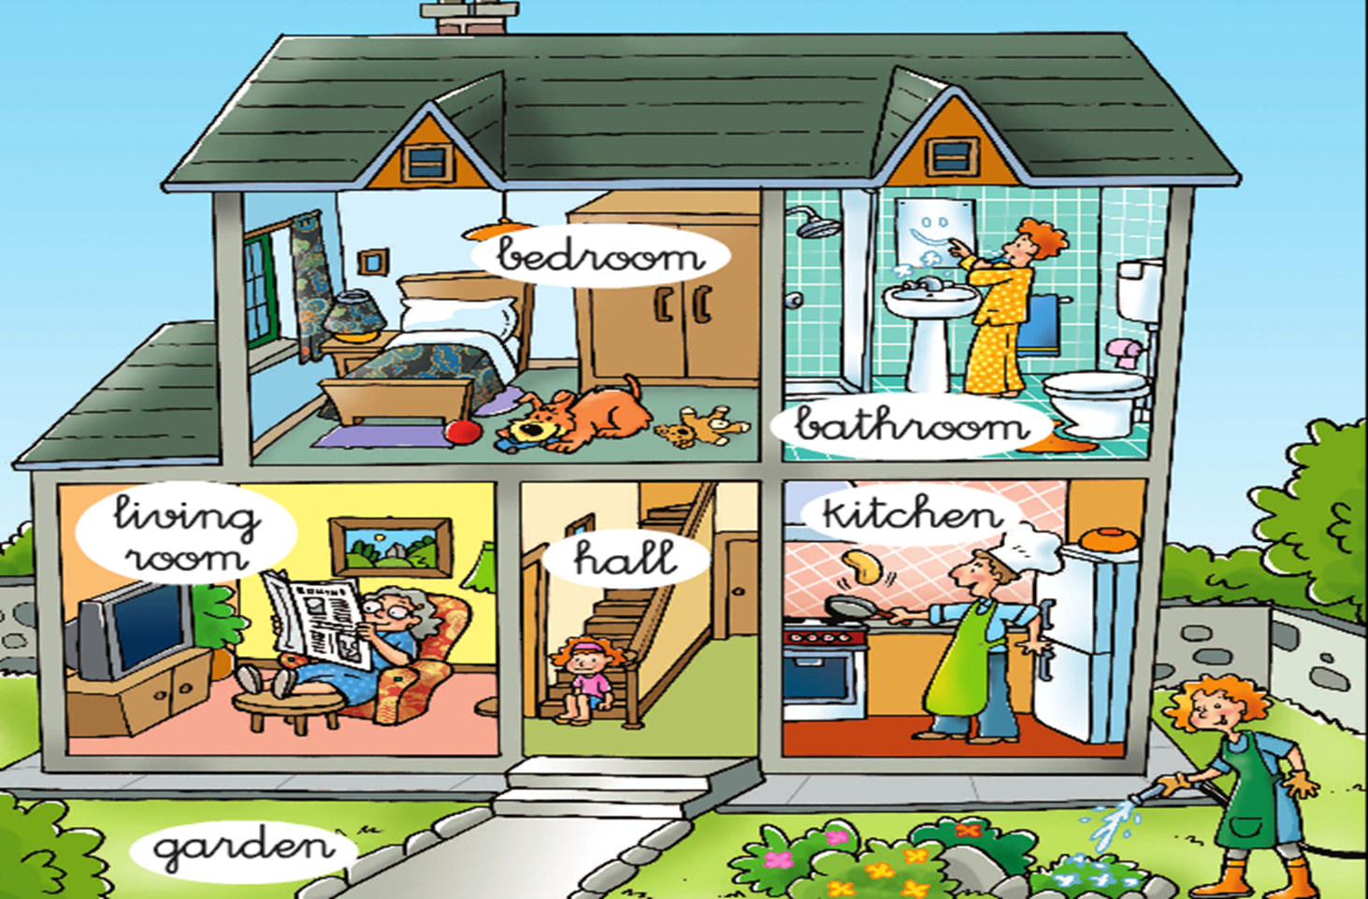
Describe your friend’s house to the class.

Slide 14

Homework
Learn vocabulary and the structure by heart.
Do Exercise B1 - p.10 and C1, 2 - p. 12 - Workbook.
Prepare the next lesson: Skills 1

