Slide 1


TRƯỜNG THCS LONG BIÊN
BÀI GIẢNG ĐIỆN TỬ MÔN TIẾNG ANH 9
UNIT 7: RECIPES AND EATING HABITS
Lesson 7 : Looking back & project
GV: Nguyễn Thị Hiền
Tổ Ngoại Ngữ - Năng khiếu

Slide 2
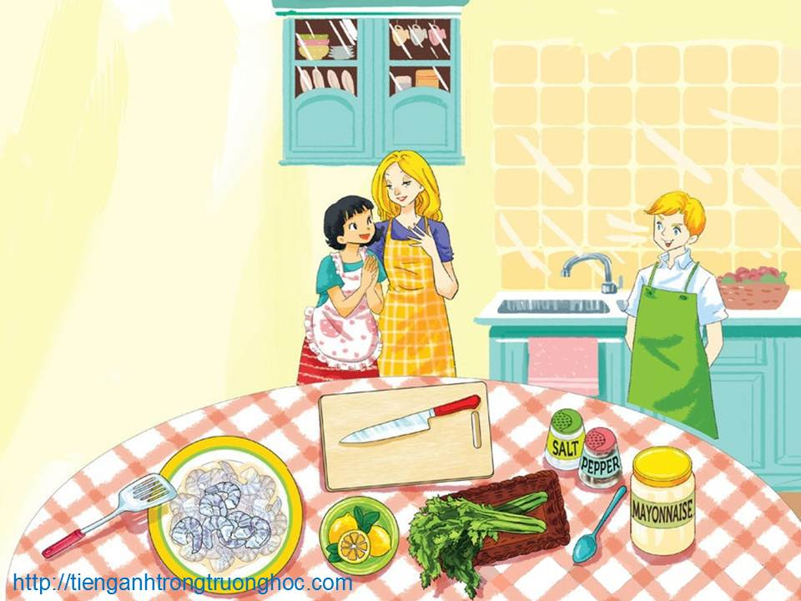
      UNIT 7: RECIPES AND EATING HABITS
      LESSON 7: LOOKING BACK
English 9

Slide 3

I. Vocabulary
Activity 1 Match the words in A with their description or definition in B.
A B
1. garnish | a. drop a few pieces or drops of something over a surface
2. versatile | b. put something quickly into a sauce and take it out again
3. purée | c. pour a mixture, usually containing oil, wine or vinegar and herbs and spices, over meat or fish before it is cooked to add flavour or make it tender
4. dip | d. decorate a dish of food with a small amount of another food
5. sprinkle | e. having many different uses
6. marinate | f. remove the outer layer of food
7. whisk | g. make fruit or vegetables into a thick, smooth sauce, usually in a blender
8. peel | h. beat eggs, cream, etc., to add air and make the food light

Slide 4
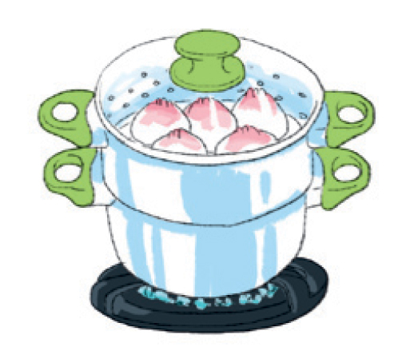
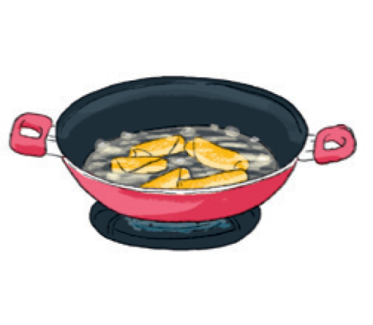
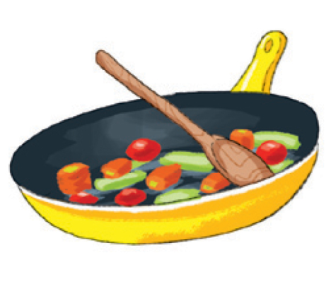
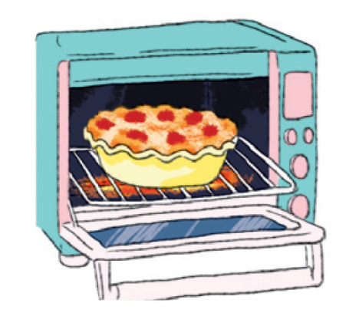
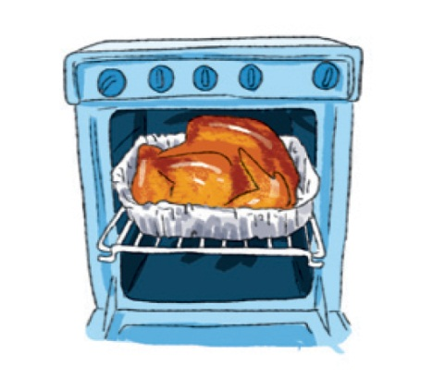
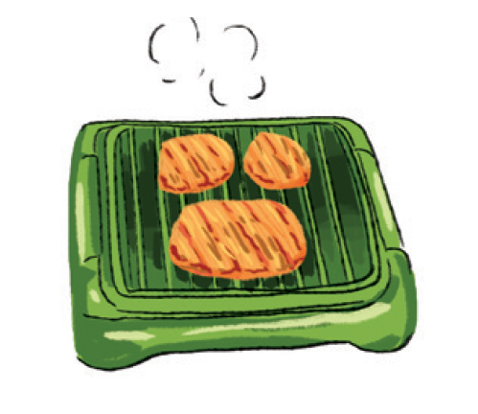
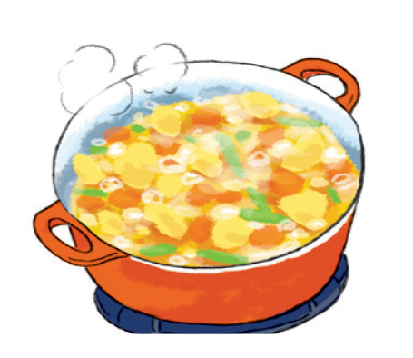
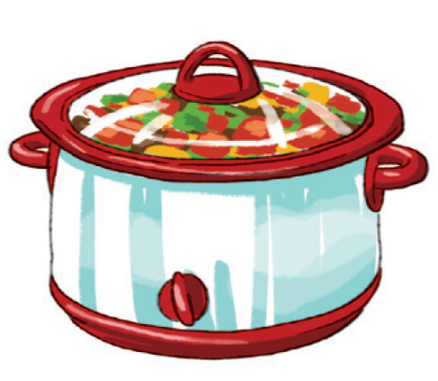
Activity 2 Write a verb for a cooking method under each picture. The first letter has been provided.
steam
deep-fry
stir-fry
bake
roast
grill
simmer
stew

Slide 5
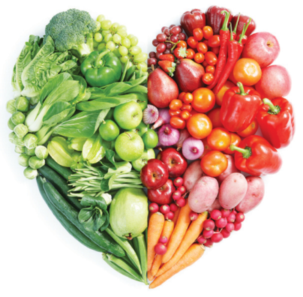
Activity 3 Fill each blank with a word/phrase in the box. There is one extra word.
Well, I think there are some ways to keep fit. Firstly, we should eat healthily. Don’t eat too much fast food. Some people have a big (1)______ and a soft drink for lunch. It isn’t a good idea because that meal doesn’t include any vegetables. Instead, if they want to have a quick healthy lunch, they should buy some avocado (2)______. Secondly, we shouldn’t (3)______ food. We should (4)______ it. Steamed dishes don’t use any fat. If you like, you can also (5)______ lean meat with vegetables. It’s healthy and nutritious.
stew sushi grill
steam hamburger deep-fry
hamburger
sushi
deep-fry
steam
stew

Slide 6

II. Grammar
Activity 4 Circle the correct answer.
1. Don’t put too much bacon in the dish. A pinch/ slice is enough.
2. To make this soup, you need two slices/sticks of celery.
3. There isn’t some/any butter in the fridge. We should go to the supermarket to buy some/any.
4. Can you go to the convenience store and buy me a tin/bag of rice?
5. Slice a clove/loaf of garlic, then add some honey.
6. Look! This bunch/cup of grapes is so fresh.

Slide 7
Activity 5 Complete the sentences with your own ideas. Use the modal verbs provided.
1. If you keep eating fast food, ___________________ ______________________________. (might)
2. If you promise to finish your homework tonight, _________________________________. (can)
3. ____________________________________________ if he doesn’t want to have toothache. (should)
4. ____________________________________________ if she wants to lose weight. (must)
5. If you join this cooking lesson, _________________ __________________________________. (can)
you might become overweight
you can go to the cinema with your friend
He should eat less sweets
She must eat less rice and bread
you can cook many delicious dishes

Slide 8

III. Communication
Activity 6 Rearrange the lines to make a complete conversation.
A. That’s right. It’s the first time I’ve made them.
B. What a pleasant Sunday morning it is!
C. Shall I peel the bananas for you?
D. I can’t wait to try your first pancakes! They look delicious.
E. Yes. It’s cool and sunny. What are you doing?
F. I’m making some pancakes.
G. Sure, you can give me a hand if you want to.
H. Really? Will we have them with honey?
I. Some pancakes?
J. Yes, some honey and some slices of banana
5
1
8
10
2
3
9
6
4
7

Slide 9

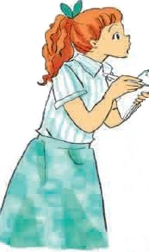
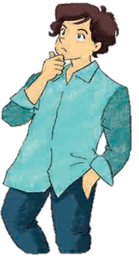
IV. PROJECT
A survey on eating habits
1. Work in groups. Go to other classes and ask different students about their eating habits. Write the students’ answers in the table.
Question | St 1 | St 2 | St 3 | St 4 | St 5
1. How often do you eat fast food?
2. How often do you eat homemade food?
3. How many meals do you have per day?
4. Which meal is the most important to you?
5. Which do you prefer: eating at home or eating out?
6. What is your favourite dish?

Slide 10
2. Now work together again. Analyse the answers you have got and organise them in the form of an answer to each question. This could be done using a visual organiser such as a chart.
3. In general, do the students at your school have healthy eating habits? Present your group’s findings to the class.

Slide 11

V. Homework
  Learn vocabulary by heart.
  Redo exercises.
  Prepare the next lesson: Getting Started

