Slide 1
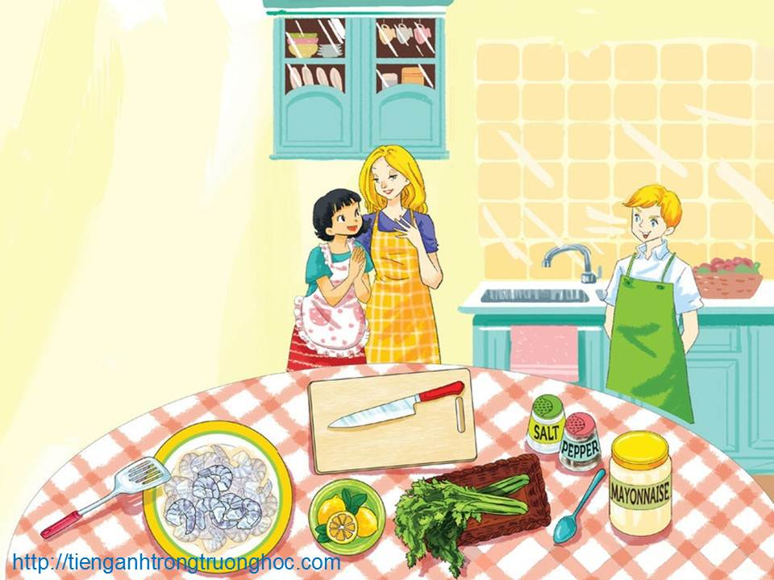
      UNIT 7: RECIPES AND EATING HABITS
      LESSON 2: A CLOSER LOOK 1
English 9

Slide 2


TRƯỜNG THCS LONG BIÊN
BÀI GIẢNG ĐIỆN TỬ MÔN TIẾNG ANH 9
UNIT 7: RECIPES AND EATING HABITS
Lesson 2 : A closer look 1
GV: Nguyễn Thị Hiền
Tổ Ngoại Ngữ - Năng khiếu

Slide 3

I. Vocabulary
whisk: beat eggs, cream, etc., with a special tool to add air and make the food light (đánh trứng, kem…)
slice: cut something into thin flat pieces (thái lát)
grate: rub food (e.g. cheese) against a grater in order to cut it into very small pieces (nạo)
dip: put something quickly into a drink, sauce or batter and take it out again (nhúng)
chop: cut something into pieces with a knife (chặt cắt)
spread: put a layer of a substance evenly onto the surface of something (phết)
sprinkle: shake small pieces of something, or drops of a liquid, on something (rắc)
marinate: pour a mixture, usually containing oil, wine or vinegar, and herbs and spices, over meat or fish before it is cooked to add flavour or make it tender (ướp)

Slide 4

Vocabulary
whisk (v) /wɪsk/
slice (v) /slaɪs/
grate (v) /greɪt/
dip (v) /dɪp/
chop (v) /ʧɒp/
spread (v) /sprɛd/
sprinkle (v) /ˈsprɪŋkl/
marinate (v) /ˈmærɪˌneɪt/
đánh trứng, kem…
thái lát
nạo
nhúng
chặt cắt
phết
rắc
ướp

Slide 5
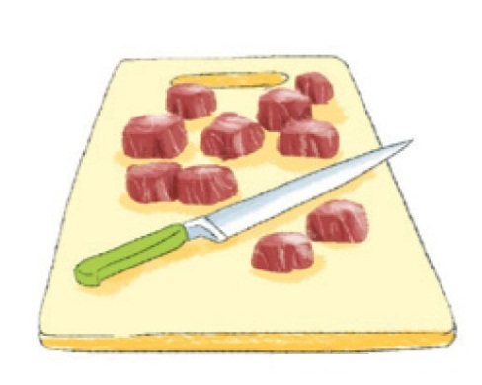
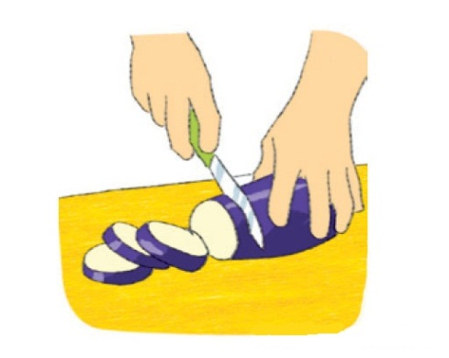
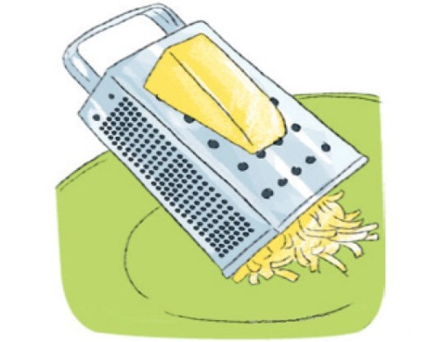
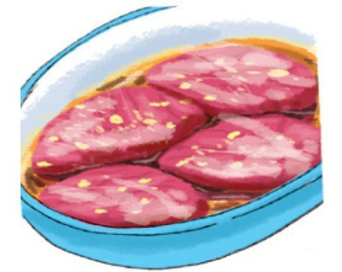
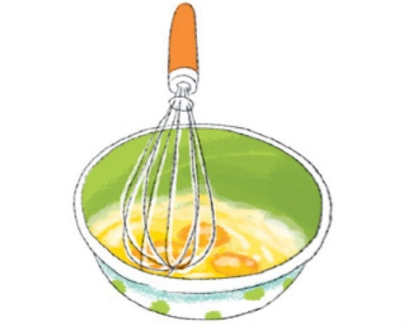
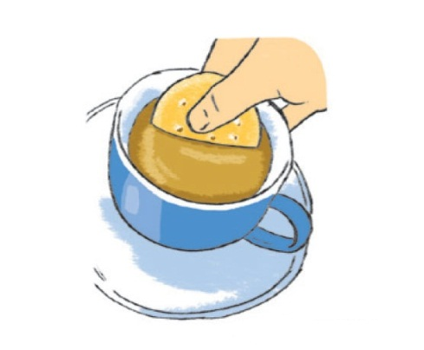
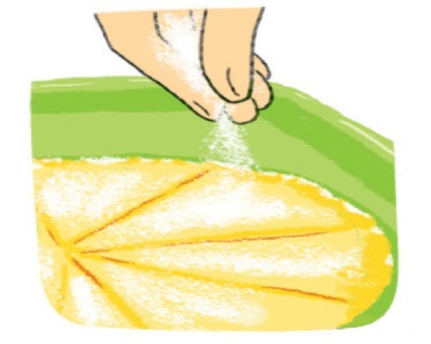
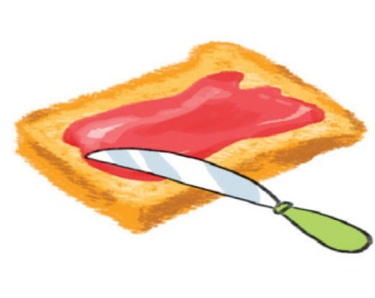
Activity 1 Write a food preparation verb from the box under each picture.
whisk grate chop sprinkle
slice dip spread marinate
chop
slice
grate
marinate
whisk
dip
sprinkle
spread

Slide 6
Activity 2 Complete the sentences with the correct form of the verbs in 1.
1. Don’t ______ the cucumber into chunks. ______ it thinly.
2. My mother usually ______ some cheese and ______ it over the pasta.
3. ______ the chicken in white wine for one hour before roasting.
4. To make this cake successfully, you should ______ the eggs lightly.
5. ______ the prawns into the batter.
6. Can you ______ the butter on this slice of bread for me?
chop
Slice
grates
sprinkles
Marinate
whisk
Dip
spread

Slide 7
Activity 3 Match each cooking verb in A with its definition in B.
1. stir-fry | a. place food over boiling water so that it cooks in the steam
2. deep-fry | b. cook something by keeping it almost at boiling point
3. roast | c. cook food under or over a very strong heat
4. grill | d. cook something slowly in liquid in a closed dish
5. bake | e. cook cakes or bread in an oven
6. steam | f. fry food in oil that covers it completely
7. stew | g. cook thin strips of vegetables or meat quickly by stirring them in very hot oil
8. simmer | h. cook meat, or vegetables without liquid in an oven or over a fire

Slide 8
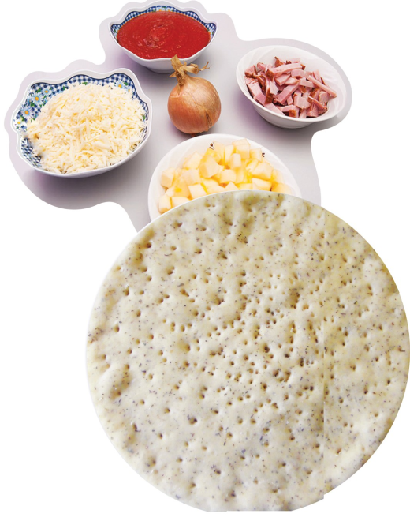
Activity 4 a What can you see in the pictures? Do you know what dish these ingredients are used for?
tomato sauce
bacon
cheese
onion
apple
pizza base
Pizza

Slide 9
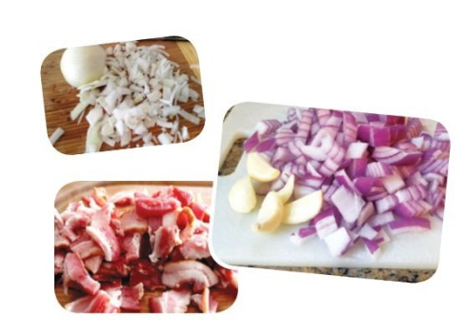
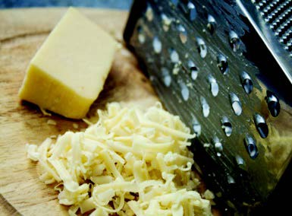
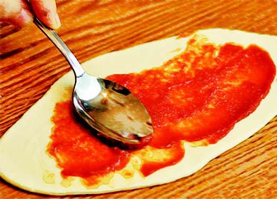
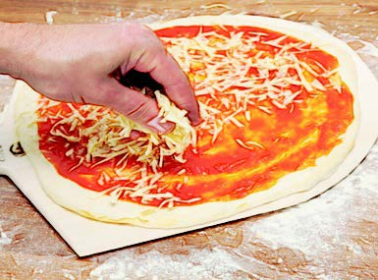
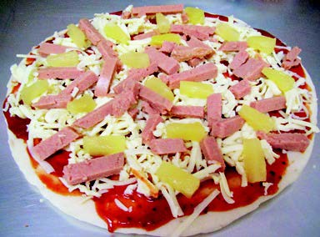
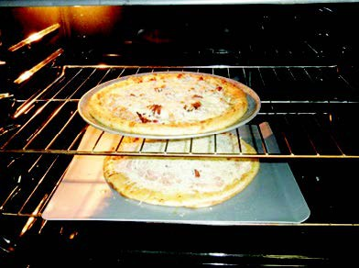
Activity 4b Complete the instructions below with the verbs in 1 and 3. One verb is used twice.
Do you think you can make a pizza yourself?
1. ______ the onion, bacon and an apple.
2. ______ the cheese.
Spread
Chop
3. ______ the tomato sauce on the pizza base.
Grate
4. ______ the cheese on the pizza base.
Spread
Bake
Sprinkle
5. ______ the chopped onion, bacon and apple on top.
6. ______ the pizza in the oven for about 10 minutes.

Slide 10

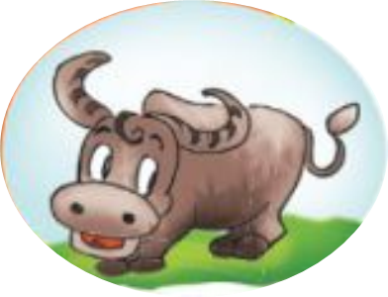
II. Pronunciation
Tones in statements used as questions
REMEMBER!
A statement can be used as a question to check that the information we have is correct. When we pronounce a statement question, our voice goes up at the end.
Listen to this part of the conversation in GETTING STARTED again and pay attention to the tone of Nick’s mum’s statement question.
Nick: Mum, the prawns are pink now. (statement)
Nick’s mum: They’re pink? (statement question)
Nick: Yes.
In contrast, our voice goes down at the end of a Wh-question.
Example:
Where did I put my glasses?

Slide 11
Activity 5 Listen to the conversations. Draw or at the end of each line. Practise the conversations with a partner.
1. A: What do we need to make a pizza?
B: A pizza base, some cheese, some bacon, an onion, and an apple.
A: An apple?
B: Yes, an apple.
2. A: What’s for dinner?
B: We’re eating out tonight.
A: We’re eating out?
B: Right.
3. A: I can’t eat this dish.
B: Why not?
A: I’m allergic to prawns.
B: Allergic to prawns?
A: Yes, my skin turns red when I eat them.

Slide 12
Activity 6a Work in pairs. Complete the mini-dialogues with suitable statement questions.
1. A: Let’s have pasta tonight.
B: I don’t like pasta.
A: _________________________________________?
B: No. It makes me fat.
2. A: What should I do next?
B: Add some salt to the salad.
A: ________________________________________?
I thought you didn’t like salty food.
B: But it’s so tasteless.
Activity 6b Practise the mini-dialogues using the correct intonation.
You don’t like pasta?
Don’t like pasta?
Add some salt?

Slide 13

II. Homework
  Learn vocabulary by heart.
  Redo exercises.
  Prepare the next lesson: A closer look 2

