Slide 1


TRƯỜNG THCS LONG BIÊN
BÀI GIẢNG ĐIỆN TỬ MÔN TIẾNG ANH 9
UNIT 7: RECIPES AND EATING HABITS
Lesson 1 : Getting started
GV: Nguyễn Thị Hiền
Tổ Ngoại Ngữ - Năng khiếu

Slide 2
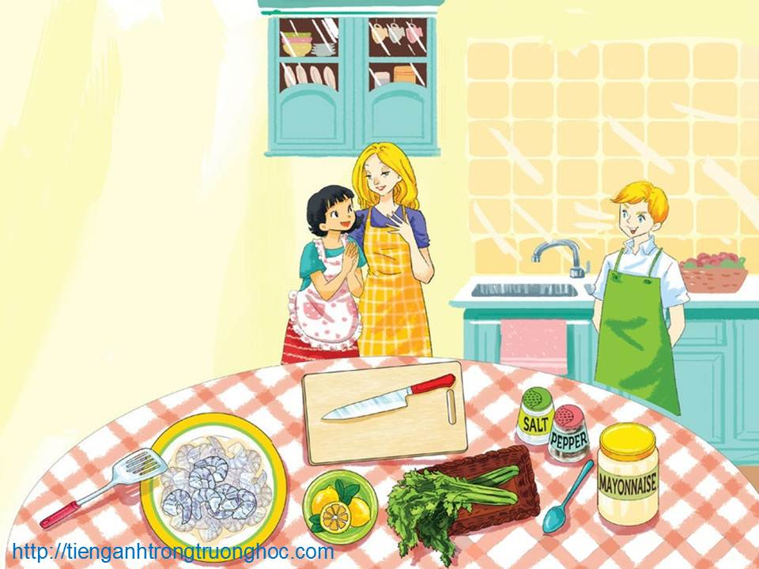
TUESDAY, JANUARY 18th , 2022
UNIT 7: RECIPES AND EATING HABITS
PERIOD 55:LESSON 1: GETTING STARTED
English 9

Slide 3

Warm up
recipe (n): a set of instructions that tells you how to cook something and the ingredients (items of food, herbs, spices, etc.) you need for it
eating habits (plural noun): the way a person or group eats, considered in terms of what types of food are eaten, in what quantities, and when
Cobb salad /kɒb ˈsæləd/
curry /ˈkʌri/
fajitas /fəˈhiːtəs/
steak pie /steɪk paɪ/
lasagne /ləˈzænjə/
sushi /ˈsuːʃi/

Slide 4


I. Vocabulary
prawn /prɔ:n/ (n)
ingredient /ɪnˈɡriː.di.ənt/ (n)
celery /'sələri/ (n)
spring onion /'spriη'ʌniən/ (n)
starter /'stɑ:tə/ (n)
supper /'sʌpə/ (n)
versatile /'və:sətail/ (adj)
drain /drein/ (v)
chop /t∫ɔp/ (v)
peel /pi:l/ (v)
tablespoon /ˈteɪblspuːn/ (n)
con tôm
phần hợp thành, thành phần
(thực vật học) cần tây
hành tươi, hành lá
món khai vị
bữa ăn nhẹ trước khi đi ngủ
nhiều tác dụng; công dụng
để ráo nước
bổ, chặt, cắt, thái
bong ra, bóc, lột vỏ
thìa sử dụng trong nấu ăn

Slide 5
My favourite salad
Nick’s mum: Today we’re making a prawn salad, which is a favourite of mine.
Mi: Fantastic. I love salad.
Nick’s mum: This salad is simple but delicious. Here are the ingredients: prawns, celery, spring onions, mayonnaise, lemon juice, salt and pepper.
Nick: What should I do first, Mum?
Nick’s mum: Get a big bowl for me. And then can you wash the celery?
Nick: Sure.
Mi: I can wash the spring onions if you like, Mrs Warner.
Nick’s mum: Please, do. I’ll boil the prawns.
Mi: So, do English people eat lots of salad?
Nick’s mum: Yes, especially in the summertime. People often serve salad as a starter. But salads also make a healthy lunch or supper
Mi: You’re right, they’re so versatile. And you can put anything in a salad.

Slide 6
Nick: Mum, the prawns are pink now.
Nick’s mum: They’re pink?
Nick: Yes.
Nick’s mum: Good, they’re ready. I’ll drain them. Nick, can you peel them? Mi, could you chop the celery and spring onions? You should be careful if you use the red knife – it’s sharp.
Mi: Right, everything’s ready. What do we do next?
Nick’s mum: OK, first, combine the prawns and celery in the bowl. Add two tablespoons of mayonnaise, half a teaspoon of salt, half a teaspoon of pepper and some lemon juice. Now, mix all the ingredients well.
Nick: OK.
Nick’s mum: Finally, add the spring onion on top. Now we cover the bowl and leave it in the fridge for an hour. You’ve done a good job, both of you.
Mi: I can’t wait to try it.
Nick: Yeah, I’m starving! An hour is a long time…

Slide 7

II. Listen and read
Activity 1a Can you find a word that means:
1. a light dish served as the first part of a meal
2. have lots of uses
3. pour the water away
4. take off the outer layer of food
5. cut food into pieces with a knife
6. mix
starter
versatile
drain
peel
chop
combine

Slide 8
Activity 1b Find all the words related to the topic of food in the conversation. Put them in the word webs.
Ingredients
Preparing
and cooking

Slide 9
Activity 1b (Cont)
pepper
salt
Ingredients
prawns
mayonna-ise
lemon juice
spring onions
celery

Slide 10
Activity 1b (Cont)
boil
wash
combine
Preparing
and cooking
add
chop
mix
peel
drain

Slide 11
Activity 1c Answer the questions.
1. Who knows the recipe for this salad?
2. Why does Nick’s mum like this salad?
3. When are salads popular in England?
4. What does Mi like about salads?
5. What does each person do to prepare the salad?
6. How do we know that Nick wants to eat the salad?
Nick’s mum.
Because it’s simple and delicious.
In the summertime.
They are versatile, and you can use lots of different ingredients in a salad.
Nick’s mum boils and drains the prawns. Nick washes the celery, peels the prawns, and mixes the ingredients. Mi washes the spring onions, chops the celery and spring onions, and mixes the ingredients.
Because he is finding it difficult to wait for one hour.

Slide 12

Watch out!
Can’t wait is used to emphasise that you are very excited about something.
Example:
She can’t wait to see her cousin again.
I can’t wait for my birthday party.
I’m starving! is an informal way of saying that you are very hungry.

Slide 13
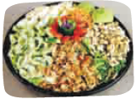

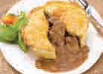
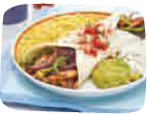
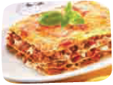
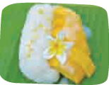
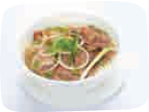
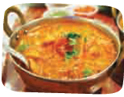
Activity 2 Write the name of each dish in the box under each picture.
Listen, check, and repeat.
lasagne steak pie curry Cobb salad fajitas
beef noodle soup sushi mango sticky rice
A
B
C
D
Cobb salad
sushi
steak pie
fajitas
E
F
G
H
lasagne
mango sticky rice
beef noodle soup
curry

Slide 14
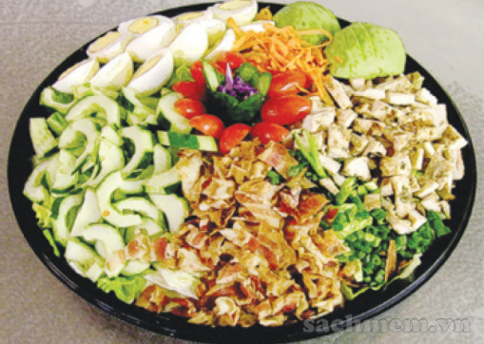
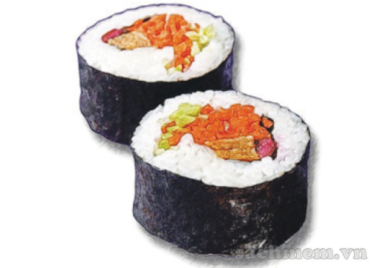
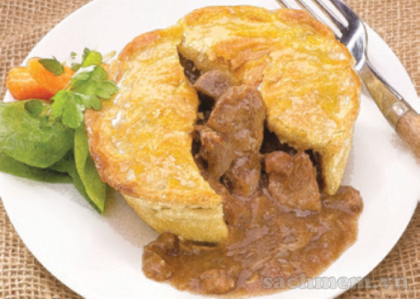
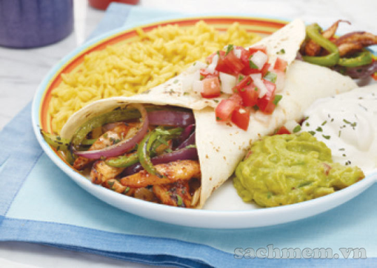
Activity 3 a In pairs, discuss which country from the box is associated with each dish in 2.
Viet Nam Thailand Japan The USA
Mexico The UK Italy India
A
B
Cobb salad - The USA
sushi - Japan
C
D
steak pie - The UK
fajitas - Mexico

Slide 15
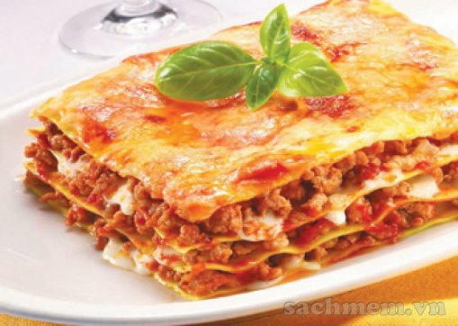
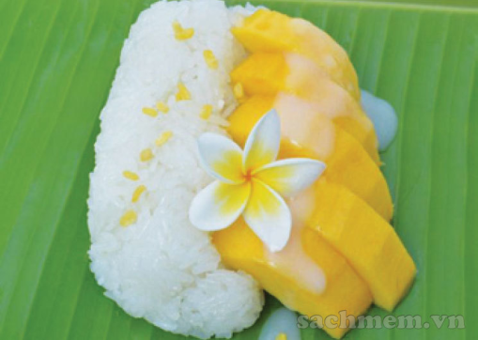
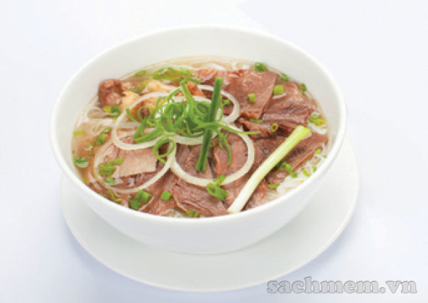
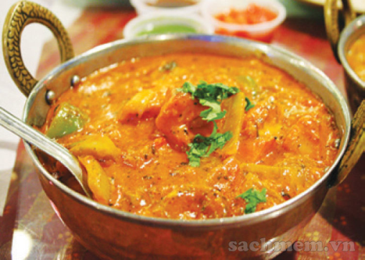
Activity 3 a In pairs, discuss which country 7arfrom the box is associated with each dish in 2.
Viet Nam Thailand Japan The USA
Mexico The UK Italy India
E
F
lasagne - Italy
mango sticky rice - Thailand
G
H
beef noodle soup - Viet Nam
curry - India

Slide 16
Activity 3b Fill each blank with the name of a dish in 2.
1. ______ is a traditional dish made from layers of pasta, meat sauce and tomato sauce. It’s popular all over the world.
2. If you like spicy food, you should try ______. It is a dish of meat or vegetables, cooked in a spicy sauce, often served with rice.
3. A ______ is a traditional meat pie served in Britain. Beef steak and gravy are enclosed in a pastry shell and baked in the oven.
4. ______ is a dish of meat and vegetables cut into strips. It is cooked and wrapped inside a flatbread.
5. If you want to eat something healthy, try ______. It is a dish of small cakes of cold cooked rice, flavoured with vinegar and served with raw fish, avocado, etc.
Lasagne
curry
steak-pie
Fajitas
sushi

Slide 17
Activity 4 FOOD QUIZ
Name …
1. ONE kind of meat
2. TWO foods which you have to peel
3. THREE foods which are made from milk
4. FOUR fruits which are red
5. FIVE vegetables which are green

Slide 18

III. Homework
Learn vocabulary by heart.
Redo exercises.
Prepare the next lesson: A closer look 1

