Slide 1


TRƯỜNG THCS LONG BIÊN
BÀI GIẢNG ĐIỆN TỬ MÔN TIẾNG ANH 9
UNIT 6: VIET NAM –THEN AND NOW
Lesson 7 : Looking back & project
GV: Nguyễn Thị Hiền
Tổ Ngoại Ngữ - Năng khiếu

Slide 2

I. Vocabulary
Activity 1 Complete the following word web with transport systems in Viet Nam then and now.
TRANSPORTATION THEN and NOW
tunnel
earthen road
concrete road
cable car
tram system
path
underpass
tunnel
alley
trench
flyover
alley
skytrain, skywalk system

Slide 3
Activity 2 Fill in each blank with one word/phrase
1. She lived in a(n) ______ family, so she didn’t have much privacy.
2. We live in a ______ family with only my parents and me.
3. Our children didn’t have good learning ______ like computers, CD players, or laboratories during the 1980s.
4. ______ used to be an image associated with our soldiers in the past.
5. Classrooms made of mud and straw with _____ all around used to be common in Viet Nam during the war.
extended family
nuclear
facilities
Rubber sandals
trenches

Slide 4
Activity 3 Read the passage and fill in each blank with
suitable word from the box.
I used to go to a school for the gifted in Ho Chi Minh City. My house was far away, so I had to live with my relatives. It was an (1) ______ family with ten people and a cousin of my age. My mother was worried because I came from a (2) ______ family- much smaller and less complicated. I was a very (3) ______ girl - the type of person who never does what they are told. I was even envious when my cousin got higher grades. Luckily, my relatives were actually very (4) ______ and (5) ______, and my cousin herself was a (6) ______ girl. She didn’t get too upset by my bad behaviour. Just as (7) ______ as her mother, she was ready to lend a hand in my study and to take care of me when I was ill. After three years with them, I also learnt that to get along with members in a big family, I should learn how to (8) ______.
tolerant disobedient sympathetic nuclear
caring understanding extended share
extended
nuclear
disobedient
sympathetic
understanding
tolerant
caring
share

Slide 5

II. Grammar
Activity 4 Complete the sentences with appropriate adjectives.
1. It is ______ to value the improved living conditions we have today.
2. She was ______ the skytrain system would solve the traffic problems in the city.
3. The government is ______ that our education system will be improved significantly by the year 2020.
4. We are all ______ that pollution is getting more and more serious.
5. We were ______ to have heard about the poor living conditions back then.
6. I am ______ that the clanging sounds of the trams in Ha Noi will stay in our hearts forever.
necessary/important
sure/certain/hopeful
sure/certain/confident
sorry/sure
sorry
convinced/sure/certain

Slide 6
Activity 5 Correct the italicised text where necessary.
We had finally finished the school year and Trang asked me to go to Da Nang by train with her. I thought that (1) it was dangerous to go by ourselves since we were just fifteen. But Trang (2) was confident that she take me there safely. Moreover, our (3) parents were too busy to go with us, so they (4) were happy let us go. They even took us to Ha Noi Station and left us there with all the luggage and tickets. I (5) was still worried that we would get lost, but Trang (6) was pleased to be allowed to go on her own. We both (7) felt that it was more convenient to go by night train because we could sleep during the night. When we arrived, I (8) was astonished that the city be very different from what I saw five years earlier, and I was so relieved that we had arrived safe and sound as she promised.
1. no change
3. no change
5. no change
7. no change
2. take → could take
4. let → to let
6. no change
8. be → was

Slide 7

III. Communication
Activity 6 Role-play. Interview a travel agent about Vietnamese people’s holiday trends before and after 2000. Use the cues in the table for your interview. You may use the example to get you started.
 | before 2000 | after 2000
Where to go? | beaches, mountains… inside the country… | beaches, mountains… to other countries
When to go? | summer holiday | Tet holiday, summer holiday, or other national holidays
How to travel around? | coach, train, rarely by airplane | car, train, airplane
Who to go with? | alone, with family | with family, friends

Slide 8
Example:
Interviewer: Have the Vietnamese changed the way they spend their holidays over the last 20 years?
Travel agent: Considerably. For example, they’ve changed their holiday destinations.
Interviewer: So… where did they often go before 2000?
Travel agent: They often went to…

Slide 9

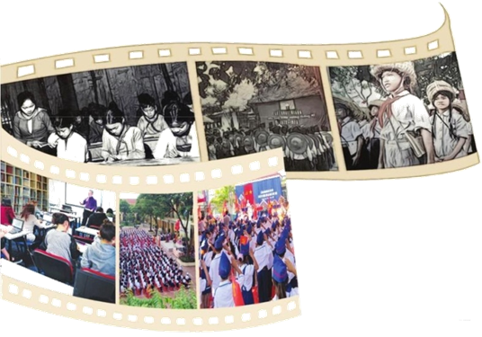
IV. PROJECT
SCHOOL LIFE IN VIET NAM: THEN AND NOW
1. What do you like most about each of the pictures? Why?
2. Plan a photo exhibition about school life in Viet Nam then and now. Work in groups of four. Search for information about the subject. Find photos which show the similarities and differences between then and now. Put them together with some captions as a photo exhibition.
3. Present your group’s photo exhibition to the rest of the class. Remember to say what values you’ve learned from school life in the past.

Slide 10
Reference:
P1. This is a classroom with wooden walls. The class doesn’t look spacious enough. There is no lighting system either. There are not many students. The T and Ss are all dressed simply. Ss are not wearing uniforms.
P2 & 3. This is the opening ceremony of a new school year in the past. The ceremony looks simple but respectful and organised. Ss are standing in rows, listening to the principal’s speech. All are wearing straw hats and red scarves.
P4. This is a modern classroom with more teaching facilities such as a good board, solid tables, bookshelves, and a projector. The room is spacious.
P5 & 6. These are pictures of the opening ceremony of a new school year at present. Ss are standing in rows to listen to their principal’s speech. They are all wearing uniforms and red scarves.

Slide 11

V. Homework
Learn vocabulary by heart.
Redo exercises.
Prepare the next lesson: Getting Started

