Slide 1


TRƯỜNG THCS LONG BIÊN
BÀI GIẢNG ĐIỆN TỬ MÔN TIẾNG ANH 9
UNIT 9: ENGLISH IN THE WORLD
Peroid 69: Skills 2
GV: Nguyễn Thị Hiền
Tổ Ngoại Ngữ - Năng khiếu

Slide 2

UNIT 9: ENGLISH IN THE WORLD
LESSON 6: SKILLS 2
English 9

Slide 3









I. Listening
Activity 1 Listen to four different people talking about speaking and learning languages. Match the summaries (A-E) to each speaker. There is one extra summary.
A. She can speak Spanish, French, and English fluently.
E
B. He decided to learn English properly after a holiday in England.
A
C. A friend advised her to come to England to learn English.
D. She had to learn English because she works for a multinational company.
B
E. The reason why he is good at German is that he lives near the border.
D

Slide 4
Activity 2 Listen to the extracts again and answer the Questions
1. What did Speaker 1 do last summer?
2. How can Speaker 2 speak Italian?
3. What was Speaker 3’s level of English in the past?
4. What did Speaker 3 do while travelling around England?
5. What did Speaker 4 think of her English learning?
He went to Rome.
She can have a conversation in Italian, but it’s a bit rusty.
He used to be quite bad at English.
He picked up enough words and phrases to get by.
She thinks that she has learned a lot since she started an English course at an English centre.

Slide 5

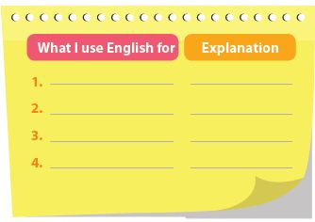
II. Writing
Activity 3 Make notes of four uses of English in your daily life and give an explanation/example for each of them. Then compare your list with a partner.

Slide 6

Activity 4a Use your notes in 3 to write about what you use English for in your daily life.
Activity 4b Swap your writing with a partner and review each other’s drafts. Make revisions and corrections if necessary. Then present your final writing to the class.

Slide 7

III. Homework
Learn vocabulary by heart.
Redo exercises.
Prepare the next lesson: Looking back - Project

