Slide 1
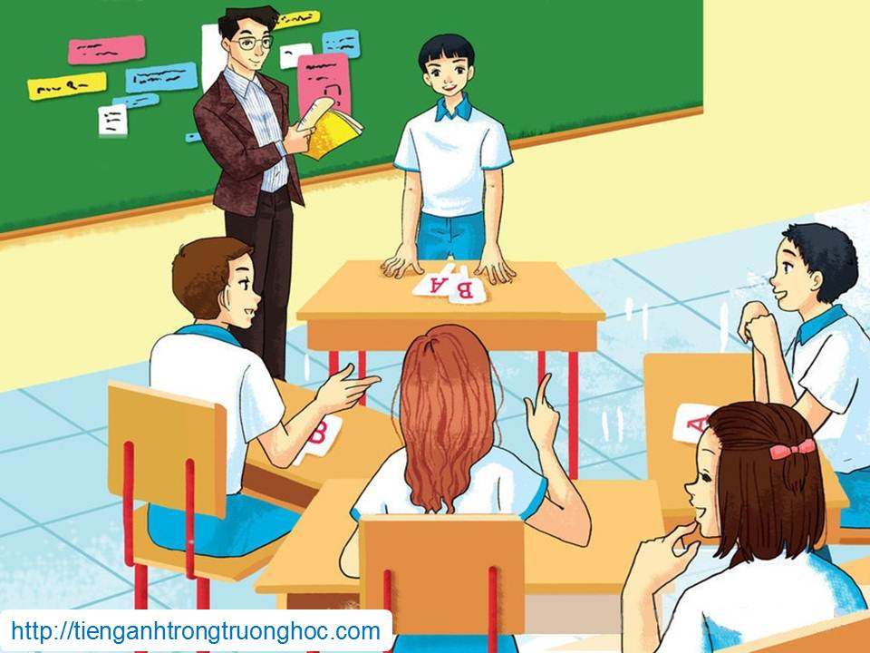
UNIT 9: ENGLISH IN THE WORLD
LESSON 3: A CLOSER LOOK 2
English 9

Slide 2
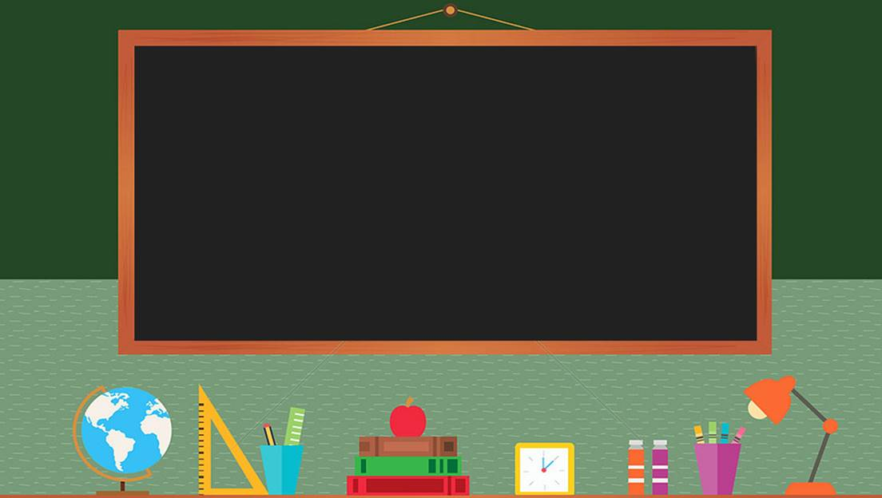

TRƯỜNG THCS LONG BIÊN
BÀI GIẢNG ĐIỆN TỬ MÔN TIẾNG ANH 9
UNIT 9: ENGLISH IN THE WORLD
Peroid 71: A closer look 2
GV: Nguyễn Thị Hiền
Tổ Ngoại Ngữ - Năng khiếu

Slide 3

IF YOU WERE A PENGUIN …
Where would you live?
What would you eat?
How would you reproduce?
How long would you live?
What animals would you be afraid of?

Slide 4
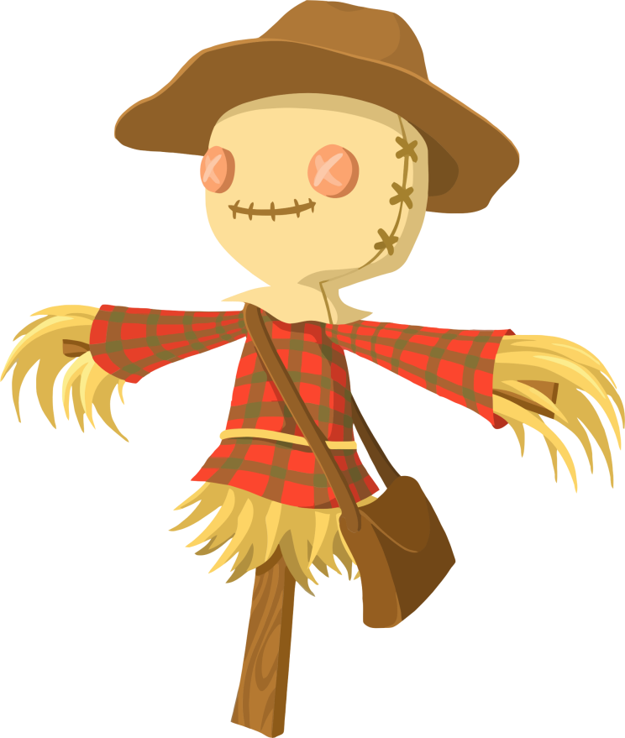
IF YOU WERE A SCARECROW …
What would you do?
Where would you live?
What would you be made of?
What would be your worst enemies?

Slide 5

I. Grammar
Conditional sentences type 2: review
Activity 1a Read this sentence from the conversation in GETTING STARTED. Do you remember when we use conditional sentences type 2?
Duong: Yeah, if there weren’t so many words, it would be easier for us to master it!

Slide 6

Look out!
In a formal context, we normally use were instead of was:
If I were you, I would think more carefully about the job. (more formal)
If I was you, I would think more carefully about the job. (more informal)

Slide 7
Activity 1b Write Yes or No to answer the questions about each sentence.
1. If Tien had an IELTS certificate, he would get the job.
Does Tien have an IELTS certificate? ______
2. If our English teacher weren’t here, we wouldn’t know what to do.
Is the English teacher here now? ______
3. If we went to England this summer, we would have the chance to pick up a bit of English.
Is it possible that they will go to England this summer? ______
4. English would be easy to master if it didn’t have such a large vocabulary.
Is English easy to master? ______
5. If she used English more often, her English wouldn’t be so rusty.
Does she often use English? ______
No
Yes
No
No
No

Slide 8
Activity 2 Rewrite the sentences using the conditional sentences type 2.
Example:
Peter has such a lot of English homework that he won’t go to the party.
→ If Peter didn’t have such a lot of English homework, he would go to the party.
1. I don’t feel confident at interviews because my English is not very good.
If my English _________________________________.
2. Minh doesn’t read many English books because she doesn’t have time.
If Minh ______________________________________.
3. I think you should spend more time improving your pronunciation.
If I were ______________________________________.
4. Mai is so good at the language because she has some friends who are native speakers of English.
If Mai didn’t have _____________________________.
5. We can’t offer you the job because you can’t speak English.
If you could speak ____________________________.
were good, I would feel confident at interviews.
had time, she would read many English books
you, I would spend more time improve my pronunciation.
some friends…, she wouldn’t be so good…
English, I would offer you the job

Slide 9
Relative clauses
Activity 3a Read part of the conversation from GETTING STARTED. Pay attention to the underlined part.
.
Teacher: Question one: Is English the language which is spoken as a first language by most people in the world?
REMEMBER!
A relative clause is introduced by a relative pronoun such as who, whom, which, that, whose, where, why and when

Slide 10
Activity 3b When do we use relative clauses? Can you think of any rules? We use relative clauses to give extra information about something/someone or to identify which particular thing/person we are talking about.
Relative pronoun | Example
which (for things and animals) | The book which I liked was the detective story.
who (for people) | The girl who is wearing a blue shirt is Mai.
whom (for people as the object of the relative clause) | That’s the boy whom we saw at school yesterday.
when (for time) | Do you remember the day when we first met, darling?
where (for places) | This is the place where they filmed Star Wars.
why (for reasons) | That’s the reason why he failed.
whose (for possession) | That’s the man whose dog we found.
that (for people, things, animals and times) | Where’s letter that came yesterday? The people that I spoke to were very helpful. We moved here the year that my uncle died.

Slide 11
RELATIVE CLAUSES
GAME
Choose the right option.

Slide 12
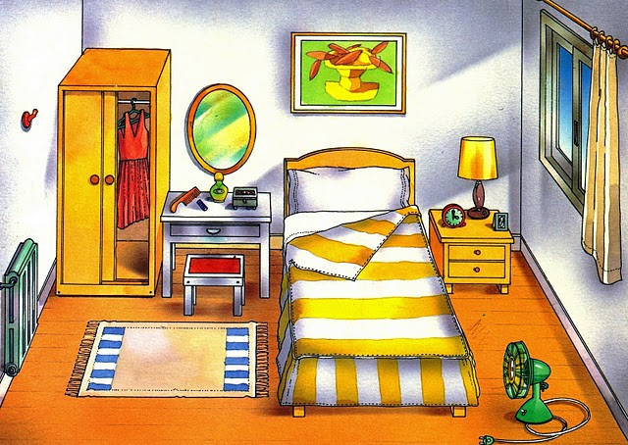


The children …are playing in the bedroom are my best friends..
GREAT
which
who
whose

Slide 13
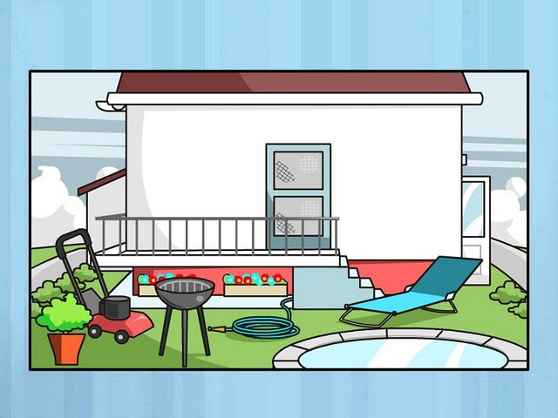


The plane… the boy is playing with was expensive.
GREAT
which
who
whose

Slide 14
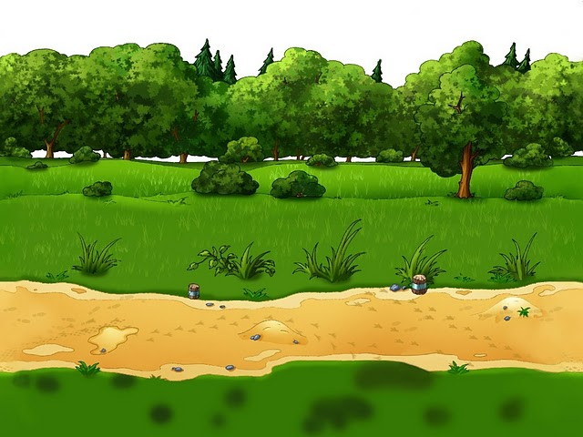
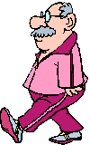

Mr. Smith, … wife is a nurse, goes to work on foot.
GREAT
which
who
whose

Slide 15
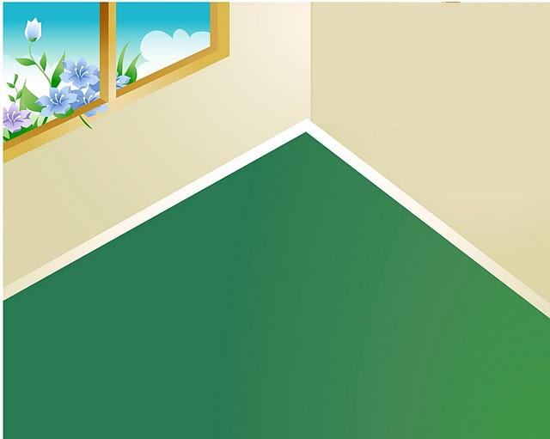
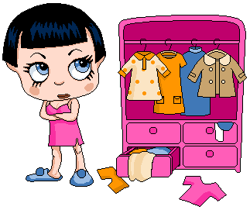

Daisy, … has a lot of clothes, never knows what to wear.
GREAT
which
who
whose

Slide 16
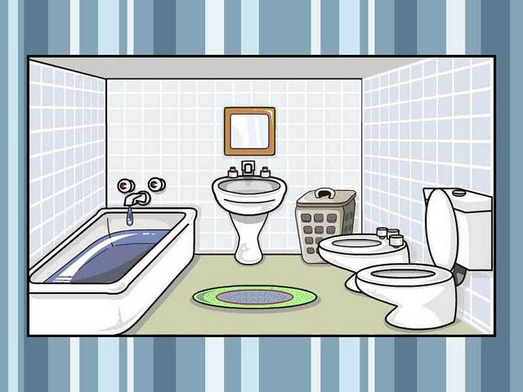

The spider… is in the bathroom is big.
GREAT
which
who
whose

Slide 17

The girl… father is a teacher likes reading.
GREAT
which
who
whose

Slide 18
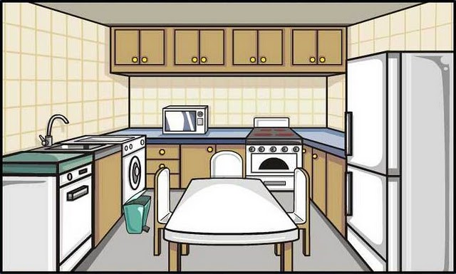
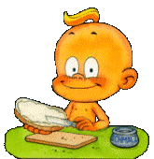
The boy … is having breakfast is my brother.
GREAT
which
who
whose

Slide 19
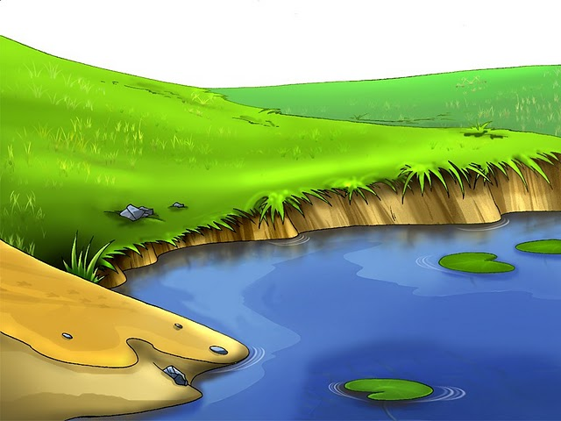
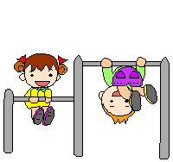

The man … children are playing is a farmer.
GREAT
which
who
whose

Slide 20
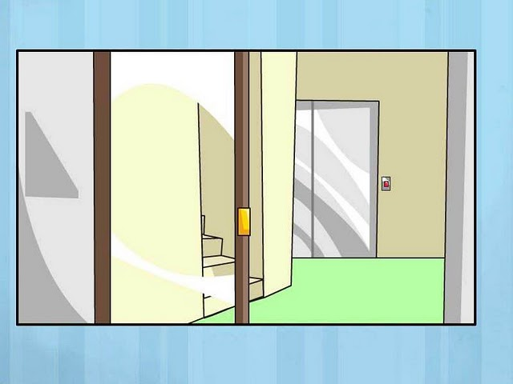

Lucy, … loves computers, is a bad student.
GREAT
which
who
whose

Slide 21
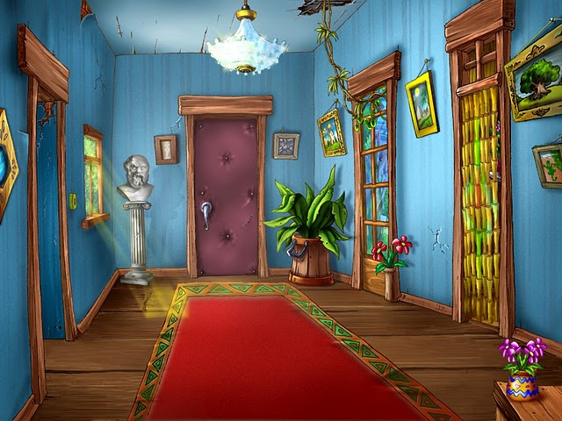

Marion, … brother is a singer, is a good student.
GREAT
which
who
whose

Slide 22
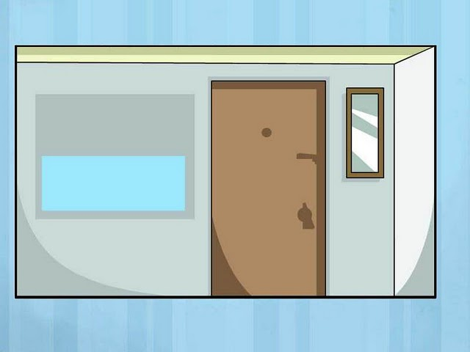

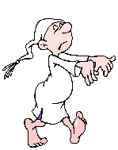
John, … is a sleepwalker, is nice.
GREAT
which
who
whose

Slide 23
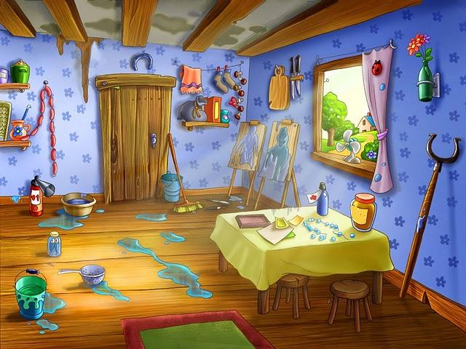

Van Gogh, … paintings are famous, didn’t have a studio like this.
GREAT
which
who
whose

Slide 24
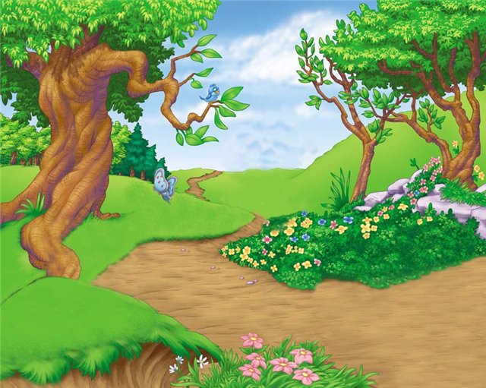

The birds… are flying are blue..
GREAT
which
who
whose

Slide 25
Activity 4 Circle the correct word. Sometimes more than one answer is possible.
1. That’s the boy who/whom/that is bilingual in English and Vietnamese.
2. This is the room which/who/where we are having an English lesson this evening.
3. The girl who/whose/which father is my English teacher is reasonably good at English.
4. Do you remember the year where/when/that we started to learn English?
5. The teacher whom/which/who you met yesterday is fluent in both English and French.
6. That’s the reason where/when/why his English is a bit rusty.

Slide 26

Look out!
We normally use who instead of whom (except in a formal context) even when it is the object of the relative clause. However, we always use whom after a preposition. In informal contexts, we usually put the preposition at the end of the clause and use who.
Is that the boy who we saw at school yesterday?
This is the woman with whom Mary is sharing the room.(more formal)
This is the woman who Mary is sharing the room with.(more informal)
We can replace where/when with a preposition + which. In informal contexts, we put the preposition at the end of the clause.
The house where/in which he lived as a child is somewhere around here.
The house which he lived in as a child is somewhere around here.
Do you know the year when/in which the steam engine was invented?
Do you know the year which the steam engine was invented in?

Slide 27
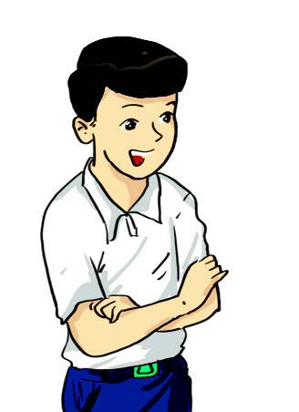
Activity 5 Write true sentences about yourself. Then share them with your partner. How many things do you have in common?
I would like to:
have a friend who ...
go to a country where ...
buy a book which ...
meet a person whose ...
do something that ...
___________________
___________________
___________________
___________________

Slide 28
Activity 6 Rewrite these sentences as one sentence using a relative clause.
1. My friend plays the guitar. He has just released a CD.
My friend who/that plays the guitar has just released a CD.
2. Parts of the palace are open to the public. It is where the queen lives.
3. English has borrowed many words. They come from other languages.
Parts of the palace where/in which the queen lives are open to the public.
English has borrowed many words which/that come from other languages.

Slide 29
4. I moved to a new school. English is taught by native teachers there.
5. I don’t like English. There are several reasons for that.
6. The new girl in our class is reasonably good at English. Her name is Mi.
I moved to a new school where/in which English is taught by native teachers.
There are several reasons why I don’t like English
The new girl in our class, whose name is Mi, is reasonably good at English.

Slide 30

II. Homework
Learn vocabulary by heart.
Redo exercises.
Prepare the next lesson: Communication

