Slide 1


TRƯỜNG THCS LONG BIÊN
BÀI GIẢNG ĐIỆN TỬ MÔN TIẾNG ANH 9
UNIT 9: ENGLISH IN THE WORLD
Peroid 70: A closer look 1
GV: Nguyễn Thị Hiền
Tổ Ngoại Ngữ - Năng khiếu

Slide 2
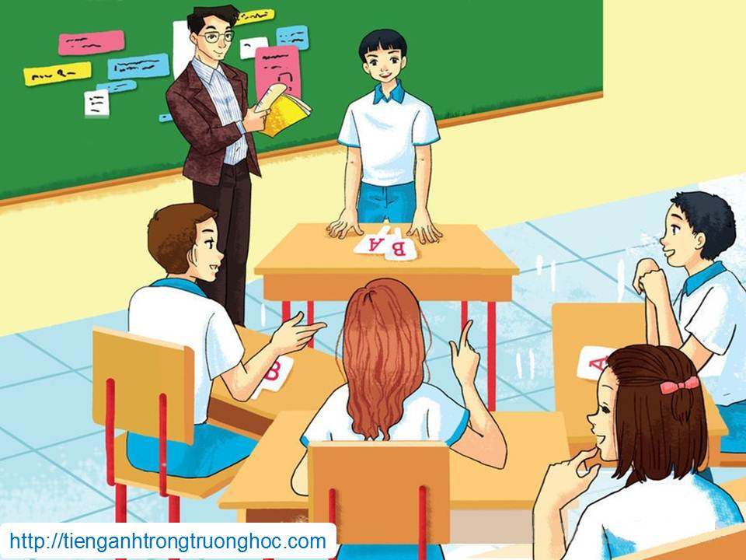
      UNIT 9: ENGLISH IN THE WORLD
      LESSON 2: A CLOSER LOOK 1
English 9

Slide 3

I. Vocabulary
Activity 1 Match the words/phrases in column A with the definitions in column B.
A | B
1. bilingual 2. fluent 3. rusty 4. pick up a language 5. reasonably 6. get by in a language | a. not as good at a language as you used to be because you have not used it for a long time b. able to speak two languages equally well because you learned them as a child c. know just enough of a language for simple communication d. learn a language by practising it, rather than by learning it in a class e. able to speak, read or write a language easily, quickly, and well f. to a degree that is fairly good, but not very good

Slide 4
Activity 2a Choose the correct words in the following phrases about language learning.
1. be bilingual in/at the language
2. be reasonably good on/at the language
3. can get to/by in the language
4. be fluent at/in the language
5. can’t speak a word of/with the language
6. can speak the language, but it’s a lot/bit rusty
7. pick up/off a bit of the language on holiday

Slide 5
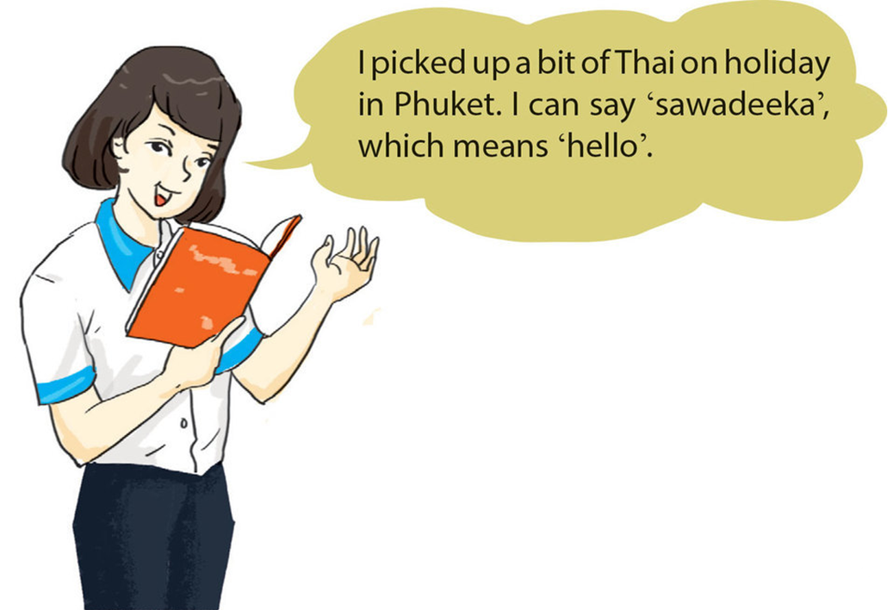
Activity 2b Choose phrases from 2a to make sentences about yourself or people you know.

Slide 6
Activity 2b Choose phrases from 2a to make sentences about yourself or people you know.
Activity 3a Match the words/phrases in column A with the words/phrases in column B to make expressions about language learning.
A | B
1. know what a | a. other speakers
2. have | b. the meaning of a word
3. make | c. your first language
4. guess | d. mistake
5. imitate | e. word means
6. translate from | f. in a dictionary
7. correct a | g. mistakes
8. look up a word | h. an accent

Slide 7
Activity 2b Fill the blanks with the verbs in the box.
If you don’t (1) ______ what a word means, try to (2) ______ the meaning, or (3) ______ the word in your dictionary. All foreign speakers (4) ______ an accent, but that doesn’t matter. To make your pronunciation better, listen to English speakers and try to (5) ______ them. Don’t worry if you (6) ______ mistakes or don’t try to (7) ______ a mistake – that’s normal! It’s often useful to (8) ______ words from one language to the other, but it’s best when you can start to think in the new language.
guess know have make
translate correct imitate look up
know
guess
look up
have
imitate
make
correct
translate

Slide 8




II. Pronunciation
Tones in new and known information
Activity 4 Listen and repeat, paying attention to the tones of the underlined words in each conversation.
1. A: I’d like some oranges, please.
  B: But we don’t have any oranges.
2. A: What would you like, sir?
  B: I’d like some oranges.
3. A: I’ll come here tomorrow.
  B: But our shop is closed tomorrow.
4. A: When is your shop closed?
  B: It is closed tomorrow.

Slide 9

Look out!
When we are referring to something in the conversation, we do not have to repeat exactly the same words. In this conversation, the voice goes up on the words/phrases that are replaced.
Example:
A: I’m from Viet Nam.
B: Really, my wife’s from there.
In this conversation, the voice goes up on ‘from there’ because in this context it means ‘Viet Nam’, so it is something which has been mentioned before.

Slide 10

REMEMBER!
In conversation, we often refer to something which has been mentioned before. This is known information, and the voice normally goes up at the end. We also tell the listener things we have not mentioned before. This is new information, and the voice normally goes down at the end.
Example:
1. A: I need some oil.
  B: But we’ve run out of oil.
2. A: What do you need?
  B: I need some oil.

Slide 11
Activity 5 Listen to the conversations. Do you think the voice goes up or down at the end of each second sentence? Draw a suitable arrow at the end of each line.
1. A: Tom found a watch on the street.
  B: No. He found a wallet on the street.
2. A: Where did Tom find this watch?
  B: He found it on the street.
3. A: Let’s have some coffee.
  B: But I don’t like coffee.
4. A: Let’s have a drink. What would you like?
  B: I’d like some coffee.
5. A: This hat is nice.
  B: I know it’s nice, but it’s expensive.
6. A: This bed is big.
  B: I know it’s big but that one’s bigger.

Slide 12

Activity 6 Read the conversation. Does the voice go up or down on the underlined words? Draw a suitable arrow at the end of each line. Then listen, check and repeat.
A: What make of TV shall we buy?
B: Let’s get the Samsung.
A: I think we should get the Sony. It’s really nice.
B: (trying to persuade A to buy a Samsung) But the Samsung is nicer.
A: But the Sony has a guarantee.
B: They both have a guarantee.
A: How much is the Sony?
B: It’s $600.
A: It’s too expensive.
B: I know it’s expensive, but it’s of better quality.
A: (trying to persuade B to buy a Sony) They’re both of good quality.

Slide 13

III. Homework
  Learn vocabulary by heart.
  Redo exercises.
  Prepare the next lesson: A closer look 2

