Slide 1


TRƯỜNG THCS LONG BIÊN
BÀI GIẢNG ĐIỆN TỬ MÔN TIẾNG ANH 9
UNIT 8: TOURISM
Peroid 66: Skills 1
GV: Nguyễn Thị Hiền
Tổ Ngoại Ngữ - Năng khiếu

Slide 2

UNIT 8: TOURISM
LESSON 5: SKILLS 1
English 9

Slide 3

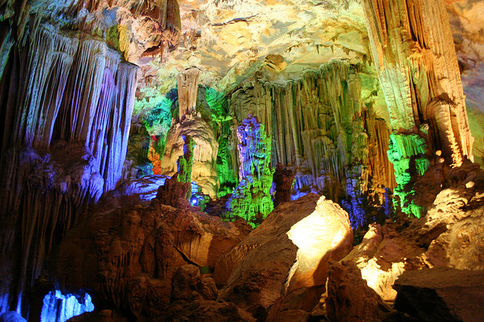
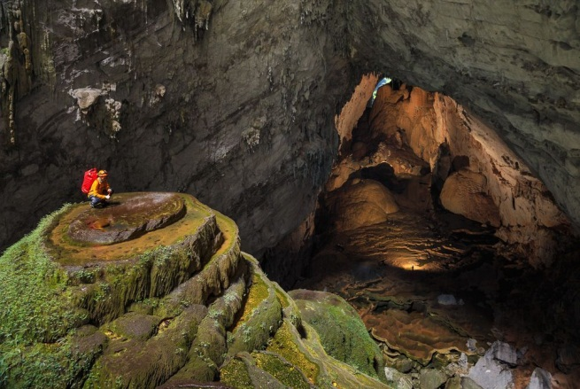
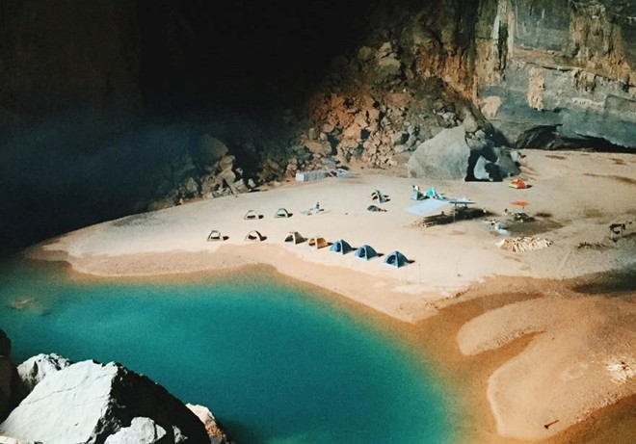
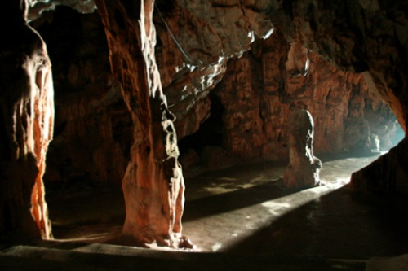
I. Reading
Activity 1a Work in groups. Name some famous caves in Viet Nam and in the world.
Famous caves in Viet Nam:
Phong Nha Cave
Son Doong Cave
En Cave (Quangbinh)
Thach Dong (Hatien)

Slide 4
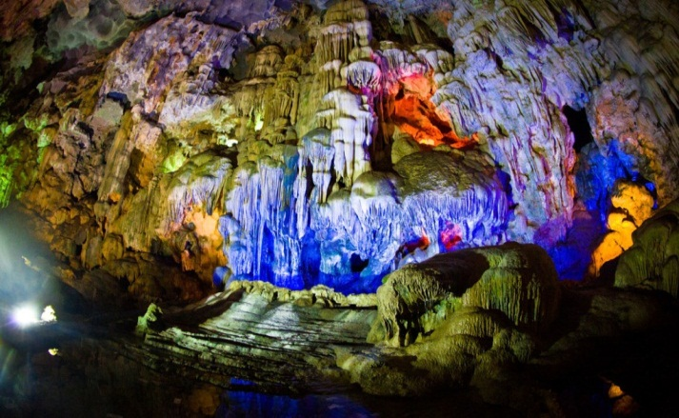
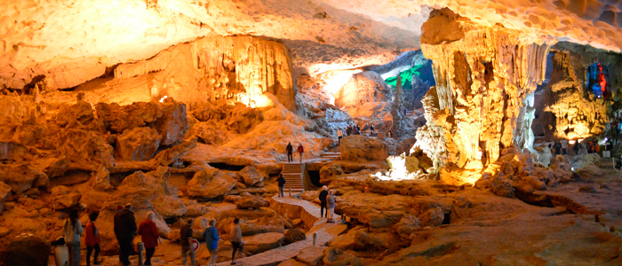
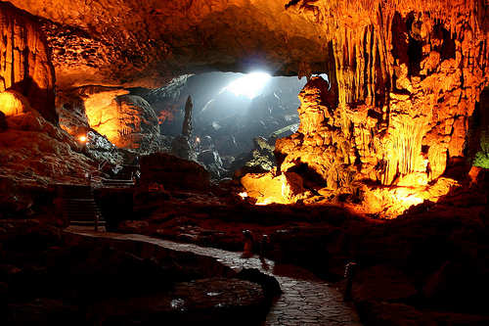
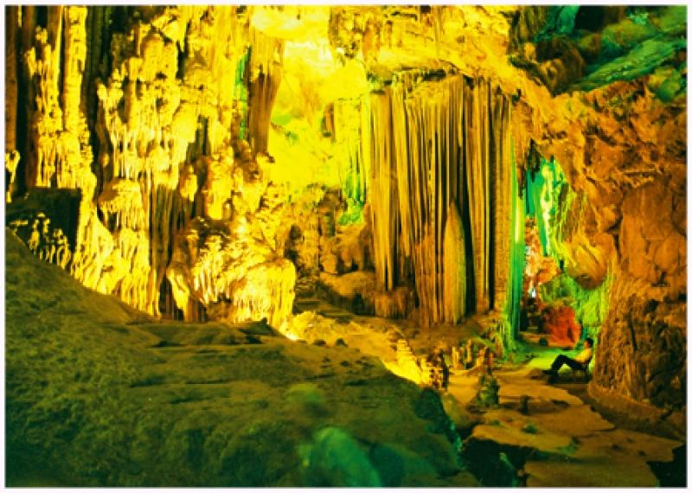
Thien cung cave
Sung Sot cave
Dau Go cave
Tam Cung cave

Slide 5
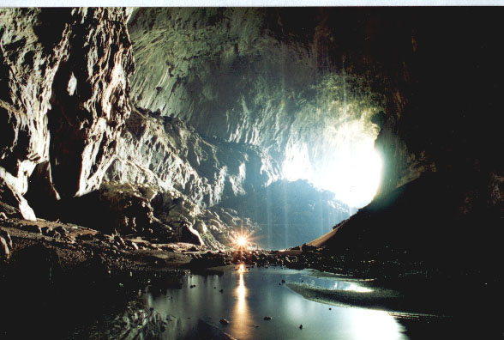
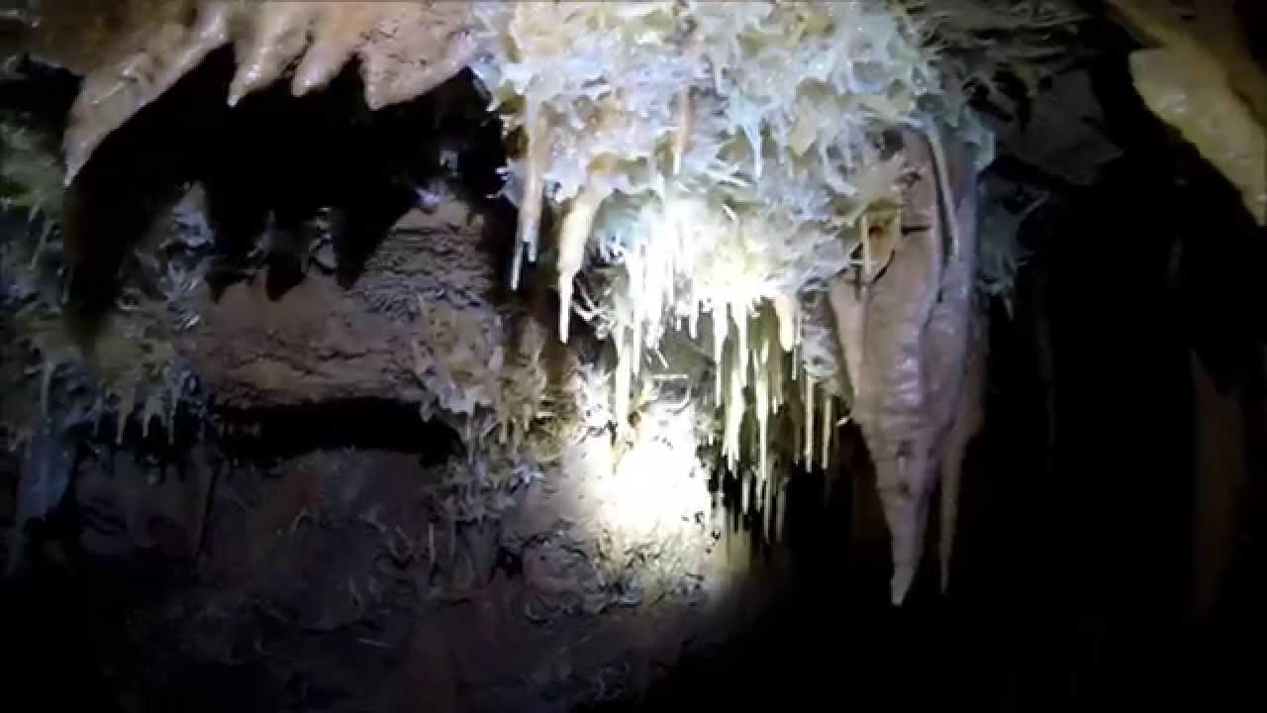
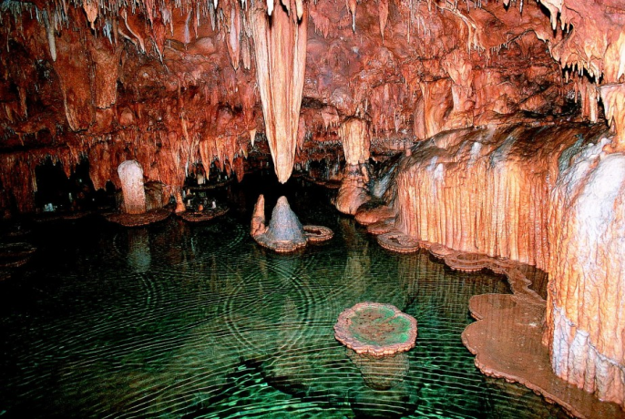
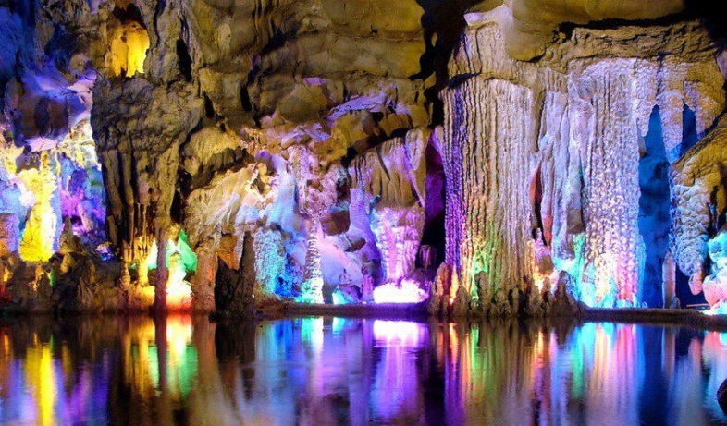
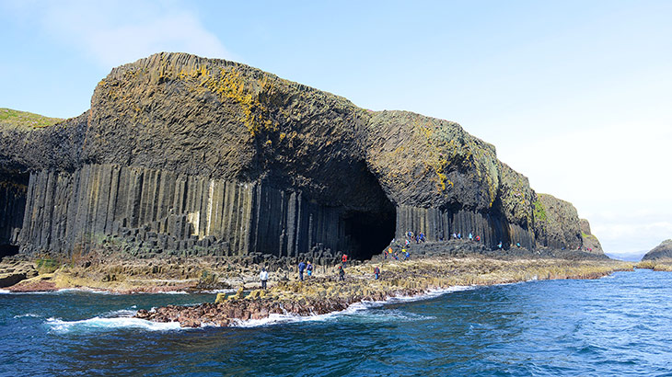
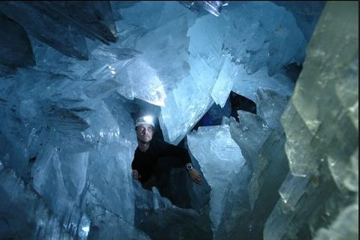
Famous caves in the world:
Deer Cave (Borneo, Malaysia)
Gou re Berger Cave (France)
Onondaga Cave (Missouri, USA)
Reed Flute Cave (Guilin, China)
Fingal’s Cave (Scotland),
Cave of Crystals (Mexico)

Slide 6
Activity 1b Answer the questions with your own ideas.
1. Where is Son Doong Cave located?
2. When was it discovered?
3. How long is the cave?
Son Doong Cace is located in Quang Binh
It was discovered by local man named Ho Khanh in 1991
The cave is nearly 9 kilometres long

Slide 7

Now read the passage and check the information.
Son Doong Cave has become more famous after the American Broadcasting Company (ABC) aired a live programme featuring its magnificence on ‘Good Morning America’ in May 2015.
Located in Quang Binh Province, Son Doong Cave was discovered by a local man named Ho Khanh in 1991, and became known internationally in 2009 thanks to British cavers, led by Howard Limbert. The cave was formed about 2 to 5 million years ago by river water eroding away the limestone underneath the mountain. It contains some of the tallest known stalagmites in the world - up to 70 metres tall. The cave is more than 200 metres wide, 150 metres high, and nearly 9 kilometres long, with caverns big enough to fit an entire street inside them. Son Doong Cave is recognised as the largest cave in the world by BCRA (British Cave Research Association) and selected as one of the most beautiful on earth by the BBC (British Broadcasting Corporation).
In August 2013, the first tourist group explored the cave on a guided tour. Permits are now required to access the cave and are made available on a limited basis. Only 500 permits were issued for the 2015 season, which runs from February to August. After August, heavy rains cause river levels to rise and make the cave largely inaccessible

Slide 8
Activity 2 Read the passage again and answer the questions, or choose the correct answers.
1. What happened in May 2015?
2. How was Son Doong Cave formed?
3. When can tourists explore the cave?
The American Broadcasting Company (ABC) aired a live programme ( featuring the magnificence of Son Doong ) on ‘Good Morning America’.
By river water eroding away the limestone underneath the mountain
From February to August

Slide 9
Activity 2 (Cont)
4. The word ‘inaccessible’ in the passage probably means ______.
A. should not be accessed
B. need to be careful
C. cannot be reached
D. may be fooded
5. From the passage, we know that ______.
A. there is a street inside Son Doong Cave
B. the cave is always covered with rain water
C. few tourists want to come to the cave
D. tourists need permission to explore the cave

Slide 10

II. Speaking
Activity 3 Which would you like to do most on holiday? Tick ( √) three things in the list.
1. explore Son Doong Cave
2. climb the Great Wall of China
3. visit the Pyramids of Egypt
4. go on a wildlife safari to Kenya
5. relax on a beach
6. go camping in Cuc Phuong National Park
7. go on an expedition to Mount Everest
8. take an adventure tour to the Arctic
9. take a sightseeing tour around New York
10. take a Trans-Viet cycling tour

Slide 11
Activity 4 Work in groups. Talk about one of your choices, trying to persuade your group to join you.
Example:
A: I’d like to go on a wildlife safari to Kenya as I’m very interested in the natural world and wildlife preservation. You can experience wild animals in their natural habitat - elephants, hippos, cheetahs, and lions…
B: I think a cycling tour from the north to the south of Viet Nam with some friends is the best. You travel at your own pace. You stop whenever and wherever you like. You can enjoy the beauty of different parts of our country and at the same time improve your health…

Slide 12

III. Homework
Learn vocabulary by heart.
Redo exercises.
Prepare the next lesson: Skills 2

