Slide 1


TRƯỜNG THCS LONG BIÊN
BÀI GIẢNG ĐIỆN TỬ MÔN TIẾNG ANH 9
UNIT 8: TOURISM
Peroid 64: Acloser look 2
GV: Nguyễn Thị Hiền
Tổ Ngoại Ngữ - Năng khiếu

Slide 2
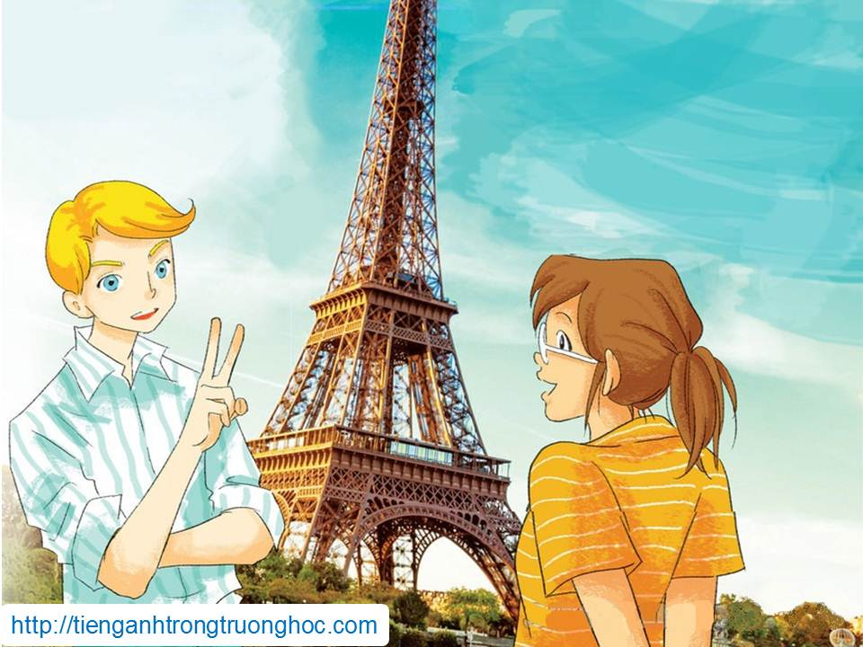
      UNIT 8: TOURISM
      LESSON 3: A CLOSER LOOK 2
English 9

Slide 3





Indefinite Articles
a and an are used before singular countable nouns

Slide 4
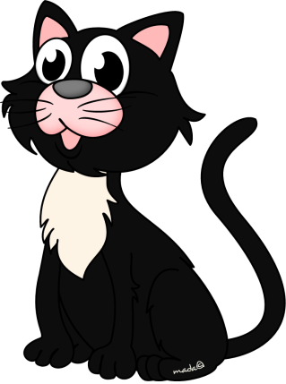
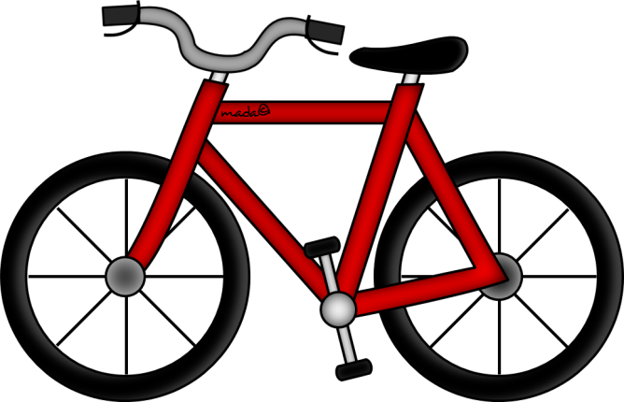
Indefinite Articles
a is used before a singular noun beginning with a consonant
a cat
a bike

Slide 5
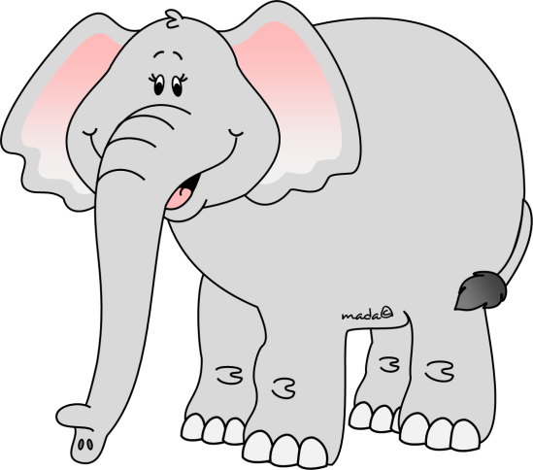
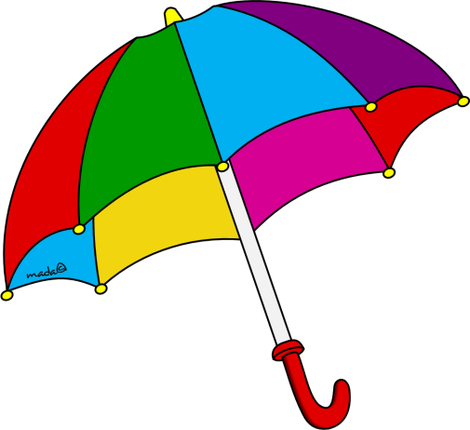
Indefinite Articles
an is used before a singular noun beginning with a vowel
an elephant
a umbrella

Slide 6
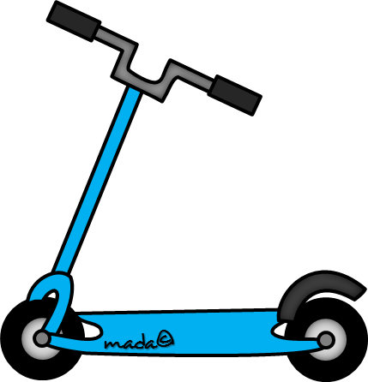
Definite Articles
the is used before singular and plural nouns when the noun is specific or particular
I can see a scooter.
The scooter is blue.

Slide 7
Definite Articles
the is used with nouns that are unique
the moon, the sky, the sun, the Pope, etc.

Slide 8
Definite Articles
the is used before the names of rivers, seas/oceans, mountain ranges, deserts and groups of islands
the Amazon, the Pacific,
the Alps, the Sahara, the Canaries, etc.

Slide 9
Definite Articles
the is used before the names of musical instruments
the flute, the violin, etc.

Slide 10
Definite Articles
the is used before nationalities
and names of families
the British, the Italians, the Jacksons, the Greens, etc.

Slide 11
Definite Articles
the is used when the place name contains of-phrase
the Statue of Liberty,
the Tower of London, etc.

Slide 12
Zero Articles
with meals, months, days, games, sports and special times of the year:
breakfast, lunch, dinner
tennis, snowboard, volleyball, etc.

Slide 13

Zero Articles
with most names of people and places (most countries, states and cities):
This is ø Steve.

Slide 14
Zero Articles
with geographical areas, lakes, mountains and islands:
Asia, Germany, Mardid, Oxford Street, Lake Michigan, etc..

Slide 15

I. Grammar
Articles: other uses
REMEMBER!
A/an is used:
1. to talk about something that the listener or the reader doesn’t know about yet:
K2 is a peak in the Himalayas.
2. to describe what something or someone is:
ABS is an unreliable travel agency.

Slide 16
The is used:
1. when the listener or reader knows what the speaker or writer is talking about:
Give me the money.
2. when the speaker specifies what or who they are talking about:
Where are the tickets I gave you yesterday?
3. with things that are the only ones around us, or that are unique:
Neil Armstrong landed on the moon in 1969.
4. when we refer to the world around us or things that we all know about:
We had a sightseeing tour around the city.

Slide 17
Zero article is used:
1. with plural or uncountable nouns when we are talking about things in general:
Passwords protect our personal information.
2. with meals, months, days and special times of the year:
I visit my grandparents on New Year’s Day.
3. with most names of people and places (most countries, states and cities):
Da Lat is in Lam Dong Province.
4. with geographical areas, lakes, mountains and islands:
We visited Lake Victoria. It’s in East Africa.

Slide 18

Look out!
We use the with the names of a few countries: the UK, the USA, the Netherlands, the Philippines We also use the with island groups, mountain ranges, oceans and names of rivers: the Thames, the Pacific, the Amazon, the Danube...

Slide 19
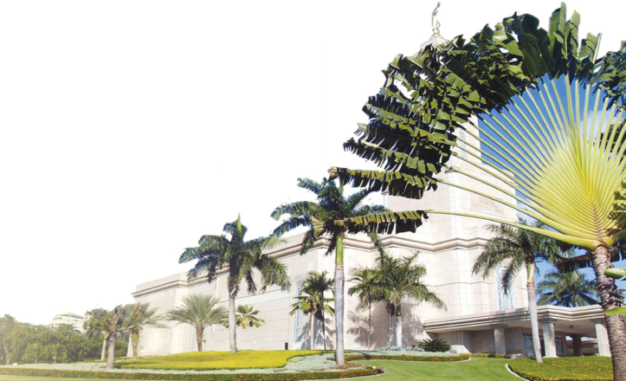
Activity 1 Complete the text with a/an, the, or zero article (Φ).
The Dominican Republic is (1)______ country on the island of Hispaniola, in (2)______ Caribbean region. It is (3)______ second largest Caribbean nation after Cuba, with nearly 10 million people, one million of whom live in (4)______ capital city Santo Domingo. (5)______ second largest city is (6)______ Santiago. The geography of (7)______ country is varied, and ranges from (8)______ semi desert plains to (9)______ lush valleys of tropical rainforest. (10)______ economy depends largely on (11)______ agriculture, with (12)______ sugar as (13)______ main crop. Tourism is (14)______ important industry.
a
the
the
the
the
ɸ
the
ɸ
ɸ
the
ɸ
ɸ
the
an

Slide 20
Activity 2a Ask and answer the questions. Choose from the list. Use the if necessary.
1. Which one is an imperial palace?
2. Which river runs through London?
3. Which one is the deepest lake in the world?
4. Which one is considered one of the New7Wonders of Nature?
5. Which one is the largest cave in the world?
6. Which one is a tourist attraction in New York?
Lake Baikal Amazon River Thames
Statue of Liberty Lake Geneva Son Doong Cave
Ha Long Bay Angkor Wat Forbidden City
The Forbidden City
The Thames
Lake Baikal
Ha Long Bay
Son Doong Cave
The Statue of Liberty

Slide 21
Activity 2b Choose one item above and say what you know about it as a tourist attraction.

Slide 22
Activity 3a Write answers to the questions, using a, an, the or zero article in each answer. Give three true answers, but two untrue ones.
1. What colour and type of bicycle would you like to have?
2. Which holiday destination do you prefer: city, mountains, seaside?
3. Where would you like to go on holiday next?
4. What’s your favourite time of the year?
5. Have you ever travelled anywhere by plane? Please explain.

Slide 23
Activity 3b Tell your answers to a partner and ask him/her to guess which answers are not true.

Slide 24
Activity 4 Make full sentences from the words/phrases, adding articles as needed. Then mark them as true (T) or false (F).
1. original name/of/Ha Noi/Phu Xuan
2. most famous/Egyptian pyramids/found/at Giza/in/Cairo
3. there/city/called/ Kiev/in/America
4. My Son/set of ruins/from/ancient Cham Empire/ UNESCO World Heritage Site
5. English/first language/in/many countries/outside/United Kingdom
The original name of Ha Noi was Phu Xuan.
F
T
The most famous Egyptian pyramids are found at Giza in Cairo.
There is a city called Kiev in America.
F
My Son, a set of ruins from the ancient Cham Empire, is
a UNESCO World Heritage Site.
T
English is the first language in many countries outside
the United Kingdom.
T

Slide 25

II. Homework
  Learn vocabulary by heart.
  Redo exercises.
  Prepare the next lesson: Communication

