Slide 1


TRƯỜNG THCS LONG BIÊN
BÀI GIẢNG ĐIỆN TỬ MÔN TIẾNG ANH 9
UNIT 7: RECIPES AND EATING HABITS
Peroid 60: Skills 2
GV: Nguyễn Thị Hiền
Tổ Ngoại Ngữ - Năng khiếu

Slide 2
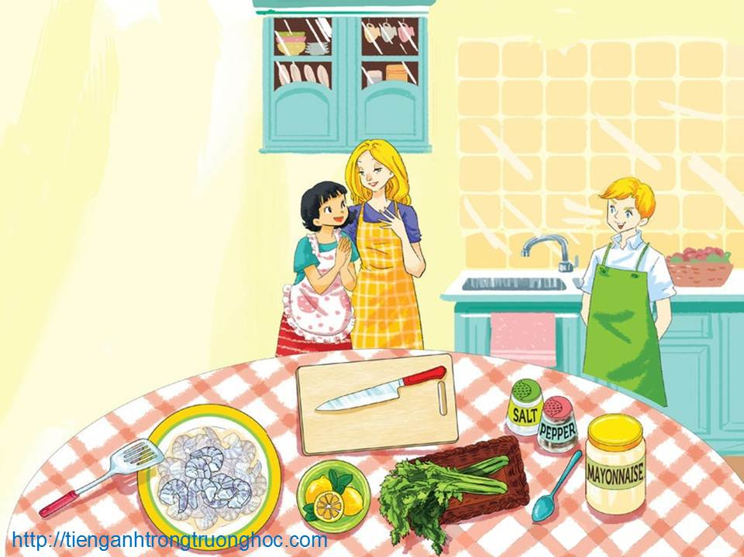
      UNIT 7: RECIPES AND EATING HABITS
      LESSON 6: SKILLS 2
English 9

Slide 3
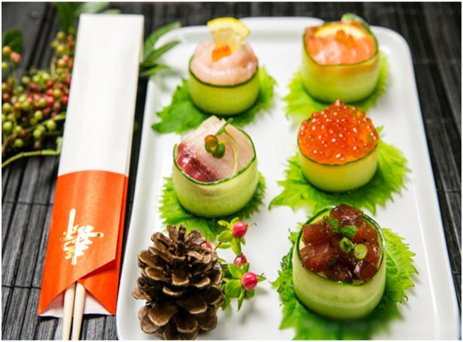
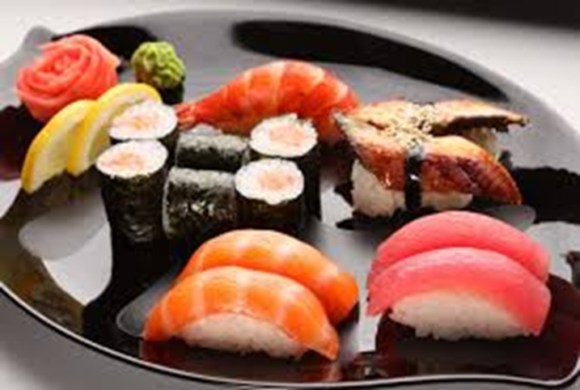
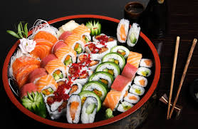
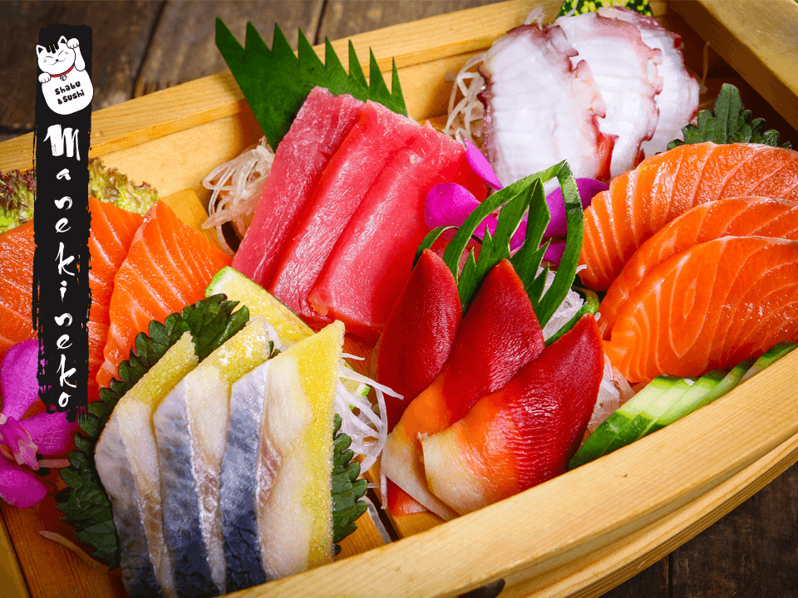
Warm up
Sushi
Sashimi

Slide 4

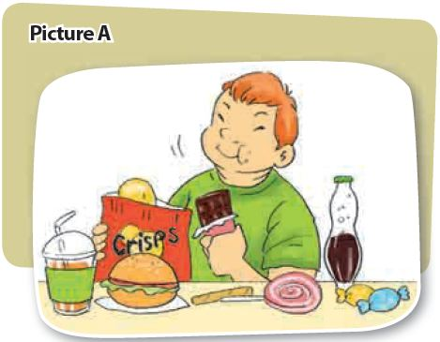
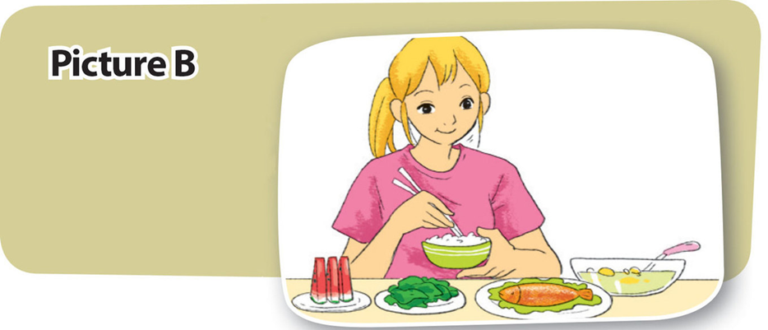
I. Listening
Activity 1 Work in pairs. One of you looks at Picture A, and the other looks at Picture B on page 17. Ask each other questions to find out the differences between your pictures.
What do the pictures tell you?

Slide 5

Activity 2 4Teen Radio is asking two students about their eating habits. Listen to what they say and decide if the statements are true (T) or false (F).
 | T | F
1. Nicolas gets up too late to have a real breakfast. 2. It’s difficult to buy his lunch at the school canteen. 3. He’s considering changing his eating habits. 4. Both Maya and her brother have good eating habits. 5. She thinks breakfast should include nutritious food. 6. She cooks dinner for her family.







Slide 6
Activity 3 Listen again and complete the table. Use no more than three words for each blank.
Name | Breakfast | Lunch | Dinner
Nicolas | some (1)______ | buys at school canteen a (2)______ a packet of (3) ______ a cola | (4) ______ noodles egg few (5)______
Maya | a bowl of (6) _____ a glass of milk (7)______ | brings lunch box (8) two ______ (9) a ______ salad sometimes sushi | favourite: (10)______ lean grilled Chicken
biscuits
fried beef
hamburger
vegetables
crisps
cereal
two slices of bread
steamed fish
boiled egg
a banana

Slide 7

II. Writing
Activity 4 Work in pairs. Ask and answer questions about each other’s eating habits. Take notes of your partner’s answers in the table. Name Breakfast Lunch Dinner
Do you think your partner has healthy eating habits? Why/Why not?
Is there anything he/she should change if he/she wants to be healthier?
Name | Breakfast | Lunch | Dinner

Slide 8
Activity 5 a Write about your partner’s eating habits. Include information about his/her meals, your opinion about his/her eating habits and possible changes.
Sample writing:
My friend, Trang, does not have healthy eating habits. She sometimes skips breakfast. When she has it, she usually buys a hamburger and a soft drink from a café near our school. For lunch, her favourite is fried rice and deep-fried chicken. The good thing is that she prefers to have dinner at home. However, she likes eating a lot of rice and fatty pork for dinner. She rarely eats vegetables, but loves fruits.
I think Trang should change her diet. First, if she wants to have more energy for the day, she should never skip breakfast. Second, she must reduce the amount of fast food she eats. Also, eating more vegetables would be good for her. She should also eat less rice for dinner. These changes will definitely keep her fit.

Slide 9
Activity 5b Exchange your work and give comments.

Slide 10

III. Homework
  Learn vocabulary by heart.
  Redo exercises.
  Prepare the next lesson: Looking back - Project

