Slide 1
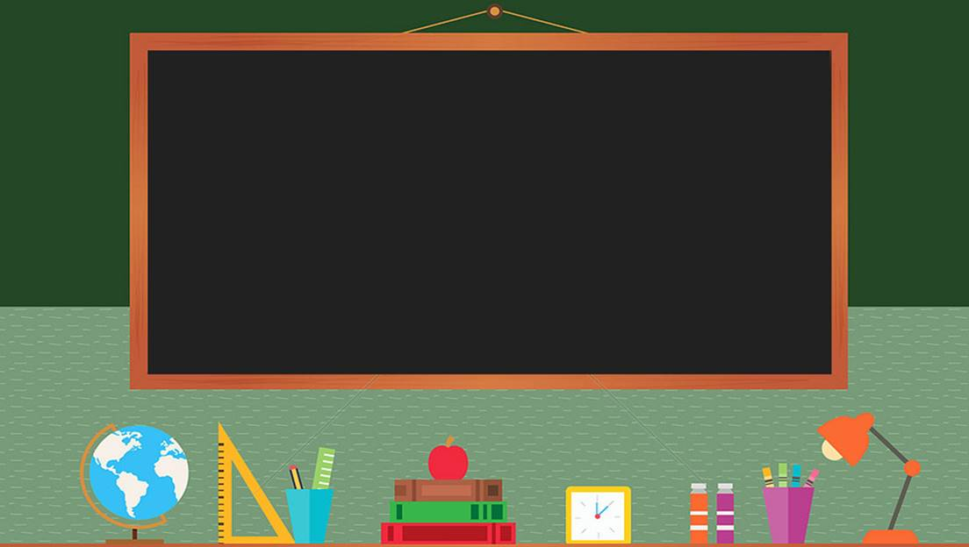

TRƯỜNG THCS LONG BIÊN
BÀI GIẢNG ĐIỆN TỬ MÔN TIẾNG ANH 9
UNIT 7: RECIPES AND EATING HABITS
Peroid 59: Skills 1
GV: Nguyễn Thị Hiền
Tổ Ngoại Ngữ - Năng khiếu

Slide 2
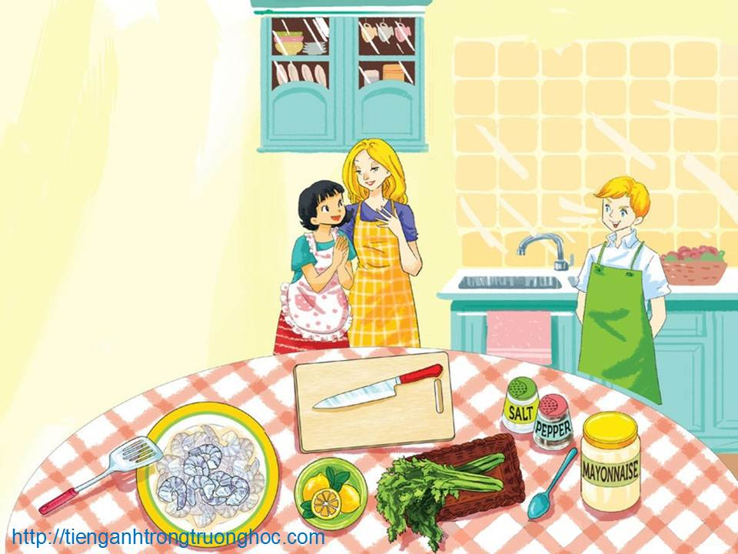
UNIT 7: RECIPES AND EATING HABITS
LESSON 5: SKILLS 1
English 9

Slide 3

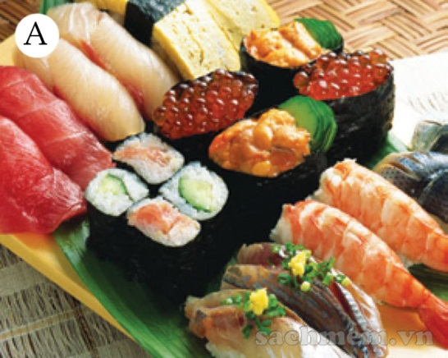
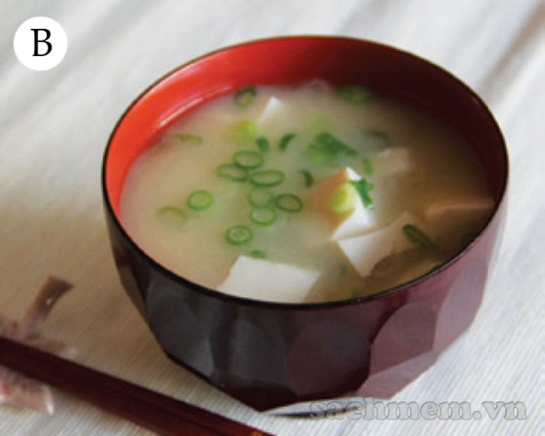
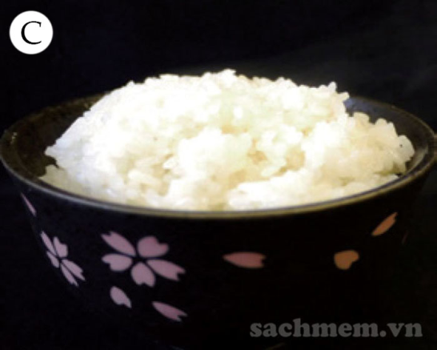
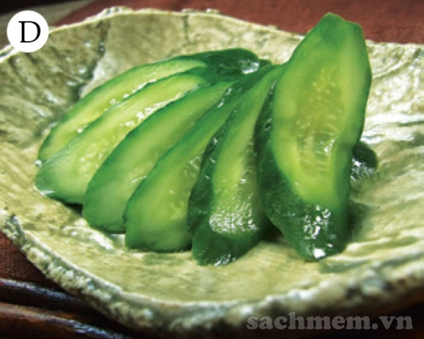
I. Reading
Activity 1 Work in pairs. Answer the questions.
1. What can you see in each picture?
2. Have you ever tried the dishes in the pictures? If so, how did you find them?
different types of sushi
miso soup
a bowl of rice
sliced cucumber

Slide 4
Activity 2 Now read an article about Japanese eating habits. Match the headings (1-3) with the paragraphs (A-C).
1. The art of arranging dishes
2. The habit of having raw food and simple sauces
3. Components in a typical Japanese meal
Japanese people are famous for their well-balanced and healthy diet. That is the main reason for their longevity
A
3. Components in a typical Japanese meal
Typically, a Japanese meal consists of rice, miso soup, the main dish(es) and pickles. Rice is the staple and plays a central part in people’s eating habits. Japanese rice is sticky and nutritious, so when combined with the main dishes and the soup, they make a complete meal. The portions of each dish are individually served

Slide 5
2. The habit of having raw food and simple sauces
B
The most important characteristic of their eating habits is they like raw food and do not use sauces with a strong flavour. Two typical examples are sashimi and sushi. The Japanese make sashimi simply by cutting fresh fish. Then they serve it with a dipping sauce made from soy sauce and spicy Japanese horseradish (wasabi). Sushi is similar. The cooked, vinegared rice can be combined with raw fish, prawn, avocado, cucumber or egg. Sushi is usually served with soy sauce and pickled ginger.
C
1. The art of arranging dishes
It is said that the Japanese eat with their eyes. Therefore,the arrangement of dishes is another significant feature of their eating habits. If you join a Japanese meal, you may be excited to see how the colourful dishes are arranged according to a traditional pattern. In addition, there are plates and bowls of different sizes and designs. They are carefully presented to match the food they carry.

Slide 6
Activity 3 Read the article again and answer the questions.
1. What is the most important feature of Japanese eating habits?
2. How do they make sashimi?
3. What sauce can both sashimi and sushi be served with?
4. How many components are there in a typical Japanese meal?
5. How is rice important in Japanese meals?
6. Why do people say that the Japanese eat with their eyes?
They like raw food and do not use sauces with a strong flavour.
They cut fresh fish.
Both can be served with soy sauce.
There are four (rice, miso soup, main dish(es), pickles).
Rice is the staple food and is very nutritious.
Because the dishes are presented in different bowls and plates, and are arranged carefully according to a traditional pattern.

Slide 7

II. Speaking
Activity 4 Work in groups. Discuss the eating habits of Vietnamese people. You can use the following questions as cues.
1. What is the most important feature of Vietnamese eating habits?
2. What are the typical components in a Vietnamese meal?
3. What is the staple of our country?
4. How are the dishes arranged?
5. Are there any other characteristics of our eating habits that you know?
6. In general, do Vietnamese people have healthy eating habits?

Slide 8
Activity 5 Imagine that you take part in an international competition in which competitors talk about the eating habits of their own country. Present your group’s ideas about Vietnamese eating habits.
Vietnamese food is varied and distinctive. It is considerably low fat and high in carbohydrates. Traditional Vietnamese cooking usually uses fresh ingredients, little dairy and oil, and various herbs and vegetables. Different sauces such as fish sauce, shrimp paste, and soya sauce are quite popular in various regions.
There is no concept of ‘courses’ in a Vietnamese meal. A meal consists of various dishes: main dish (meat, fish, egg or tofu), vegetable, soup and rice. Rice is the staple in Viet Nam. In many families, people eat around a tray of food with a small bowl of fish sauce in the middle. Around this bowl are the dishes. If people place the food on a table, a similar arrangement is followed. Dishes are served communally. Usually there is a big dish/bowl of each dish, and people use chopsticks and spoons to get their share.
In general, Vietnamese food is considered healthy and is popular in other countries.

Slide 9

III. Homework
Learn vocabulary by heart.
Redo exercises.
Prepare the next lesson: Skills 2

