Slide 1


TRƯỜNG THCS LONG BIÊN
BÀI GIẢNG ĐIỆN TỬ MÔN TIẾNG ANH 7
UNIT 9. FESTIVALS AROUND THE WORLD
GV: Lê Hà Chi
Tổ Ngoại ngữ - Năng khiếu

Slide 2
GAME GUESS THE FESTIVALS
Students work in groups of 5
T opens the boxes
Students write the names of festival
1 correct answer, 1 point

Slide 3
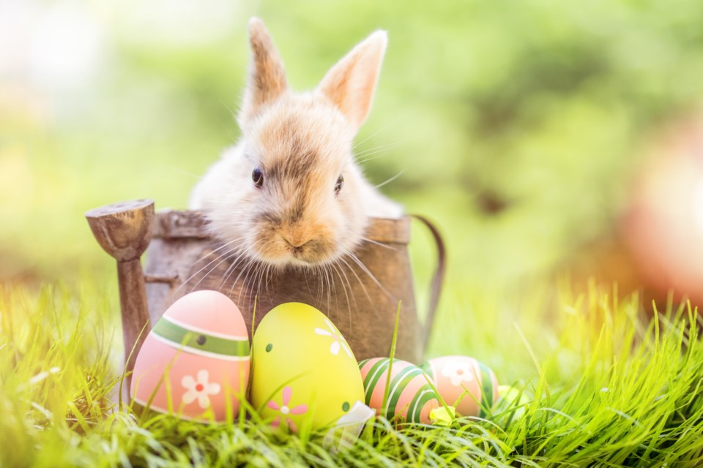
Easter
KEY

Slide 4
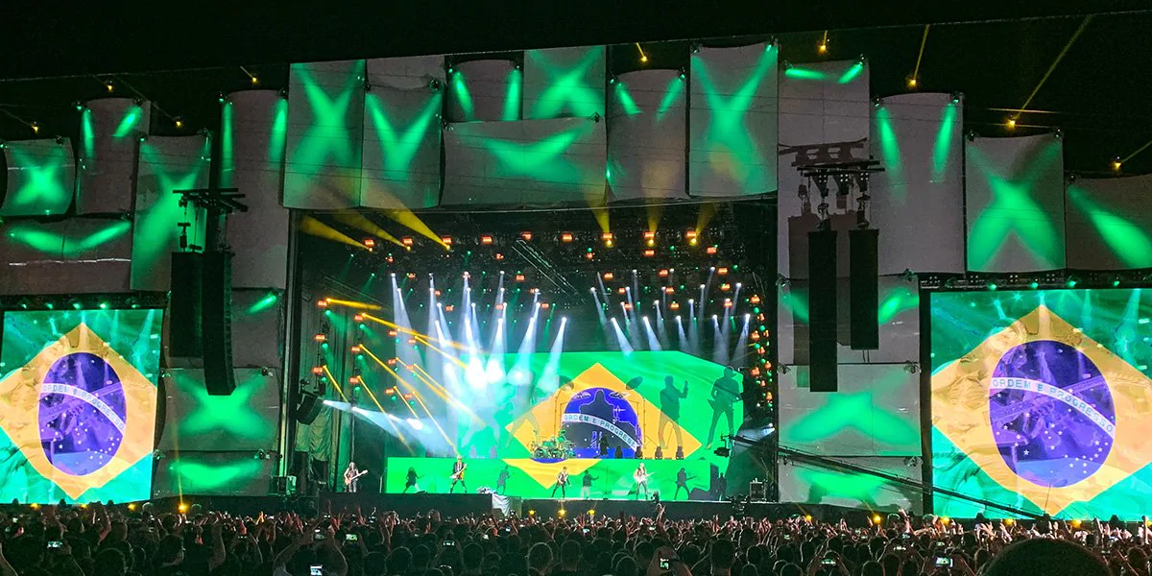
Rock in Rio
KEY

Slide 5
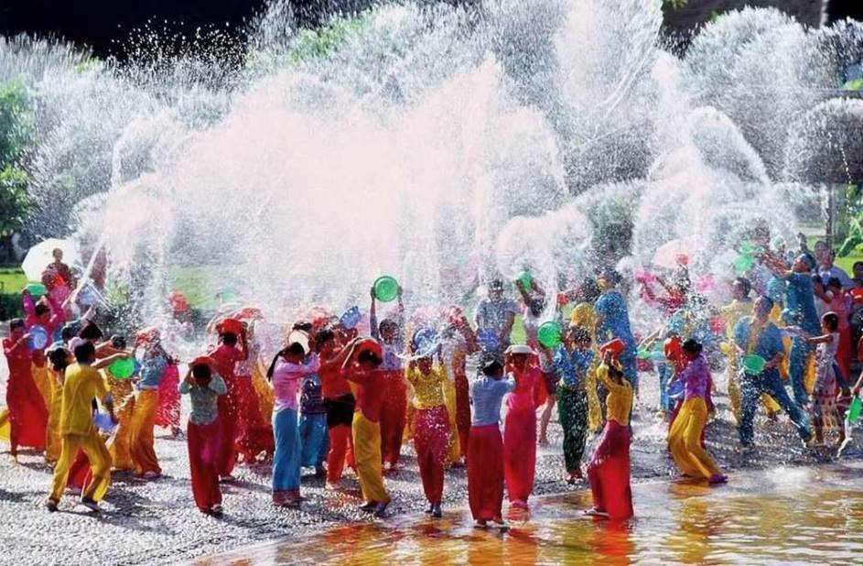
Water festival
KEY

Slide 6
Unit 9
FESTIVALS AROUND THE WORLD
LESSON 1 GETTING STARTED

Slide 7
OBJECTIVES
01
02
have an overview about the topic Festivals around the world
learn some lexical items about types of festivals and festival activities.

Slide 8
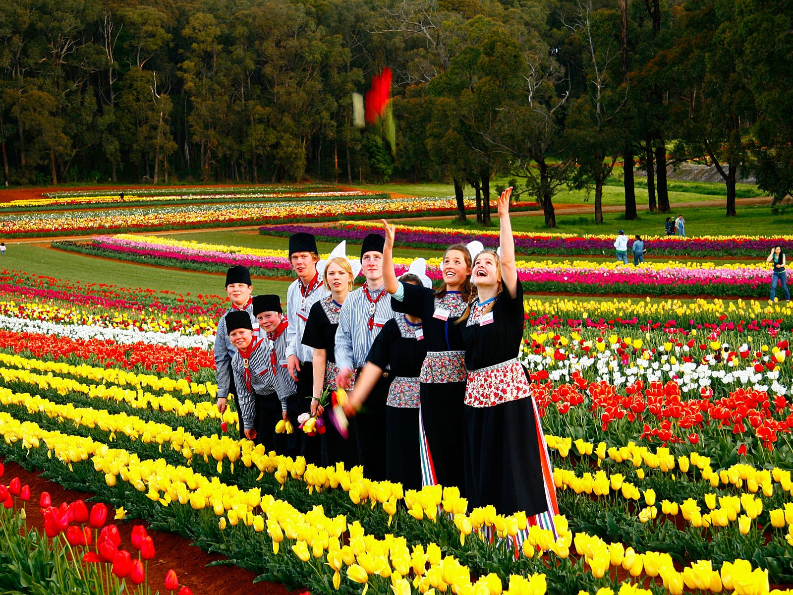
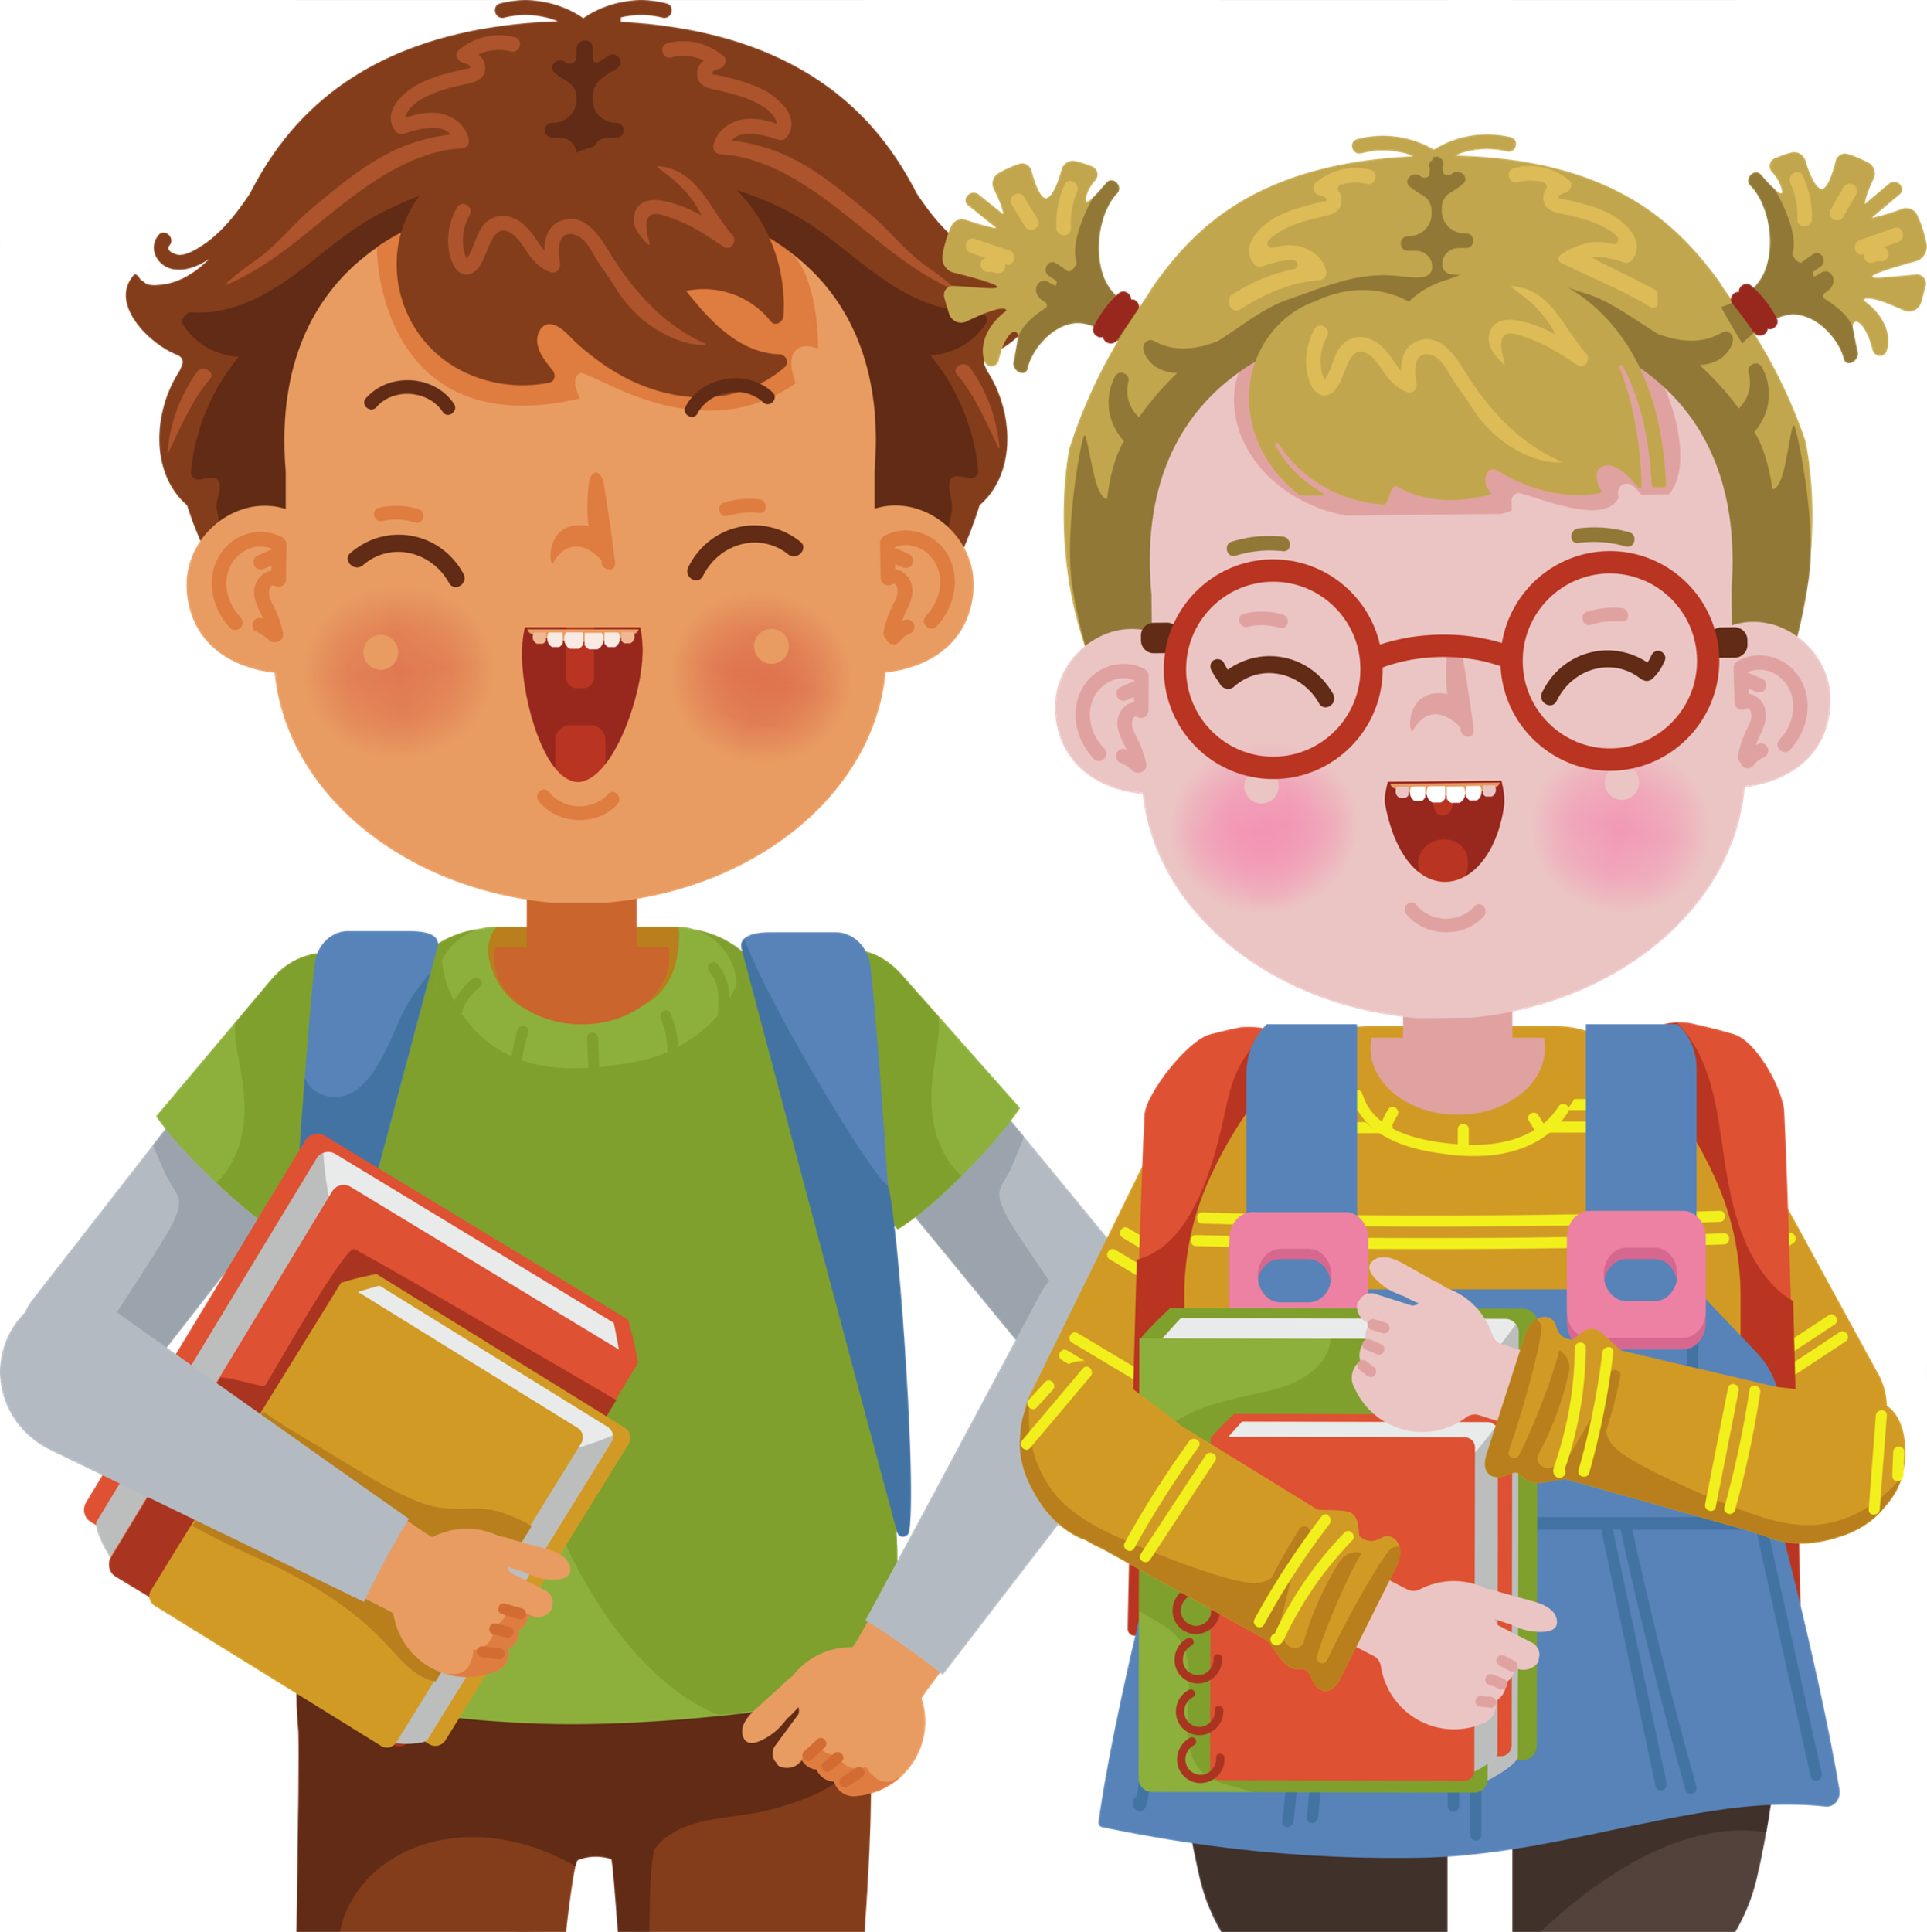
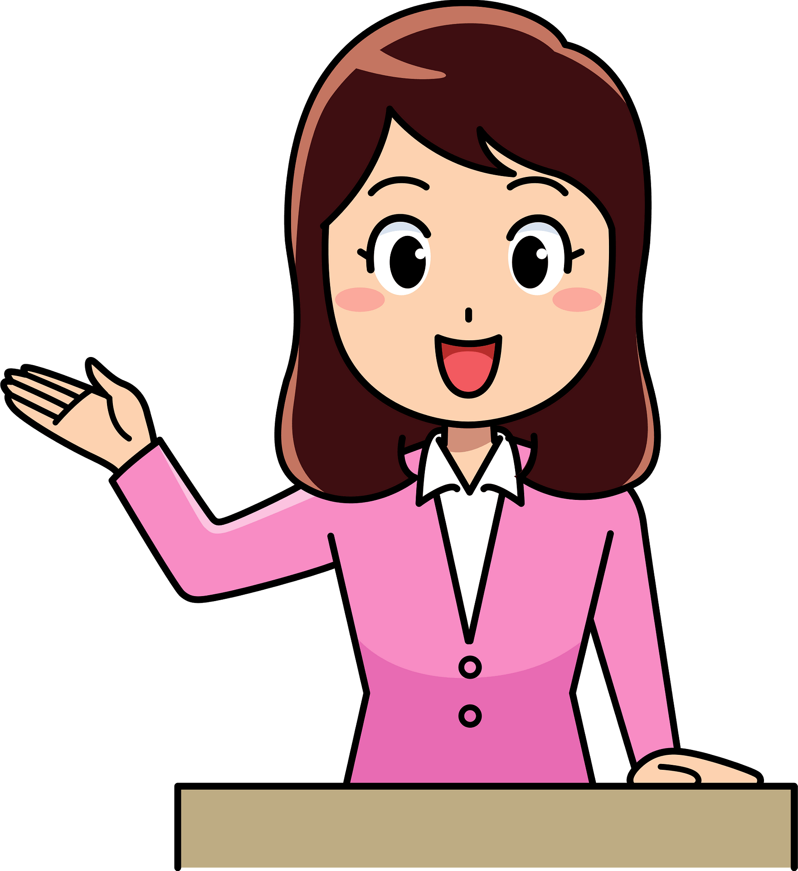
A Tulip festival
Who are they?
What are they talking about?
Mark and Trang
Ms Hoa
Notes:
Underline the proper names in the dialogue

Slide 9
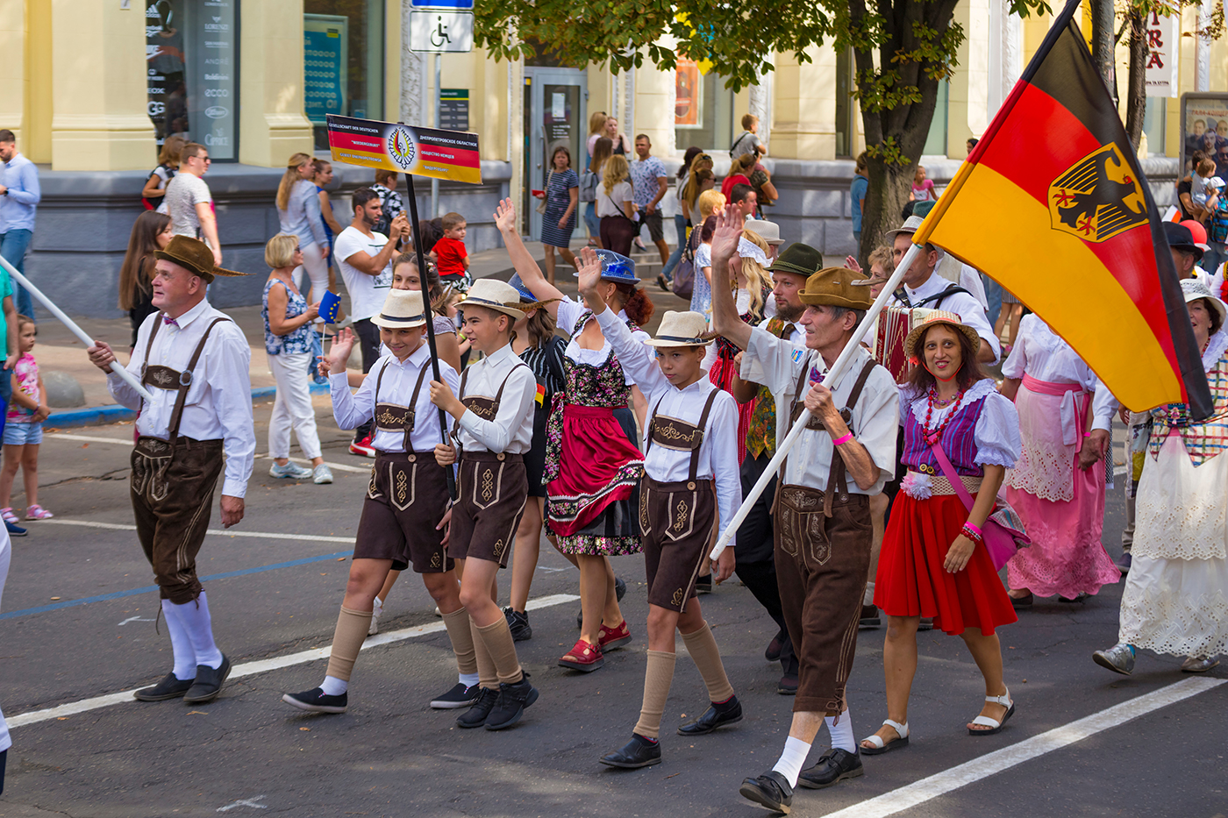
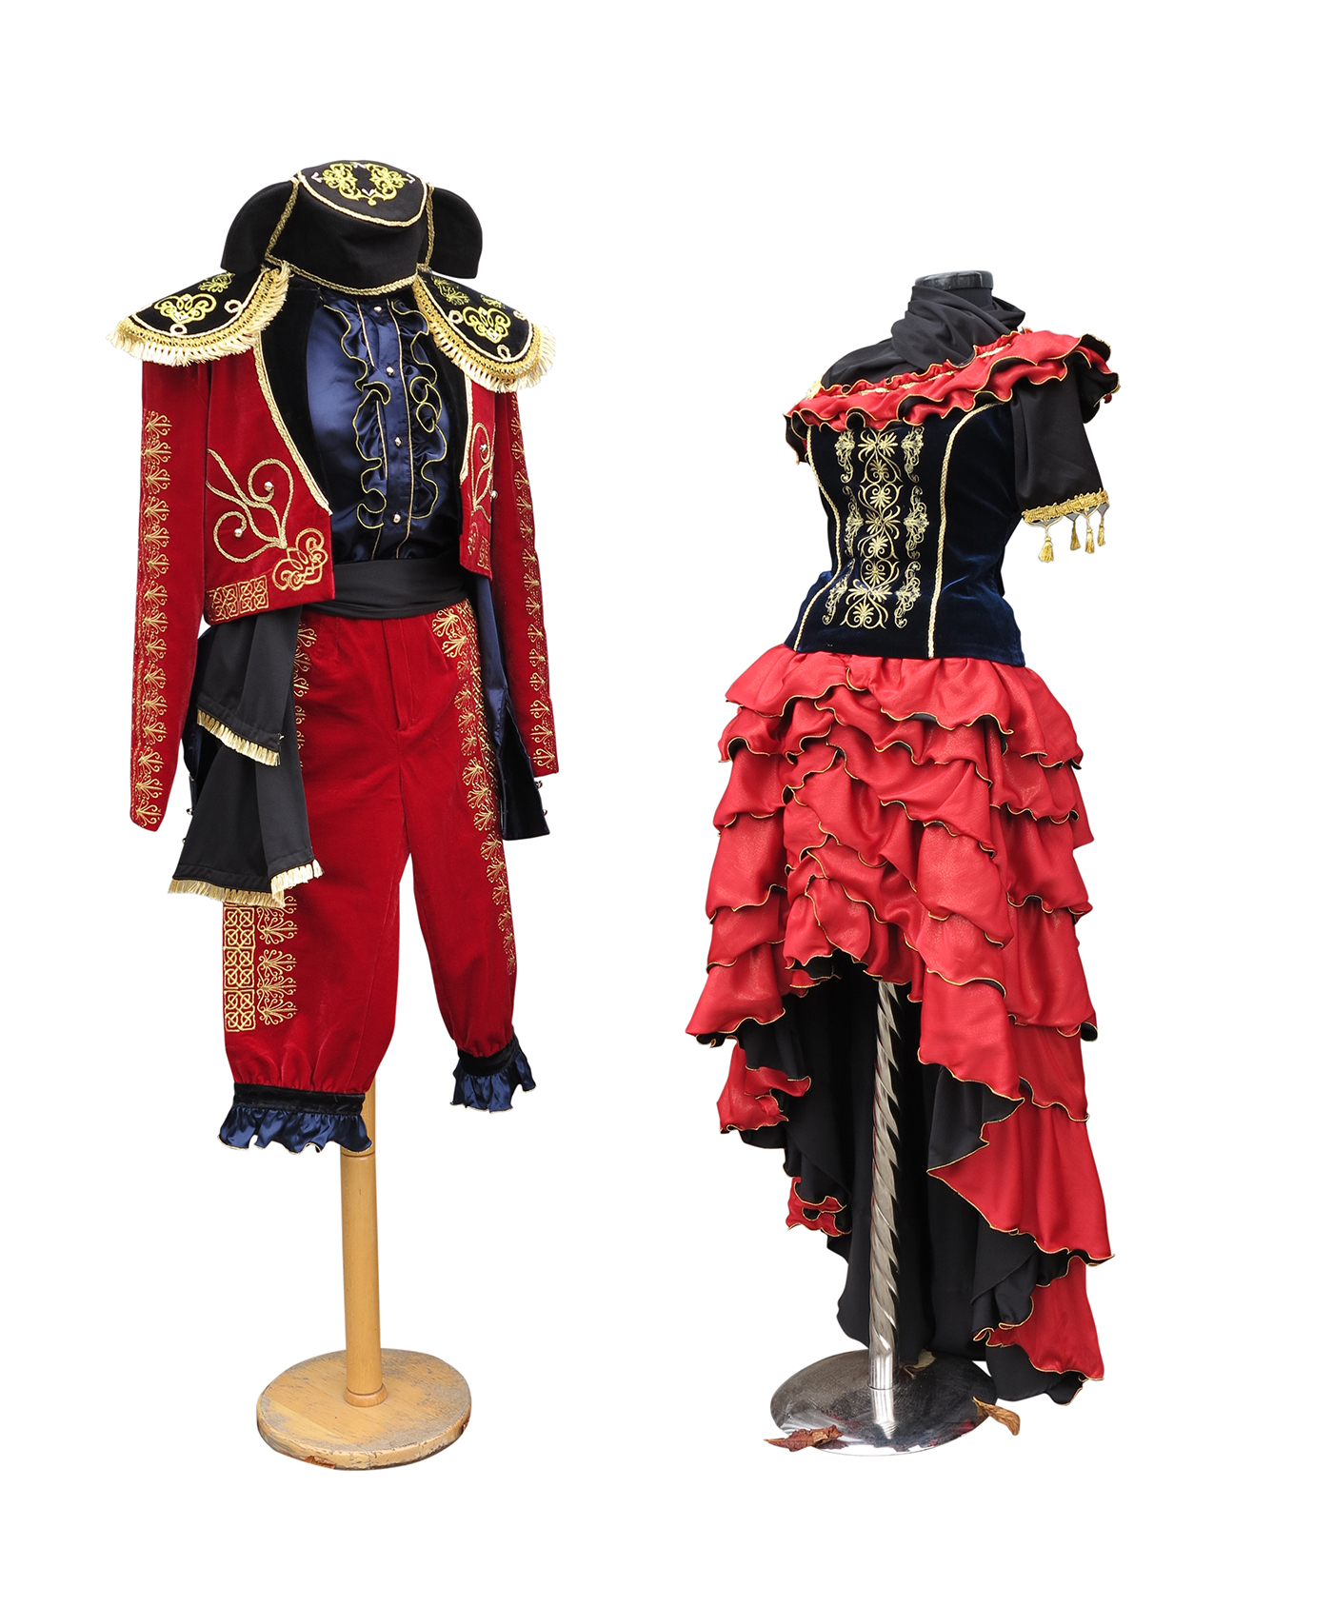
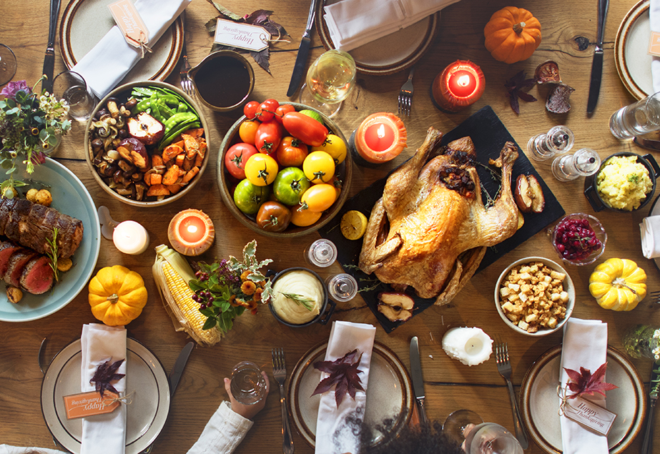
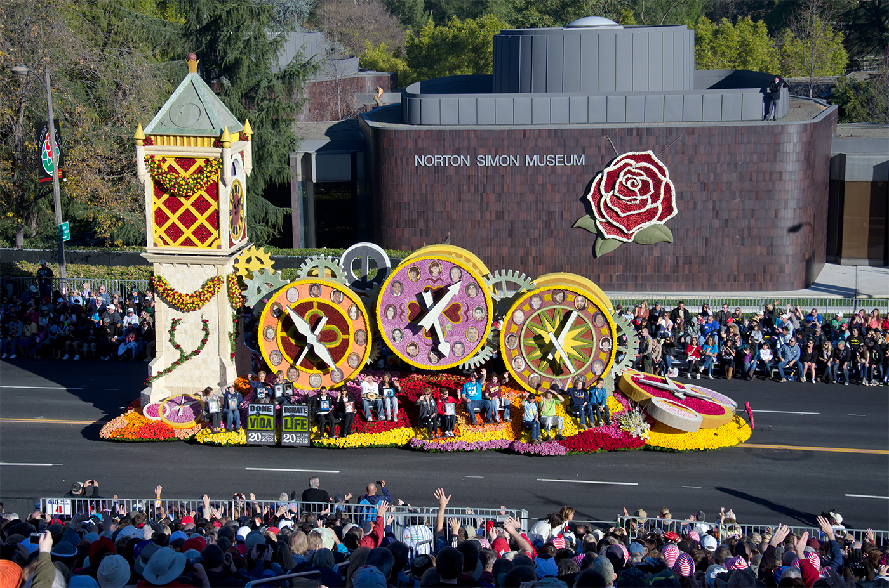
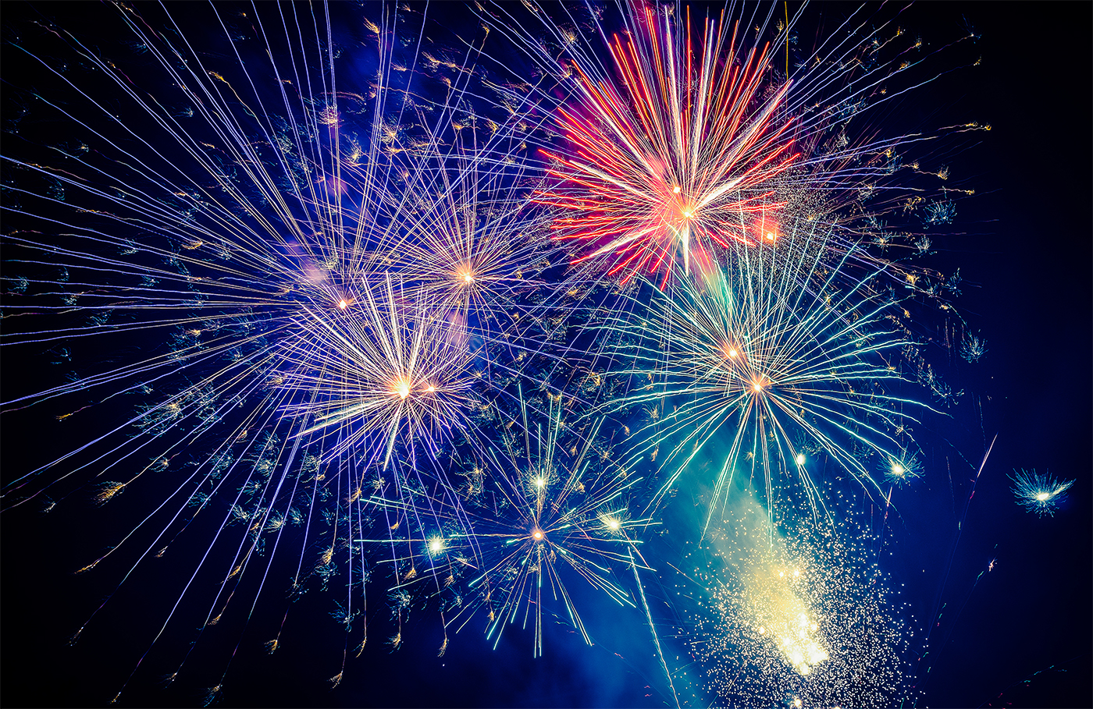
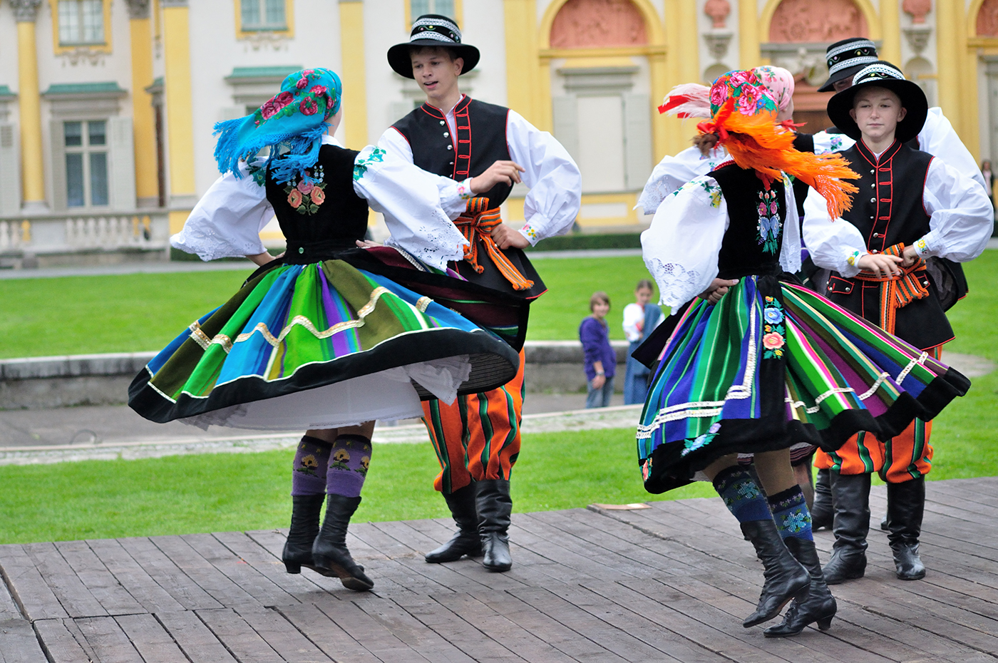
Ex 3 (pg. 93). Write a word or phrase from the box under each picture.
costumes
feast
fireworks
display
parade
float
folk dance

Slide 10

Ex 3 (pg. 93). Write a word or phrase from the box under each picture.
costumes
feast
fireworks
display
parade
float
folk dance
parade
/pəˈreɪd/

Slide 11
Ex 3 (pg. 93). Write a word or phrase from the box under each picture.
costumes
feast
fireworks
display
float
folk dance
costumes
/ ˈkɒstjʊmz/

Slide 12
Ex 3 (pg. 93). Write a word or phrase from the box under each picture.
feast
fireworks
display
float
folk dance
feast
/ fiːst /
Notes:
Tiệc: khác với meal, bữa tiệc cung cấp bữa ăn ăn quy mô, phong phú, gồm món khai vị, chính, tráng miệng

Slide 13
Ex 3 (pg. 93). Write a word or phrase from the box under each picture.
fireworks
display
float
folk dance
float
/ fləʊt /

Slide 14
Ex 3 (pg. 93). Write a word or phrase from the box under each picture.
fireworks
displays
folk dance
fireworks display
/ ˈfaɪəwɜːks dɪˈspleɪ/

Slide 15
Ex 3 (pg. 93). Write a word or phrase from the box under each picture.
folk dance
folk dance
/ ˈfəʊk dɑːns/

Slide 16
Game “Pictionary” - A student draws a picture of a word. - The others guess what it is.

Slide 17

Ex 1 (pg. 92) Listen and read
Mark and Trang: Good afternoon, Ms Hoa.
Ms Hoa: Oh, hi. Come in.
Trang: Wow! This is a nice cozy room, Ms Hoa. I like the photos on the wall. I can see you among all those tulips. Where did you take the photos?
Ms Hoa: I took them at the Tulip Festival in Australia last September.
Mark: Really? I went to a tulip festival two years ago but it was in the Netherlands. It was the Dutch Tulip Festival.
Trang: What did you do at the festival, Ms Hoa?
Ms Hoa: I watched Dutch folk dances. The dancers wore traditional costumes. I also got a chance to try some delicious Dutch food and drinks. What about you, Mark?
Mark: I watched folk dances too, but there wasn't any food or drinks. I also saw beautiful tulip floats at a parade.
Trang: Do they hold the festival every year in Australia? Ms Hoa: Yes, they do.

Slide 18
Ex 2 (pg. 92) Read and tick who did the following activities?
 | Mark | Ms.Hoa
1. went to the Tulip Festival in Australia
2. went to the Tulip Festival in the Netherlands
3. tried Dutch food and drinks
4. watched traditional Dutch dancing
5. saw tulip floats

Slide 19

Ex 2 (pg. 92) Check your answer.
 | Mark | Ms.Hoa
1. went to the Tulip Festival in Australia
Ms Hoa:
I took them at the Tulip Festival in Australia last September.

Slide 20
Ex 2 (pg. 92) Check your answer.
 | Mark | Ms.Hoa
2. went to the Tulip Festival in the Netherlands
Mark:
Really? I went to a tulip festival two years ago but it was in the Netherlands. It was the Dutch Tulip Festival.

Slide 21
Ex 2 (pg. 92) Check your answer.
 | Mark | Ms.Hoa
3. tried Dutch food and drinks.
Ms Hoa:
I watched Dutch folk dances. The dancers wore traditional costumes. I also got a chance to try some delicious Dutch food and drinks.

Slide 22
Ex 2 (pg. 92) Check your answer.
 | Mark | Ms.Hoa
4. watched traditional Dutch dancing
Ms Hoa:
I watched Dutch folk dances. The dancers wore traditional costumes. I also got a chance to try some delicious Dutch food and drinks.
Mark: I watched folk dances too, but there wasn't any food or drinks. I also saw beautiful tulip floats at a parade.
*folk dances = traditional dances

Slide 23
Ex 2 (pg. 92) Check your answer.
 | Mark | Ms.Hoa
5. saw tulip floats.
Mark:
I watched folk dances too, but there wasn't any food or drinks. I also saw beautiful tulip floats at a parade.

Slide 24
Ex 2 (pg. 92) Check your answers
 | Mark | Ms.Hoa
1. went to the Tulip Festival in Australia
2. went to the Tulip Festival in the Netherlands
3. tried Dutch food and drinks
4. watched traditional Dutch dancing
5. saw tulip floats

Slide 25
Ex 4 (pg. 93). Fill in each blank with a word or phrase from 3. You may have to change the form of the word or phrase. .
costumes
feast
fireworks
display
parade
float
folk dance
1. The dancers performed ___________ at the Tulip Festival.
2. On New Year's Eve, we went to Hoan Kiem Lake to watch the ___________.
3. For Tet, we usually prepare a ___________ with special food.
4. People hold flower __________ in several countries to welcome the new season.
5. The ___________ carried the dancers in special ___________.

Slide 26
Ex 4 (pg. 93) Check your answer.
costumes
feast
fireworks
display
parade
float
folk dance
1. The dancers performed ________________ at the Tulip Festival.
2. On New Year's Eve, we went to Hoan Kiem Lake to watch the ___________________.
3. For Tet, we usually prepare a __________with special food.
4. People hold flower _______________ in several countries to welcome the new season.
5. The ___________ carried the dancers in special ____________.
folk dances
fireworks display
feast
parades
floats
costumes

Slide 27
What festival is it? Match the description with the festivals
a. La Tomatina => 2
d. Tet => 3
b. Cheese rolling => 5
e. Mid-Autumn Festival => 1
c. Christmas => 4

Slide 28
Do you know any other festivals in the world? Tell one description about it.

Slide 29

RECAP
1. What did we read about?
A. Rose festival B. Tet Holiday C. Tulip festival
2. Odd one out.
A
B
C
D

