Slide 1
UNIT 1
My NEW SCHOOL
Lesson 5: Skills 1

Slide 2
OBJECTIVES
After this lesson, students will be able to
Reading
Speaking
read for general and specific information about schools
talk about the type of school one would like to go to

Slide 3

01
READING

Slide 4
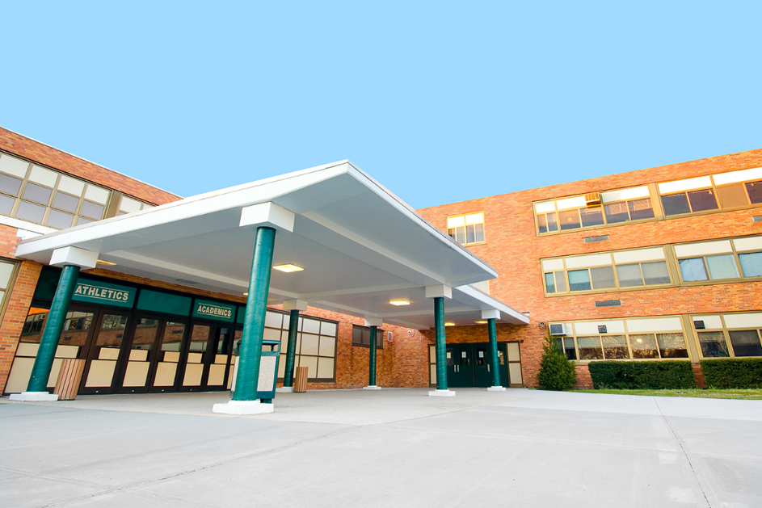
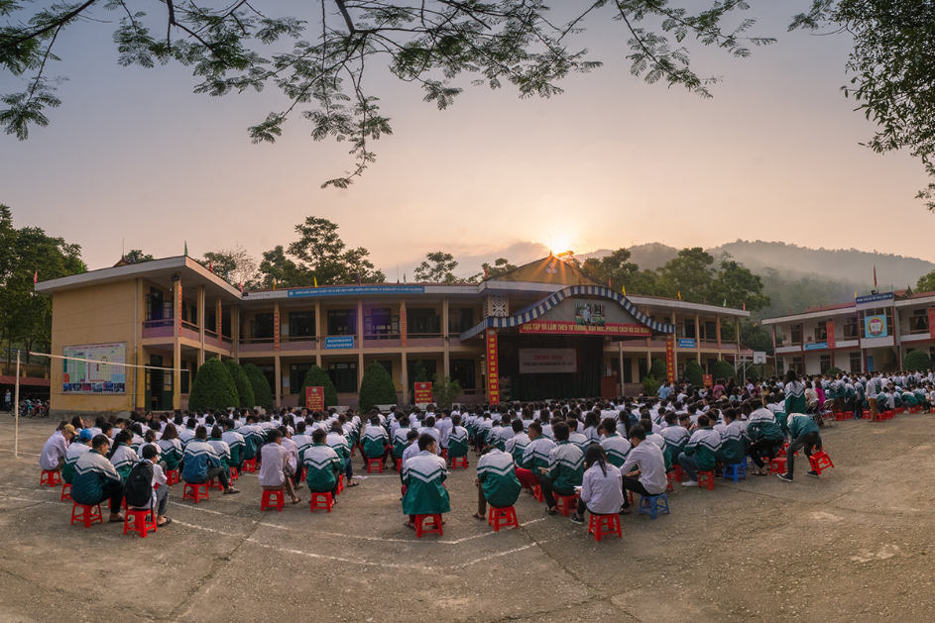

Before reading the text, can you match 1-3 with A-C?
A. a school in Bac Giang
B. an international school
C. a boarding school in Sydney
1
2
3
C. a boarding school in Sydney
A. a school in Bac Giang
B. an international school
Read the text quickly and check (p.12)

Slide 5
2. Read & Underline the key words.
2. Read again & complete the sentences. (p.12)
1. Sunrise is a boarding school in Sydney. Students study and live there. About 1,200 boys and girls go to Sunrise. It has students from all over Australia. They study subjects like maths, science and English.
2. An Son is a lower secondary school in Bac Giang. It has only 8 classes. There are mountains and green fields around the school. There is a computer room and a library. There is also a school garden and a playground.
3. Dream is an international school. Here students learn English with English-speaking teachers. In the afternoon, they join many interesting clubs. They play sports and games. Some students do paintings in the art club.
1. Students live and study in a ____________ school. They only go home at weekends.
2. Sunrise is a school in ______________.
3. There are ____________ around An Son School.
4. ___________ has an art club.
5. At Dream School, students learn English with ______________.

Slide 6
2. Read again & complete the sentences. (p.12)
2. Read & Underline the key words.
1. Sunrise is a boarding school in Sydney. Students study and live there. About 1,200 boys and girls go to Sunrise. It has students from all over Australia. They study subjects like maths, science and English.
1. Students live and study in a ____________ school. They only go home at weekends.
2. Sunrise is a school in ______________.
3. There are ____________ around An Son School.
4. ___________ has an art club.
5. At Dream School, students learn English with ______________.
boarding

Slide 7
2. Read again & complete the sentences. (p.12)
2. Read & Underline the key words.
1. Sunrise is a boarding school in Sydney. Students study and live there. About 1,200 boys and girls go to Sunrise. It has students from all over Australia. They study subjects like maths, science and English.
1. Students live and study in a ____________ school. They only go home at weekends.
2. Sunrise is a school in ______________.
3. There are ____________ around An Son School.
4. ___________ has an art club.
5. At Dream School, students learn English with ______________.
boarding
Sydney

Slide 8
2. Read again & complete the sentences. (p.12)
2. Read & Underline the key words.
2. An Son is a lower secondary school in Bac Giang. It has only 8 classes. There are mountains and green fields around the school. There is a computer room and a library. There is also a school garden and a playground.
1. Students live and study in a ____________ school. They only go home at weekends.
2. Sunrise is a school in ______________.
3. There are ____________________ ______________ around An Son School.
4. ___________ has an art club.
5. At Dream School, students learn English with ______________.
boarding
Sydney
mountains and
green fields

Slide 9
2. Read again & complete the sentences. (p.12)
2. Read & Underline the key words.
1. Students live and study in a ____________ school. They only go home at weekends.
2. Sunrise is a school in ______________.
3. There are ____________________ ______________ around An Son School.
4. ______________ has an art club.
5. At Dream School, students learn English with ______________.
3. Dream is an international school. Here students learn English with English-speaking teachers. In the afternoon, they join many interesting clubs. They play sports and games. Some students do paintings in the art club.
boarding
Sydney
mountains and
green fields
Dream School

Slide 10
2. Read again & complete the sentences. (p.12)
2. Read & Underline the key words.
1. Students live and study in a ____________ school. They only go home at weekends.
2. Sunrise is a school in ______________.
3. There are ____________________ ______________ around An Son School.
4. ______________ has an art club.
5. At Dream School, students learn English with ______________.
3. Dream is an international school. Here students learn English with English-speaking teachers. In the afternoon, they join many interesting clubs. They play sports and games. Some students do paintings in the art club.
boarding
Sydney
mountains and
green fields
Dream School
English-speaking teachers

Slide 11
3. Read and underline the key words.
3. Answer the questions in your notebook. (p.12)
1. Sunrise is a boarding school in Sydney. Students study and live there. About 1,200 boys and girls go to Sunrise. It has students from all over Australia. They study subjects like maths, science and English.
2. An Son is a lower secondary school in Bac Giang. It has only 8 classes. There are mountains and green fields around the school. There is a computer room and a library. There is also a school garden and a playground.
3. Dream is an international school. Here students learn English with English-speaking teachers. In the afternoon, they join many interesting clubs. They play sports and games. Some students do paintings in the art club.
1. Which school is a boarding school?
2. Where is An Son School?
3. Is there a school garden in
An Son School?
4. What do Dream School students do in the afternoon?

Slide 12
3. Answer the questions in your notebook. (p.12)
1. Which school is a boarding school?
2. Where is An Son School?
3. Is there a school garden in
An Son School?
4. What do Dream School students do in the afternoon?
1. Sunrise is a boarding school in Sydney.
Sunrise
2. An Son is a lower secondary school in Bac Giang.
In Bac Giang
2. An Son … There is also a school garden and a playground.
Yes, it is.
3. Dream is an international school. … In the afternoon, they join many interesting clubs. They play sports and games. Some students do paintings in the art club.
They join many interesting clubs

Slide 13

02
SPEAKING

Slide 14
4. Which school would you like to go to? Why? Complete the table.
1
Name of school | Reasons you like it | Reasons you don’t like it
Sunrise
For example:
Sunrise
I want to study and live with my friends.
Sometimes, it’s bored.
2
An Son
3
Dream

Slide 15

4. Work in group. Now discuss your choice with your groups.
1
Sunrise
2
Which school would you like to go to?
I’d like to go to Dream School.
An Son
3
Why?
Because I’d like to paint in the art club.
Dream
Notes:
Example: A: Which school would you like to go to? B: Id like to go to Dream School. A: Why? B: Because Id like to paint in the art club.

Slide 16
OBJECTIVES
Read the statement and decided if it is TRUE or FALSE.
1. The text is about 4 types of school.
2. At boarding school, students study and live there.
3. An Son is an international school.
4. At an international school, students learn English with English-speaking teachers.
5. You talk about the school you would like to go to and reasons why.
3
1. F
2. T
a lower secondary school
3. F
4. T
5. T

Slide 17
Thanks FOR YOUR ATTENTION
Please keep this slide for attribution.

