Slide 1
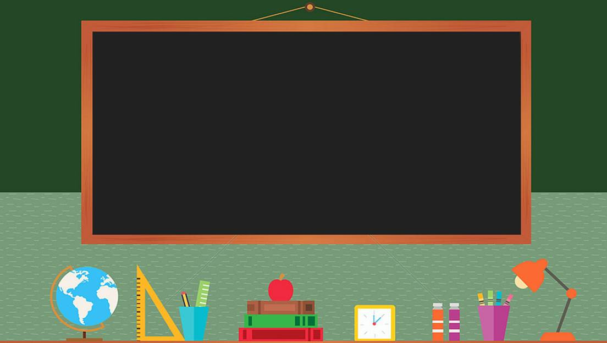

TRƯỜNG THCS LONG BIÊN
BÀI GIẢNG TIẾNG ANH 7
UNIT 8: Communication
GV: Nguyễn Thu Hằng
Tổ Ngoại Ngữ- Năng Khiếu

Slide 2
UNIT 8: FILMS
Lesson 4: Communication

Slide 3
OBJECTIVES
By the end of the lesson, students will be able to:
accept and decline suggestions
do a survey about group members’ favourite film;

Slide 4
Everyday English
1

Slide 5
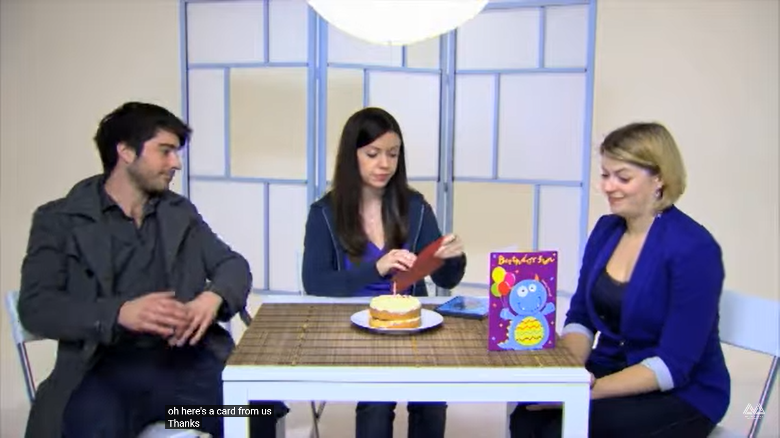
It’s Ann’s birthday. Watch the conversation between Ann, Martin and Sally.
Martin
Ann
Sally

Slide 6
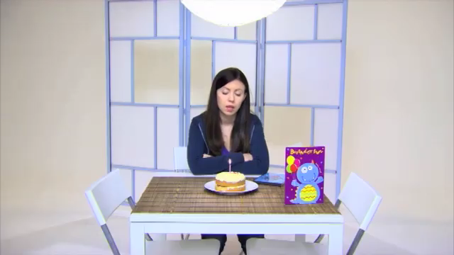
Watch closely and fill in the blank.
Sally: _______________ go out for meal somewhere?
Why don’t we
Notes:
Why don’t we go out for meals somewhere
How about going out
Let’s go bowling

Slide 7
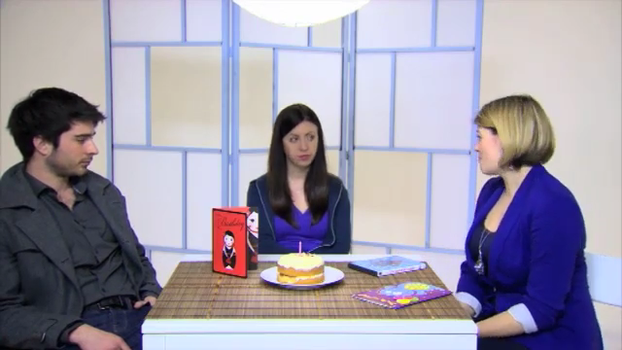
Watch closely and fill in the blank.
How about
Sally: _______________ Thai kitchen?
Notes:
Why don’t we go out for meals somewhere
How about going out
Let’s go bowling

Slide 8
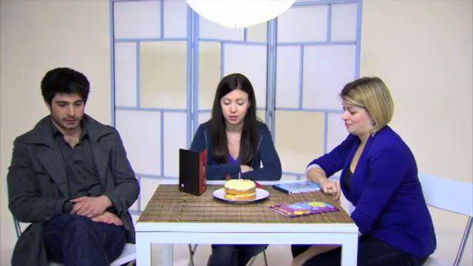
Watch closely and fill in the blank.
Let’s
Martin: _______________ go bowling!
Notes:
Why don’t we go out for meals somewhere
How about going out
Let’s go bowling

Slide 9

Suggestion
Responses?
Why don’t we go out for meal somewhere
How about Thai kitchen?
Let’s go bowling!

Slide 10



1. Listen and read the conversations. Pay attention to the highlighted sentences.
Tom: How about going to the cinema tonight?
Anna: That's a great idea.
Accepting suggestions
Minh: Let's go to see A Nightmare at Sao Mai Cinema tonight.
Mi: I'd love to, but that's too far for me to travel.
Declining suggestions

Slide 11
Can you add more responses?
Accepting suggestions
Declining suggestions
That's a great idea.
I'd love to, but …
Ok. Yes, let’s.
Yes, I’d love to.
What a good idea!
Why not?
That sounds like a good idea.
No, let’s not.
No, I'd rather not.
I don't feel like it.
I don’t think it will work.
I’m not sure about this idea.

Slide 12
2. Work in pairs. Make similar conversations with the following situations.
Student A suggests going to the cinema and student B accepts.
?
Student A: Hey, let’s go to the cinema this weekend!
Student B: Good idea! I like action movie.
Student A: So do I. I’ll see you at 6 p.m. this Sunday.
Student B: Great. See you.
A
B

Slide 13

2. Work in pairs. Make similar conversations with the following situations.
Student A suggests going for a picnic but student B declines.
?
Student A: It’s sunny today. How about going for a picnic?
Student B: Oh sorry, I can’t. I have a lot of homework to do.
Student A: That’s a pity. Maybe next time.
Student B: Sure.
A
B

Slide 14

2. Work in pairs. Make similar conversations with the following situations.
Student A suggests playing badminton after school, student B accepts.
?
Student A: Let’s play badminton after class!
Student B: It sounds nice. Where should we play?
Student A: How about the park behind school?
Student B: Good idea.
A
B

Slide 15
2
A survey about films

Slide 16
3. Listen to the conversation and fill in the blanks with the words you hear.
Tom: Hi Lan. I’m doing a survey about films. Can I ask you some questions? Lan: Sure. Go ahead. Tom: What kind of films do you like (1) _____________? Lan: I love (2) _____________. Tom: What’s the name of your (3) _____________ comedy? Lan: It’s Dr Johnny. Tom: Who (4) _____________ in it? Lan: Bill Harris. Tom: What do you think of it? Lan: It’s very (5) _____________. Tom: Thank you.
best
comedies
favourite
stars
funny

Slide 17
Complete the table with the information about Lan.
Tom: Hi Lan. I’m doing a survey about films. Can I ask you some questions? Lan: Sure. Go ahead. Tom: What kind of films do you like best? Lan: I love comedies. Tom: What’s the name of your favorite comedy? Lan: It’s Dr Johnny. Tom: Who stars in it? Lan: Bill Harris. Tom: What do you think of it? Lan: It’s very funny. Tom: Thank you.
Name
Name of the film
Type of film
Main actor(s)/ actress(es)
Reviews
Lan
Dr Johnny
Tom: What’s the name of your favorite comedy?
Dr Johnny.

Slide 18
Complete the table with the information about Lan.
Tom: Hi Lan. I’m doing a survey about films. Can I ask you some questions? Lan: Sure. Go ahead. Tom: What kind of films do you like best? Lan: I love comedies. Tom: What’s the name of your favorite comedy? Lan: It’s Dr Johnny. Tom: Who stars in it? Lan: Bill Harris. Tom: What do you think of it? Lan: It’s very funny. Tom: Thank you.
Name
Name of the film
Type of film
Main actor(s)/ actress(es)
Reviews
Lan
Tom: What kind of films do you like best?
Dr Johnny
comedies
comedy

Slide 19
Complete the table with the information about Lan.
Tom: Hi Lan. I’m doing a survey about films. Can I ask you some questions? Lan: Sure. Go ahead. Tom: What kind of films do you like best? Lan: I love comedies. Tom: What’s the name of your favorite comedy? Lan: It’s Dr Johnny. Tom: Who stars in it? Lan: Bill Harris. Tom: What do you think of it? Lan: It’s very funny. Tom: Thank you.
Name
Name of the film
Type of film
Main actor(s)/ actress(es)
Reviews
Lan
Dr Johnny
comedy
Tom: Who stars in it?
Bill Harris
Bill Harris

Slide 20
Complete the table with the information about Lan.
Tom: Hi Lan. I’m doing a survey about films. Can I ask you some questions? Lan: Sure. Go ahead. Tom: What kind of films do you like best? Lan: I love comedies. Tom: What’s the name of your favorite comedy? Lan: It’s Dr Johnny. Tom: Who stars in it? Lan: Bill Harris. Tom: What do you think of it? Lan: It’s very funny. Tom: Thank you.
Name
Name of the film
Type of film
Main actor(s)/ actress(es)
Reviews
Lan
Dr Johnny
comedy
Bill Harris
Tom: What do you think of it?
very funny
very funny

Slide 21

4. Work in groups. Do a survey about your group members’ favourite films.
Member’s name
Name of the film
Type of film
Main actor(s)/ actress(es)
Reviews
Lan
Dr Johnny
comedy
Bill Harris
very funny

Slide 22
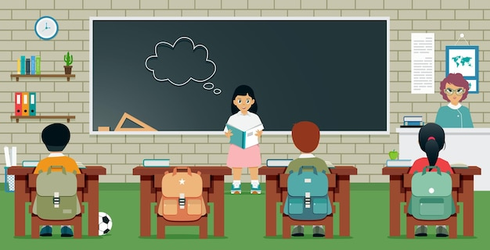
5. Report your results to the class.

Slide 23
WRAP - UP
In this lesson, we have learnt to:
accept and decline suggestions
do a survey about group members’ favourite film;

Slide 24
Thank you for your attention!

