Slide 1
Unit 5: Wonders of Viet Nam
Lesson 2: A closer look 1
TEACHER: NGUYEN THU HANG

Slide 2
VOCABULARY

Slide 3

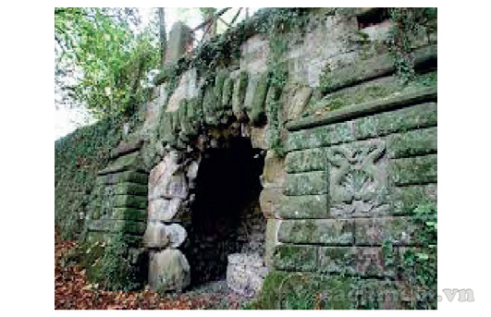
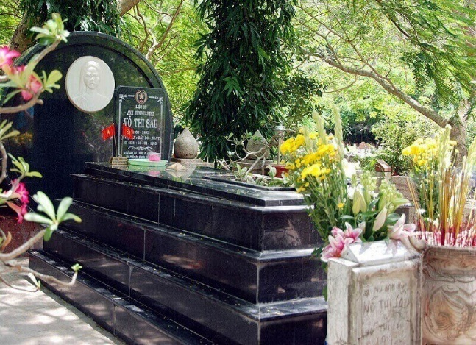
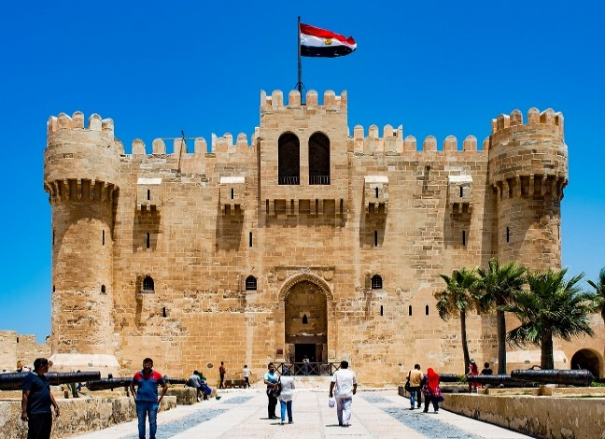
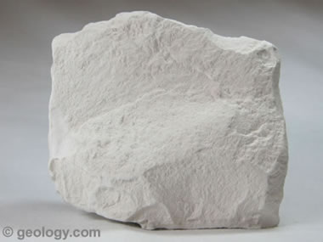
* Vocabulary:
- picturesque /ˌpɪktʃəˈresk/ (adj)
: đẹp (phong cảnh)
- astounding /əˈstaʊndɪŋ/ (adj)
: làm sững sờ
- administrative /ədˈmɪnɪstrətɪv/ (adj)
: hành chính
- fortress/ˈfɔːtrəs/ (n)
: pháo đài
- recognition /ˌrekəɡˈnɪʃn/(n)
: sự công nhận
- tomb /tuːm/ (n)
: ngôi mộ
- cavern /ˈkævən/ (n)
:hang lớn, động
- limestone /ˈlaɪmstəʊn/ (n)
: đá vôi

Slide 4
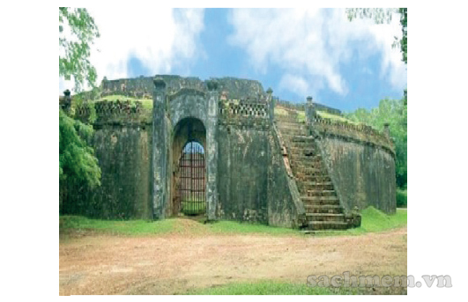
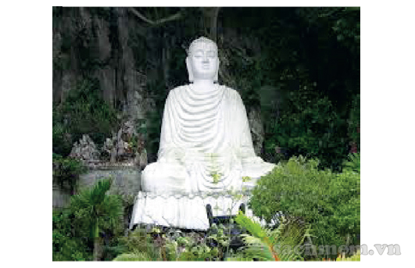
Vocabulary
Write the words with the correct pictures.
A. cavern B. limestone C. fortress
D. tomb E. citadel F. sculpture
1._ _ _ _ _ _ _ _ _ 2._ _ _ _ _ _ _ _ _ 3._ _ _ _ _ _ _ _ _
4._ _ _ _ _ _ _ _ _ 5._ _ _ _ _ _ _ _ _ 6._ _ _ _ _ _ _ _ _

Slide 5

pháo đài
fortress
làm sững sờ
astounding
hành chính
administrative
đẹp (phong cảnh)
sculpture
picturesque
nghệ thuật điêu khắc
recognition
sự công nhận
tomb
ngôi mộ
cavern
hang lớn, động
đá vôi
limestone

Slide 6
Vocabulary
Write the words with the correct pictures.
A. cavern B. limestone C. fortress
D. tomb E. citadel F. sculpture
A. limestone
D. tomb
A. cavern
1._ _ _ _ _ _ _ _ _ 2._ _ _ _ _ _ _ _ _ 3._ _ _ _ _ _ _ _ _
E. citadel
C. fortress
B. sculpture
4._ _ _ _ _ _ _ _ _ 5._ _ _ _ _ _ _ _ _ 6._ _ _ _ _ _ _ _ _

Slide 7
2. Fill in each blank with a suitable adjective from the box.
geological located/ situated picturesque
astounding administrative
1. The hotel is beautifully_ _ _ _ _ _ _ _ _ _ _in a quiet
spot near the river.
2. It is a quiet fishing village with a _ _ _ _ _ _ _ _ _ _ _
harbour.
3. The original size of the Forbidden City is _ _ _ _ _ _ _ _ _
- it’s hard to believe.
4. This book is about _ _ _ _ _ _ _ _ _ _ _ features of Viet
Nam.
5. Ha Noi is the _ _ _ _ _ _ _ _ _ _ _ centre of our country.

Slide 8
2. Fill in each blank with a suitable adjective from the box.
geological located/ situated picturesque
astounding administrative
1. The hotel is beautifully_ _ _ _ _ _ _ _ _ _ _in a quiet
spot near the river.
2. It is a quiet fishing village with a _ _ _ _ _ _ _ _ _ _ _
harbour.
3. The original size of the Forbidden City is _ _ _ _ _ _ _ _ _
- it’s hard to believe.
4. This book is about _ _ _ _ _ _ _ _ _ _ _ features of Viet
Nam.
5. Ha Noi is the _ _ _ _ _ _ _ _ _ _ _ centre of our country.
located/ situated
picturesque
astounding
geological
administrative

Slide 9
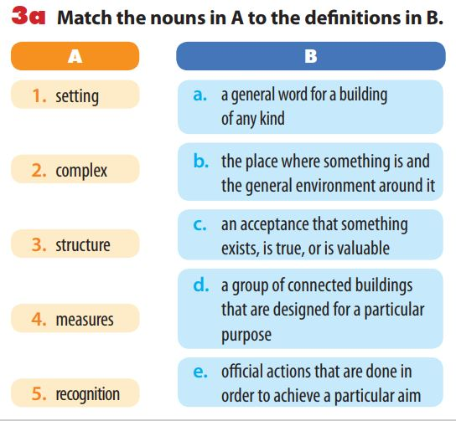
1. setting
a. a general word for a building
of any kind
2. complex
b. the place where something is and
the general environment around it
c. an acceptance that something
exists, is true, or is valuable
3. structure
d. a group of connected buildings
that are designed for a
particular purpose
4. measures
e. official actions that are done in
order to achieve a particular aim
5. recognition

Slide 10
b. Now use the nouns in 3a to complete the sentences.
1. setting
2. complex
3. structure
4. measures
5. recognition
1. This_ _ _ _ _ _ _ _ _ _has been standing since the 15th
century.
2. The government must take _ _ _ _ _ _ _ _ _ _ to preserve
historical sites in the area.
3. I like a hotel in a beautiful _ _ _ _ _ _ _ _ _ _ of
landscaped gardens.
4. The Imperial Citadel of Thang Long is a _ _ _ _ _ _ _ _ _ _
that consists of royal palaces and monuments.
5. There is a growing _ _ _ _ _ _ _ _ _ _ that protecting
natural wonders has financial benefits as well as cultural
importance.

Slide 11
PRONUNCIATION
1

Slide 12
Pronunciation
Stress on short words in sentences
4. Listen and repeat, paying attention to the words in red in each pair of sentences.
1. A: This is a solution, but not the only one. B: Attempts to find a solution have failed.
2. A: I’m fond of bananas. B: Bananas are what I’m fond of.
3. A: It’s not trick and treat; it’s trick or treat. B: I need Peter and Mary or John and Nick to help me.
4. A: It’s good but expensive. B: You shouldn’t put ‘but’ at the end of the sentence.
a
a
of
of.
and
or
and
or
and
but
‘but’

Slide 13
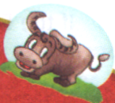
Remember!
Short words like articles (a, an, the), conjunctions (and, or), and prepositions (at, of, to) are usually unstressed or in the weak form. However, we use these short words in the strong form in the following cases:
When the short words are used at the end of sentences.
Example: What are you playing at?
Mary is the person I’m looking for.
When the short words are used for emphasis or contrast.
Example: This is the place to eat.
It’s not a solution, but the solution
When the short words are used for citation.
Example: You should put ‘and’ at the end of the sentence.

Slide 14
5. Read the mini-talks and underline the short word (for, the, from, and, but, at, of, to) you think use the strong form.
Then listen and check.
Ex: A: Who are you looking for?
B: Peter is the person I’m looking for.
1. A: Where are you from? B: I’m from Ha Noi.
2. A: Can you come and check this paragraph for me? B: It’s OK but you shouldn’t use ‘and’ at the beginning of the paragraph.
3. A: Did you ask her to join our group? B: I’ve asked her several times but she doesn’t want to.
4. A: Is this letter from Peter? B: No, the letter is to him, not from him.

Slide 15
WRAP UP
REMEMBER WHAT HAVE YOU LEARNT TODAY!

Slide 16
HOME WORK
- Learn by heart new words.
- Do all the exercises again
- Prepare Unit 5 : A closer look 2
DELIVERY SERVICE
Your shipping company
DELIVERY SERVICE
Your shipping company

Slide 17
THANKS!

