Slide 1



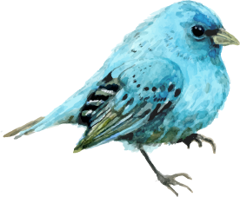
UNIT 2:
CITY LIFE
LESSON 6: SKILLS 2
TEACHER: NGUYEN THU HANG

Slide 2

VOCABULARY

Slide 3
- High cost of living
VOCABULARY
sinh hoạt đắt đỏ
- crime /kraɪm/ (n)
tội phạm
/ˈmetrəʊ/ (n)
tàu điện ngầm
- metro
- Overcrowding (n)
quá đông đúc
/ˌəʊvəˈkraʊdɪŋ/

Slide 4

LISTENING

Slide 5
1. Does your city, or the one nearest to, have any of these drawback?
- Urban sprawl
- Air pollution
- noise
- Bad weather
- High cost of living
- crime
- Traffic jams
- overcrowding

Slide 6
2. Listen and write the missing word in each gap.
cities
“Some ------------------------ have problem with population crime, or bad weather- here we have traffic jam”
2. Before going to the ------------------------ , she has to take her children to school.
3. In the evening the ------------------------ is even worse
4. Now so many people have a car, and there aren’t enough ------------------------ in the city
office
traffic
roads

Slide 7
3. Listen again and choose the correct answer.
What is the most serious in Bangkok?
A. pollution B. bad weather C. traffic jam
2. How does Suzan go to work?
A. By car B. by sky train C.by metro
3. How long does it take Suzan to go to work everyday?
A. Two hours B. five hours C. half an hour
4. In the evening the traffic is ------------
A. better B. worse C. the same
5. Why is traffic so bad in Bangkok?
People move around by boat
There aren’t enough roads
C. There isn’t a sky train or metro

Slide 8



READING

Slide 9
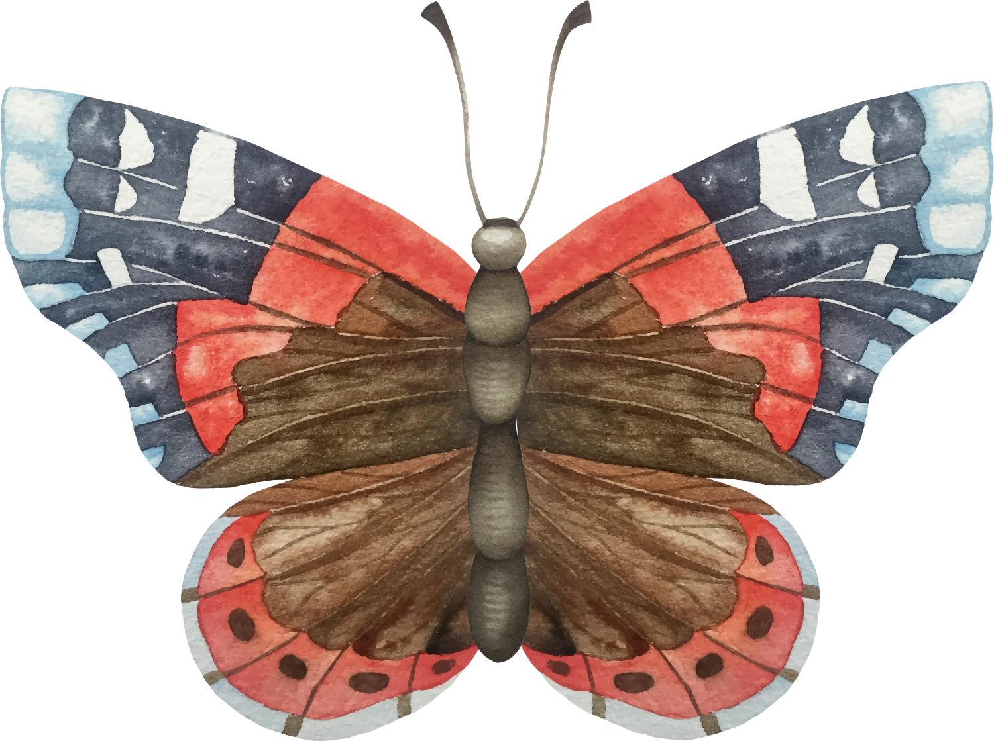
4. Read the paragraph and complete the outline below
Living in a city has a number of drawbacks. Firstly, there is the problem of traffic jams and traffic accidents. The increase in population and the increasing number of vehicles have caused many accidents to happen every day. Secondly, pollution negatively affects people’s health, and it also has a bad influence on the environment More and more city dwellers suffer from coughing or breathing problems. Thirdly, the city is noisy, even at night. Noise pollution comes from the traffic and from construction sites. Buildings are always being knocked down and rebuilt. These factors contribute to making city life more difficult for its residents.
Topic sentence:
Problem 1:
Problem 2:
Problem 3:
Conclusion:
- Living in a city has a number of drawbacks
- There is the problem of traffic jams and traffic accidents.
-Air pollution negatively affects people’s health, and it also has a bad influence on the environment.
-The city is noisy.
- These factors contribute to making city life more difficult for its residents

Slide 10
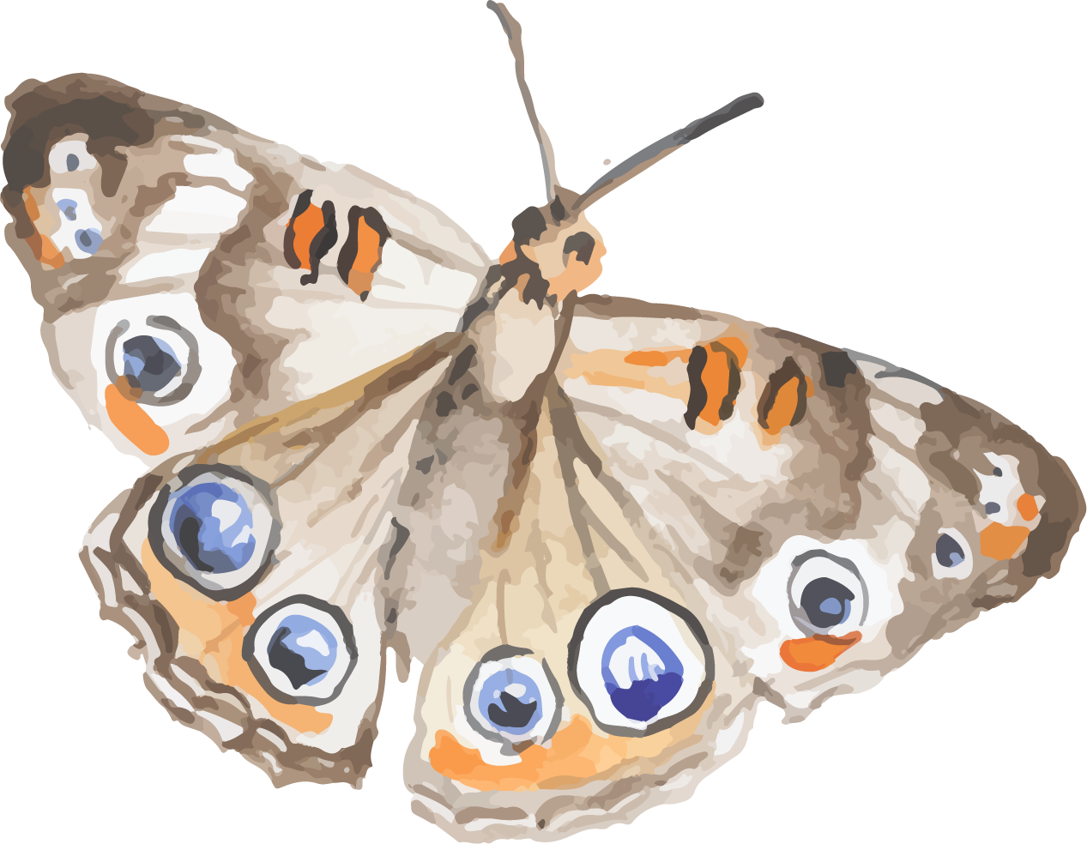
WRITING

Slide 11
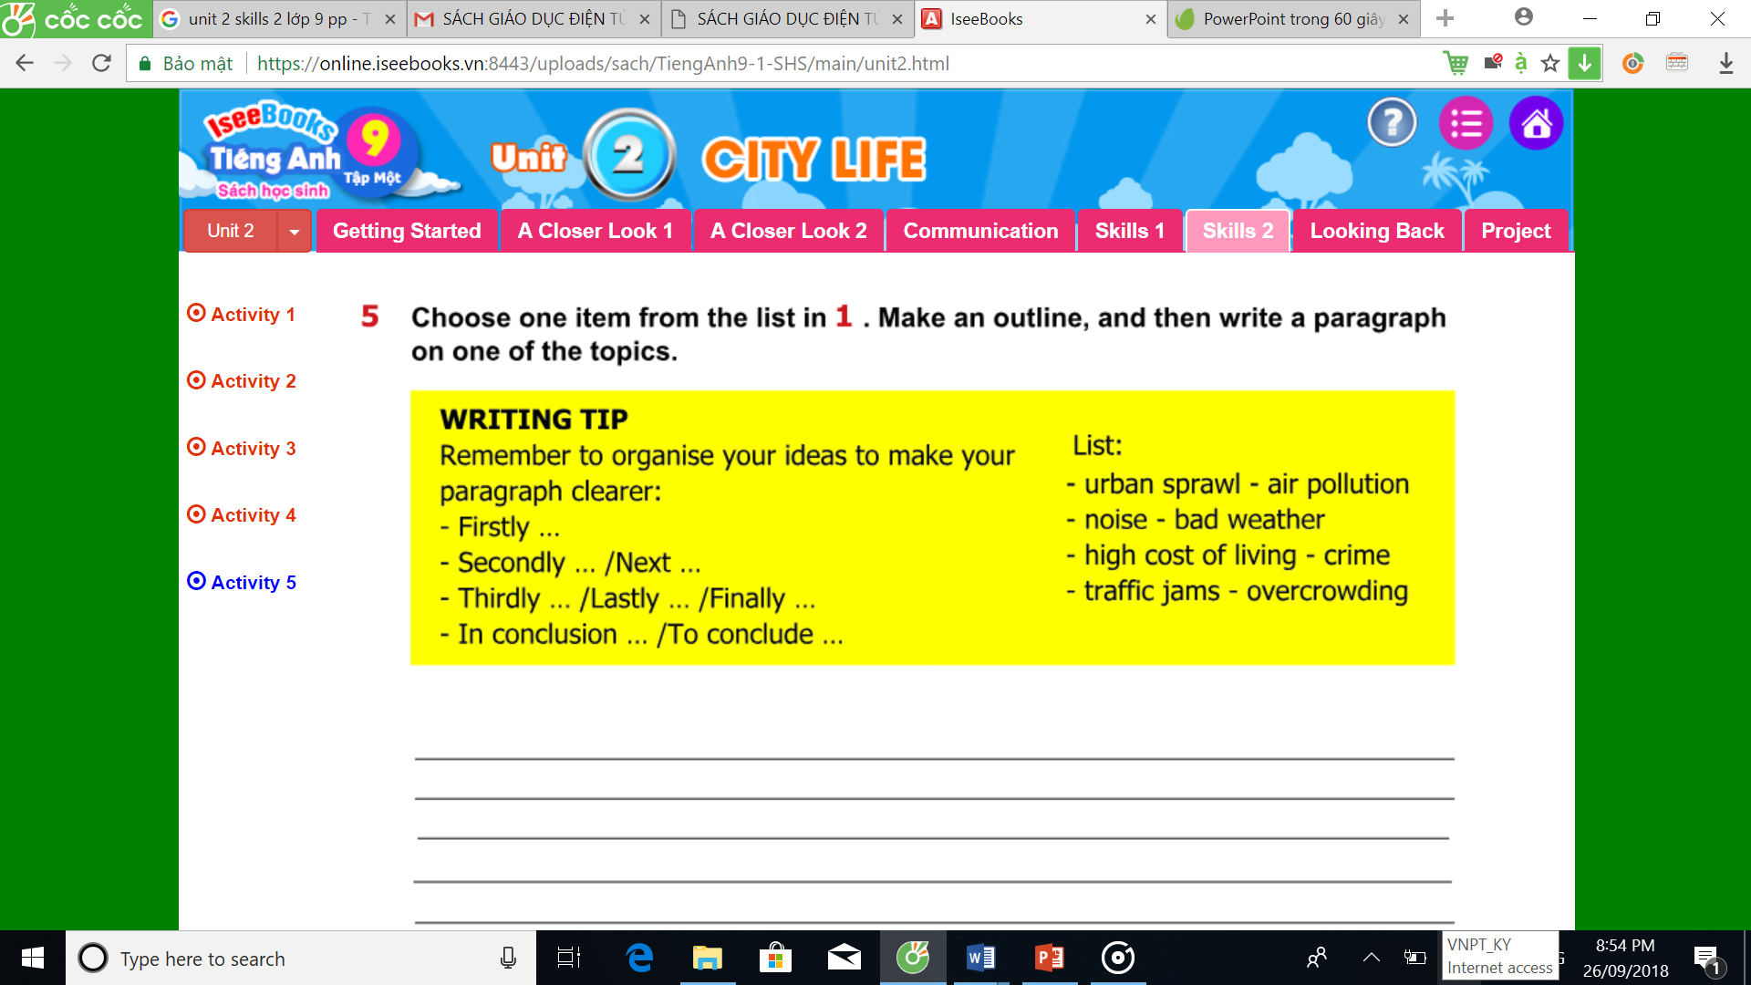
5. Choose one item from the list in 1. Make an outline, and the write a paragraph on one of the topics

Slide 12
Suggestion:
There are a lot of disadvantages of living in a big city, air pollution is among the most serious problems.
Firstly,
Secondly,
Finally
To conclude
air pollution comes from the factories in the city. Big cities attract a lot of both inside and outside investments, so the number of factories is increasing quickly. This makes the air extremely polluted by smoke from factories.
that there are too many transportation means also makes this problem worse. Exhaust from cars, motorbike is one of the factors that make the air polluted.
the city is noisy. Noise pollution come from machines, vehicles, industrial factories. It may affect the mind, health and behavior. It may cause physically discomfort and temporary or permanent damage to hearing. It causes headache and irritability. It may cause deafness, stress and high-blood pressure
air pollution, which contributes to making more and more people get many serious diseases, such as lung cancer, tuberculosis and so on, is a big drawback of city life.

Slide 13

Suggestion:
There are a lot of disadvantages of living in a big city, air pollution is among the most serious problems.
Firstly,
Secondly,
To conclude
public services such as health service, postal service cost a lot. This is because the development of big cites is faster and faster, these big cities become big economic centers of country.
price of food in big city is also much higher than in other area. Vegetables and fruits, which are really cheap in the villages, cost a lot in the urban area. This makes it difficult for people to consume healthy food.
it is not easy to live in a big city, especially for the poor and workers because they have to pay too much for public services while their salary is too low..

Slide 14
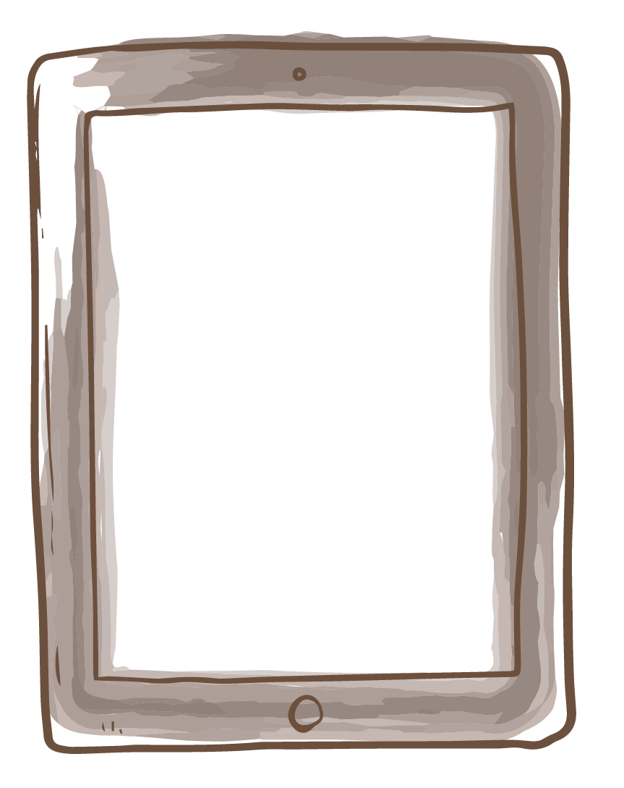
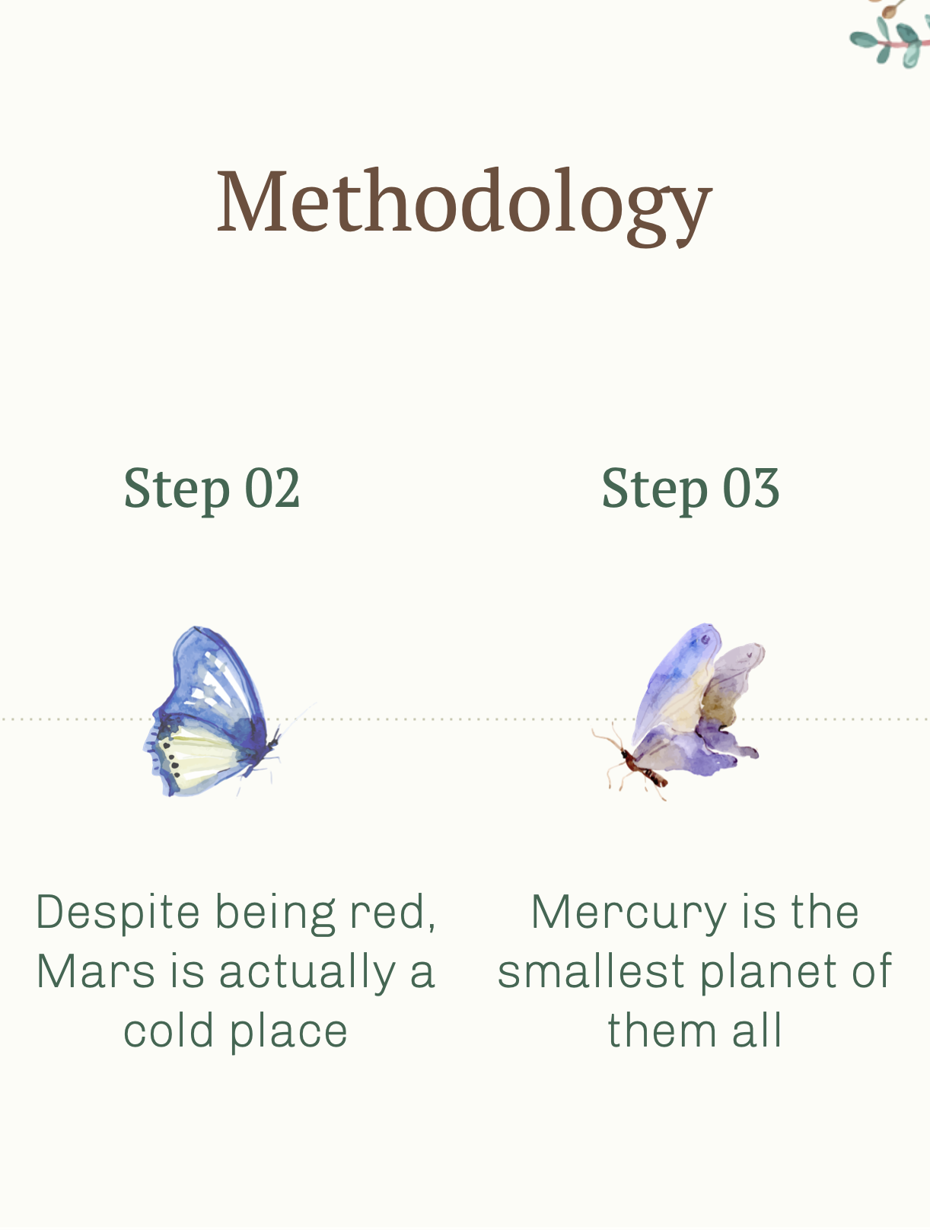
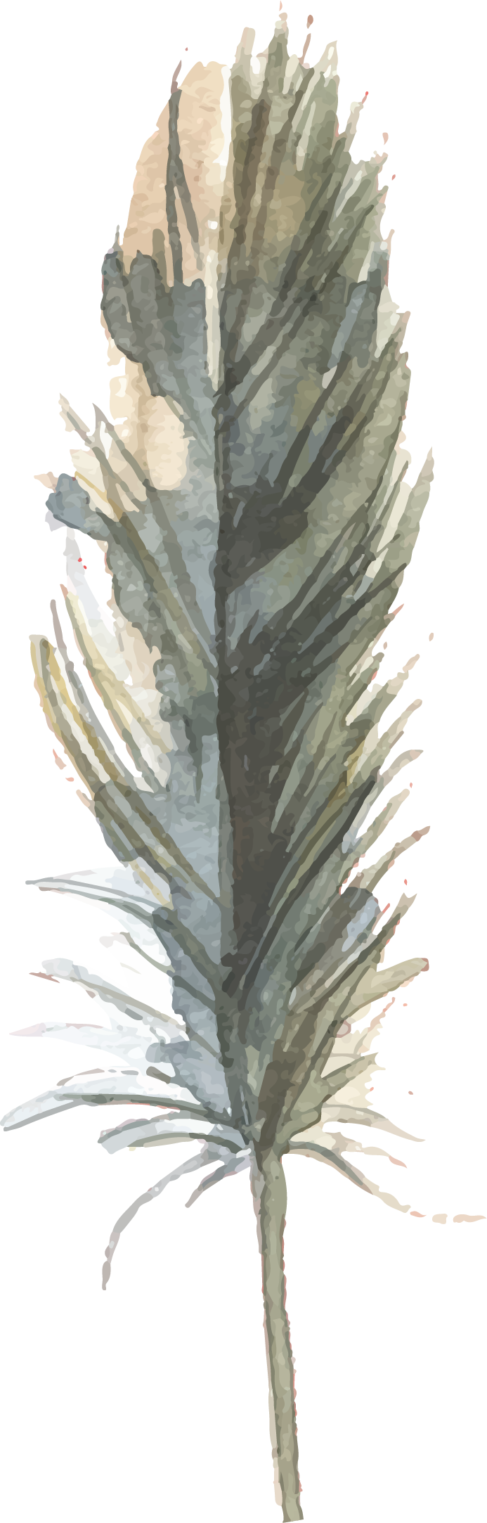
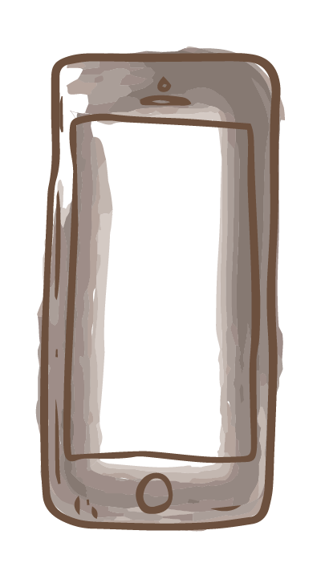
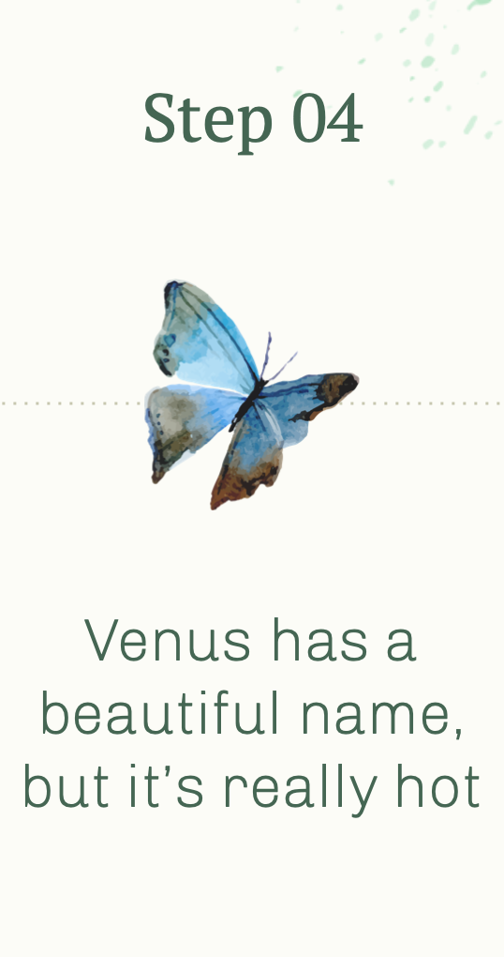
REMEMBER WHAT HAVE YOU LEARNT TODAY!

Slide 15


HOME WORK
- Learn the new words by heart. ​
- Write a paragraph about the disadvantages/drawbacks of city life.
- Do exercises E1, 2 in workbook (page 15)​
- Prepare for Unit 2: Looking back (New words, grammar)​

