Slide 1



Unit 1: Local environment
TEACHER: NGUYEN THU HANG

Slide 2

VOCABULARY

Slide 3
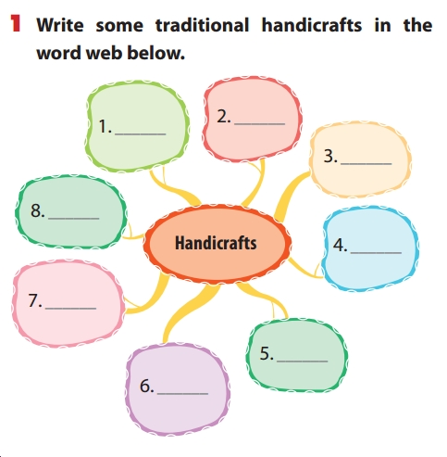

Slide 4
1. Write some traditional handicrafts in the word web below.
painting
pottery
drums
marble sculptures
silk
Handicrafts
lacquerware
lanterns
conical hats

Slide 5
2. Complete the second sentence in each pair by putting the correct form of a verb from the box into each blank.
carve - cast - weave - embroider - knit - mould
1. The artisan made this statue by pouring hot liquid bronze into a mould.
- The artisan ____________ this statue in bronze.
2. I’m decorating a cloth picture with a pattern of stitches, using coloured threads.
- I’m ____________ a picture.
3. They made baskets by crossing strips of bamboo across, over, and under each other.
They ____________ baskets out of bamboo.
4. My mum made this sweater for me from wool thread by using two bamboo needles.
My mum ____________ a wool sweater for me.
5. He made this flower by cutting into the surface of the wood.
He ____________ this flower from wood.
6. I took some clay and used my hands to make it into the desired shape.
- I ____________ the clay into the desired shape.
cast
embroidering
wove
knitted
carved
moulded

Slide 6
3. Complete the passage with the words/phrases from the box.
looked team-building zoo lunch
interest looking forward to craft museum
zoo
Last week we had a memorable trip to a new (1) __________ on the outskirts of the city. We were all (2) _____________ the trip. There are lots of wild animals, and they are looked after carefully. Each species is kept in one big compound and the animals look healthy. After we (3) __________ round the animal zone, we gathered on a big lawn at the back of the zoo. There we played some (4) ______________ games and sang songs. Then we had a delicious (5) __________ prepared by Nga and Phuong. In the afternoon, we walked to a (6) __________ nearby. There is a big collection of handicrafts made by different (7) __________ villages. I’m sure that the zoo will be our new place of (8) __________ .
looking forward to
looked
team-building
lunch
museum
craft
interest

Slide 7
4. Complete the complex sentences with your own ideas.
Although this village is famous for its silk products,
__________________________________________ . 2. Many people love going to this park because _______
_____________________________________________ 3. Since ______________________________________, foreign tourists often buy traditional handicrafts. 4. Moc Chau is a popular tourist attraction when_______
_____________________________________________ 5. This weekend we're going to the cinema in order that _____________________________________________

Slide 8
5. Rewrite each sentence so that it contains the phrasal verb in brackets. You may have to change the form of the verb.
1. I don't remember exactly when my parents started this workshop. 2. We have to try harder so that our handicrafts can stay equal with theirs.
3. What time will you begin your journey to Da Lat?
4. We arranged to meet in front of the lantern shop at 8 o'clock,
but she never arrived. 5. The artisans in my village can earn enough money from basket weaving to live.
set up
keep up with
set off
turned up.
live on from basket weaving

Slide 9


6. Work in groups. One student thinks of a popular place of interest in their area. Other students ask Yes/No questions to guess what place he/she is thinking about.
Example:
A: Is the place near the city center?
B: Yes, it is.
C: Can we play sports there?
B: Yes, we can.
A: Can we play games there?
B: Yes, we can.
C: Do people go shopping there?
B: No, they don’t.
A: Is it the ABC sports center?
B: You’re right.

Slide 10
PROJECT

Slide 11
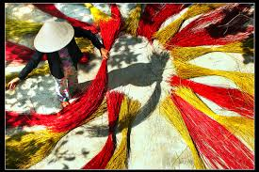
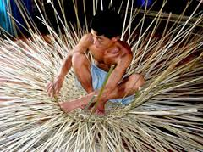
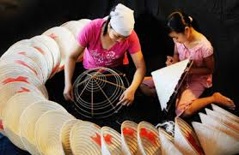
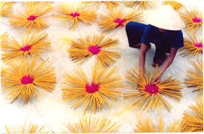
What traditional handicapped do they do?
DRY THE MATERIALS
MAKING THE BASKETS
MAKING CONICAL HATS
DRYING THE INCENSES

Slide 12
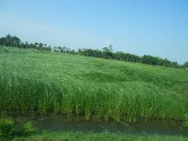
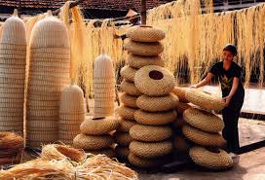
*Discuss the thing you are going to talk about
FIRSTLY, LET’S GO TO FIND SOME INFORMATION ABOUT THE TRADITIONAL HANDICRAFT IN OUR AREA. IN BEN LUC TOWN , BECAUSE OF HAVING A FAMOUS MAT MAKING VILLAGE, WE WILL SEE SOME PICTURES ABOUT THIS VILLAGE THE LAND WHERE PEOPLE GROW THE MATERIALS OF MAT, THE MATERIALS IS CALLED “LÁT” IN VIETNAM
IN THESE PICTURES, WE CAN SEE HOW TO MAKE THE TRADITIONAL HANDICRAFT. AND THIS IS THE SUBJECT OF THIS SECTION: HOW TO PRESERVE THE TRADITIONAL HANDICRAFT IN OUR AREA ?

Slide 13
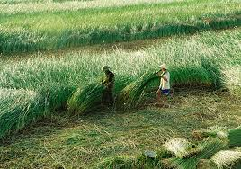
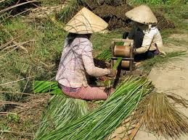
WHEN THE “LÁT” GROWS ENOUGH, PEOPLE HARVEST AND LOAD THEM INTO THEIR HOUSE TO SLIDE THE “LÁT”.

Slide 14
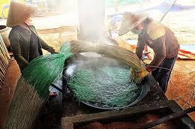
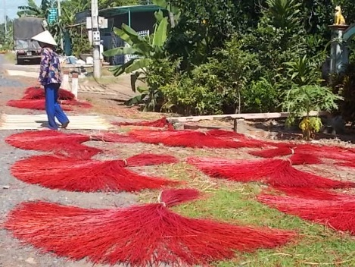
After sliding the “lat”, they dyed them with the natural colors like green from leaves; yellow from clay; red from mud and etc,…
Then they dry them in the sunlight from 1 to 2 days before the last stage.

Slide 15
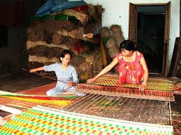
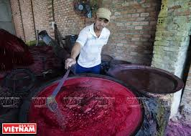
And after a lot of hard stages, they made the mat with the fun and happiness on their face, are the achievement from their hardworking
Or the people who make the mats use the chemical colors to dye the mat, and it’s easy to make people’s skin allergic.

Slide 16
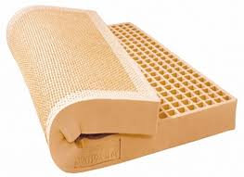
Although it’s famous, there are a lot of challenges for this village.
Now, people usually use the latexes more than using mats because they are more comfortable than mats.
So I think we can protect this work With some solutions :
- Help the mat makers know how to develop this village and preserve this work.
- Bring the mat to another event to broadcast the mat for everybody know more than about the mat.

Slide 17

REMEMBER WHAT HAVE YOU LEARNT TODAY!

Slide 18
HOME WORK
- Write the project in your notebook
- Prepare: Unit 2

