Slide 1


TRƯỜNG THCS LONG BIÊN
BÀI GIẢNG ĐIỆN TỬ MÔN TIẾNG ANH 9
Tiết 56
UNIT 7: RECIPES AND EATING HABITS
Lesson 2: A closer look 1
GV: Đoàn Thị Lê
Tổ Ngoại Ngữ - Năng khiếu

Slide 2
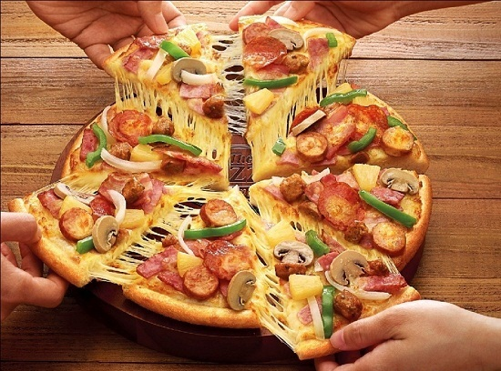
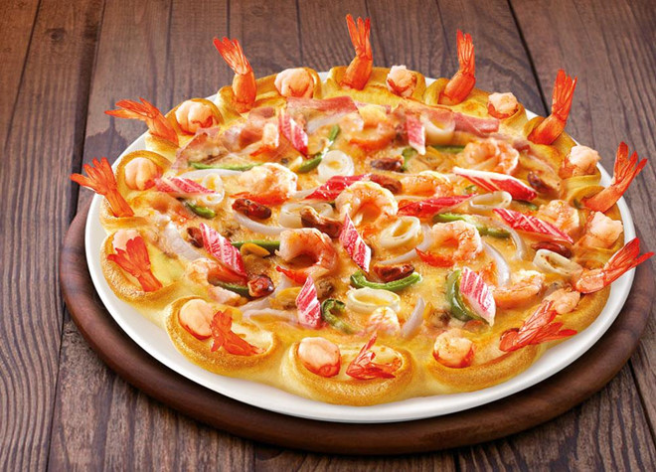
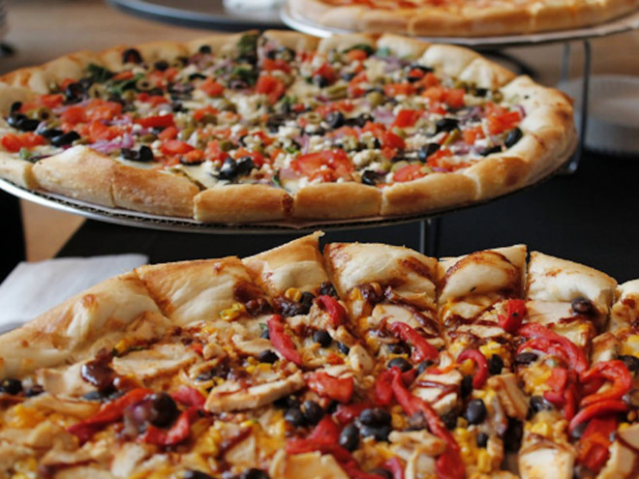
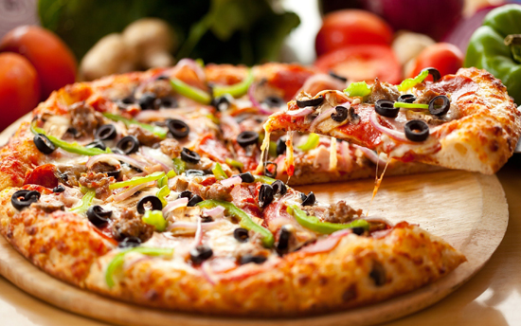

Slide 3
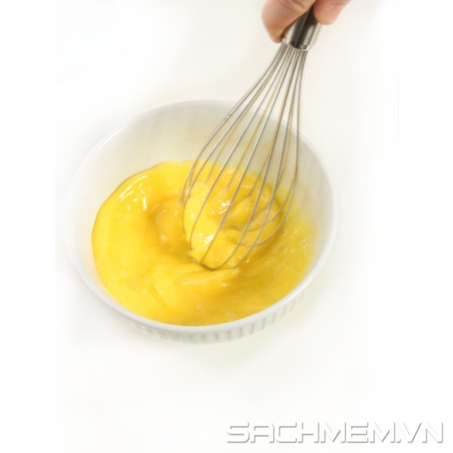
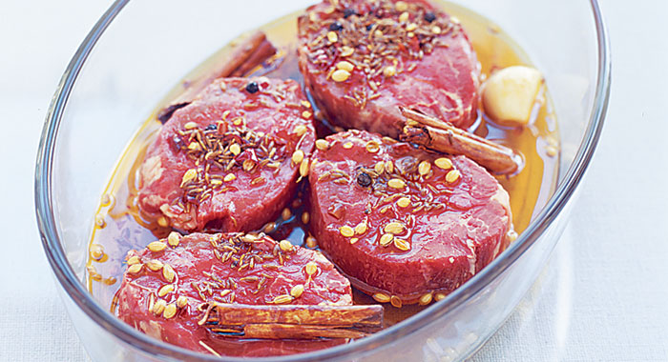
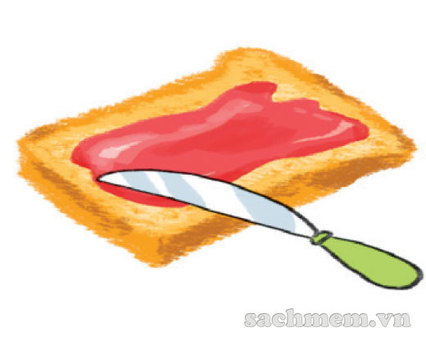
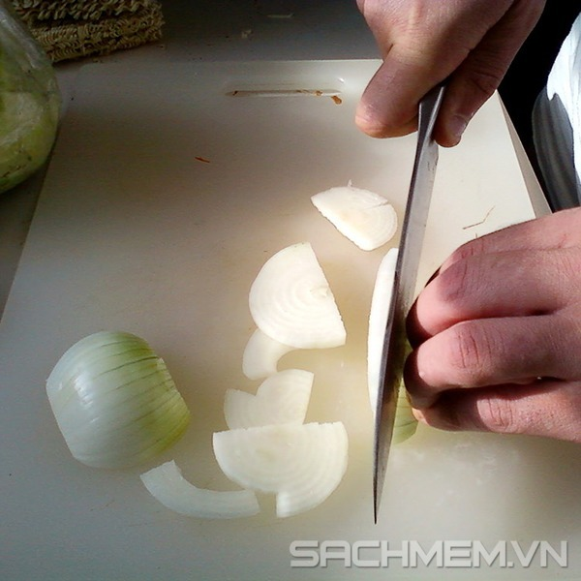
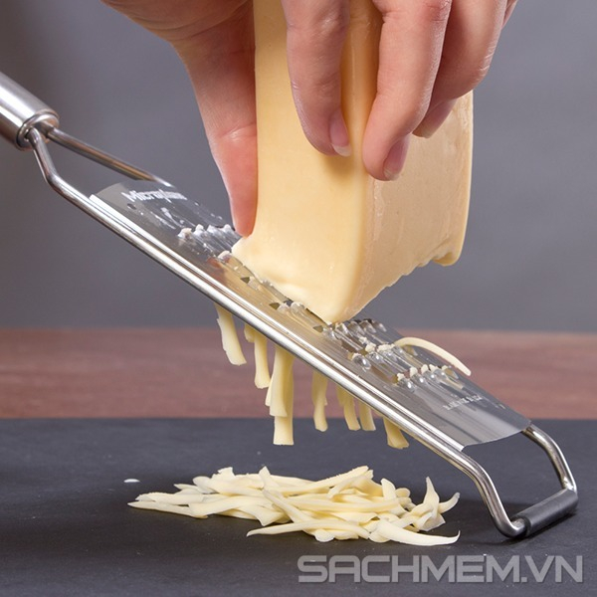
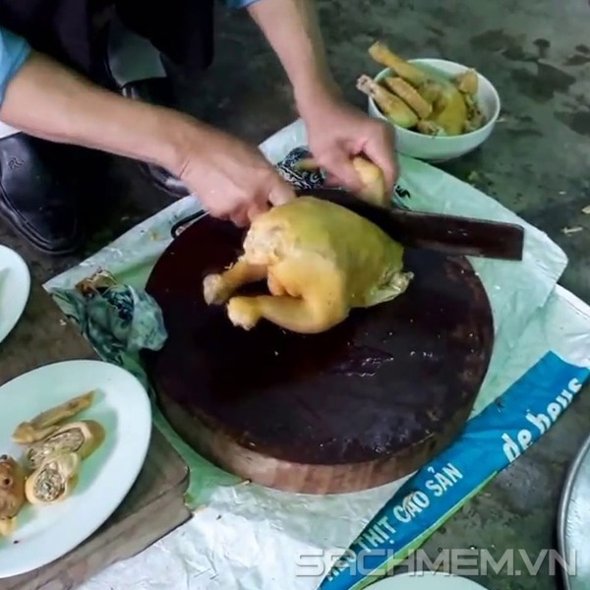
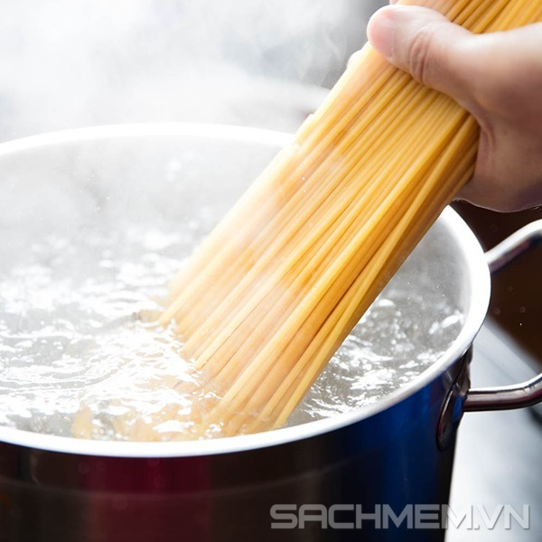

New words
chop /tʃɒp/ (v)
chặt
dip /dɪp/ (v)
nhúng
grate /ɡreɪt/ (v)
nạo
marinate /ˈmærɪneɪt/ (V)
ướp
spread /spred/ (v)
phết
sprinkle /ˈsprɪŋkl/ (v)
rắc
slice /slaɪs/ (v)
cắt lát
whisk /wɪsk/ (v)
đánh (trứng…)

Slide 4
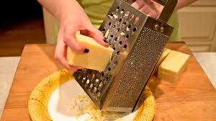
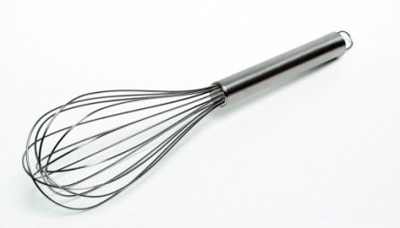


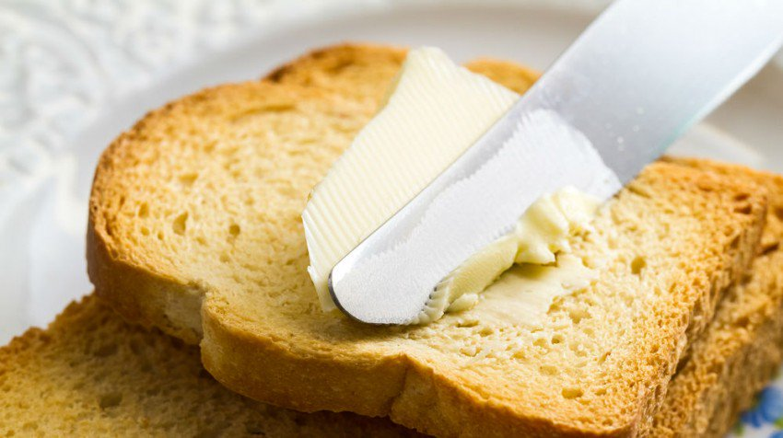
1. Write a food preparation verb from the box under each picture.
chop
slice
spread
dip
grate
whisk
sprinkle
marinate
whisk
A………………
B………………
C………………
D……………
E………………..
F………………
G………………
H…………….

Slide 5
2. Complete the sentences with the correct form of the verbs in 1 .
1. Don’t ____the cucumber into chunks. ___ thinly.
2. My mother usually ______ some cheese and _________ it over the pasta.
3. ______ the chicken in white wine for one hour
before roasting.
4. To make this cake successfully, you should ______
the eggs lightly.
5. ______ the prawns into the batter.
6. Can you ______ the butter on this slice of bread
for me?
chop
Slice
grates
sprinkles
Marinate
whisk
Dip
spread

Slide 6
3. Match each cooking verb in A with its definition in B.
A | B
1. stir-fry | a. place food over boiling water so that it cooks in the steam.
2. deep-fry | b. cook something be keeping it almost at boiling point.
3. roast | c. cook food under or over a very strong heat.
4. grill | d. cook something slowly in liquid in a closed dish.
5. bake | e. cook cakes or bread in an oven.
6. steam | f. fry food in oil that covers it completely.
7. stew | g. cook thin strips of vegetables or meat quickly by stirring them in very hot oil
8. simmer | h. cook meat, or vegetables without liquid in an oven or over a fire.

Slide 7
3. Match each cooking verb in A with its definition in B.
A | B
1. stir-fry | g. cook thin strips of vegetables or meat quickly by stirring them in very hot oil
2. deep-fry | f. fry food in oil that covers it completely.
3. roast | h. cook meat, or vegetables without liquid in an oven or over a fire.
4. grill | c. cook food under or over a very strong heat.
5. bake | e. cook cakes or bread in an oven.
6. steam | a. place food over boiling water so that it cooks in the steam.
7. stew | d. cook something slowly in liquid in a closed dish.
8. simmer | b. cook something be keeping it almost at boiling point.

Slide 8
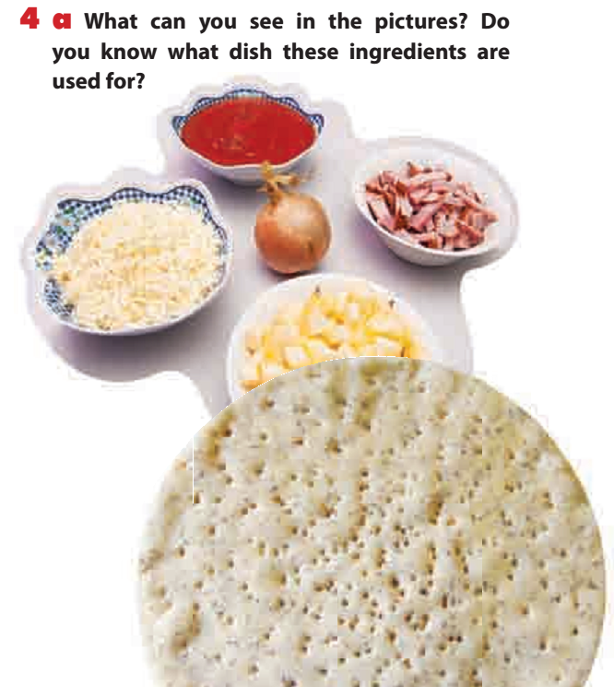
tomato sauce
bacon
onion
cheese
apple
Pizza
pizza base

Slide 9
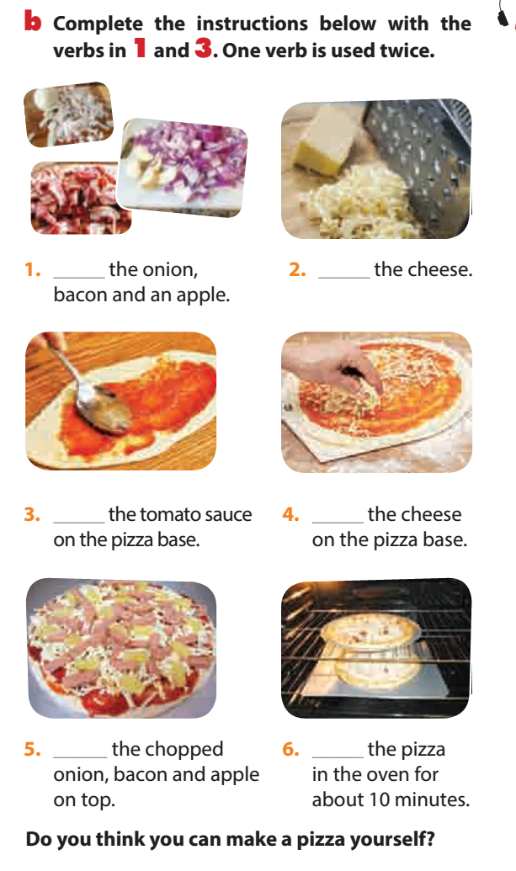
Do you think you can make a pizza yourself?
Chop
Grate
Spread
Sprinkle
Spread
Bake

Slide 10

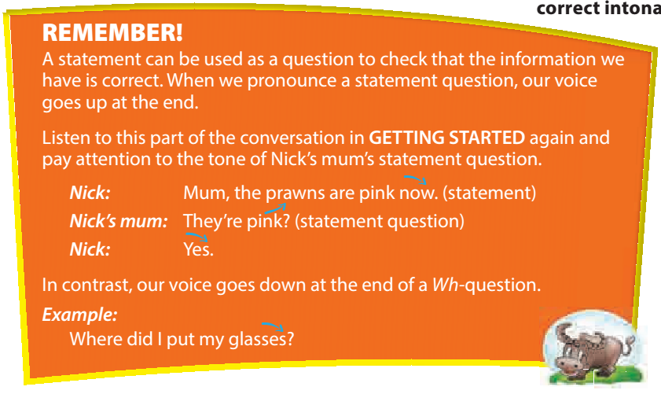


Slide 11
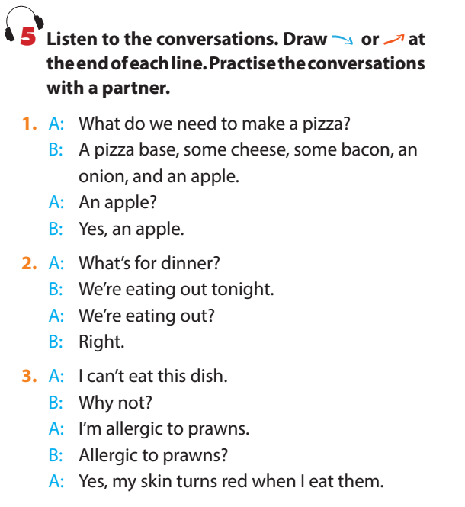
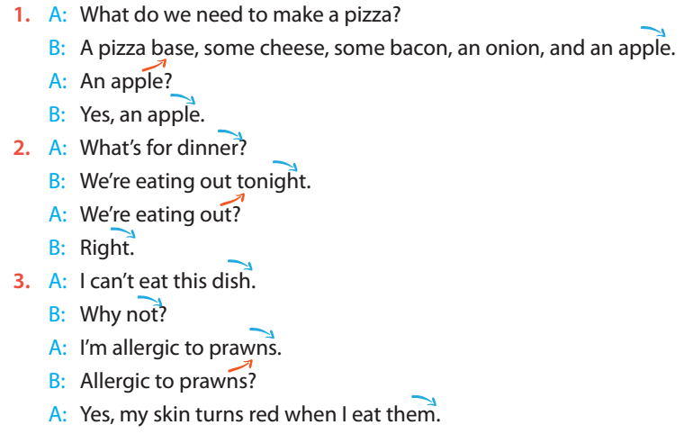

Slide 12
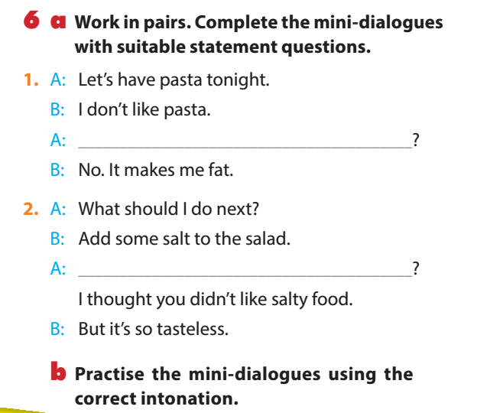
You don’t like pasta?
Don’t like pasta?
Add some salt?

Slide 13

HOMEWORK
- Learn the vocabulary.
- Prepare the new lesson Unit 7: Lesson 3:
A closer look 2.

Slide 14
THANK YOU
FOR
YOUR ATTENTION !!!

