Slide 1

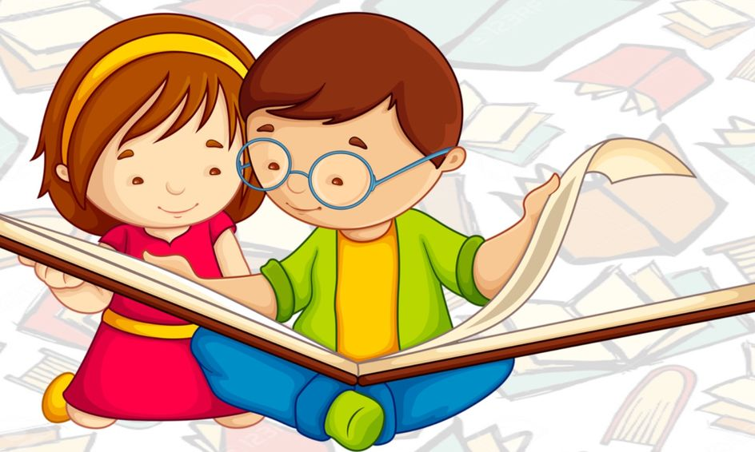
Unit
5
OUR CUSTOMS AND TRADITIONS
Unit
ETHNIC GROUPS OF VIET NAM
LESSON 3: A CLOSER LOOK 2
LESSON 3: A CLOSER LOOK 2
Zero articles
Unit
HOBBIES

Slide 2
WARM-UP
Option 1
CALL OUT THE PHRASES!

Slide 3
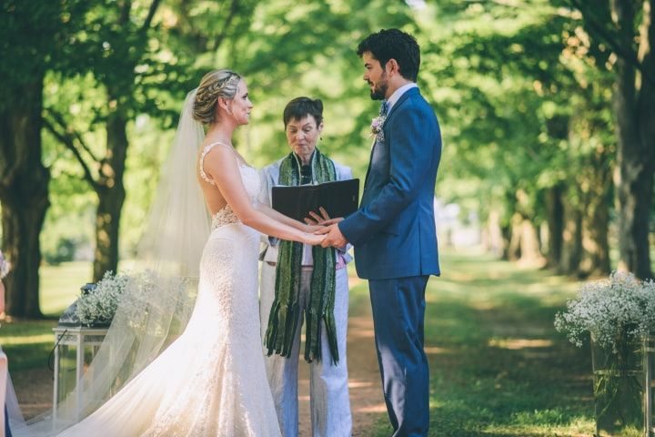
WARM-UP
wedding ceremony

Slide 4
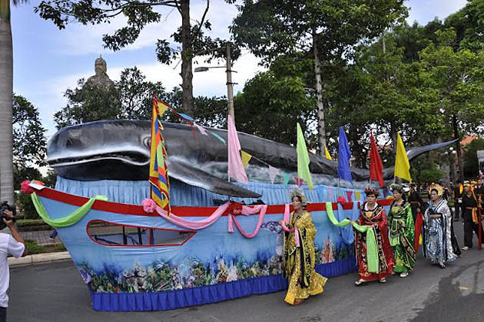
WARM-UP
whale worship

Slide 5
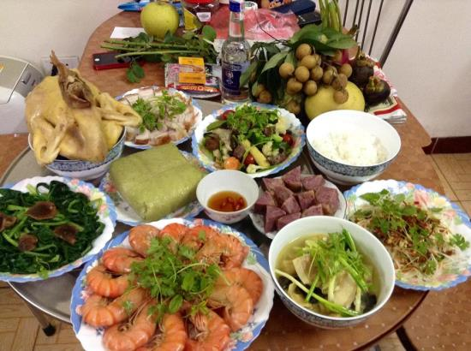
WARM-UP
food offerings

Slide 6
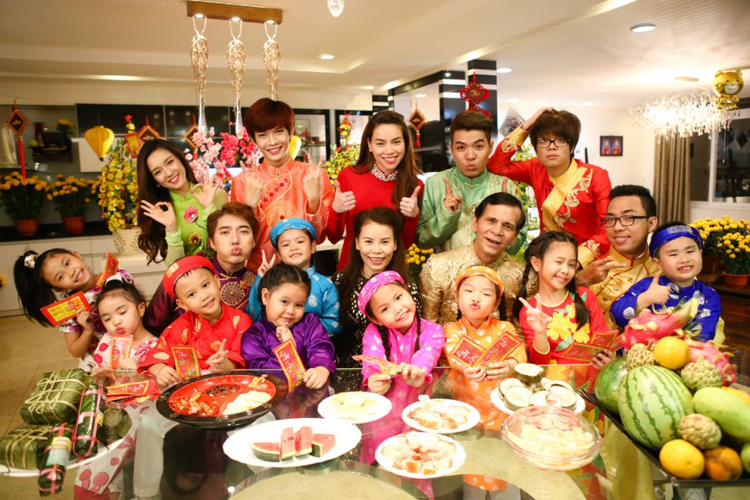
WARM-UP
family reunion

Slide 7
WARM-UP
1.We held a family reunion last week.
2. My mum prepares food offerings at Tet.

Slide 8
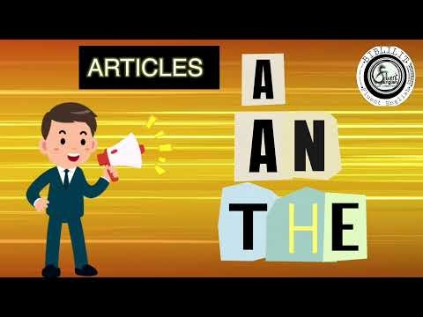
WARM-UP
Option 2
Watch the video and answer the question!
Notes:
Video link: www.youtube.com/watch?v=uqNugAvxXXo

Slide 9
WARM-UP
When do we use a / an / the?

Slide 10
PRESENTATION
an: indefinite article
an + singular noun beginning with a vowel
1. She is an engineer.
a: indefinite article
a + singular noun
beginning with a consonant
2. We held a
family reunion last week. The
party was enjoyable.
the: definite article

Slide 11
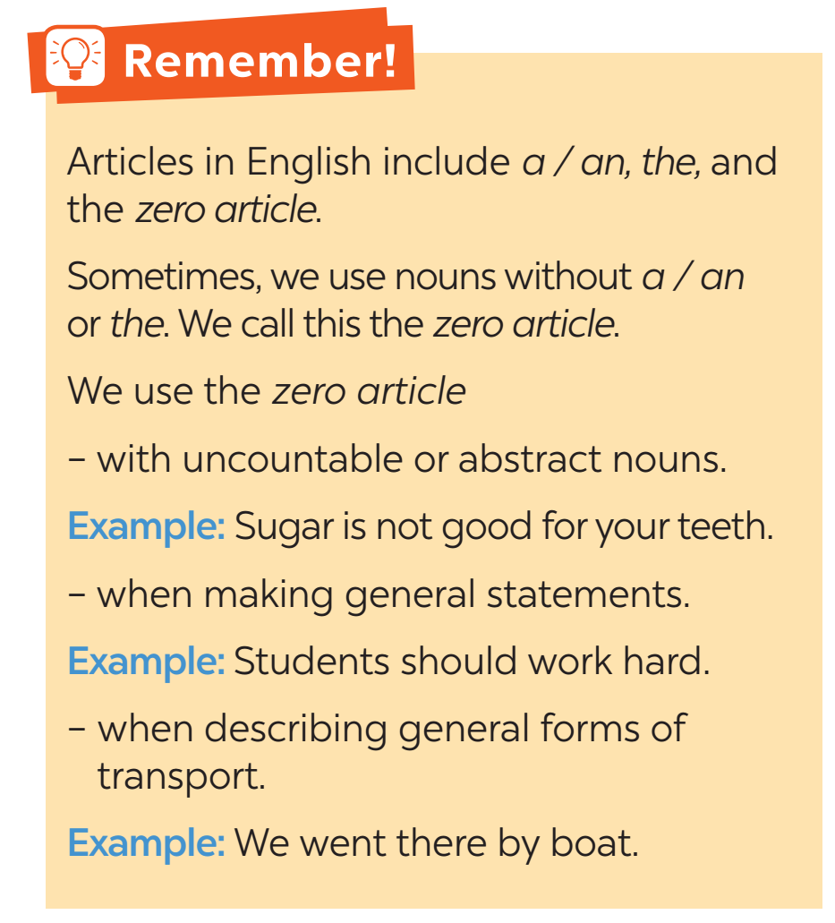
PRESENTATION
We can use noun without a / an or the. We call this
zero article.

Slide 12
PRACTICE
1
Choose the correct option in each sentence below.
1. It takes more than a / an hour to drive to Can Tho.
2. It’s a / Ø tradition for children to wake up early on Christmas Day.
3. The Ok Om Bok Festival takes place in the / Ø October.
4. We went to Can Tho by an / Ø air.
5. A: Where’s a / the book?
B: I thought you left it next to the TV.

Slide 13
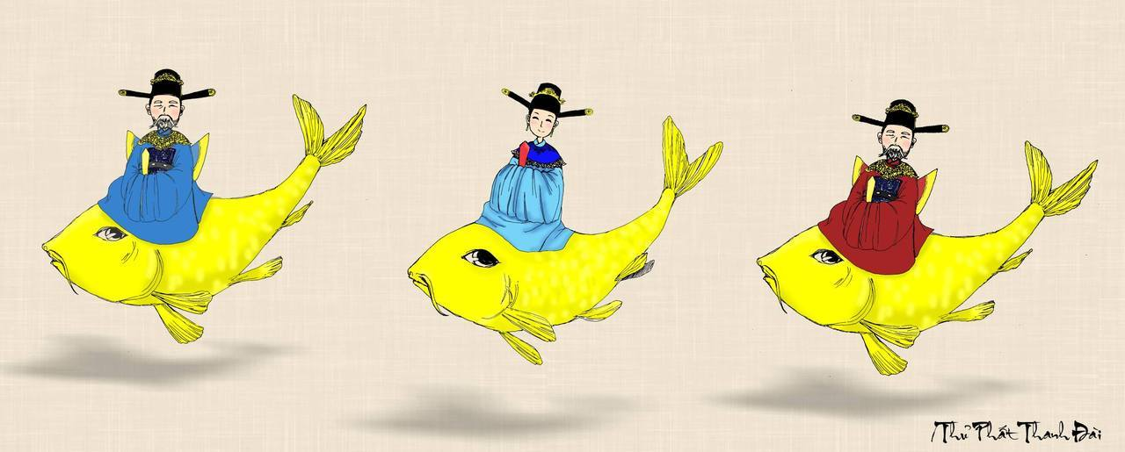
PRACTICE
The Kitchen Gods Worshipping Ceremony
When is it?
On the 23rd day of the twelfth lunar month.

Slide 14
PRACTICE
What happens in this ceremony?
Vietnamese people prepare offerings for the Kitchen Gods, who will report the family’s affairs over the past year to the Jade Emperor.

Slide 15
PRACTICE
2
Which of the underlined parts in each question is incorrect? Find and correct it.
1. The worshipping Kitchen Gods is a long-time tradition of the
A B C
Vietnamese.
2. People organise the worshipping ceremony at noon so that a
A B C
Kitchen Gods can leave for Heaven at 12 o’clock.
→ Ø
→ the

Slide 16
PRACTICE
3. Most families in the Viet Nam prepare oﬀerings for the Kitchen Gods.
A B C
4. The oﬀerings include a set of flowers and fruits, a paper clothes,
A B C
and three carps.
5. The Vietnamese people believe that the Kitchen Gods go to
A B
Heaven on carps.
C
→ Ø
→ Ø
→ Ø

Slide 17
PRACTICE
3
Complete the sentences with a, an, the, or Ø (zero article).
Ø
1. It is a custom in my family to have ______ breakfast at home on Sundays.
2. When visiting a family home in some countries, you should bring ______ small gift with you.
3. Our village festival is held on the 10th of ______ January.
4. Ancient Egyptians worshipped ______ Sun.
5. Many people think that hard work is ______ important Vietnamese value.
a
Ø
the
an

Slide 18
PRACTICE
4
Complete the text with the or Ø (zero article).
A recent study in (1) ______ UK shows that family time traditions are good for (2) ______ teens. These traditions include family members playing card games, watching their favourite TV programmes, or performing (3) ______ karaoke shows at weekends with one another. These activities often lead to lots of laughter and (4) ______ fun conversations. By taking part in such activities, teens strengthen
(5) ______ bonds with their family.
the
Ø
Ø
Ø
the

Slide 19

FURTHER PRACTICE
5
- Work in group
- Each group has a list of five sentences.
- Find and correct the mistakes in sentences.
- Say “Bingo!” as soon as your group finishes.
- The first group to come up with all the correct answers wins.

Slide 20
FURTHER PRACTICE
5
1. I usually meet my cousin at the weekends.
2. My uncle moved to United States three years ago.
3. Our teachers assigned us a homework for our history and science classes.
4. I turn off the light and go to the bed at 11 p.m.
5. Mark often wears red sweater to match his red hair.
→ Ø
→ the United States
→ Ø
→ Ø
→ a red sweater

Slide 21
CONSOLIDATION
1
Wrap-up
FISHING GAME

Slide 22
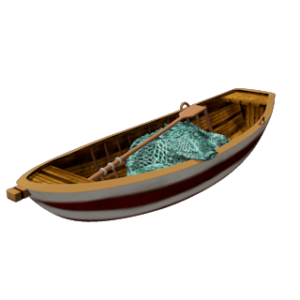
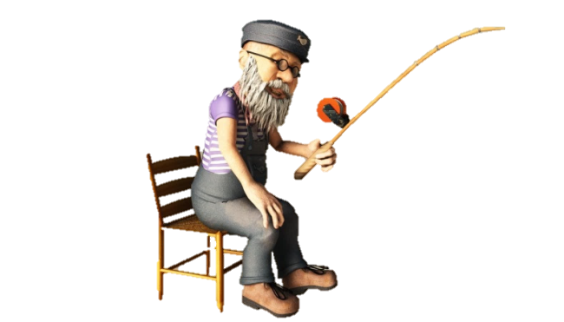
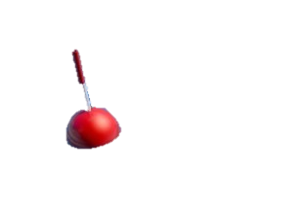
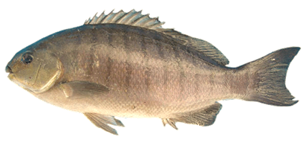
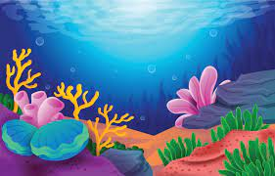
Are you coming to ........... party next Saturday?
GREAT!
the
a
Ø
the
an

Slide 23
I bought .......new TV set yesterday.
GREAT!
a
the
Ø
a
an

Slide 24
He thinks that ............... love is what will save us all
GREAT!
Ø
the
a
Ø
an

Slide 25
She was wearing ...... ugly dress when she met him.
GREAT!
an
the
a
an
Ø

Slide 26

CONSOLIDATION
2
Homework
Make 5 sentences using articles.
Do exercises in the workbook.

