Slide 1
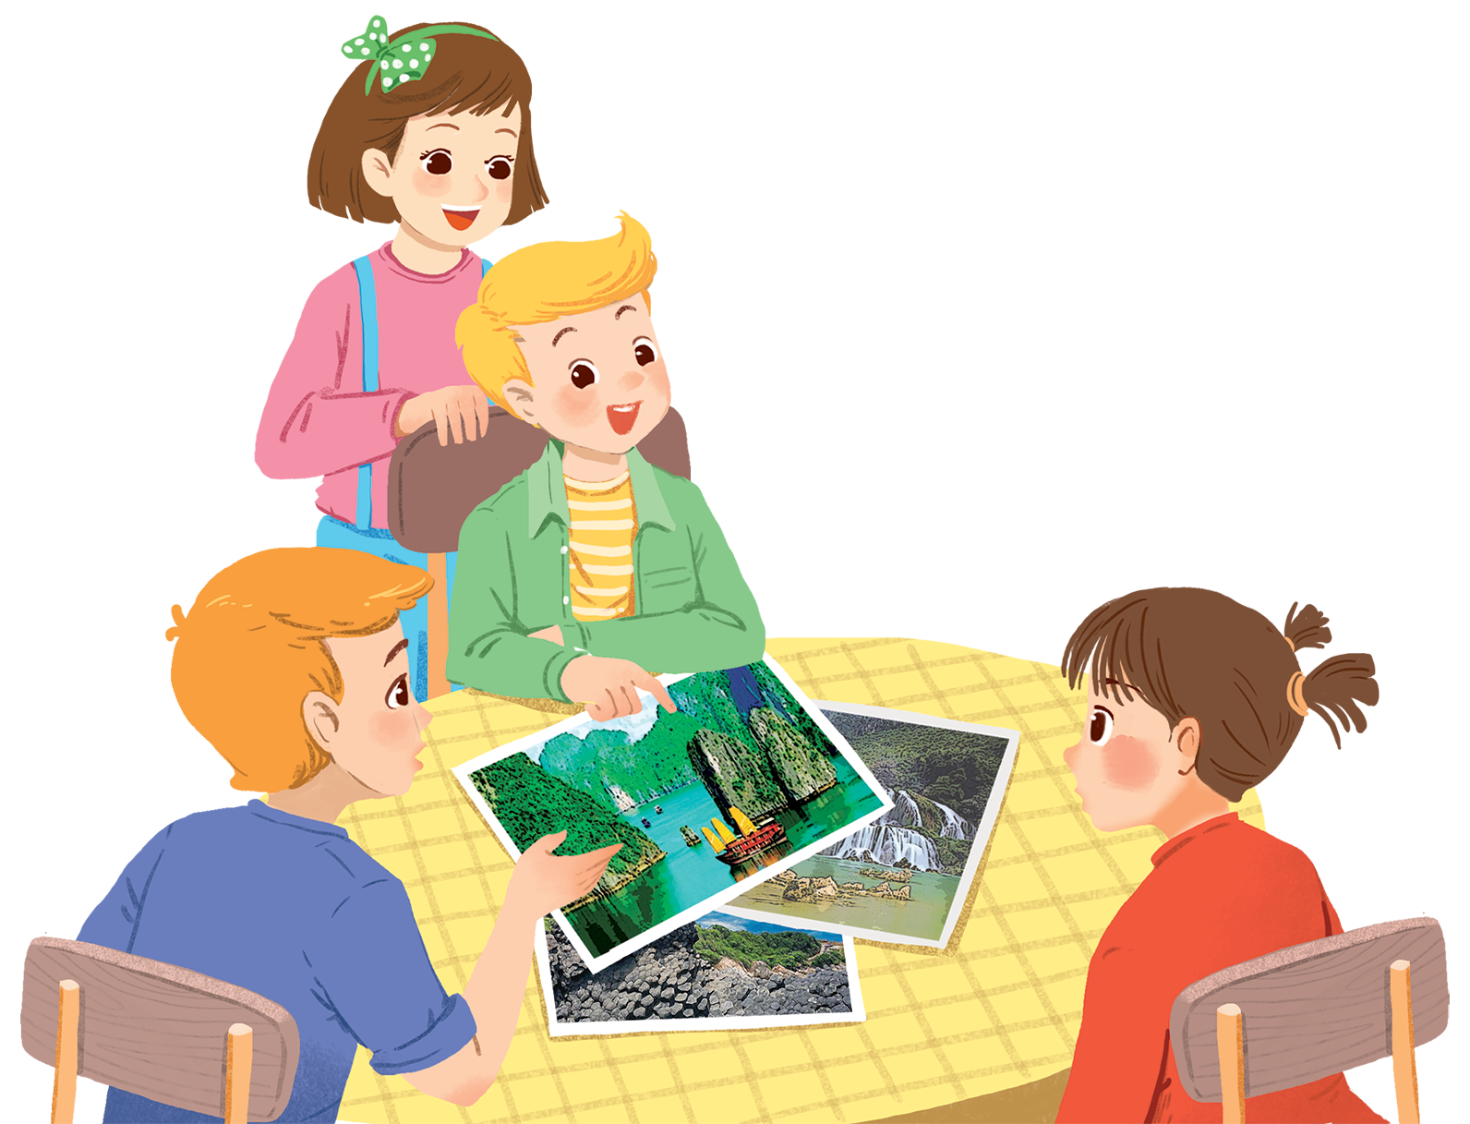
      UNIT 5: NATURAL WONDERS OF VIETNAM
      LESSON 4: COMMUNICATION
English 6

Slide 2


Everyday English
Making and accepting appointments
1
Listen and read the short conversation below, paying attention to the highlighted parts.
2
Work in pairs. Make a short conversation, following the example in 1.
A travel guide
3
Read the travel guide entry.
4
Now make a list of the things you must bring to the Himalayas. Then add things you mustn’t bring.
5
Role-play being a tour guide and a tourist. Tell your partner what to prepare for their trip to the Himalayas, and give reasons.

Slide 3


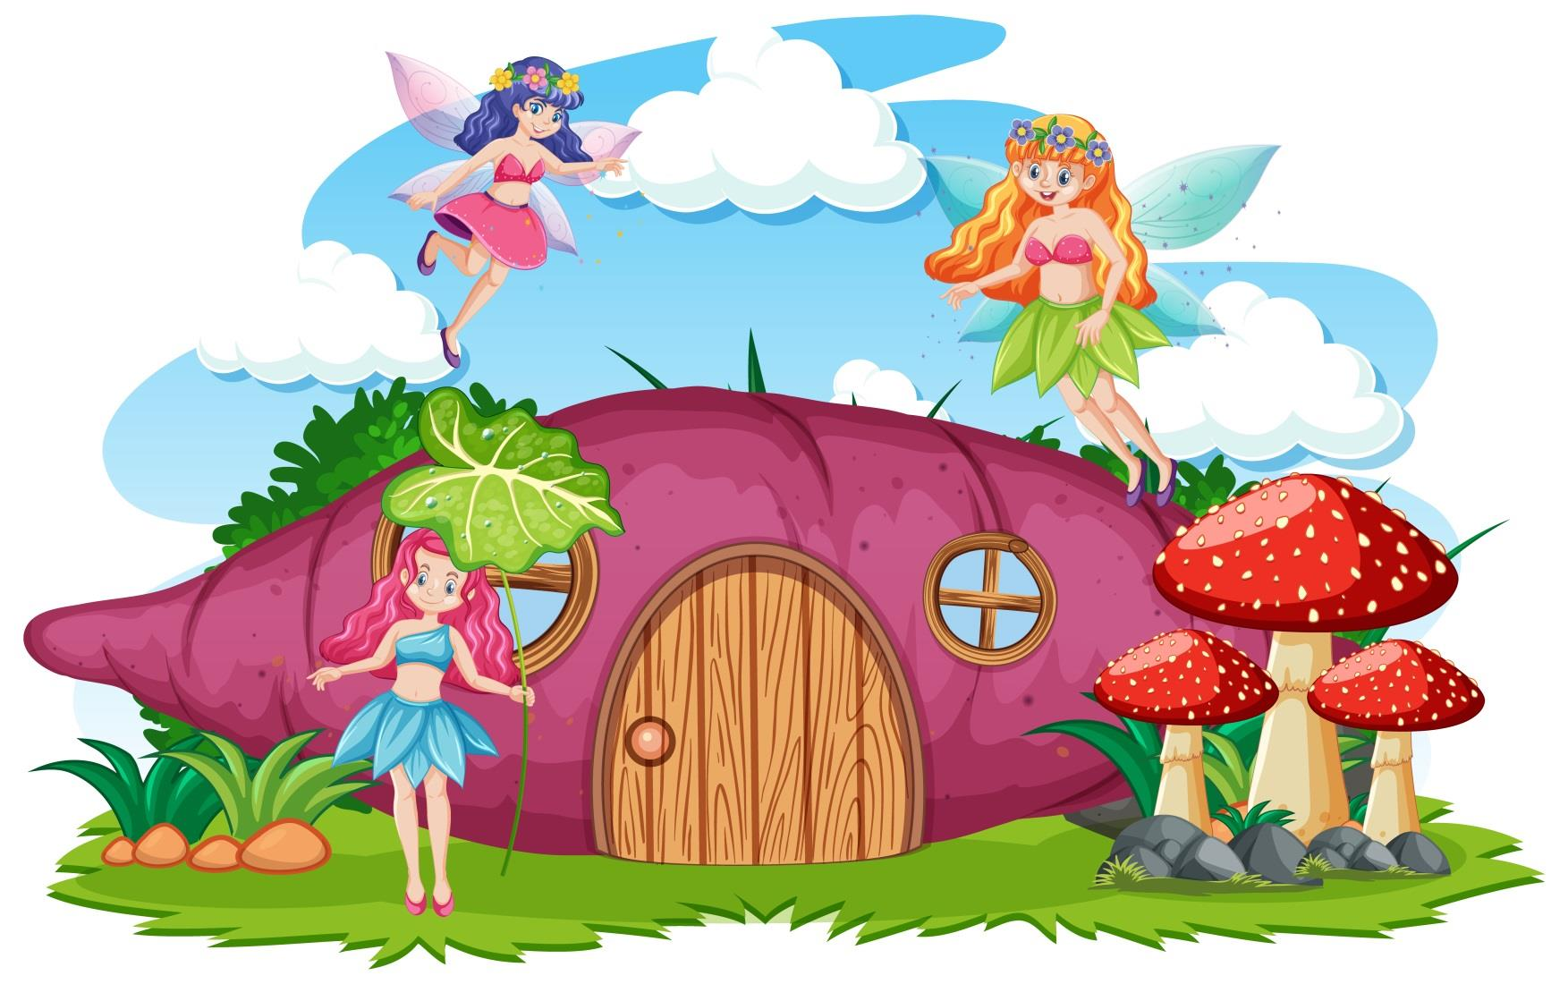


Student 1
Student 2
Student 3
Student 4
Student 5
Student 6
Student 7
Student 8
Student 9
Make a sentence with must/ mustn’t.
Student 10

Slide 4
Everyday English
Making and accepting appointments

Slide 5

1
Listen and read the short conversation below, paying attention to the highlighted parts.
Steven: Duong, let’s go for a picnic this Sunday.
Duong: That’s fine. What time can we meet?
Steven: How about 9 o’clock?
Duong: Sure. I’ll meet you at that time.
Notes:
Slide này không đúng.

Slide 6
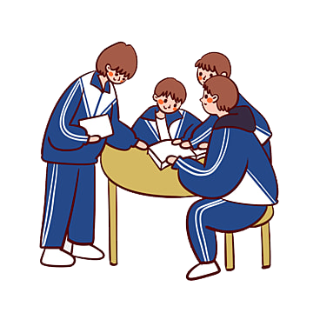
2
Work in pairs. Make a short conversation, following the example in 1.

Slide 7
A travel guide

Slide 8
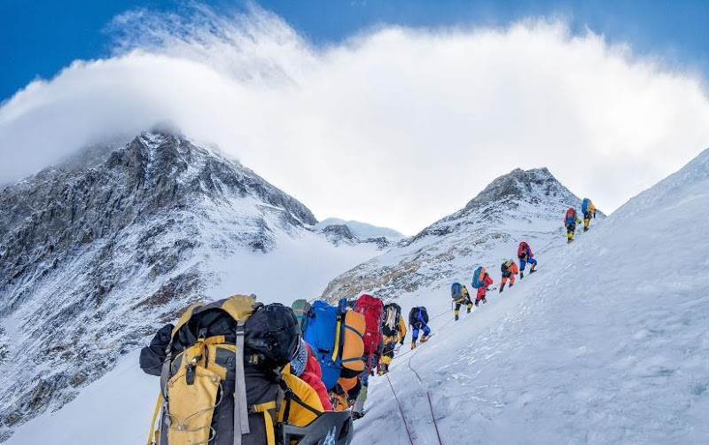

Slide 9

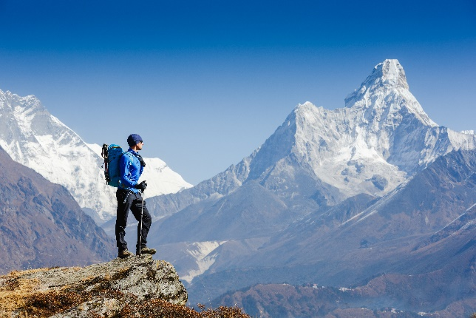
3
Read the travel guide entry.
GLOBAL TRAVEL GUIDE
The Himalayas is a mountain range.
It’s very special. It has the world’s highest mountain – Mount Everest.
When visiting the Himalayas, remember to follow these rules.
You must ask before you visit the area.
You mustn’t travel alone. Always go in a group.
You mustn’t litter.
You must bring only the necessary things.
You must bring the right clothes too. Don’t bring shorts or T-shirts!
Notes:
City landmarks phải ở trên mục 3

Slide 10
4
Now make a list of the things you must bring to the Himalayas. Then add things you mustn’t bring.
MUST | MUSTN’T
compass
bicycle

Slide 11
5
Role-play being a tour guide and a tourist. Tell your partner what to prepare for their trip to the Himalayas, and give reasons.
Example:
A: I’d like to go to the Himalayas next month.
B: OK. I think you must bring a waterproof coat. It’s cold and rainy there!
A: Yes. Anything else?
B: You must …, and you mustn’t …

Slide 12
Nga: Lan , let’s go somewhere this Saturday.
Lan : That’s fine. Where can we go?
Nga: How about the Ba To Park?
Lan Sure. I’ll meet you there at 9 o’clock.
Example :

Slide 13

Homework
  Learn vocabulary and the structure by heart.
  Do exercise in your work book
  Prepare the next lesson: Skills 1

