Slide 1
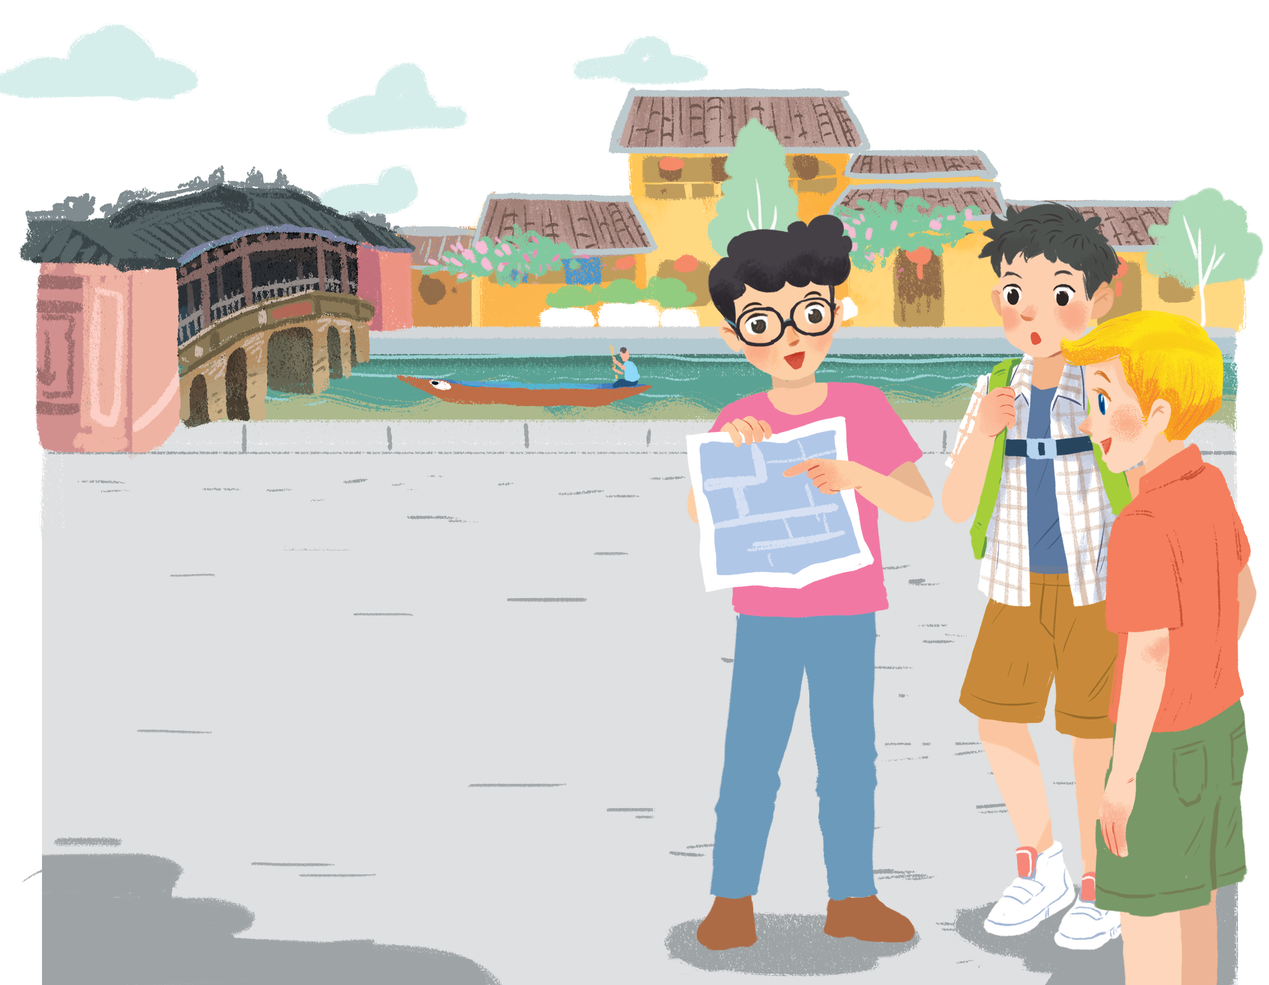
      UNIT 4: MY NEIGHBOURHOOD
      LESSON 2: A CLOSER LOOK 1
English 6

Slide 2


Vocabulary
1
Match the places below with the pictures. Then listen, check and repeat the words.
2
Work in pairs. Ask and answer questions about where you live.
3
Work in groups. Ask and answer about your neighbourhood. You can use the adjectives below.
Pronunciation
/ɪ/ and /i:/
4
Listen and repeat the words. Pay attention to the sounds
/ɪ/ and /i:/
5
Listen and practise the chant. Notice the sounds /ɪ/ and /i:/.

Slide 3


J
U
M
B
L
E
Places
PLAY

Slide 4
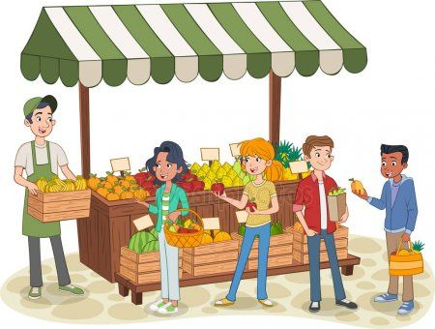
Hint
M
A
R
K
E
T
NEXT
T
A
K
M
R
E

Slide 5

Hint
S
C
H
O
O
L
NEXT
O
S
L
H
O
C

Slide 6
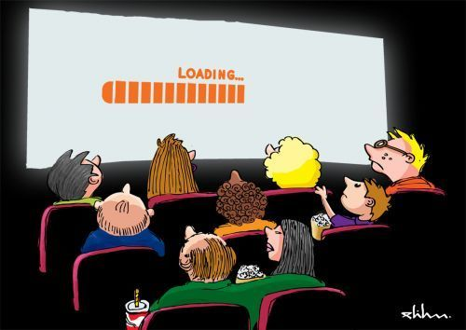
Hint
C
I
N
E
M
A
NEXT
A
I
E
N
C
M

Slide 7

Hint
B
A
N
K
NEXT
K
N
A
B

Slide 8

Hint
C
I
N
E
M
A
NEXT
A
I
E
N
C
M

Slide 9

Hint
T
E
M
P
L
E
NEXT
P
E
T
M
L
E

Slide 10
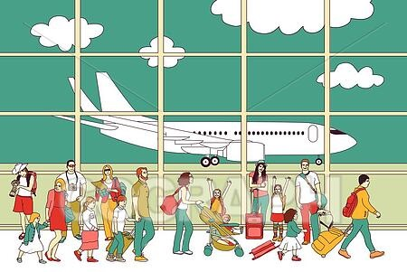
Hint
A
I
R
P
O
R
T
NEXT
A
R
P
R
O
I
T

Slide 11

Hint
H
O
S
P
I
T
A
L
H
S
NEXT
A
P
O
I
L
T

Slide 12

Hint
B
O
O
K
S
T
O
R
E
NEXT
R
T
O
B
O
E
K
O
S

Slide 13
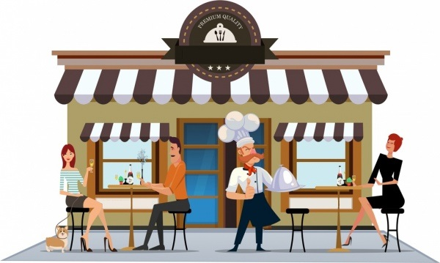
Hint
R
E
S
T
A
U
R
A
N
T
NEXT
A
R
N
U
A
S
T
E
T
R

Slide 14
Vocabulary

Slide 15


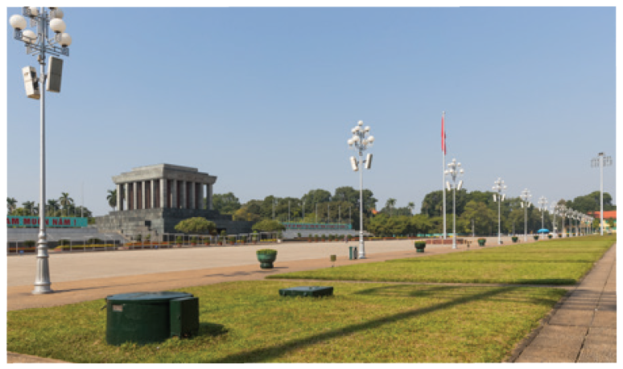
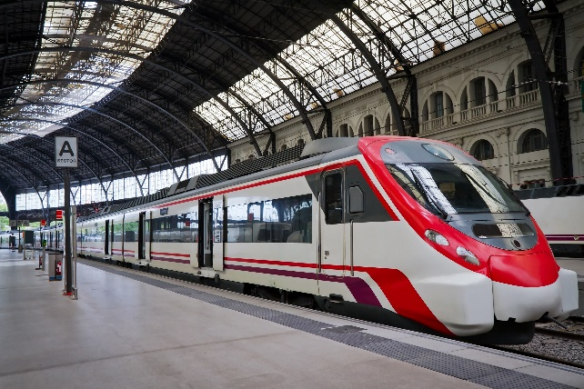
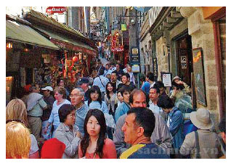
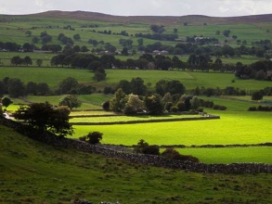
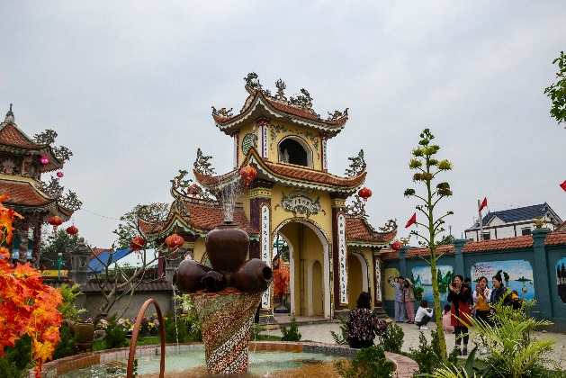
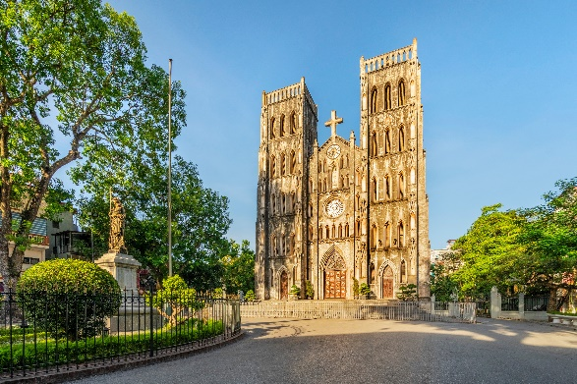
U4 L2
Vocabulary
square (n)
quảng trường
ca‘thedral (n)
thánh đường
‘railway sta‘tion (n)
nhà ga xe lửa
‘temple (n)
ngôi đền
‘crowded (adj)
đông đúc
‘peaceful (adj
thanh bình
‘modern (adj)
hiện đại
‘interesting (adj)
thú vị

Slide 16
MATCHING
square (n)
nhà ga xe lửa
cathedral (n)
thanh bình
railway station (n)
quảng trường
temple (n)
hiện đại
crowded (adj)
thánh đường
peaceful (adj
đông đúc
modern (adj)
ngôi đền
interesting(adj)
thú vị

Slide 17

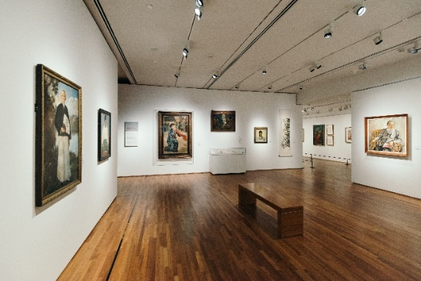
Match the places below with the pictures. Then listen, check and repeat the words.
1
a
b
b
a
1. square
2. art gallery
3. catherdral
4. temple
4. temple
4. temple
5. railway station
5. railway station
5. railway station
c
d
e
1. square
3. catherdral
2. art gallery
Name some other places in your neighbourhood.

Slide 18
2
Work in pairs. Ask and answer questions about where you live.
Example:
A: Is there a square in your neighbourhood?
B: Yes, there is. / No, these isn’t.

Slide 19
3
Work in groups. Ask and answer about your neighbourhood. You can use the adjectives below.
noisy
busy
modern
peaceful
quiet
crowded
boring
beautiful
Example:
A: Is your neighbourhood quiet?
B: Yes, it is. / No, it’s noisy.

Slide 20
Pronunciation
/ɪ/ and /i:/

Slide 21
4
Listen and repeat the words. Pay attention to the sounds /ɪ/ and /i:/.
noisy
cheap
peaceful
expensive
noisy
cheap
peaceful
expensive
clean
exciting
friendly
convenient
clean
exciting
friendly
convenient
Now, in pairs put the words in the correct column.
/ɪ/ | /i:/
noisy
convenient
expensive
cheap
exciting
peaceful
friendly
clean

Slide 22

GAME

Slide 23

He took a chilly dip six feet deep in the sea.
He says it keeps him fit.
2. He thinks he's slick in his sleek wheels meeting and greeting the elite.

Slide 24
5
Listen and practise the chant. Notice the sounds /ɪ/ and /i:/.
MY NEIGHBOURHOOD
My city is very noisy.
There are lots of trees growing. The people here are busy.
It’s a lively place to live in.
My village is very pretty.
There are lots of places to see.
The people here are friendly.
It’s a fantastic place to be.

Slide 25

Homework
  Learn vocabulary and the structure by heart.
  Do exercise in your work book
  Prepare the next lesson: A closer look 2

