Slide 1
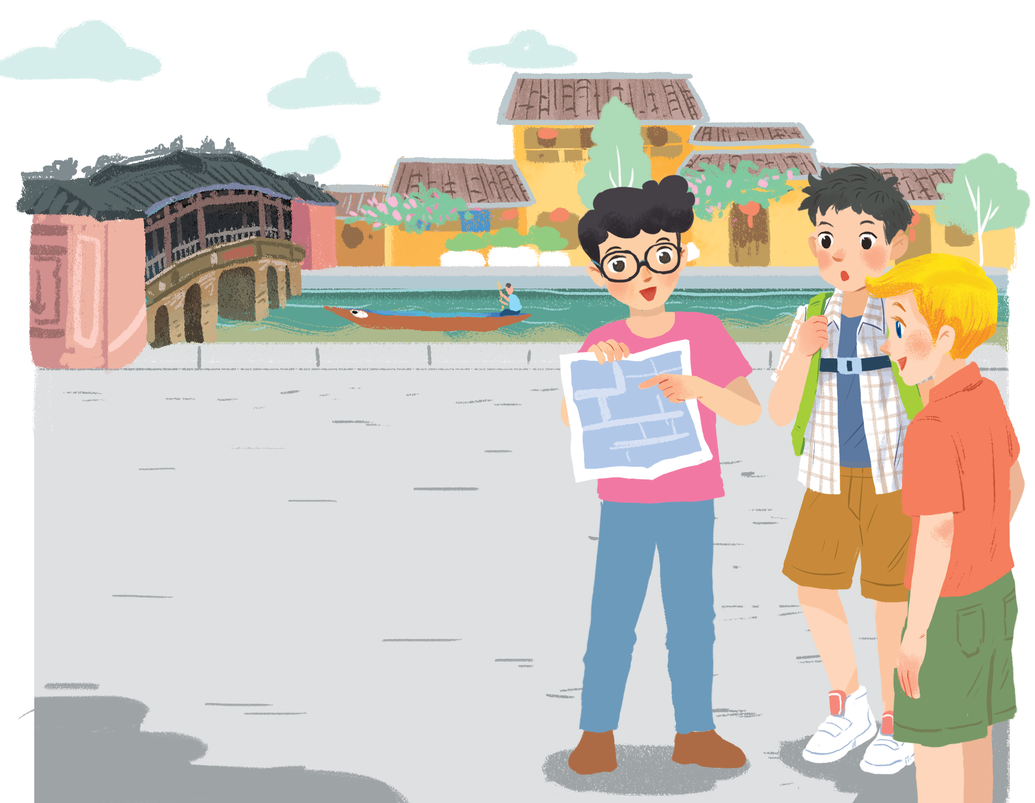
      UNIT 4: MY NEIGHBOURHOOD
      LESSON 1: GETTING STARTED
English 6

Slide 2



Lost in the old town!
1
Listen and read.
2
Find in the conversation the sentences used to make suggestions.
3
Read the conversation again. Put the actions in order.
4
Find and underline the following directions in the conversation.
5
Find places
Work in pairs. Give your partner directions to one of the places on the map, and he / she tries to guess. Then swap.

Slide 3



Slide 4












R 3
P
H
K
L
__ ersonality
__ ard working
__ ind
__ oving
R 2
S
A
A
F
__ houlder
__ ctive
__ ppearance
__ unny
R1
__ lim
__ aring
__ riendly
__ areful
S
C
F
C
S
S
L
K
H
A
F
A
C
F
C
P

Slide 5

1
Listen and read.
Lost in the old town!
What are Nick, Phong and Khang doing?
What might be happening to them
Have you ever got lost?
Where and when?
How did you feel then?
What did you do?
Notes:
Thiếu tên bài đọc.

Slide 6

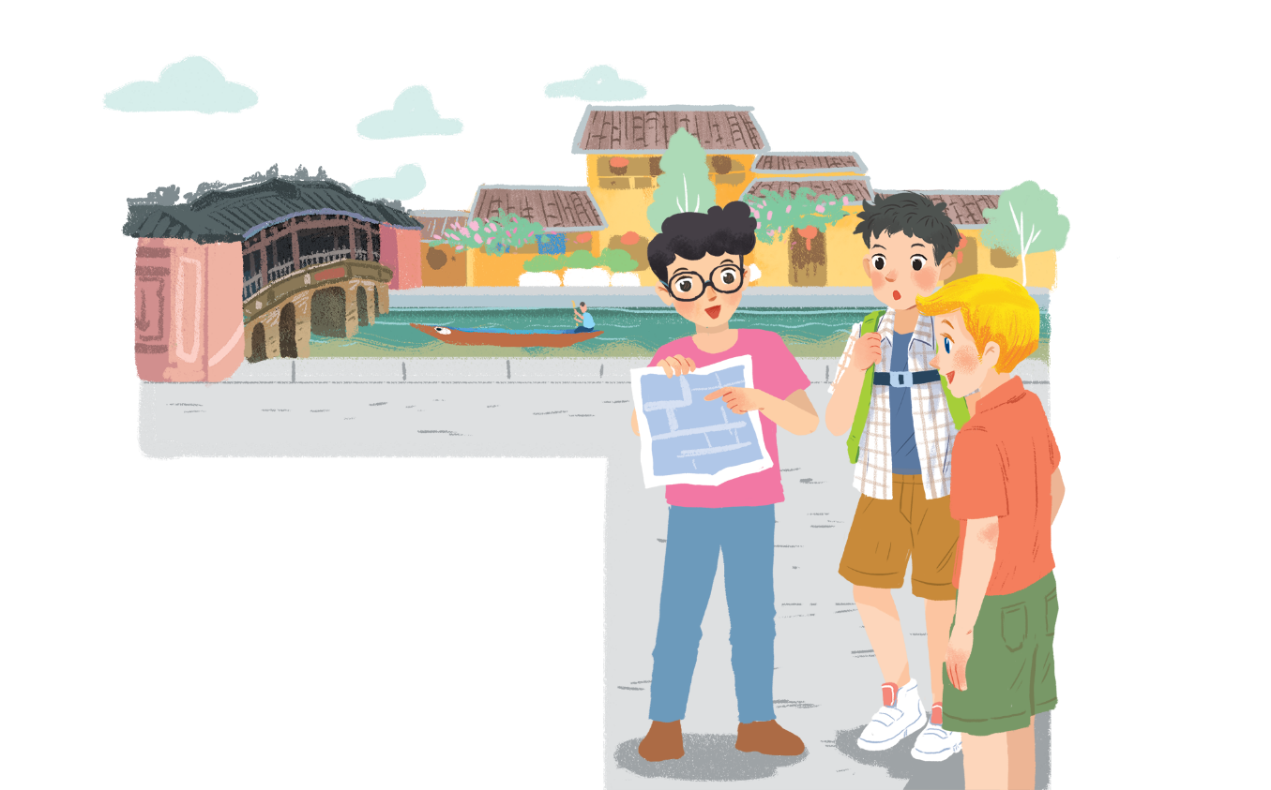
Lost in the old town!
Phong: Wow! We’re in Hoi An. I’m so excited.
Nick: Me too. It’s so beautiful. Where shall we go first?
Khang: Let’s go to Chua Cau.
Phong: Well, but Tan Ky house is nearer. Shall we go there first?
Nick & Khang: OK, sure.
Phong: First, cross the road, and then turn left.
Nick: Fine, let’s go.
Phong: Wait.
Khang: What’s up, Phong?
Phong: I think we’re lost.
Nick: Look, there’s a girl. Let’s ask her.
They have arrived in Hoi An and they've got lost on their way to Tan Ky House
Phong: Excuse me? Can you tell us the way to Tan Ky House?
Girl: Sure. Go straight. Take the second turning on the left, and then turn right.
Phong, Nick & Khang: Thank you.

Slide 7

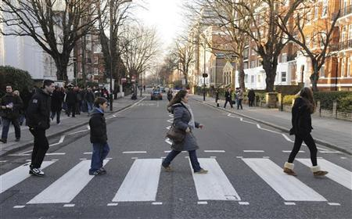



U4 L1
Vocabulary
cross the road
băng qua đường
turn right / left
rẽ phải / trái
go / keep straight
đi thẳng
‘neighbourhood (n)
vùng lân cận
to be/get lost
bị lạc

Slide 8
Rub out and remember
cross the road
băng qua đường
turn right / left
rẽ phải / trái
go / keep straight
đi thẳng
neighbourhood (n)
vùng lân cận
to be/get lost
bị lạc

Slide 9
Structure
Phong: Wow! We’re in Hoi An. I’m so excited.
Nick: Me too. It’s so beautiful. Where shall we go first?
Khang: Let’s go to Chua Cau.
Phong: Well, but Tan Ky house is nearer. Shall we go there first?
Nick & Khang: OK, sure.
Phong: First, cross the road, and then turn left.
Nick: Fine, let’s go.
Phong: Wait.
Khang: What’s up, Phong?
Phong: I think we’re lost.
Nick: Look, there’s a girl. Let’s ask her.
Phong: Excuse me? Can you tell us the way to Tan Ky House?
Girl: Sure. Go straight. Take the second turning on the left, and then turn right.
Phong, Nick & Khang: Thank you.

Slide 10
2
Find in the conversation the sentences used to make suggestions.
Example:
Let’s go to Chua Cau.

Slide 11
Lost in the old town!
Phong: Wow! We’re in Hoi An. I’m so excited.
Nick: Me too. It’s so beautiful. Where shall we go first?
Khang: Let’s go to Chua Cau.
Phong: Well, but Tan Ky house is nearer. Shall we go there first?
Nick & Khang: OK, sure.
Phong: First, cross the road, and then turn left.
Nick: Fine, let’s go.
Phong: Wait.
Khang: What’s up, Phong?
Phong: I think we’re lost.
Nick: Look, there’s a girl. Let’s ask her.
Phong: Excuse me? Can you tell us the way to Tan Ky House?
Girl: Sure. Go straight. Take the second turning on the left, and then turn right.
Phong, Nick & Khang: Thank you.

Slide 12

2
Find in the conversation the sentences used to make suggestions.
Example:
Let’s go to Chua Cau.
We can use shall we and let’s to make suggestions.

Slide 13
3
Read the conversation again.
Put the actions in order.
a.
The girl shows them the way to Tan Ky House.
5
b.
Nick, Khang and Phong arrive in Hoi An.
1
c.
Nick, Khang and Phong decide to go to Tan Ky House.
2
d.
Nick, Khang and Phong get lost.
3
e.
Phong asks a girl how to get to Tan Ky House.
4

Slide 14
4
Find and underline the following directions in the conversation.
turn right
turn left
take the second turning on the left
A.
C.
E.
B.
cross the road
D.
go straight
Can you tell me the way to the post office near here?

Slide 15

Lost in the old town!
Phong: Wow! We’re in Hoi An. I’m so excited.
Nick: Me too. It’s so beautiful. Where shall we go first?
Khang: Let’s go to Chua Cau.
Phong: Well, but Tan Ky house is nearer. Shall we go there first?
Nick & Khang: OK, sure.
Phong: First, cross the road, and then turn left.
Nick: Fine, let’s go.
Phong: Wait.
Khang: What’s up, Phong?
Phong: I think we’re lost.
Nick: Look, there’s a girl. Let’s ask her.
Phong: Excuse me? Can you tell us the way to Tan Ky House?
Girl: Sure. Go straight. Take the second turning on the left, and then turn right.
Phong, Nick & Khang: Thank you.

Slide 16
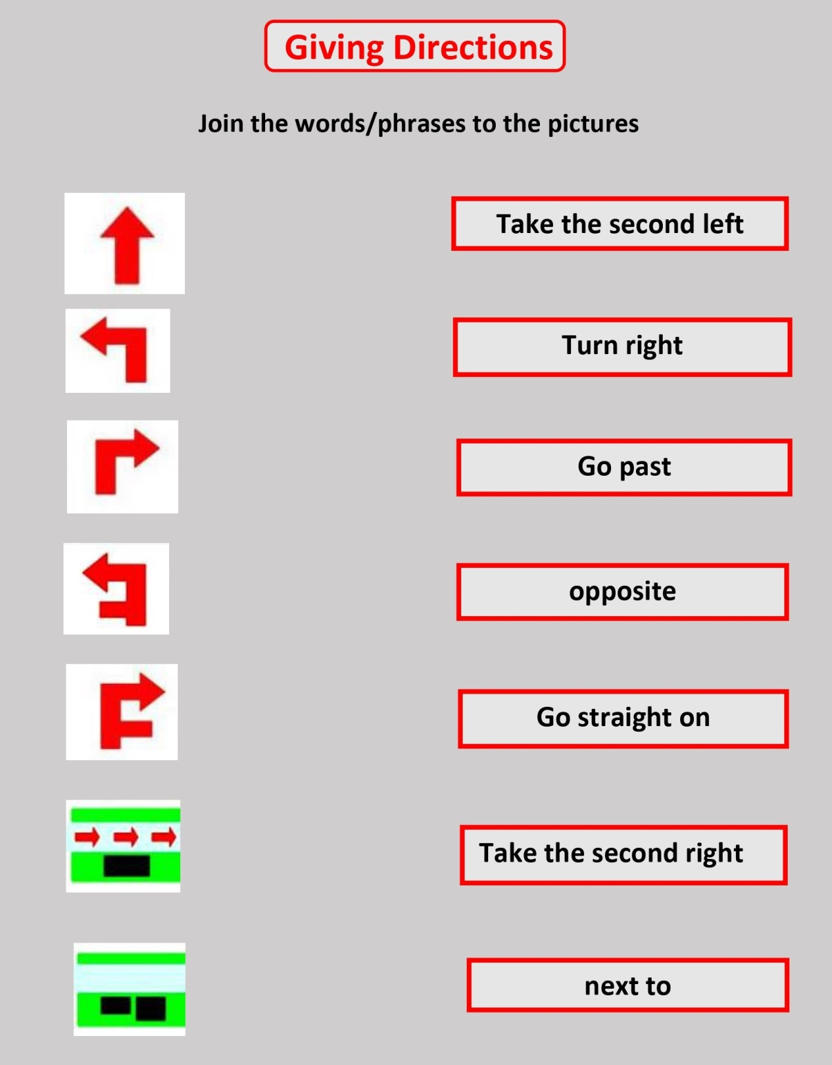
rẽ trái ở ngã thứ hai
rẽ phải
đi qua
đối diện
đi thẳng
rẽ phải ở ngã thứ hai
bên cạnh

Slide 17


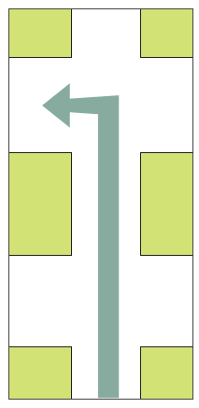


Now match these directions with the diagrams below.
1
2
3
cross the road
turn right
5
take the second turning on the left
4
turn left
go straight
A.
turn right
C.
turn left
E.
take the second turning on the left
B.
cross the road
D.
go straight

Slide 18
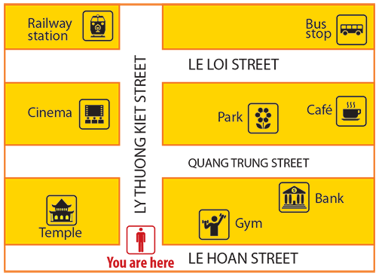
5
Find places
Work in pairs. Give your partner directions to one of the places on the map, and he / she tries to guess. Then swap.
Example:
A: Go straight. Take the second turning on the left. It’s on your right.
B: Is that the gym?
A: No, try again.

Slide 20



?

Slide 21
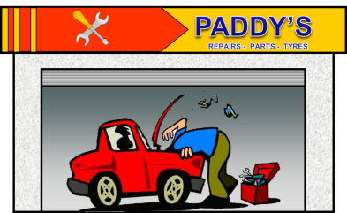
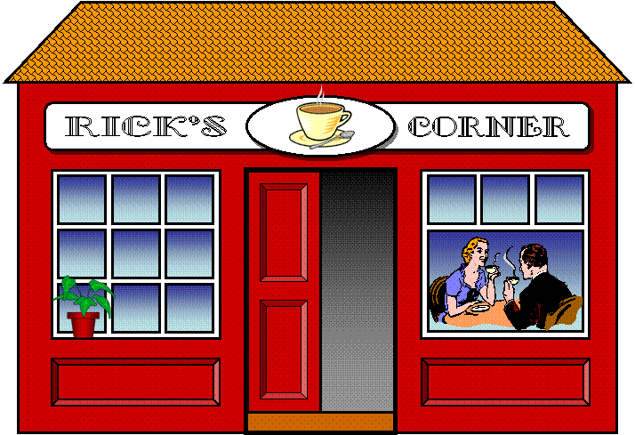
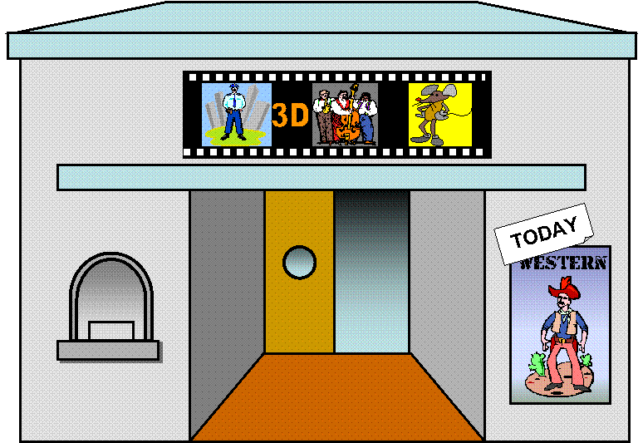
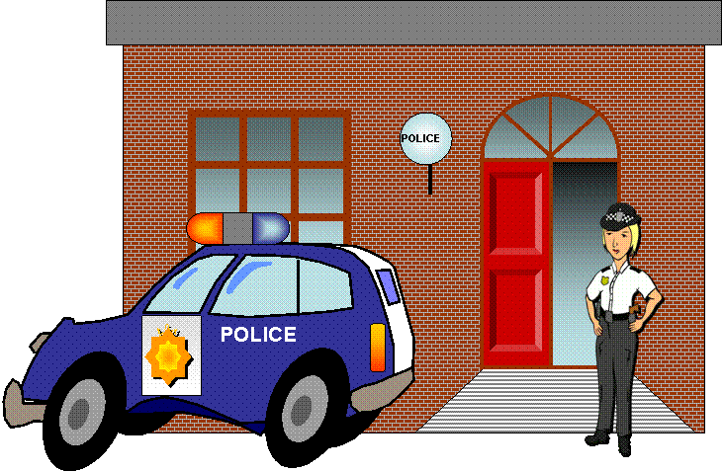

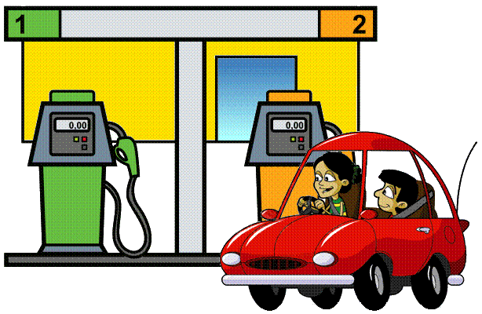




How do I get to the police station?

Slide 22


1. Go two blocks
2. Turn on the right
3. Go one block
4. It’s on the left

Slide 23

How do I get to the hospital?
Park Avenue
Oak Street

Slide 24
1. Go to the corner
2. Turn right
3. Go straight on
4. It’s at the corner of Park Ave. and Oak St.
Park Avenue
Oak Street

Slide 25
How do I get to the stadium?
Park Avenue
Oak Street

Slide 26
1. Go to the corner
2. Turn right
3. Go two blocks
4. It’s on the right opposite the gas station
Park Avenue
Oak Street

Slide 27
How do I get to the garage?
Park Avenue
Oak Street

Slide 28
1. Go two blocks
2. Turn left
4. It’s on the right across from the park
Park Avenue
Oak Street

Slide 29
THANK YOU FOR YOUR HELP!
YOU’RE WELCOME!

Slide 30
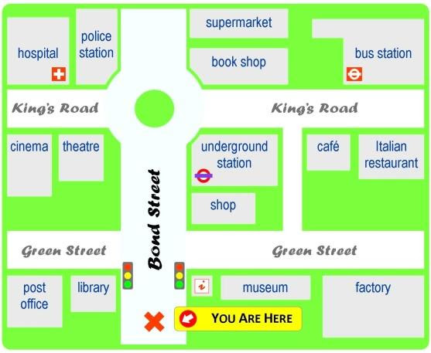

Slide 31

Homework
  Learn vocabulary and the structure by heart.
  Do exercise in your work book
  Prepare the next lesson: A closer look 1

