Slide 1
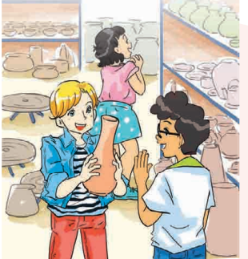
ENGLISH 9
UNIT 1: LOCAL ENVIRONEMNT
LESSON 2:
A CLOSER LOOK 1

Slide 2
WARM UP
https://quizizz.com/admin/quiz/613960b37636e0001df882d9/startV4
conical hats
pottery
handicrafts
lacquerware
paintings
silk
marble sculpture

Slide 3
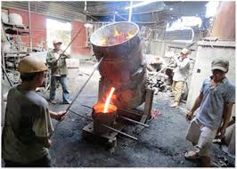
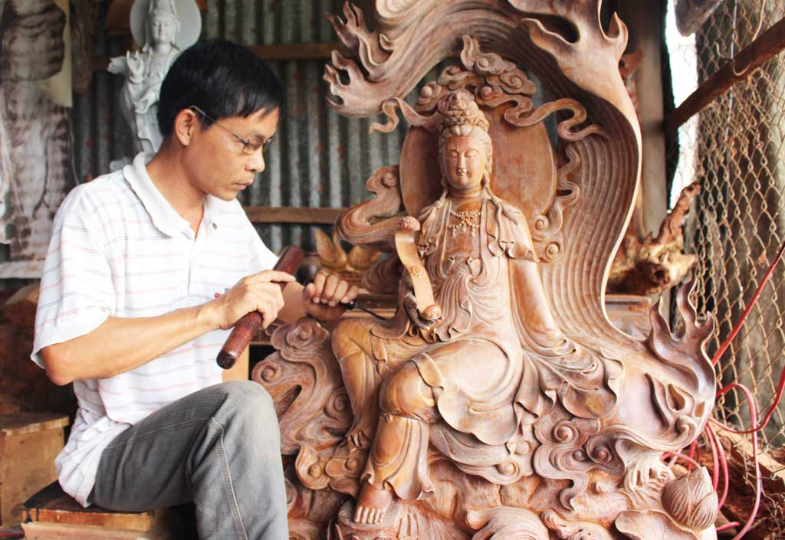
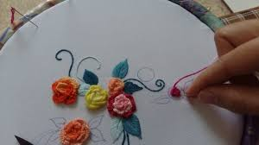
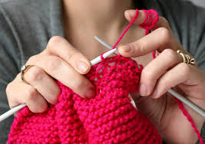
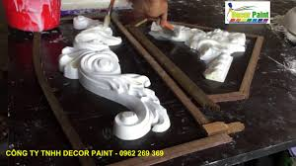
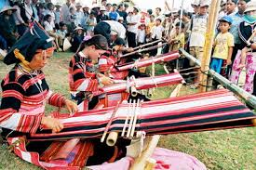
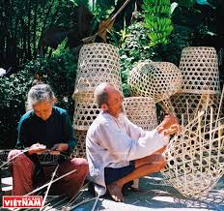
VOCABULARY
- carve [ kɑːv] (v): chạm, khắc
- cast [kɑːst] (v): đúc
- embroider [ɪmˈbroɪdə] (v): thêu
- weave [wiːv] (v): đan (rổ, rá) dệt (vải)
- knit [nɪt] (v): đan len
- mould [məʊld] (v): đổ khuôn

Slide 4
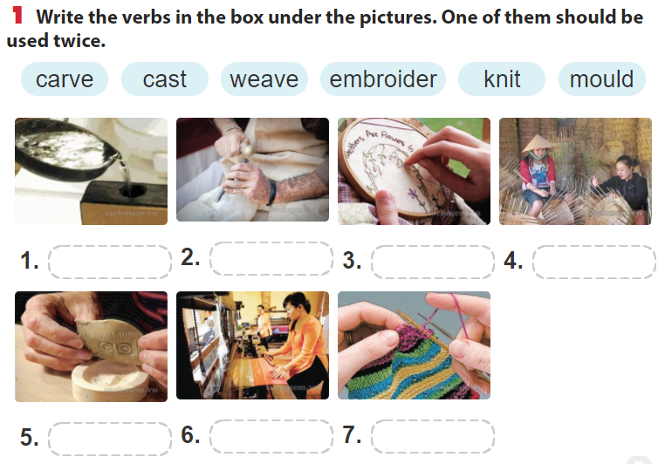
VOCABULARY
A
cast
B
carve
C
embroider
D
weave
E
mould
F
weave
G
knit

Slide 5
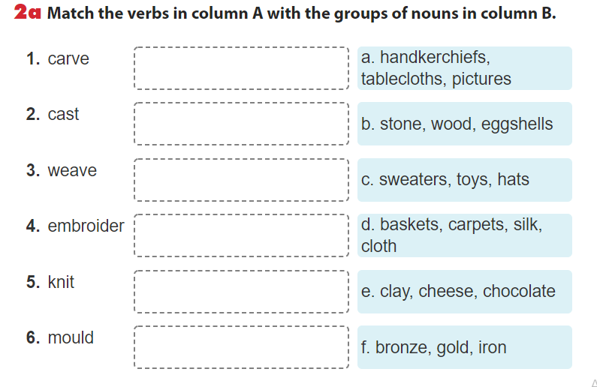






VOCABULARY

Slide 6
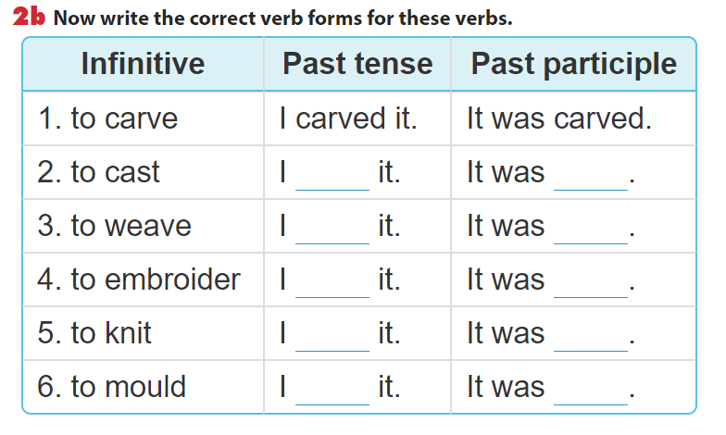
VOCABULARY
cast
cast
wove
woven
embroidered
embroidered
knitted
knitted
moulded
moulded

Slide 7
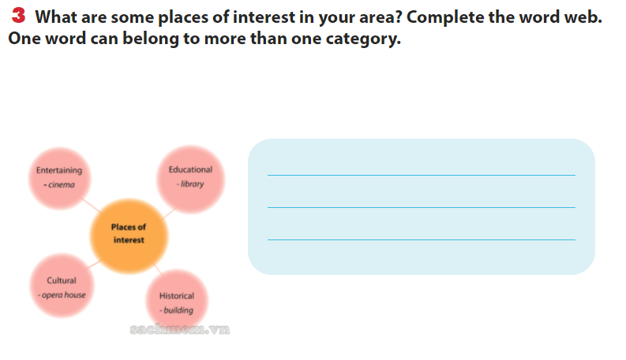
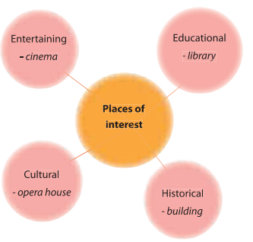
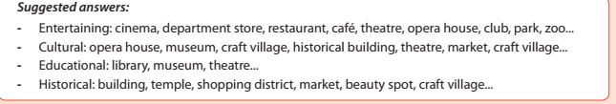
VOCABULARY

Slide 8
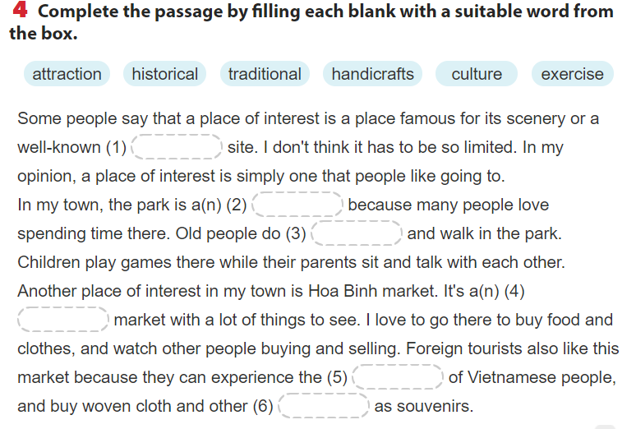
VOCABULARY
historical
attraction
exercise
traditional
culture
handicraft

Slide 9
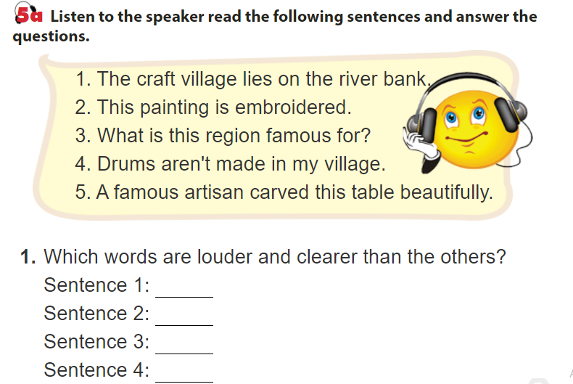

PRONUNCIATION
Craft, village, lines, river, bank
Painting, embroidered
What, region, famous
Drums, aren’t, made, village
Famous, artisan, carved, table, beautifully

Slide 10
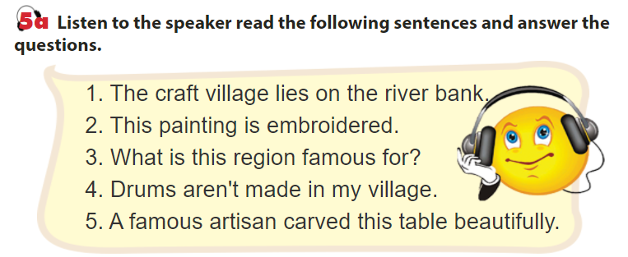
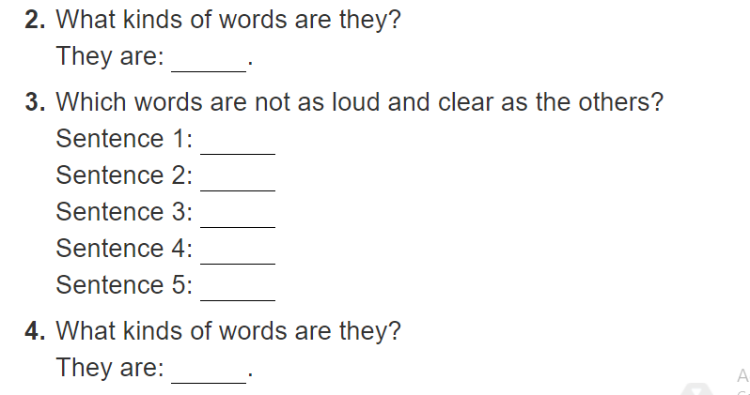

PRONUNCIATION
N, V, Adj, Adv, WH-words, negative auxilary
Aaricles, pre., pronouns, Possessive adjs

Slide 11
PRONUNCIATION
Stressed words
Unrtressed words
main verbs, nouns; adjectives, adverbs; wh-question words;
negative auxiliaries (e.g. don’t).
pronouns, prepositions, articles, conjunctions, possessive adjectives, be (even if it is a main verb in the sentence), and auxiliary verbs are normally unstressed.
https://www.sachmem.vn/trial/books/24/exercises/7659?type=student

Slide 12
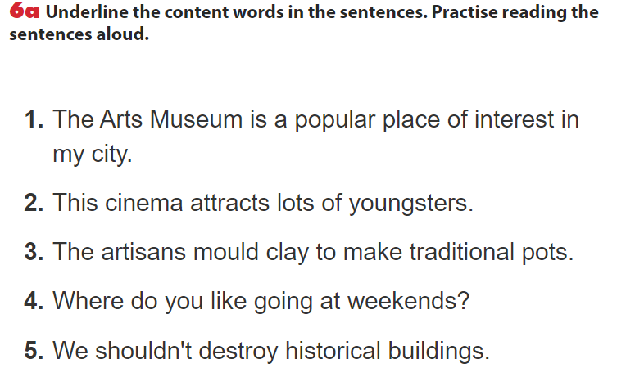
PRONUNCIATION

Slide 13
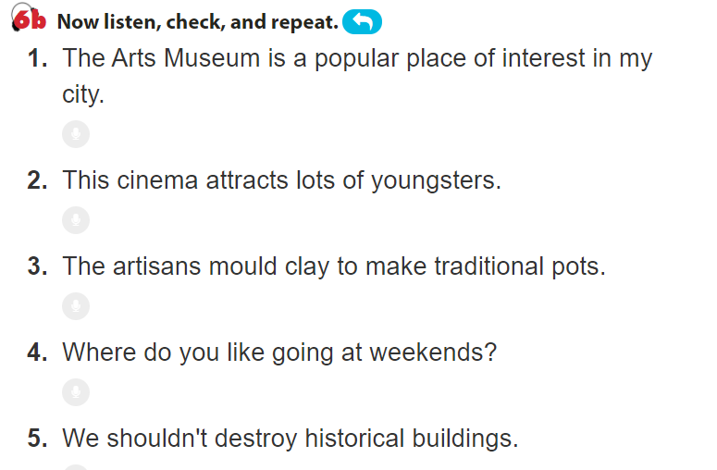
PRONUNCIATION

Slide 14
WRAP-UP
VOCABULRY
- Traditional crafts
- Places of interest
2. PRONUNICIATION
Stress on content words in a sentence
https://www.menti.com/tfart7cboh

Slide 15
Sum up: What have we learned today about vocabulary?
conical hat
pottery
Vocabulary
(review)
lacquerware
paintings
marble sculpture
silk

Slide 16
Sum up: What have we learned today about vocabulary?
carve
knit
6 New words
weave
embroider
mould
cast

Slide 17
Sum up: What about pronunciation?
main verbs
(lies/made)
Nouns
(village)
stressed words
Adv
(beautifully)
Adj
(famous)
wh-question words
(what/where)
negative auxiliaries
(don’t/ isn’t)

Slide 18
Sum up: Pronunciation?
Pronouns
(We/this)
Prepositions
(in/on)
Unstressed
words
Articles
(a/an/the)
Conjunctions
(because)
Be/auxiliaries
(is/was/does/did)
Possessive adjectives
(my/his)

Slide 19
HOMEWORK
- Do exercises looking back 1,2,3.
- Prepare: Complex sentences

Slide 20

Thank You!

