Slide 1
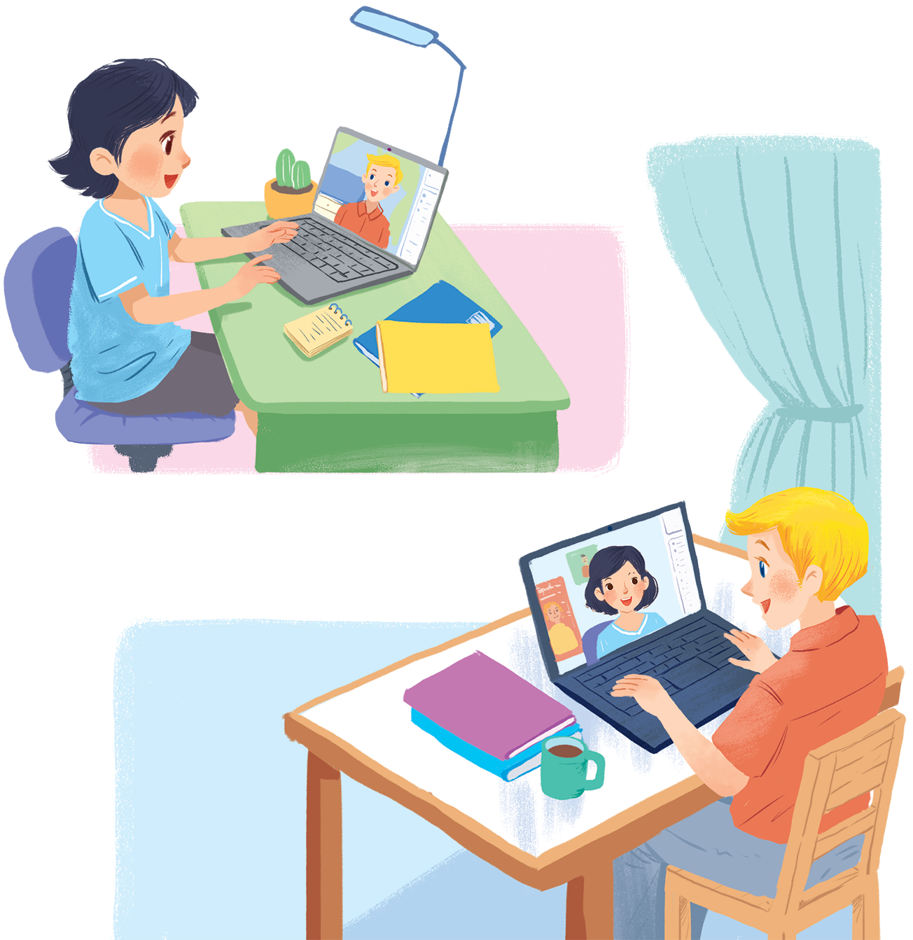
UNIT 2: MY HOUSE
LESSON 1: GETTING STARTED
English 6

Slide 2


A look inside
1
Listen and read.
2
Which family members does Mi talk about? Put a tick ().
3
Read the conversation again. Complete each sentence with ONE word.
Complete the word web. Use the words from the conversation and the ones you know.
4
5
Work in groups. Ask your friends where they live. Then report their answers.

Slide 3




Slide 4
Instructions:
For each right answer, the team will get 1 point and 1 secret letter to help them find out the hidden word today.
There is one picture including two secret words. The team gets this picture will get 2 points.
The team which has more points or can guess the hidden word first will be the winner

Slide 5
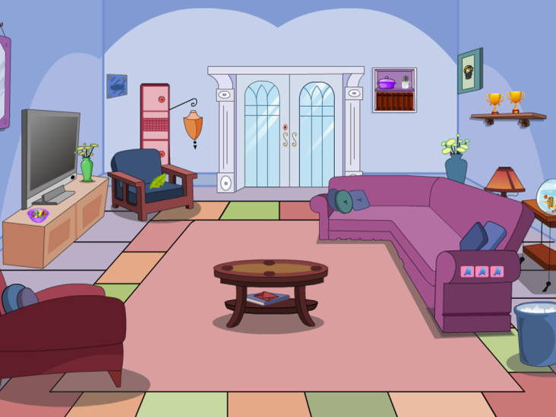

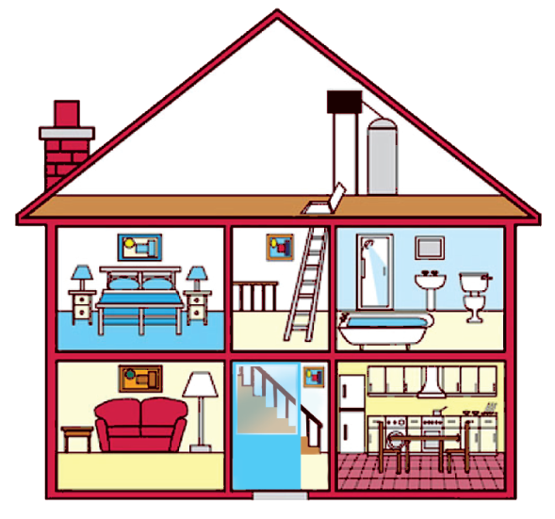
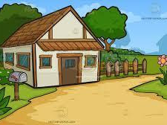
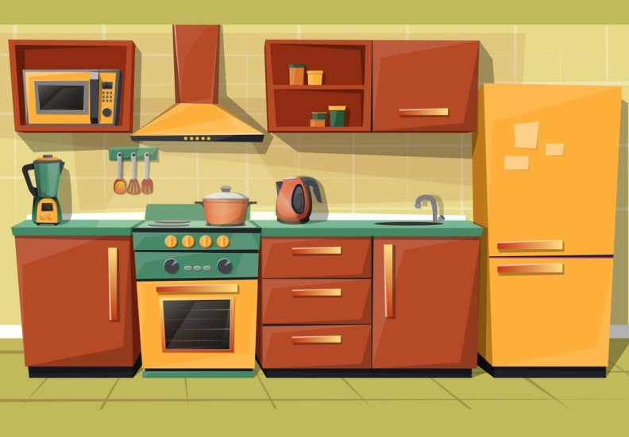
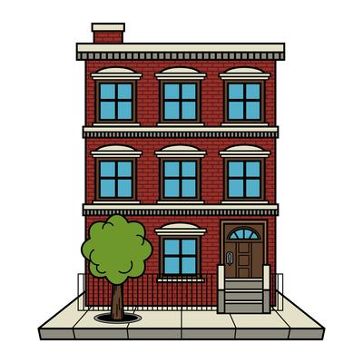
ROOM
M
TOWN
O
SIX
S
6
1
2
3
COUNTRY
U
Y
KITCHEN
H
APARTMENT
E
4
5
6
KEY
M
Y
H
O
U
S
E

Slide 6
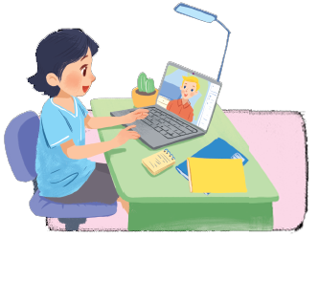
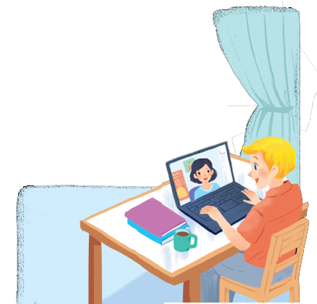
1
Listen and read.
A look inside
What are Nick and Mi doing?
What might they talk about?
Notes:
Thiếu tên bài đọc.

Slide 7

A look inside
Mi: Wow! Your room looks so big, Nick.
Nick: It’s Elena’s room. she’s my sister.
Mi: I see. Is there a TV behind you?
Nick: Yes, there is. Where do you live, Mi?
Mi: I live in a town house. And you?
Nick: I live in a country house. Who do you live with?
Mi: My parents and younger brother. We’re moving to a ﬂat next month!
Nick: Are you?
Mi: Yes. My aunt lives near there, and I can play with my cousin.
Nick: Are there many rooms in your new ﬂat?
Mi: Yes, there are. There’s a living room, three bedrooms, a kitchen and two bathrooms.
They are talking about their house.
Mi shares that her family is moving to a new flat and she briefly describes her new flat.

Slide 8


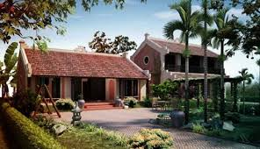
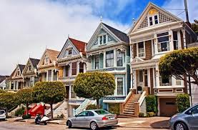
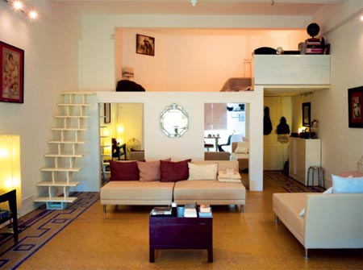
U2 L1
Vocabulary
flat (n)
căn hộ
‘country house (phr. n)
nhà ở quê
town house (phr. n)
nhà ở phố
be‘hind (prep)
ở đằng sau
‘cousin (n)
anh,chị ,em họ
move (v)
di chuyển

Slide 9
MATCHING
1. flat
a. đằng sau
2. country house
b. nhà ở phố
3. town house
c. nhà ở quê
4. behind
d. di chuyển
5. cousin
e. anh,chị ,em họ
6. move
f. căn hộ

Slide 10
Structure
Mi: Wow! Your room looks so big, Nick.
Nick: It’s Elena’s room. she’s my sister.
Mi: I see. Is there a TV behind you?
Nick: Yes, there is. Where do you live, Mi?
Mi: I live in a town house. And you?
Nick: I live in a country house. Who do you live with?
Mi: My parents and younger brother. We’re moving to a ﬂat next month!
Nick: Are you?
Mi: Yes. My aunt lives near there, and I can play with my cousin.
Nick: Are there many rooms in your new ﬂat?
Mi: Yes, there are. There’s a living room, three bedrooms, a kitchen and two bathrooms.
They are talking about their house.
Mi shares that her family is moving to a new flat and she briefly describes her new flat.

Slide 11
2
Which family members does Mi talk about?
Put a tick ().

1. | parents
2. | sister
3. | brother
4. | aunt
5. | cousin




Slide 12
Read the conversation again. Complete each sentence with ONE word.
3
1.
Elena is Nick’s .
sister
2.
TV
There is a in Elena’s room.
3.
Now Mi lives in a house.
town
country
4.
Nick lives in a house.
5.
Mi’s new flat has bedrooms.
three

Slide 13
4
Complete the word web. Use the words from the conversation and the ones you know.
TYPES OF
villa
town house
cottage
country house
flat
farm house
stilt house

Slide 14
5
Work in groups. Ask your friends where they live. Then report their answers.
A: Where do you live?
B: I live in a flat.
In my group, Lan and Nam live in flats. Ngoc lives in a country house.

Slide 15

Homework
Learn vocabulary by heart.
Do Exercise B5 (page 11) - Workbook.
Prepare the next lesson: A closer look 1

