Slide 1
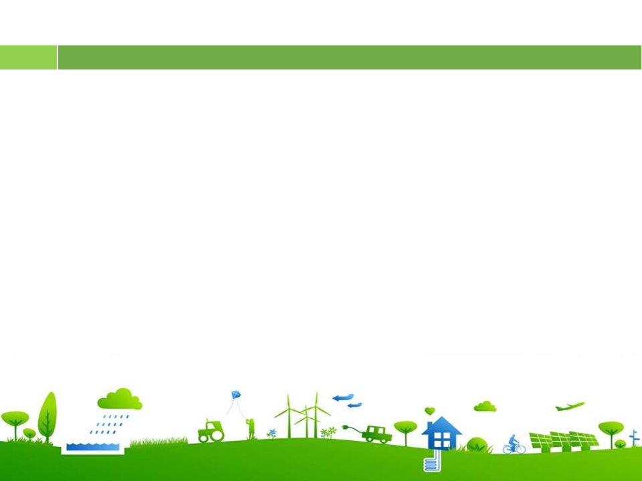

Slide 2
recycle
If we (recycle)………………more, we will help the Earth.

Slide 3
Factories (not dump) ………………………waste into rivers if the government fines them heavily.
won’t dump

Slide 4
If people travel to work by bus, there (be) ………………fewer car fumes.
will be

Slide 5
UNIT 7. POLLUTION Period 57. Lesson 3. A closer look 2

Slide 6
I. REVIEW: CONDITIONAL SENTENCES TYPE 1
1. Usages:
-The conditional sentences type 1 refers to a possible condition and its probable result in the present or future.
2. Structure:
If we recycle more, we will help the Earth.
If-clause | Main clause
If + S + V (present simple) | S + will/can/may + V

Slide 7
Combine each pair of sentences to make a conditional sentence type 1
1. Students are more aware of protecting the environment. Teachers teach environmental issues at school.
Students will be more aware of protecting the environment if teachers teach environmental issues at school.
2. Light pollution happens. Animals change their behavior patterns.
3. The levels of radioactive pollution decrease. We switch from nuclear power to renewable energy sources.
4. The water temperature increases. Some aquatic creatures are unable to reproduce.
5. People get more diseases. The water is contaminated.

Slide 8
Combine each pair of sentences to make a conditional sentence type 1
1. Students will be more aware of protecting the environment if teachers teaches environmental issues at school.
2. If light pollution happens, animals will change their behavior patterns.
3. The levels of radioactive pollution will decrease if we switch from nuclear power to renewable energy sources.
4. If the water temperature increases, some aquatic creatures will be unable to reproduce.
5. People will get more diseases if the water is contaminated.

Slide 9
II. CONDITIONAL SENTENCES TYPE 2
1. Usages:
-The conditional sentences type 2 describes an unlikely condition in present and its probable result.
2. Structure:
If the water wasn’t polluted, the fish wouldn’t die.
If-clause | Main clause
If + S + V (past simple) | S + would/could/might + V

Slide 10
Matching
A |  | B
1. If I were you, |  | a. What would happen?
2. If Lan wasn’t ill, |  | b. I’d look for a new place to live.
3. If there were fewer cars on the roads, |  | c. She would join our tree planting activity.
4. If people really cared about the environment, |  | d. There would be less pollution.
5. If there was no fresh water in the world, |  | e. They wouldn’t dump waste into the lake.

Slide 11


Lucky box
1
2
3
4
5
6
7
8

Slide 12
1. If you (be) …………… the president, what (you/ do) …………………… to help the environment?
were
would you do

Slide 13
2. They get sick so often. If they (exercise) ……………….more, they (be) ……………….. healthier.
exercised
would be

Slide 14
had
3. If I (have) …………one million US dollars, I (build) ……………….. more parks in our city.
would build

Slide 15
4. Ngoc’s mother is unhappy. If Ngoc (tidy) …………….. her room every day, her mother (not be) ……………………so upset.
tidied
wouldn’t be

Slide 16
5. There isn’t a garden at our house. If there (be) …………, we (grow) …………………… vegetables.
was
would grow

Slide 17

Congratulations!

Slide 18
Combine each pair of sentences to make a conditional sentence type 2
Example: People throw rubbish in the street. The street doesn’t look attractive.
→ If people didn’t throw rubbish in the street, it would look attractive.
1.There are so many billboards in our city. People cannot enjoy the view.
2.There is so much light in the city at night. We cannot see the stars clearly.
3.We turn on the heater all the time. We have to pay three million dong for electricity a month.
4.The karaoke bar makes so much noise almost every night. The residents complain to its owner.
5.She has a headache after work every day. She works in a noisy office.

Slide 19
Combine each pair of sentences to make a conditional sentence type 2
1.There are so many billboards in our city. People cannot enjoy the view.
2.There is so much light in the city at night. We cannot see the stars clearly.
3.We turn on the heater all the time. We have to pay three million dong for electricity a month.
If there weren’t so many billboards in our city, people could enjoy the view.
If there wasn’t/weren’t so much light in the city at night, we could see the stars clearly.
If we didn’t turn on the heater all the time, we wouldn’t have to pay three million dong for electricity a month.

Slide 20
Combine each pair of sentences to make a conditional sentence type 2
4.The karaoke bar makes so much noise almost every night. The residents complain to its owner.
5.She has a headache after work every day. She works in a noisy office.
If The karaoke bar didn’t make so much noise almost every night, the residents wouldn’t complain to its owner.
She wouldn’t have a headache after work every day if she didn’t work in a noisy office.

