Slide 2

Today, we learn
Add a short description
01
start up
02
Vocabulary
Dance a song
03
Practice
04
summary
exercise
getting started

Slide 3
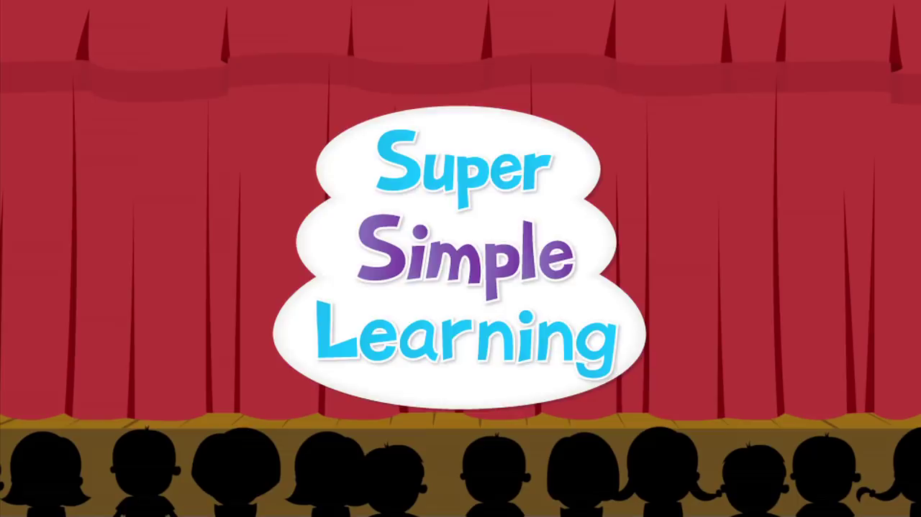
I, Start up

Slide 4
II, Vocabulary
1, head: đầu 14,lips: đôi môi
2, hair: tóc 15, elbow: khuỷu tay
3, nose: mũi 16, ears: tai
4, hand: bàn tay 17, toes: ngón chân
5, shoulder: vai 18, face: mặt
6, cheek: má
7, mouth: miệng
8, arm: cánh tay
9, leg: chân
10, foot: bàn chân
11, _tooth
_ teeth: răng
12, knee: đầu gối
13,finger: ngón tay:

Slide 5
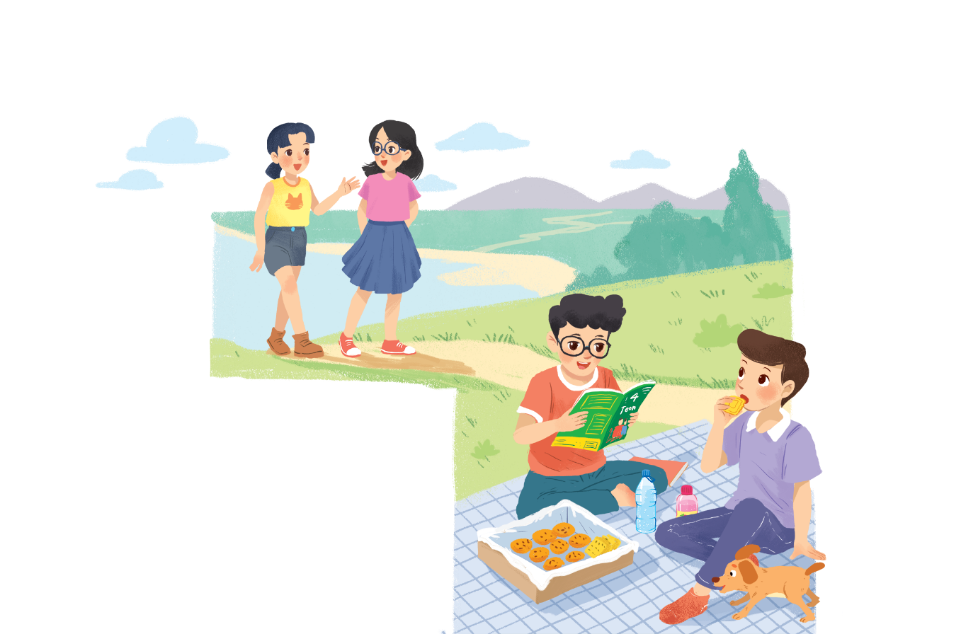
III, practice
Ex1, Listen and read.
A SURPRISE GUEST
Phong: That was a great idea, Nam.
I love picnics!
Nam: Please pass me the biscuits.
Phong: Sure. Here you are.
Nam: Thanks. What are you reading, Phong?
Phong: 4Teen. It’s my favourite magazine!
Nam: Look! It’s Mai. And she is with someone.
Phong: Oh, who’s that? She has glasses and long black hair.
Nam: I don’t know. They’re coming over.
Mai: Hi there. This is my friend Chau.
Phong & Nam: Hi, Chau. Nice to meet you.
Chau: Nice to meet you, too.
Nam: Would you like to sit down? We have lots of food.
Mai: Oh, sorry, we can’t. We’re going to the bookshop.
Chau: Bye for now.
Phong & Nam : Bye bye.

Slide 6
Ex2, Fill the blanks with the words from the conversation.
1, Phong and Nam are having a ________.
2, 4teen is Phong’s __________.
3, Phong and Nam see______and_______.
4, Chau has________and___________.
1, Phong and Nam are having a picnic.
2, 4teen is Phong’s favourite magazine.
3, Phong and Nam see Mai and Chau.
4, Chau has glasses and long black hair.

Slide 7
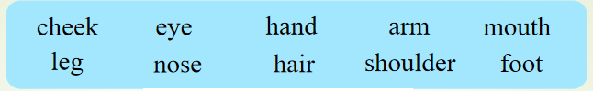
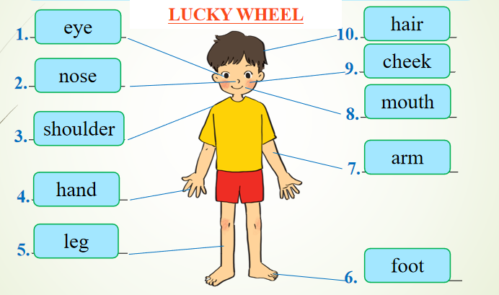
Ex3, Label the body parts with the words in the box.

Slide 8

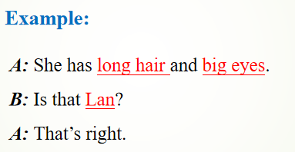
Work in groups. Take turns to describe a classmate. Other group members guess who he / she is.

Slide 9
IV, summary: play game
I came up with the vocabulary. Your job is to ask me many questions and guess the word in 1 minute
nose
head
mouth
arms
legs

Slide 10
Homeworks:
- Review knowledge
-Complete the workbook
-Prepare lesson ‘A closer look 1’

Slide 11


