Slide 1

UNIT 1: LOCAL ENVIRONMENT
A CLOSER LOOK 1

Slide 2

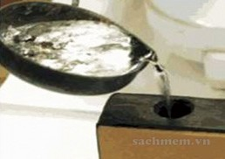
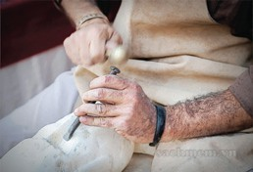
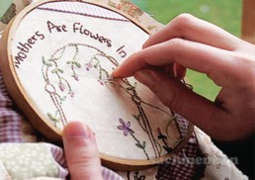
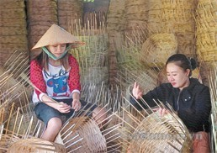
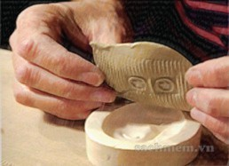
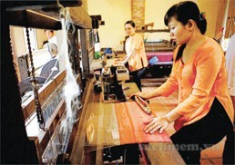
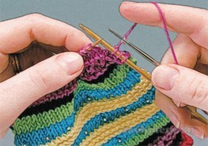
1. Write the verbs in the box under the pictures. ...
carve
cast
weave
embroider
knit
mould
cast
carve
embroider
weave
mould
weave
knit

Slide 3
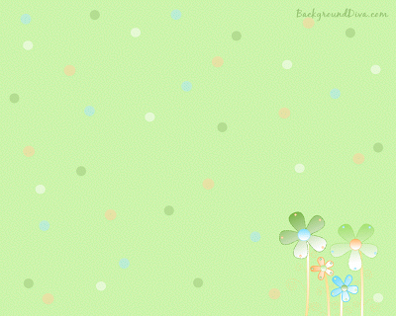
2a. Match the verbs in column A with ...
A | B
1. Carve
2. Cast
3. Weave
4. Embroider
5.Knit
6.Mould
b. stone, wood, eggshells
d. bronze, gold, iron
e. baskets, carpets, silk, cloth
a. handkerchiefs, tablecloths, pictures
f. sweaters, toys, hats
c. clay, cheese, chocolate

Slide 4

b. Now write the correct verb forms ...
Infinitive | Past tense | Past participle
1. to carve | I carved it. | It was carved.
2. to cast | I _________ it. | It was _________
3. to weave | I _________ it. | It was _________
4. to embroider | I __________ it. | It was _________
5. to knit | I _________ it. | It was _________
6. to mould | I _________ it. | It was _________
cast
cast
wove
woven
embroidered
embroidered
knitted
knitted
moulded
moulded

Slide 5
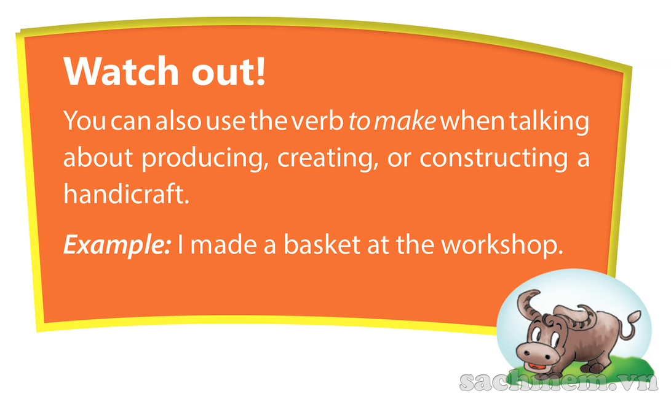

Slide 6

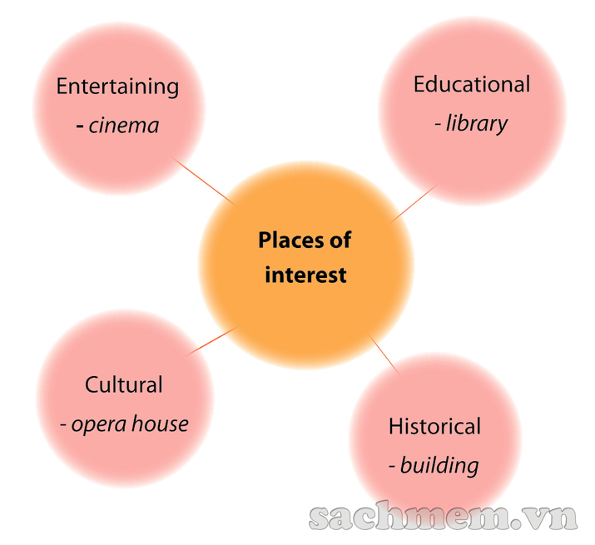
3. What are some places of interest in your area? …
- Entertaining: cinema, department store, restaurant, café, theatre, opera house, club, park, zoo...
- Cultural: opera house, museum, craft village, historical building, theatre, market, craft village...
- Educational: library, museum, theatre...
- Historical: building, temple, shopping district, market, beauty spot, craft village...

Slide 7

4. Complete the pasage by filling each blank …
Some people say that a place of interest is a place famous for its scenery or a well-known (1)________ site. I don’t think it has to be so limited. In my opinion, a place of interest is simply one that people like going to.
In my town, the park is a(n) (2)________ because many people love spending time there. Old people do (3)_______ and walk in the park. Children play games there while their parents sit and talk with each other. Another place of interest in my town is Hoa Binh market. It’s a(n) (4)________ market with a lot of things to see. I love to go there to buy food and clothes, and watch other people buying and selling. Foreign tourists also like this market because they can experience the (5)_________ of Vietnamese people, and buy woven cloth and other (6)___________ as souvenirs.
historical
attraction
exercise
traditional
culture
handicrafts

Slide 8

5a. Listen to the speaker read the following ...
1. The craft village lies on the river bank. 2. This painting is embroidered. 3. What is this region famous for? 4. Drums aren’t made in my village. 5. A famous artisan carved this table beautifully.

Slide 9

1.Which words are louder and clearer than the others?
Sentence 1: Sentence 2: Sentence 3: Sentence 4: Sentence 5:
craft, village, lies, river, bank
painting, embroidered.
what, region, famous.
drums, aren’t, made, village
famous, artisan, carved, table, beautifully.
2.What kinds of words are they?
They are:
nouns, verbs, adjectives, adverbs, wh-question words, and negative auxiliaries.
3.Which words are not as loud and clear as the others?
Sentence 1: Sentence 2: Sentence 3: Sentence 4: Sentence 5:
the, on, the
this, is
is, this, for
in, my
a, this
4.What kinds of words are they?
They are:
articles, prepositions, pronouns, and possessive adjectives.

Slide 10
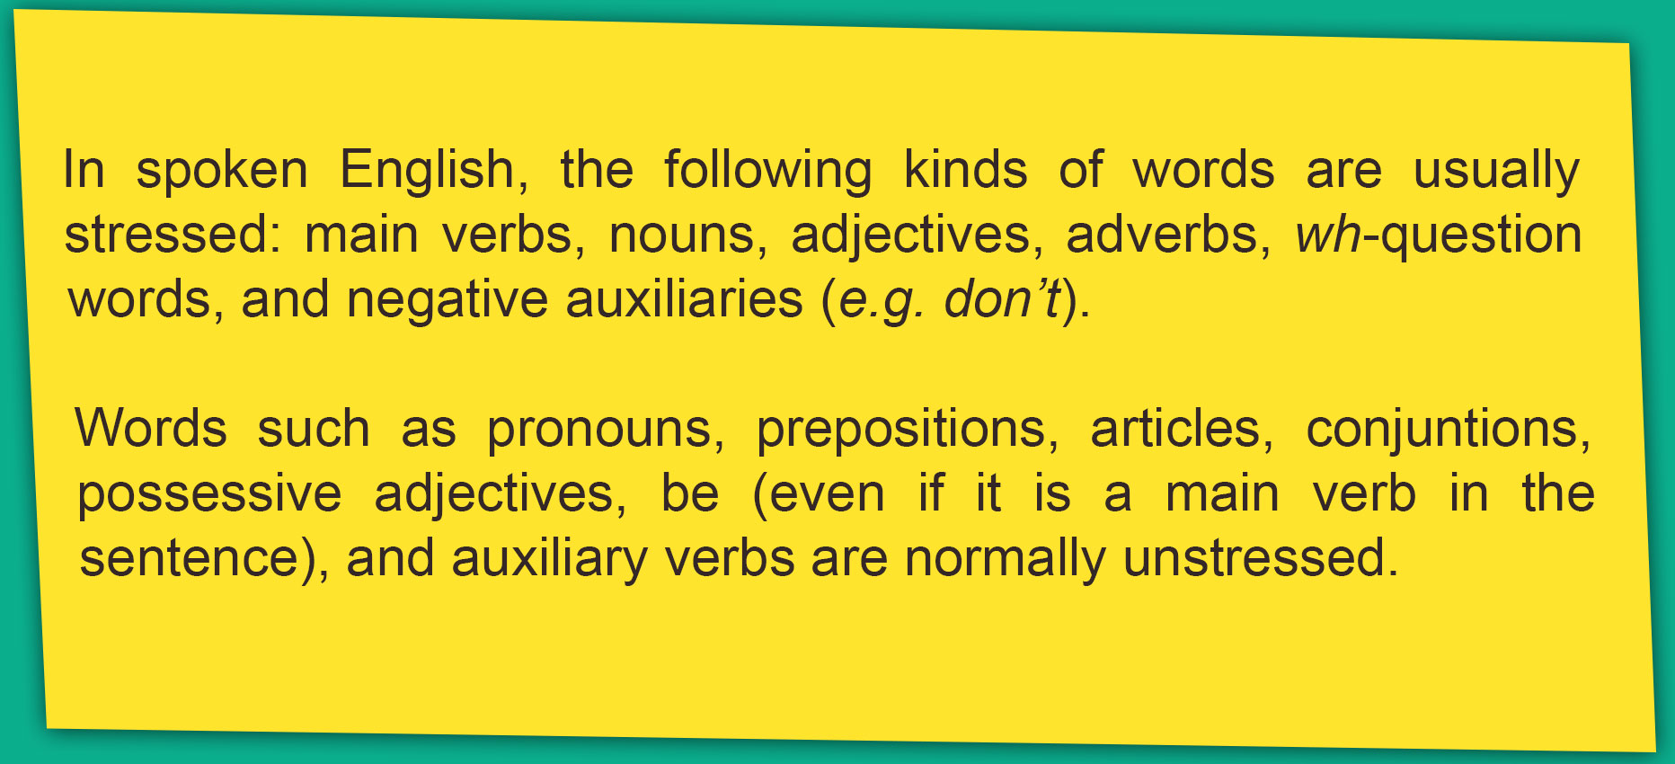
5b. Now listen, check, and repeat
1.The craft village lies on the river bank.
2.This painting is embroidered.
3.What is this region famous for?
4.Drums aren’t made in my village.
5.A famous artisan carved this table beautifully.

Slide 11

6a. Underline the content words in the sentences. ...
1.The Arts Museum is a popular place of interest in my city.
2.This cinema attracts lots of youngsters.
3.The artisans mould clay to make traditional pots.
4.Where do you like going at weekends?
5.We shouldn’t destroy historical buildings.

Slide 12

6b. Now listen, check and repeat
1.The Arts Museum is a popular place of interest in my city.
2.This cinema attracts lots of youngsters.
3.The artisans mould clay to make traditional pots.
4.Where do you like going at weekends?
5.We shouldn’t destroy historical buildings.

Slide 13


