Slide 1

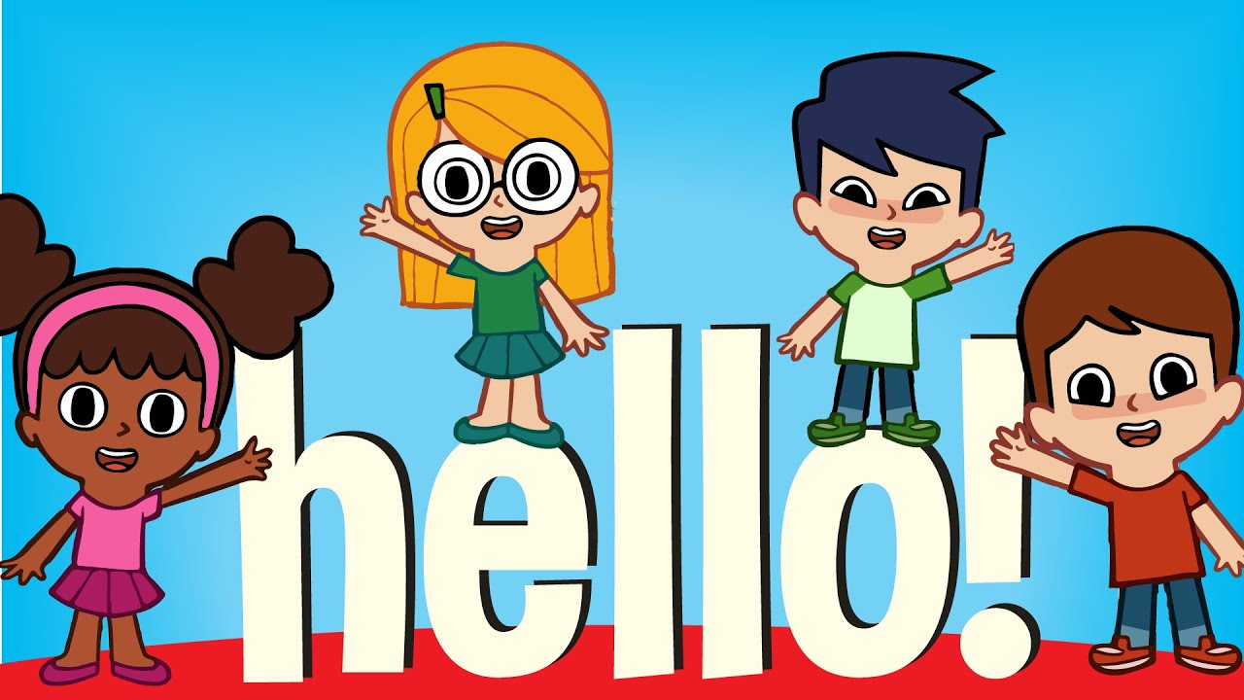

Slide 2
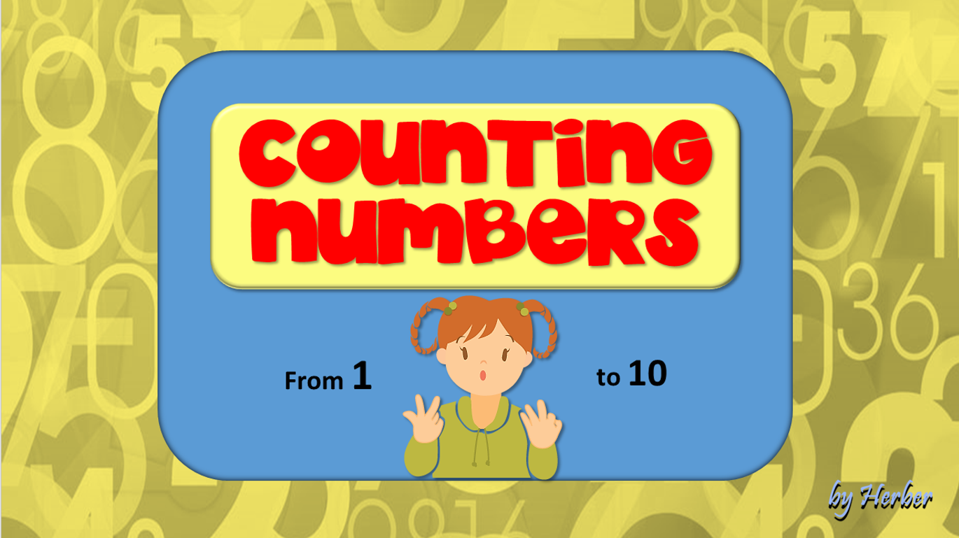

Slide 3



Slide 4
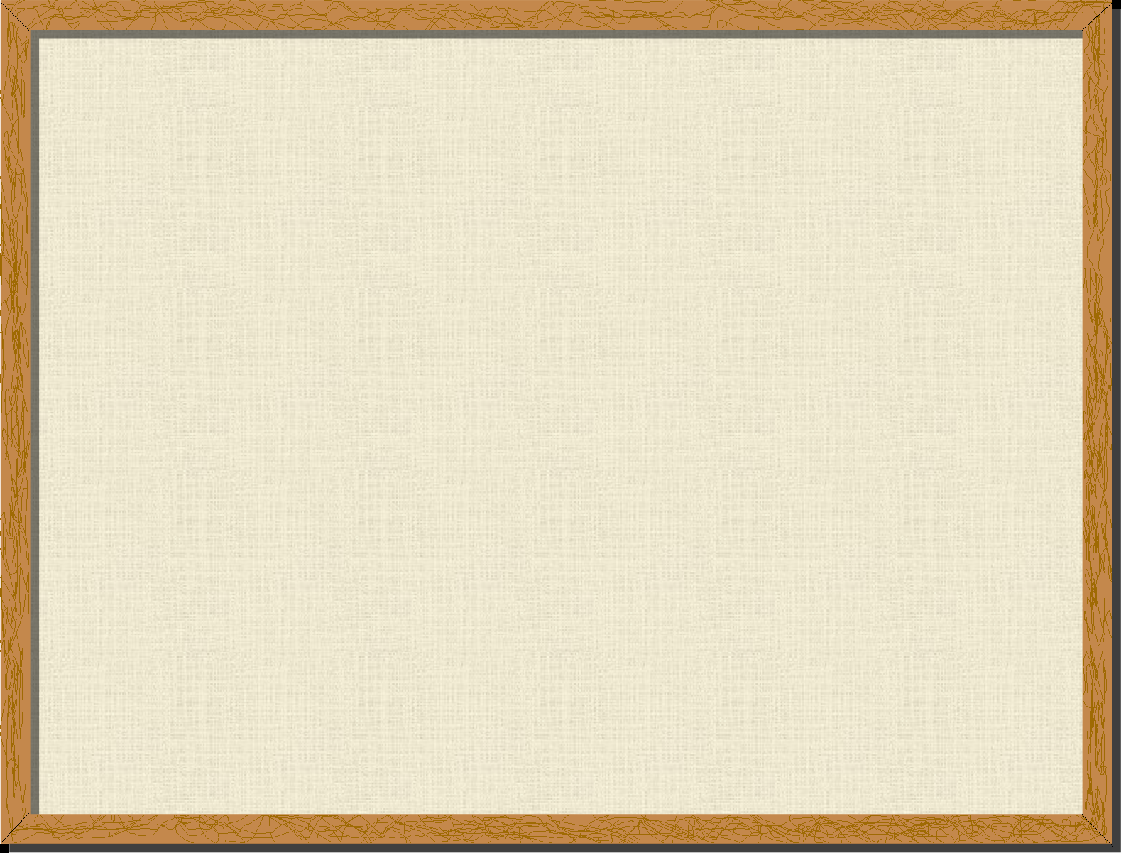

BASSIC COLORS
MIX THE COLORS
GUESS THE COLORS

Slide 5
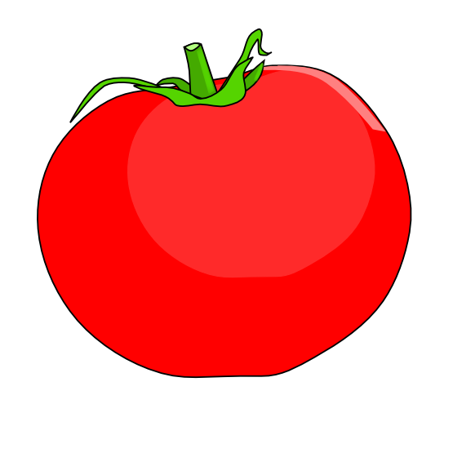
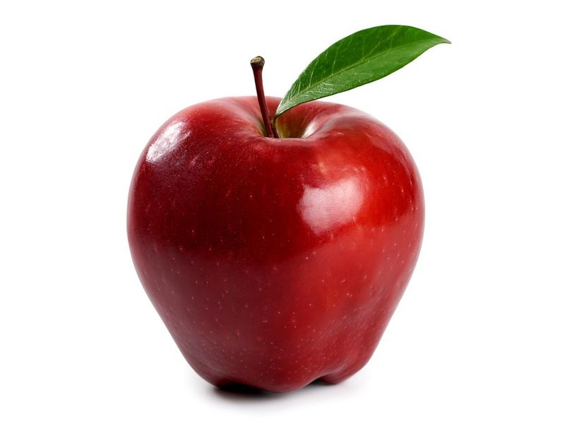

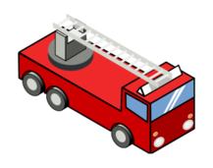

What are these?
tomato
Apple
Fire Truck

Slide 6

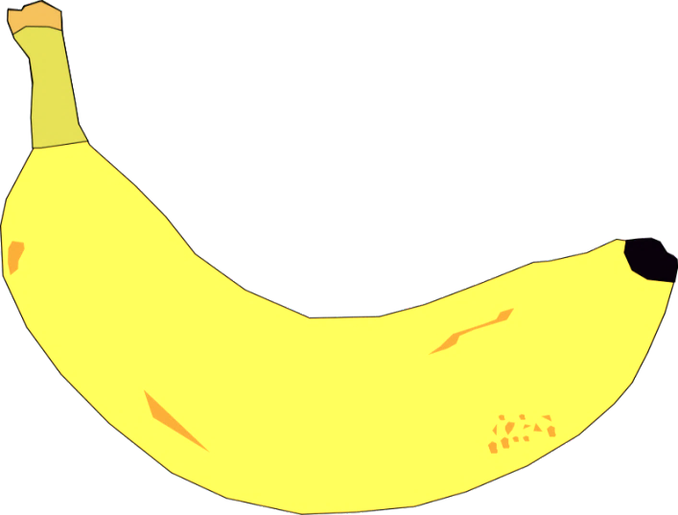

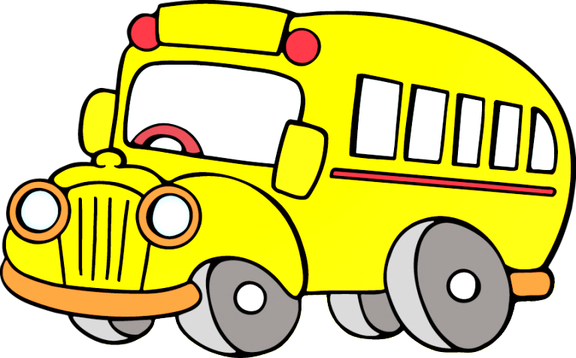
What are these?
lemon
banana
school bus

Slide 7
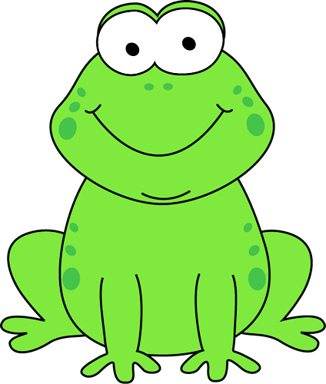
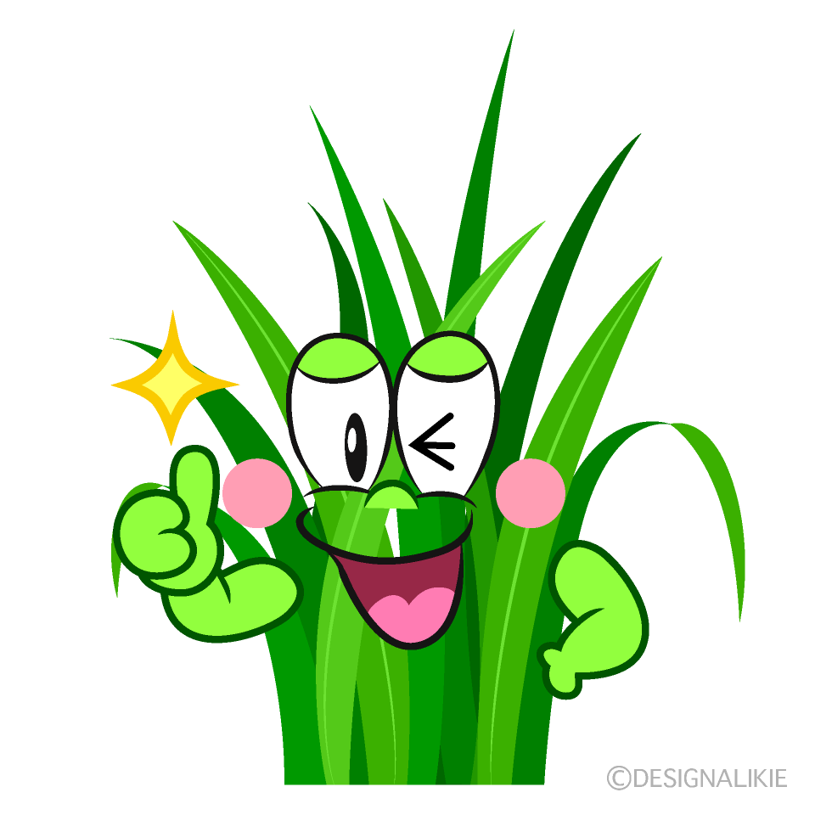


What are these?
frog
grass
clover

Slide 8
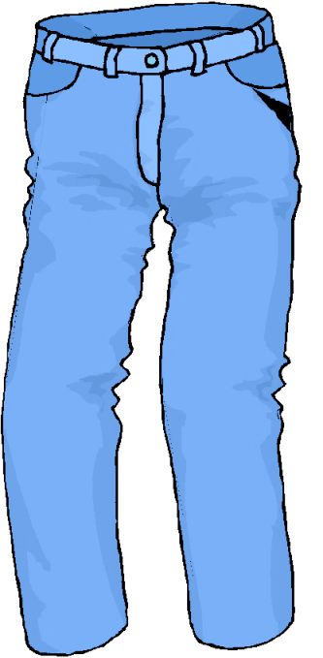
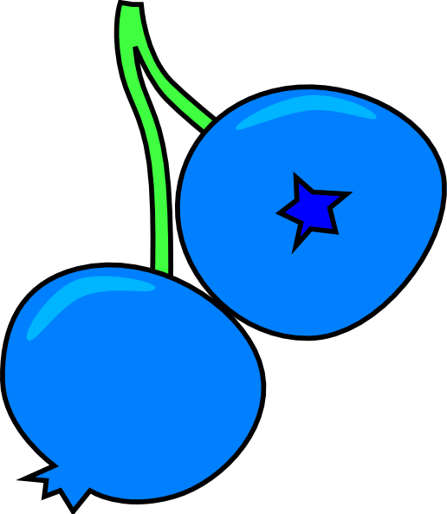


What are these?
jeans
blueberry
sky

Slide 9
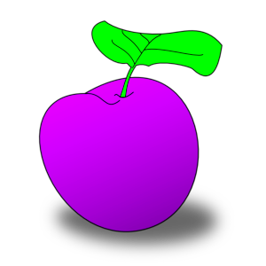


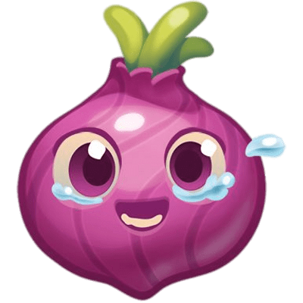
What are these?
plum
violet
ornion

Slide 10
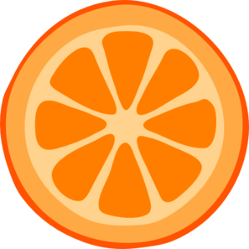


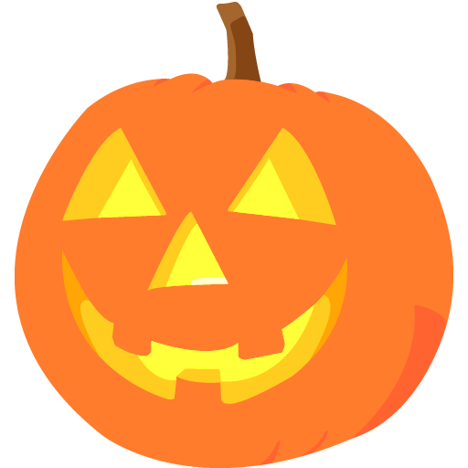
What are these?
orange
carrot
pumpkin

Slide 11
What colour do you get by mixing these ones?
yellow
green
blue

Slide 12
What colour do you get by mixing these ones?
red
orange
yellow

Slide 13
What colour do you get by mixing these ones?
red
purple
blue

Slide 14
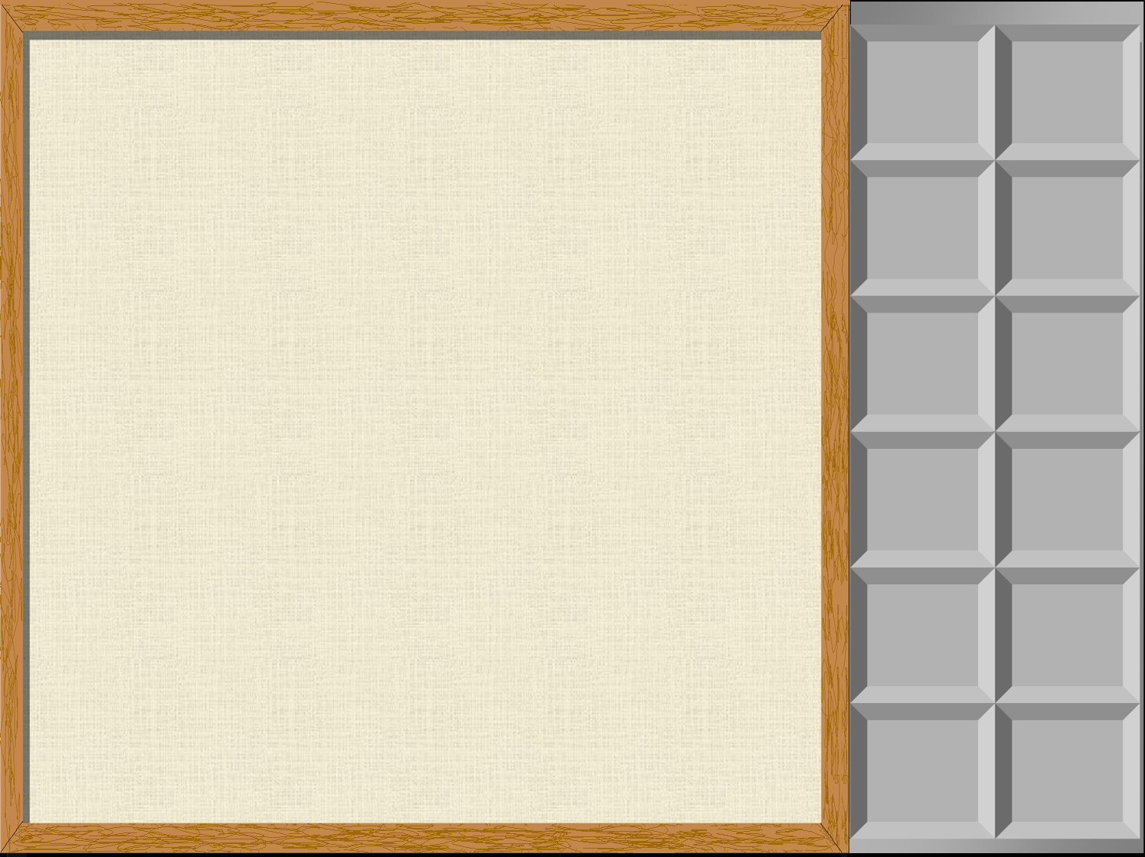

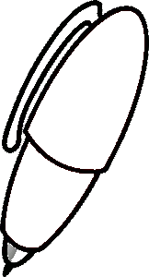


This pen is …
1
2
3
4
5
6
7
8
9
10
RED

Slide 15
This flower is …
1
2
3
4
5
6
7
8
9
10
YELLOW

Slide 16
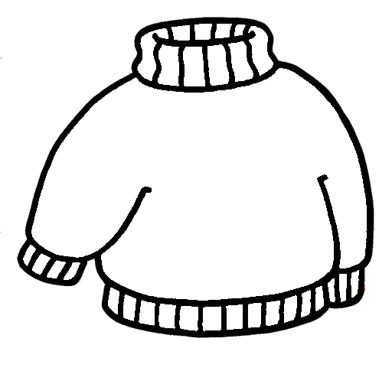
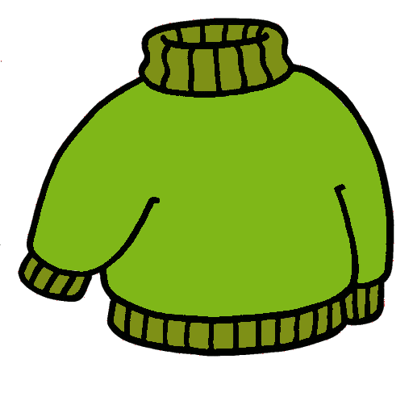
This jumper is …
1
2
3
4
5
6
7
8
9
10
GREEN

Slide 17
This book is …
1
2
3
4
5
6
7
8
9
10
BLUE

Slide 18
This crayon is …
1
2
3
4
5
6
7
8
9
10
ORANGE

Slide 19
This ball is …
1
2
3
4
5
6
7
8
9
10
PURPLE

Slide 20


