Slide 1
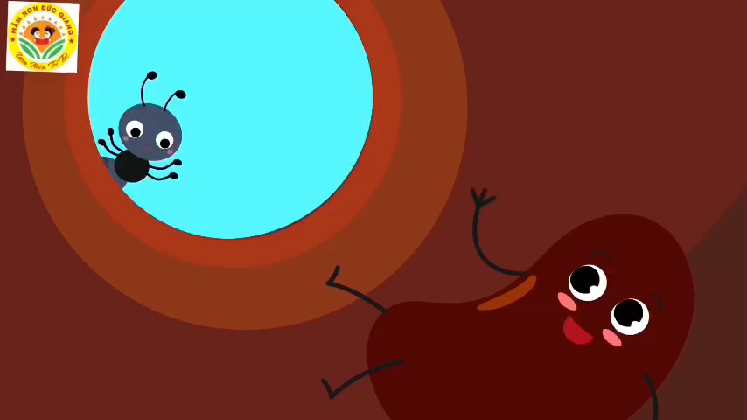

Slide 2

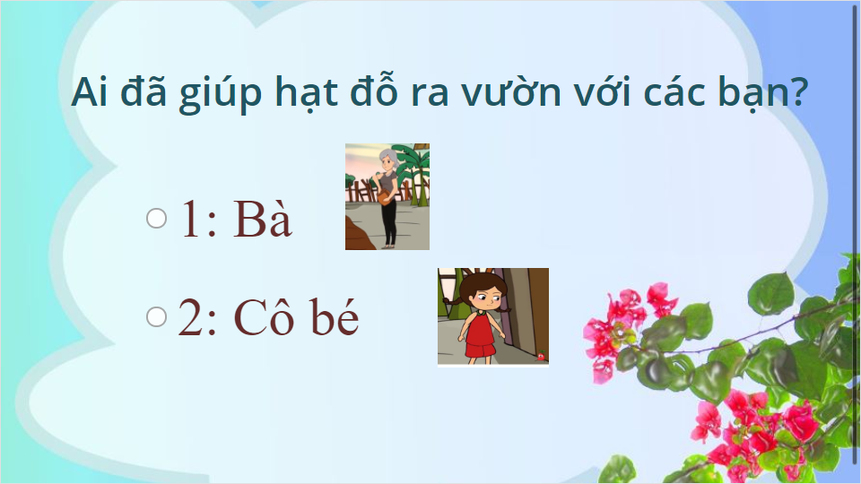
Quiz
Click the Quiz button to edit this object

Slide 3
