Slide 1

Unit 7: MY FAMILY
Lesson 2.3
Page 97

Slide 2
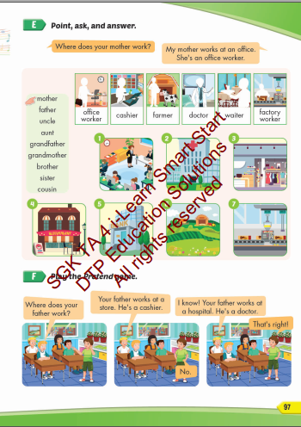
Lesson Outline
Warm-up
Practice
Speaking
Consolidation
Wrap-up

Slide 3
Objectives
By the end of this lesson, students will be able to talk about where their family members work.
Vocabulary: store, hospital, restaurant,
office, farm, bank.
Structure: Where does your mother work?
My mother works at an office.
She's an office worker.

Slide 4

WARM UP

Slide 5

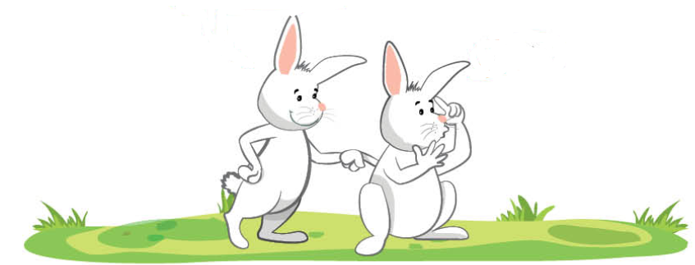
What’s this?
It’s an OFFICE.

Slide 6

What’s this?
It’s a HOSPITAL.

Slide 7
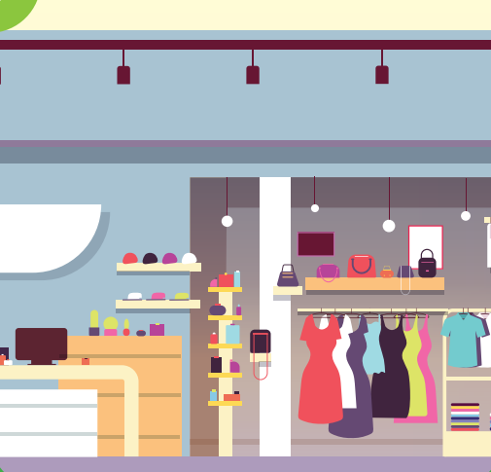
What’s this?
It’s a STORE.

Slide 8
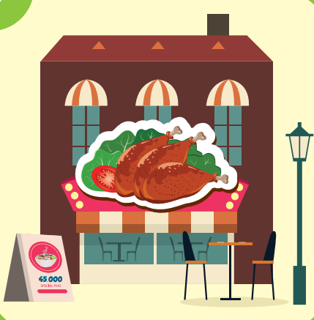
It’s a RESTAURANT.
What’s this?

Slide 9

What’s this?
It’s a FARM.

Slide 10
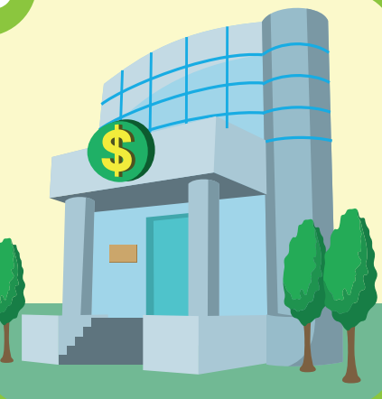
What’s this?
It’s a BANK.

Slide 11

Practice

Slide 12

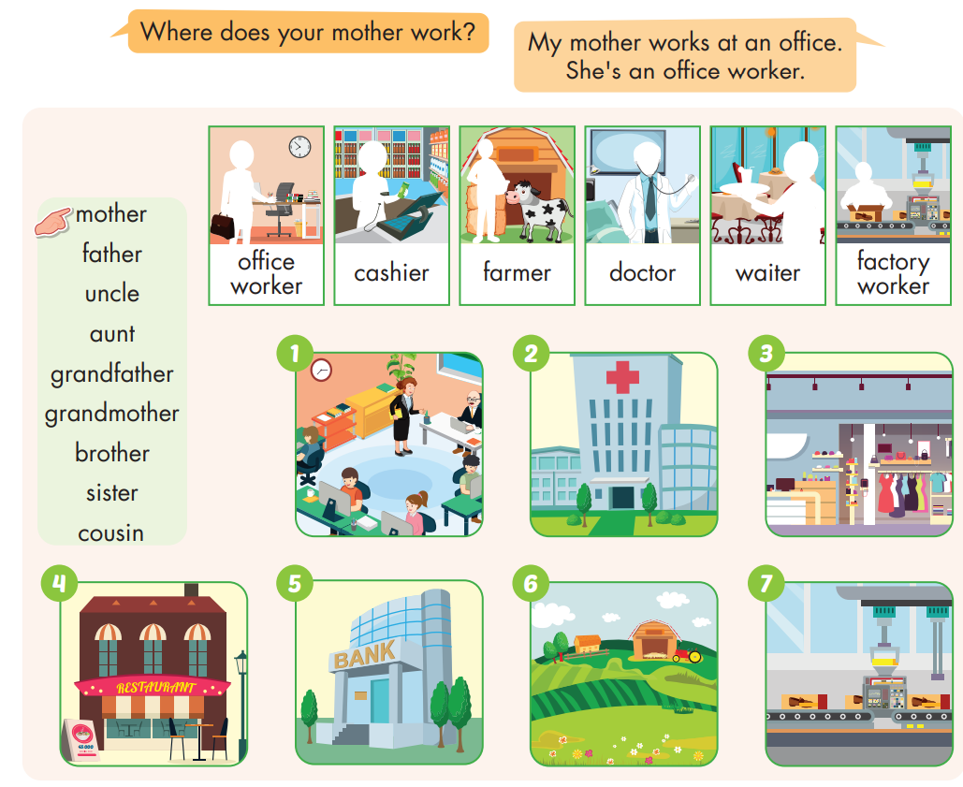

Slide 13
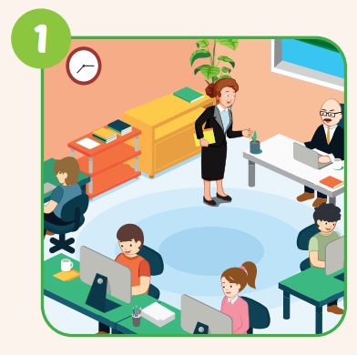
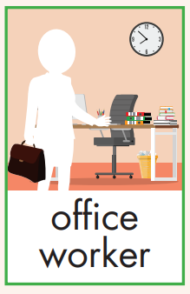
Where does your mother work?
My mother works at an office.
She's an office worker.

Slide 14
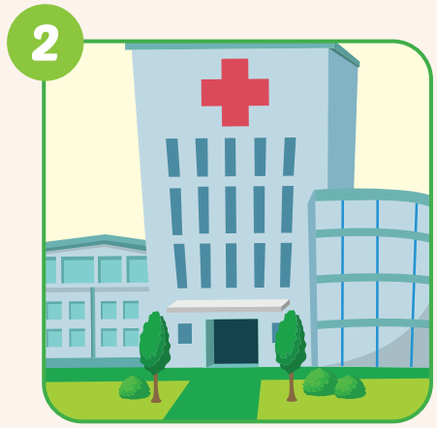
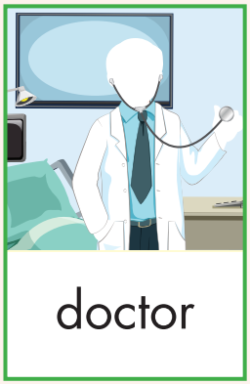
Where does your father work?
My father works at a hospital.
He's a doctor.

Slide 15
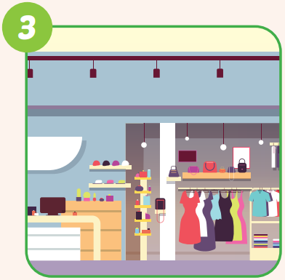
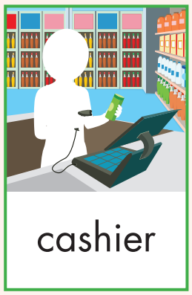
Where does your aunt work?
My aunt works at a store.
She's a cashier.

Slide 16
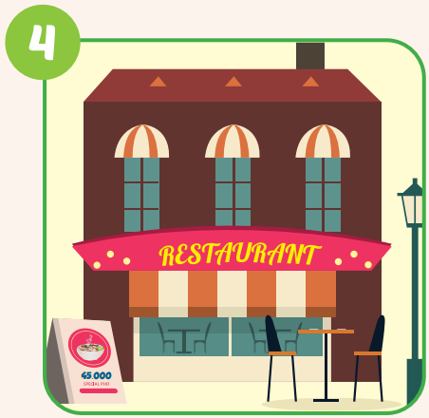
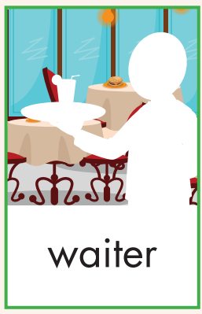
Where does your uncle work?
My uncle works at a restaurant.
He's a waiter.

Slide 17
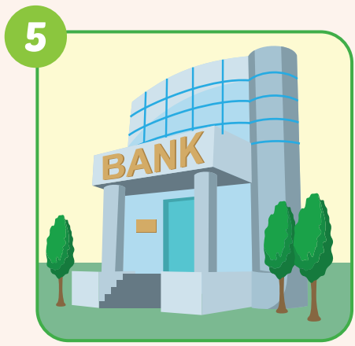
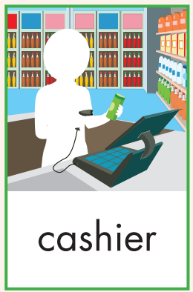
Where does your sister work?
My sister works at a bank.
She's a cashier.

Slide 18
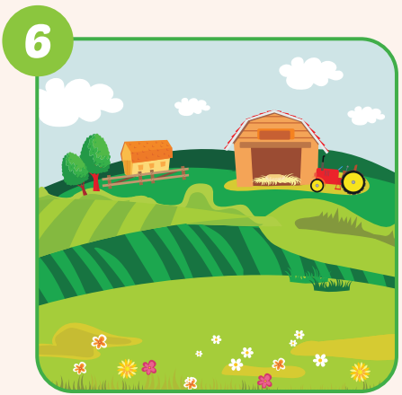
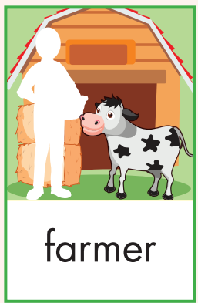
Where does your brother work?
My brother works at a farm.
She's a farmer.

Slide 19
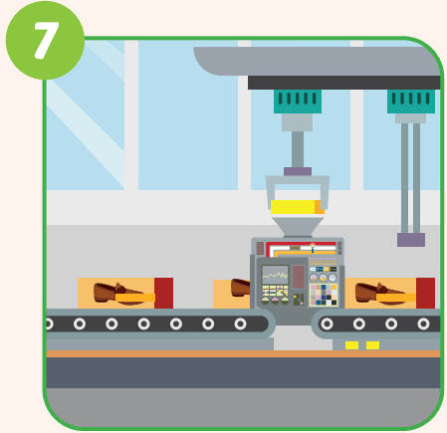

Where does your cousin work?
My cousin works at a factory.
She's a factory worker.

Slide 20

Speaking

Slide 21

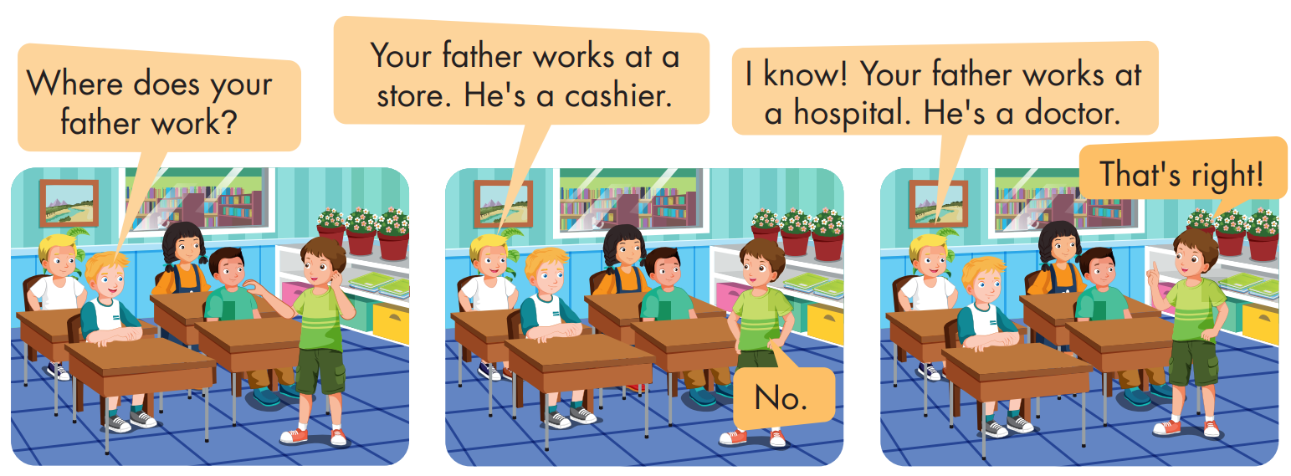

Slide 22

CONSOLIDATION

Slide 23





Motor Racing
Rules:
Class will be divided into 2 teams. Take turns to play.
There is a sentence with a picture beside
Read the sentence and choose YES or NO.
If you’re correct, you will get 1 star for your team.

Slide 24
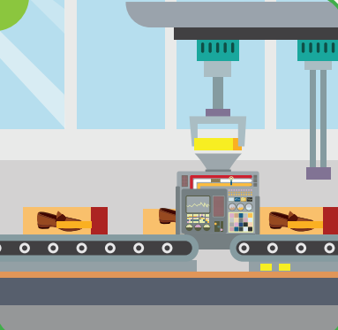



This is a factory.
YES
NO
NEXT

Slide 25


This is a farm.
YES
NO
NEXT

Slide 26

This is a bank.
YES
NO
NEXT

Slide 27
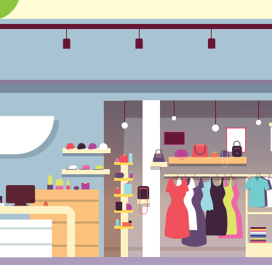
This is an office.
YES
NO
NEXT

Slide 28
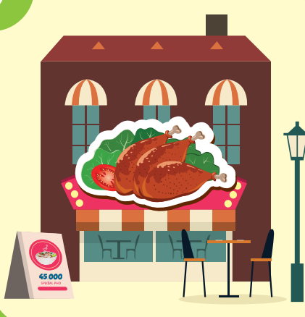
This is a restaurant.
YES
NO
NEXT

Slide 29

This is a hospital.
YES
NO
EXIT

Slide 30

WRAP-UP

Slide 31
Today’s lesson
Vocabularies
store, hospital, restaurant, office,
farm, bank.
Structures/ Sentence patterns
Where does your mother work?
My mother works at an office.
She's an office worker.

Slide 32
Homework
Practice the vocabularies and structure, and make sentences using them.
Do the exercises in Tiếng Anh 4 i-Learn Smart Start WB (page 65)
Prepare the next lesson (page 98 SB)
Play the consolidation games in Tiếng Anh 4 i-Learn Smart Start DHA App on www.eduhome.com.vn

Slide 33

Enjoy your day!

