Slide 1

Unit 7: MY FAMILY
Lesson 2.2
Page 96

Slide 2
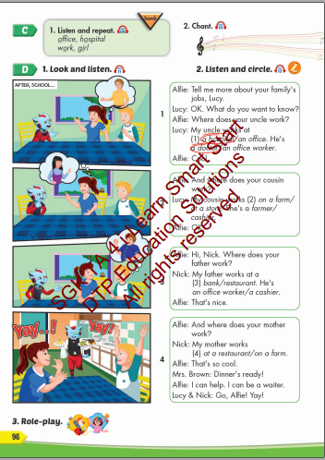
Lesson Outline
Warm-up
Listening
Consolidation
Wrap-up

Slide 3
Objectives
By the end of this lesson, students will be able to talk about where their family members work.
Vocabulary: office, hospital, work, girl
Structure: Where does your father work?
My father works at a bank. He's a cashier.

Slide 4

WARM UP

Slide 5



Slide 6
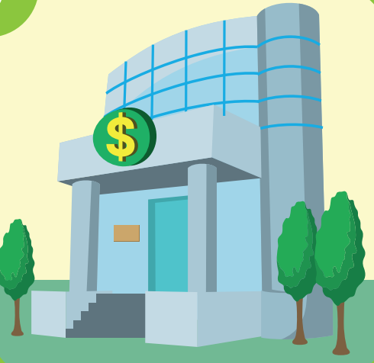

Slide 7


Slide 8


Slide 9
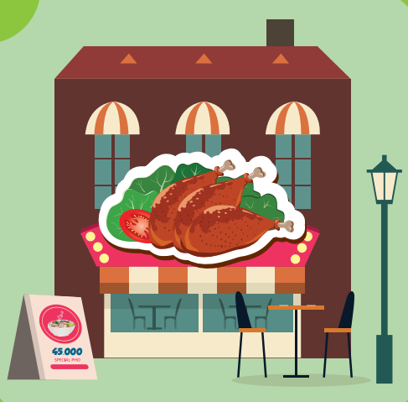

Slide 10

It’s time to learn …

Slide 11

Listening

Slide 12






Click each English word to hear the sound.
office
hospital
work
girl
/ˈɑːfɪs/
Văn phòng
/ˈhɑːspɪtəl/Bệnh viện
/ˈwɜːrk/
Công việc
/ˈɡɜːrl/
Con gái

Slide 13


Click the earphone to hear the sound.
Where does your mom work?
My mom works at a hospital.
Where does your dad work?
My dad works at an office.

Slide 14

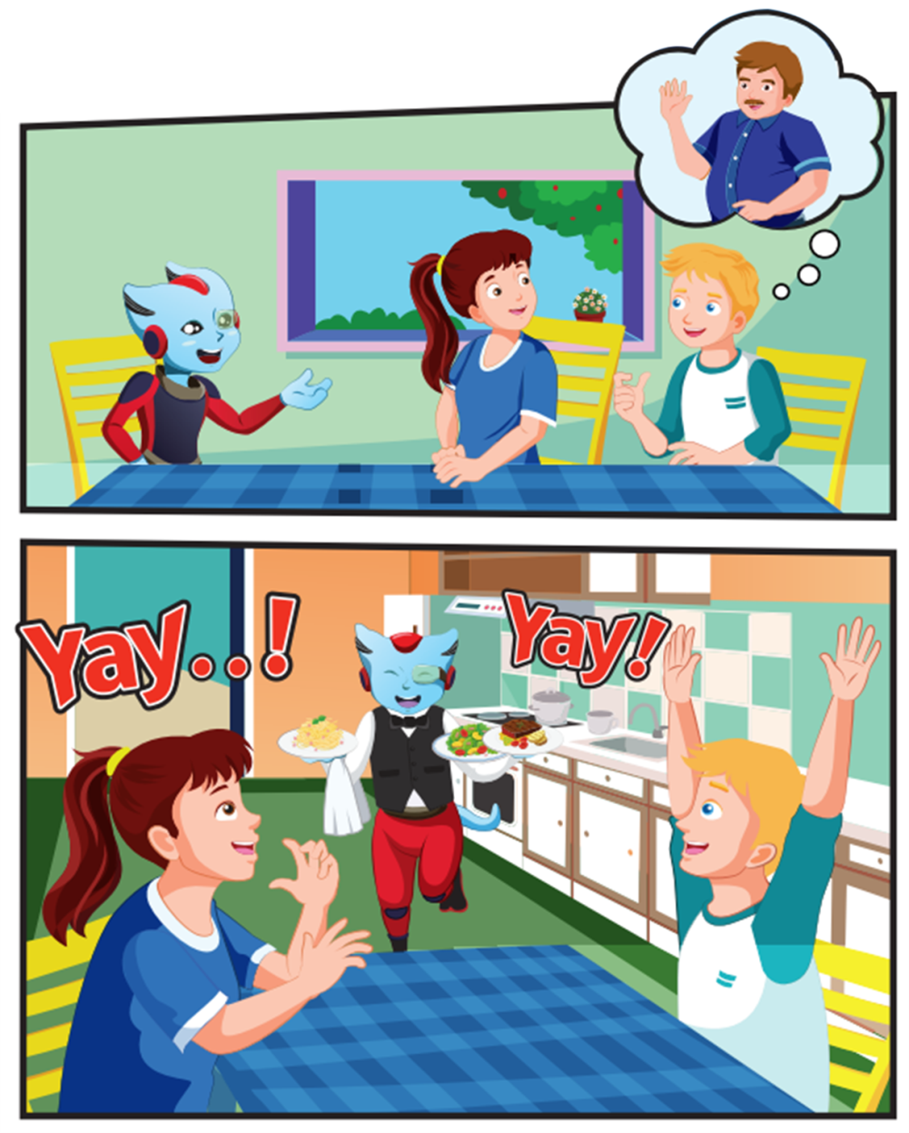
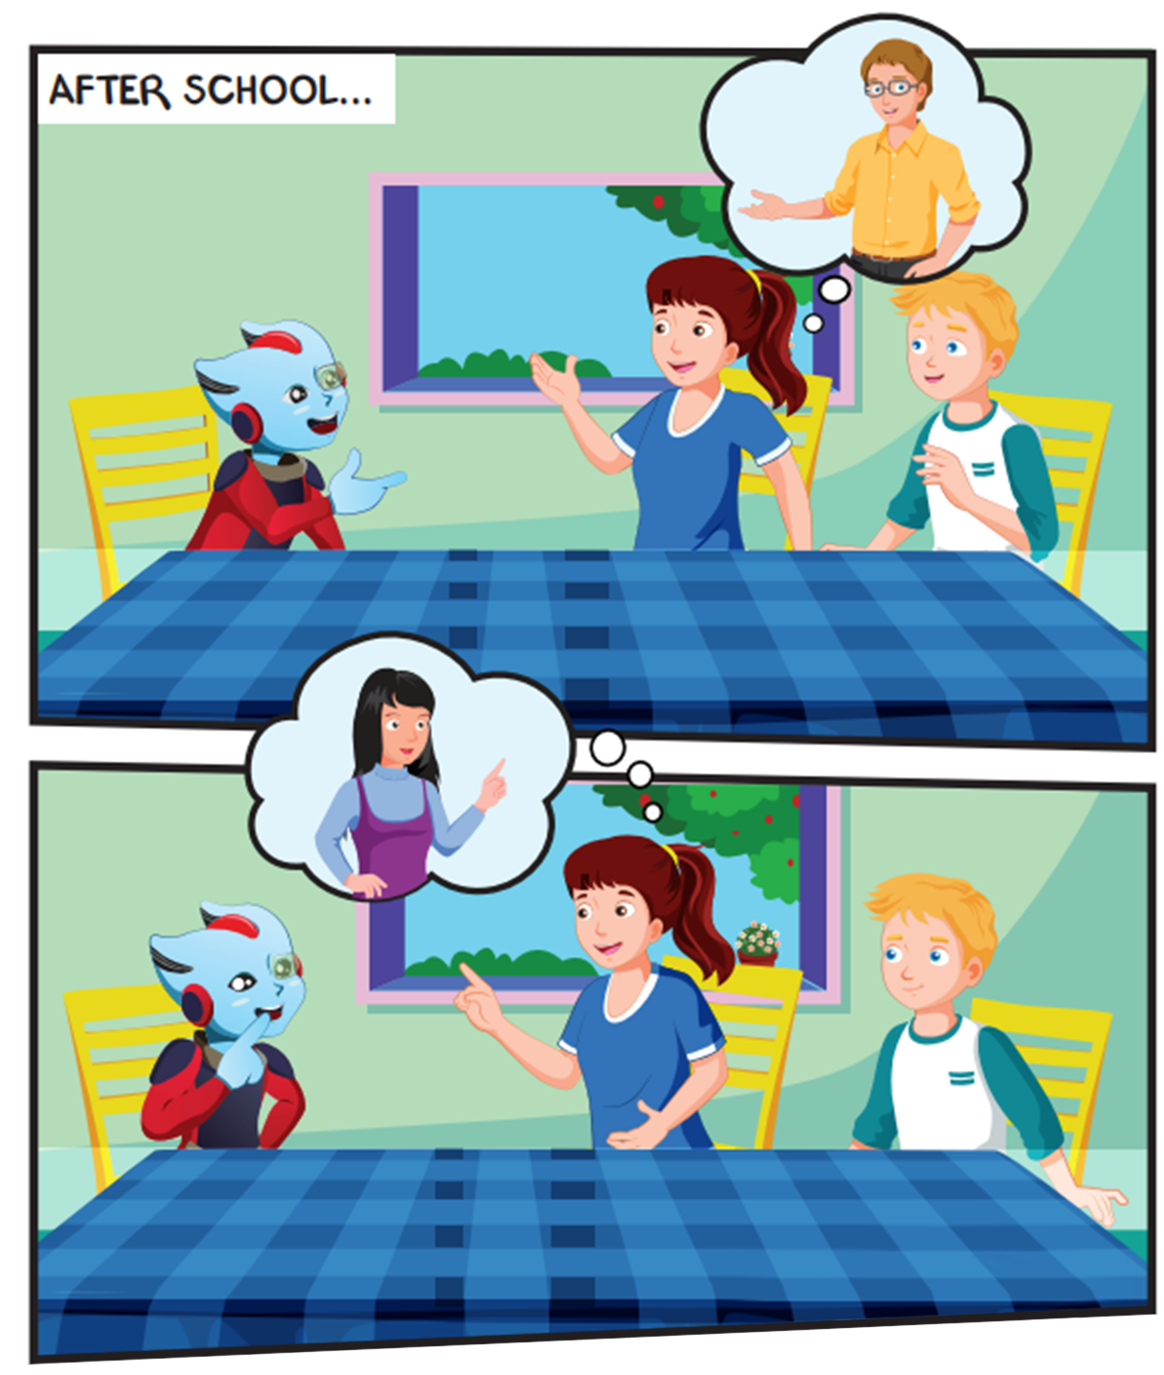
Click the loud speaker to hear the sound.

Slide 15
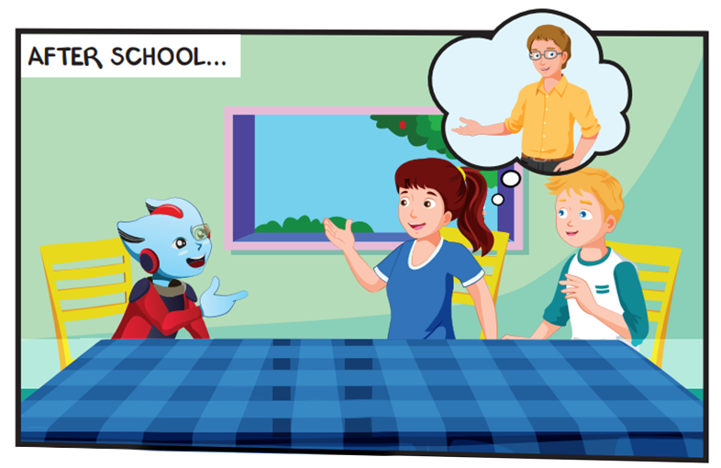
Where are they?
Who are they talking about?

Slide 16
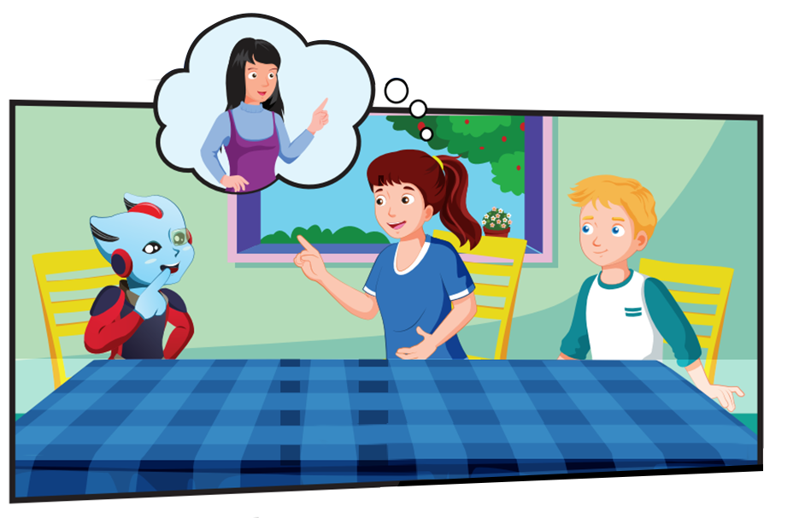
Who are they talking about?
What color is the table?

Slide 17
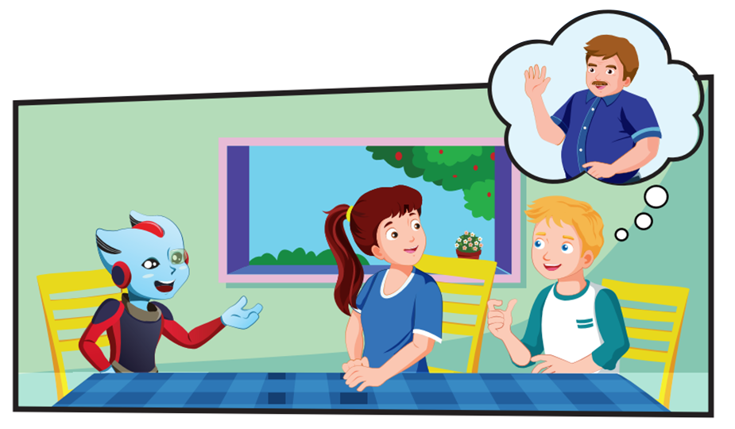
Who are they talking about?

Slide 18
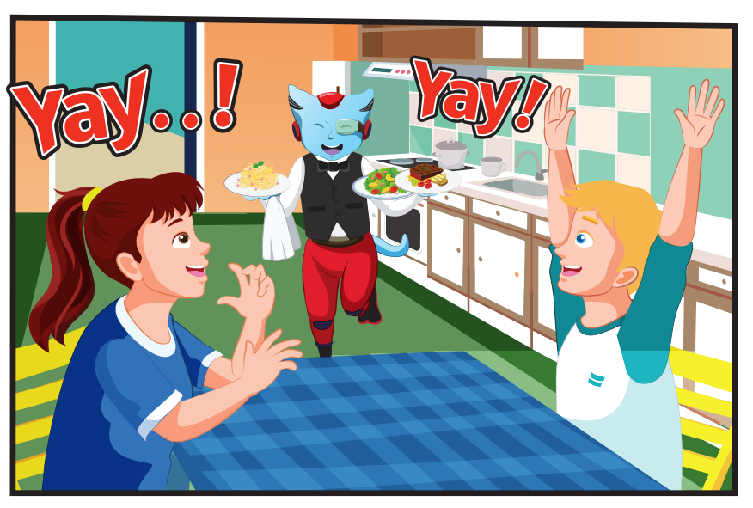
Where are they?
How are they feeling?

Slide 19

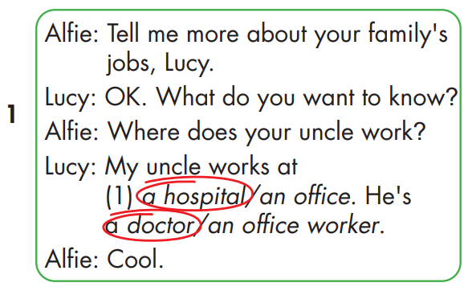
Click the loud speaker to hear the sound.

Slide 20

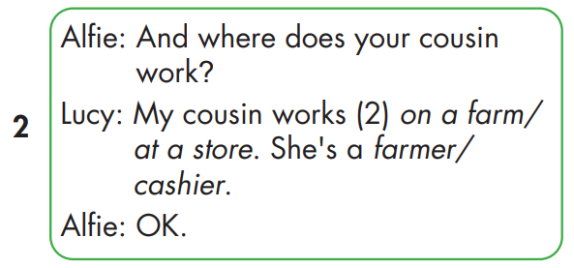
Click the loud speaker to hear the sound.

Slide 21
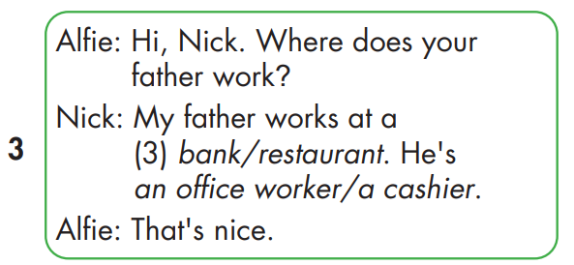
Click the loud speaker to hear the sound.

Slide 22
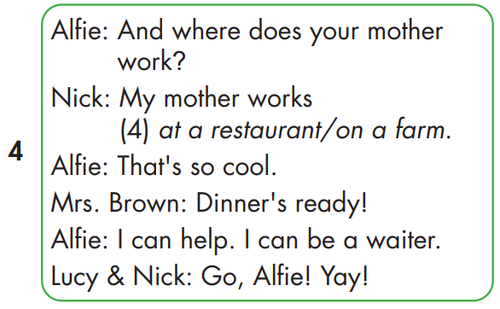
Click the loud speaker to hear the sound.

Slide 23

Practice

Slide 24
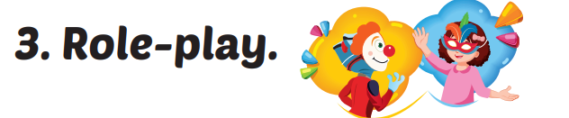


Where does your mom work?
My mom works at a hospital.
My dad works at an office.
Where does your dad work?

Slide 25
Where does your mom work?
My mom works at a store.
My dad works at a farm.
Where does your dad work?

Slide 26
Where does your mom work?
My mom works at a bank.
My dad works at a restaurant.
Where does your dad work?

Slide 27

CONSOLIDATION

Slide 28

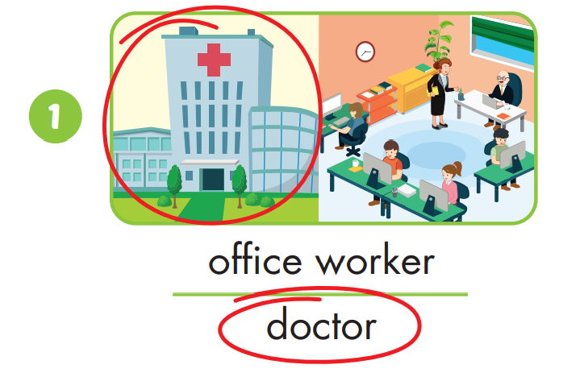

Slide 29
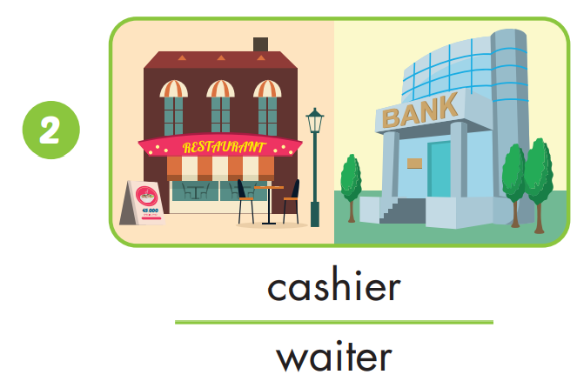

Slide 30
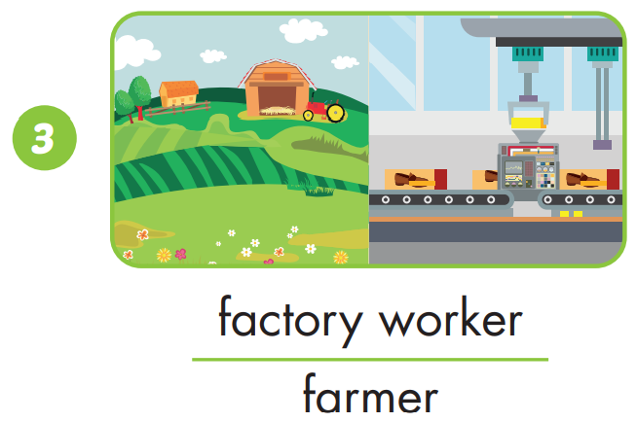

Slide 31
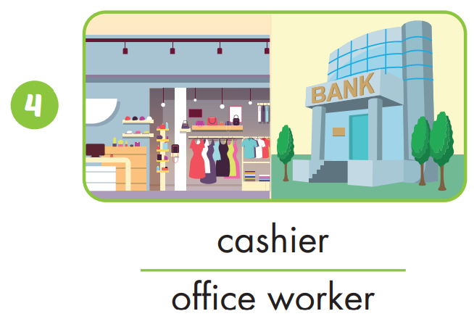

Slide 32

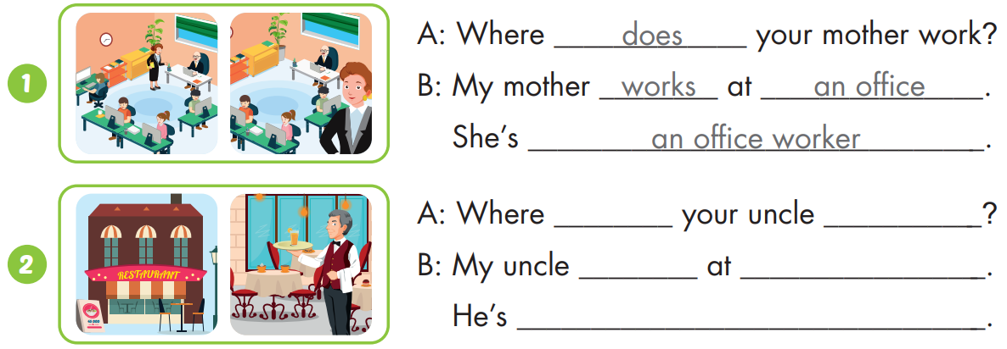
does
work
works
a restaurant
a waiter

Slide 33
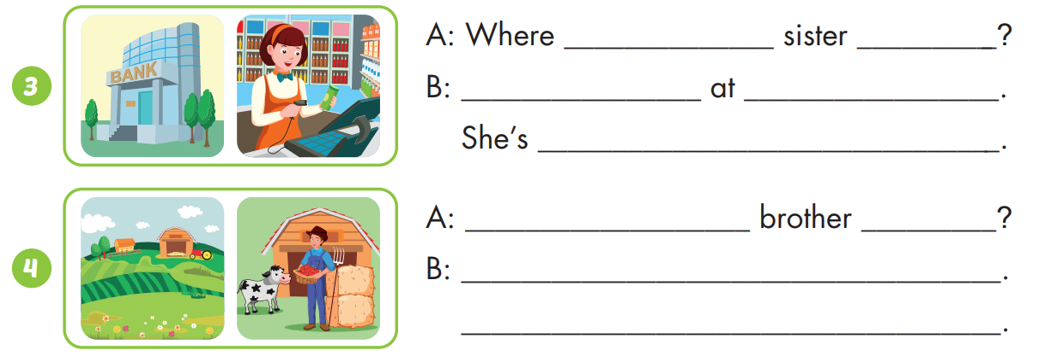
does your
work
My sister works
a bank
a cashier
Where does your
work
My brother works at a farm
He’s a farmer

Slide 34

WRAP-UP

Slide 35
Today’s lesson
Vocabularies
office, hospital, work, girl
Structures/ Sentence patterns
Where does your father work?
My father works at a bank.
He's a cashier.

Slide 36
Homework
Practice the vocabularies and structure, and make sentences using them.
Do the exercises in Tiếng Anh 4 i-Learn Smart Start WB (page 65)
Do the exercises in Tiếng Anh 4 i-Learn Smart Start Notebook (page ….)
Prepare the next lesson (page 97 SB)
Play the consolidation games in Tiếng Anh 4 i-Learn Smart Start DHA App on www.eduhome.com.vn

Slide 37

Have a nice day!

