Slide 1
Vu Xuan Thieu Primary School
WELCOME TO CLASS 4A4
Teacher: Nguyen Thi Thuy

Slide 2

WARM UP

Slide 3
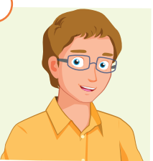


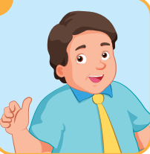
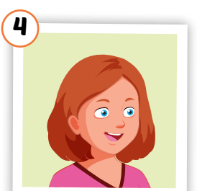

REVIEW
F
A
T
H
E
R
1
F
A
2
A
U
N
T
M
O
T
H
E
R
3
M
S
I
4
I
S
T
E
R
U
N
C
L
5
L
E
B
A
B
Y
6
Y

Slide 4

Unit 7: MY FAMILY
Lesson 1.1
Page 92

Slide 5
Objectives
By the end of this lesson, students will be able to talk about what jobs their family members do.
Vocabulary: cashier, doctor, office worker, factory worker, farmer, waiter.
Structure: What does your father do?
He's a doctor.
What does your mother do?
She's an office worker.

Slide 6

Presentation

Slide 7


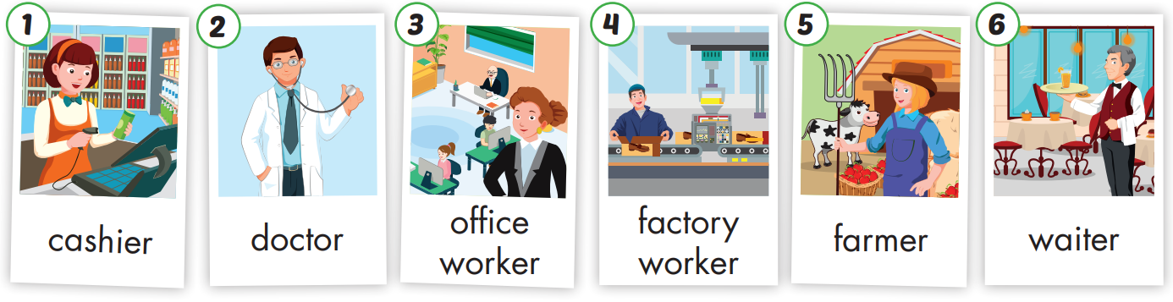

Slide 8
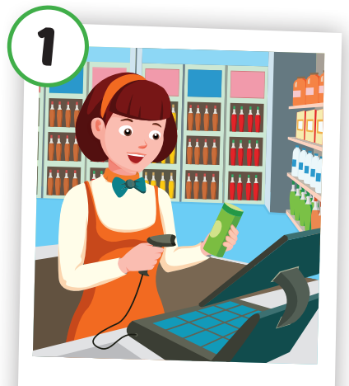
Click each English word to hear the sound.
cashier
/kæˈʃɪr/

Slide 9
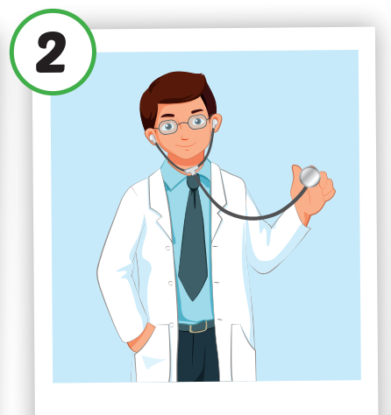
Click each English word to hear the sound.
doctor
/ˈdɑːktər/

Slide 10
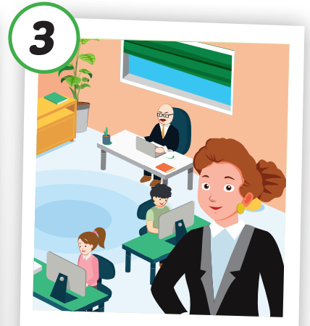
Click each English word to hear the sound.
office worker
/ˈɒfɪs wɜːkə(r)/

Slide 11
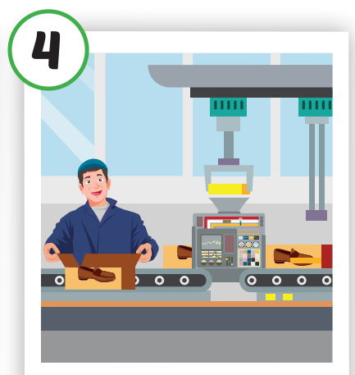
Click each English word to hear the sound.
factory worker
ˈfæktriˈwɜːkə(r)

Slide 12
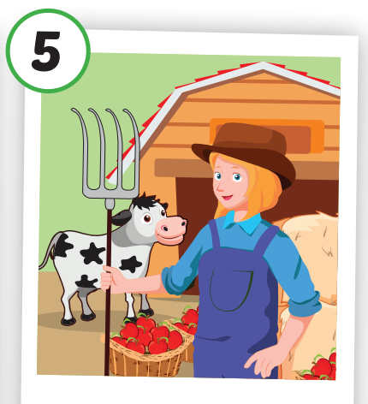
/ˈfɑːrmər/
Nông dân
Click each English word to hear the sound.
farmer
/ˈfɑːrmər/

Slide 13
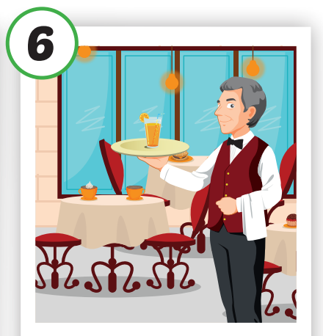
/ˈfɑːrmər/
Nông dân
Click each English word to hear the sound.
waiter
/ˈweɪtər/

Slide 15

Say correct picture

Slide 16

Structures:
What does your father do?
He's a doctor.
What does your mother do?
She's an office worker.

Slide 17


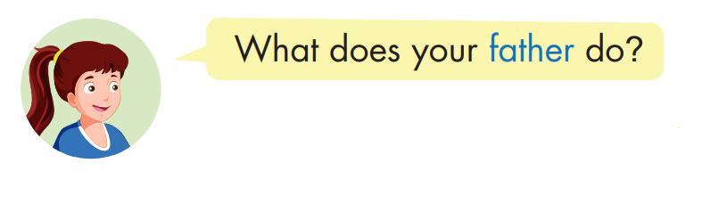

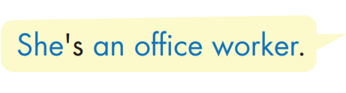

Slide 18

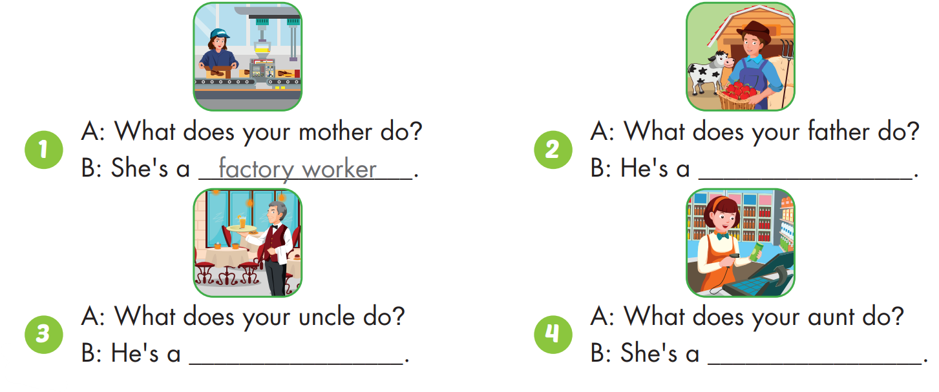
farmer
waiter
cashier

Slide 19

CONSOLIDATION

Slide 20
Lesson 3
Today’s lesson
Vocabularies
cashier, doctor, office worker, factory worker, farmer, waiter.
Structures/ Sentence patterns
What does your father do?
He's a doctor.
What does your mother do?
She's an office worker.

Slide 21
Lesson 3
Homework
Practice the vocabularies and structure, and make sentences using them.
Do the exercises in Tiếng Anh 4 i-Learn Smart Start WB (page 62)
- Prepare the next lesson (page 93 SB)

Slide 22

Practice

Slide 23

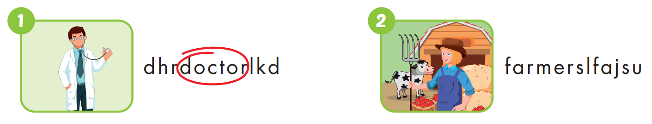

Slide 24


Slide 25


Slide 26

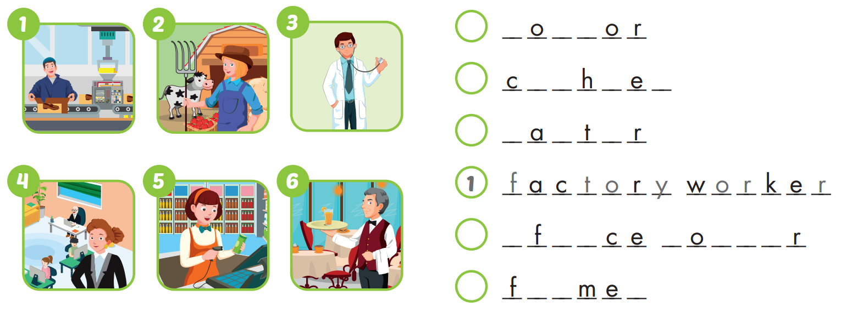
3
d
c
t
5
a
s
i
r
6
w
i
e
4
o
f
i
w
r
k
e
2
a
r
r

Slide 27

WRAP-UP

Slide 28

Have a nice day!

Slide 29
1
F
A
T
H
E
R
2
A
U
N
T
3
M
O
T
H
E
R
4
S
I
T
E
R
5
U
N
C
L
E
6
B
A
B
Y

Slide 30

Lesson Outline
Warm-up
Vocabulary
Structure
Consolidation
Wrap-up

Slide 31
Talk about what your family members look like.
Pair work:
Students take turns to talk about what their family members look like.
E.g. My grandfather is handsome and old.
My brother is tall and cute.
My sister has long, blond hair.

Slide 32

It’s time to learn …

Slide 33
New words
cashier,
doctor,
office worker, factory worker, farmer,
waiter.

Slide 34

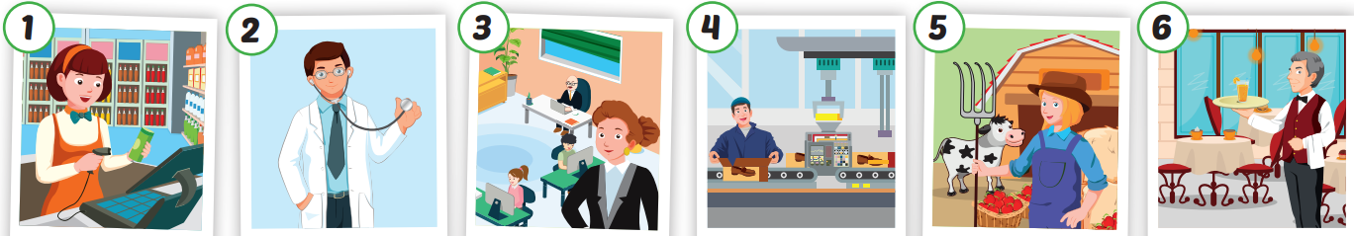
Click each English word to hear the sound.
cashier
doctor
office worker
factory worker
farmer
waiter
/kæˈʃɪr/
Thu ngân
/ˈdɑːktər/
Bác sĩ
Nhân viên văn phòng
Công nhân nhà máy
/ˈfɑːrmər/
Nông dân
/ˈweɪtər/
Nhân viên phục vụ bàn

Slide 35

