Slide 1

Unit 6: FOOD AND DRINKS
Lesson 1.3
Page 80

Slide 2
Objectives
By the end of this lesson, students will be able to ask and answer about what they need to cook.
Vocabulary: sugar, butter, flour, chocolate chips, oil, milk.
Sentence pattern: I need a little butter.
She needs some oil.

Slide 3

WARM-UP

Slide 4


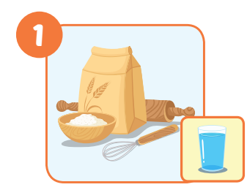


Click on the right word
some sugar
a little milk
a lot of flour

Slide 5
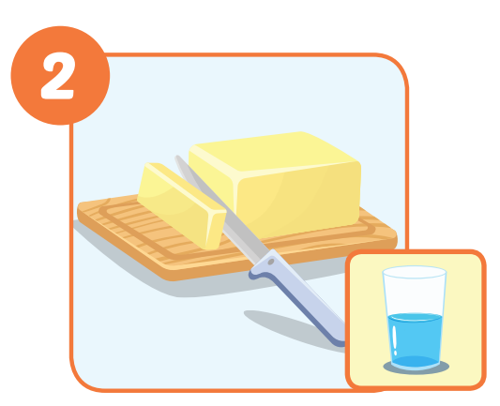
Click on the right word
a few chocolate chips
some butter
a little oil

Slide 6
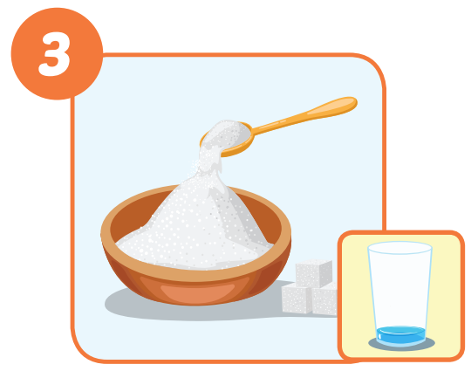
Click on the right word
some flour
a lot of milk
a little sugar

Slide 7
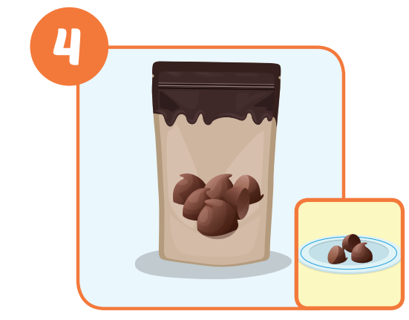
Click on the right word
a little oil
a few chocolate chips
a lot of milk

Slide 8
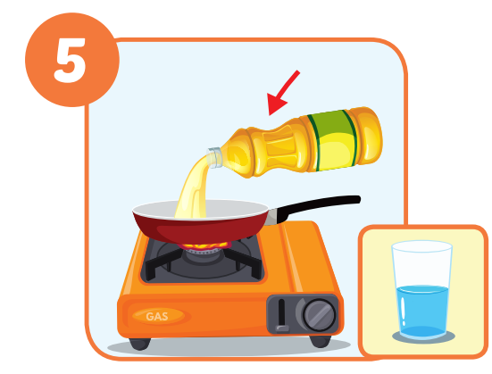
Click on the right word
a little oil
some oil
a lot of milk

Slide 9
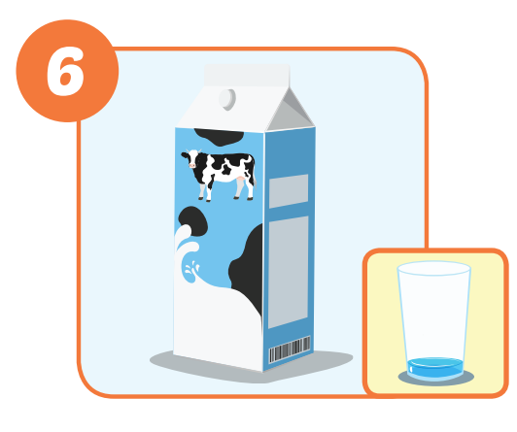
Click on the right word
a little milk
a little sugar
a lot of flour

Slide 10

Structure
I need a lot of butter.

Slide 11

Presentation

Slide 12




Slide 13
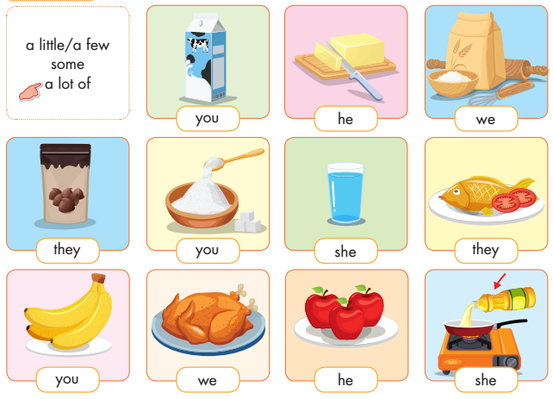

Slide 14
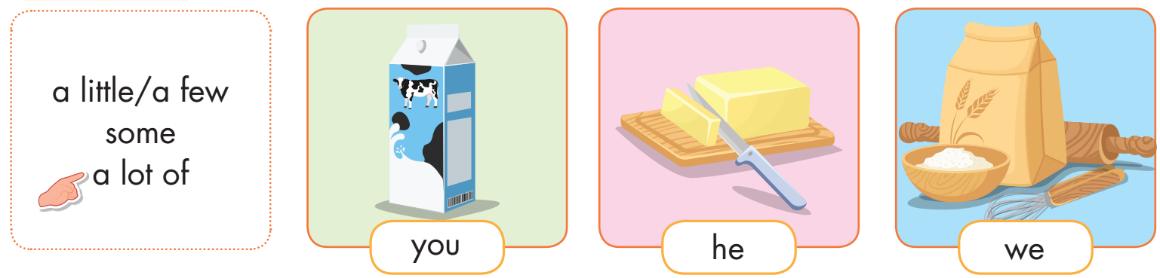

Slide 15
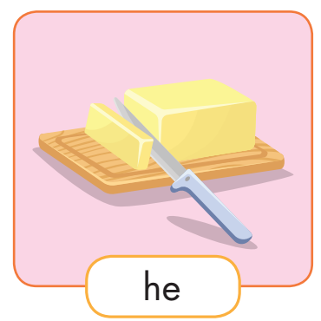

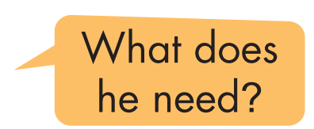
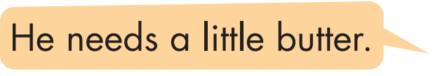

Slide 16

Practice

Slide 17
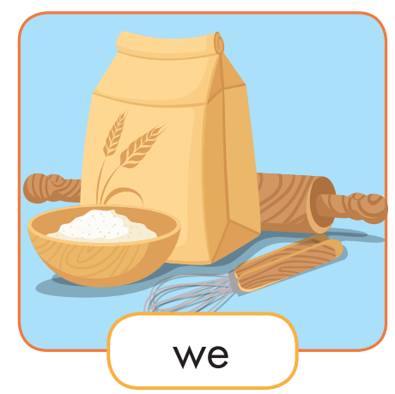
What do we need?
We need ___________.
some flour

Slide 18
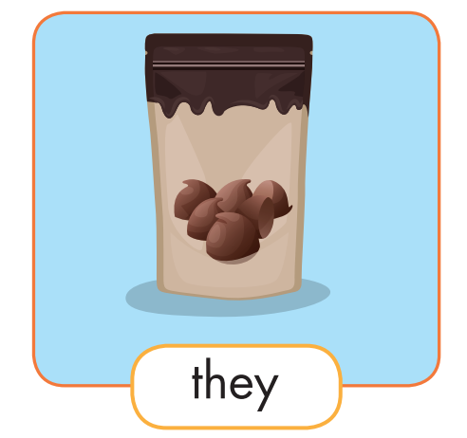
What do they need?
They need ____________________.
a few chocolate chips

Slide 19
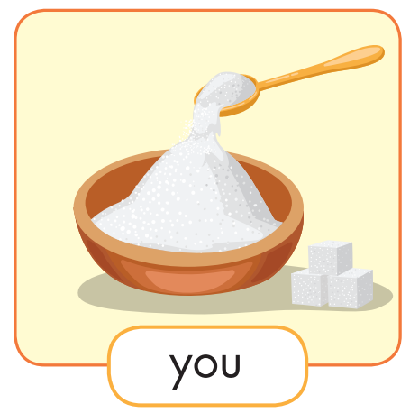
What do you need?
I need ______________.
a lot of sugar

Slide 20
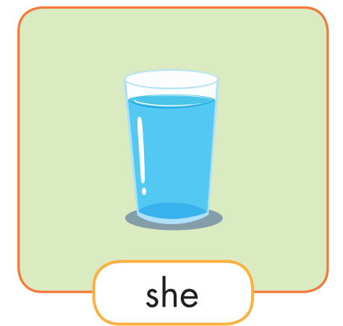
What does she need?
She needs ______________.
a lot of water

Slide 21
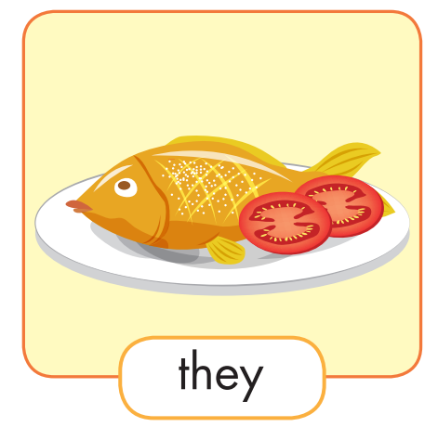
What do they need?
They need __________.
some fish

Slide 22
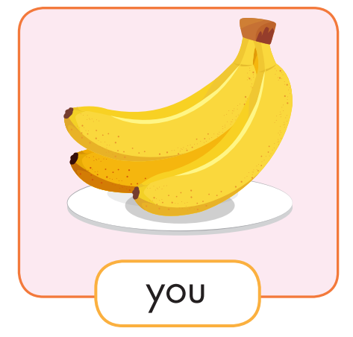
What do you need?
I need _______________.
a few bananas

Slide 23
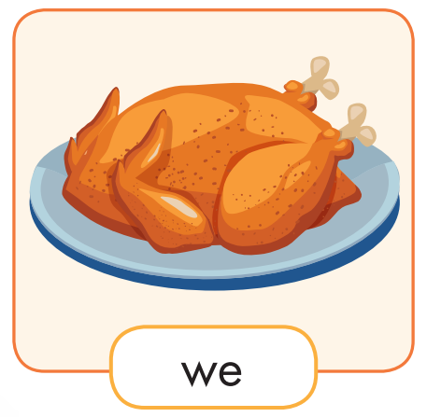
What do you need?
We need _______________.
some chicken

Slide 24
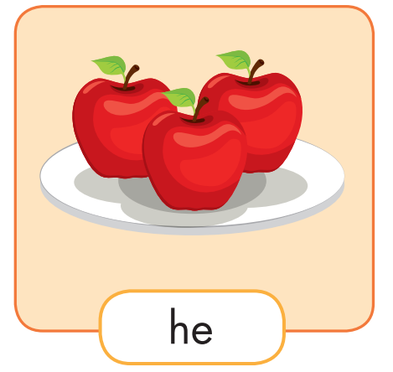
What does he need?
He needs _______________.
a lot of apples

Slide 25
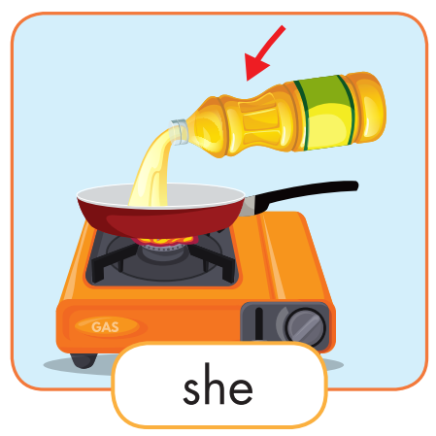
What does he need?
He needs ___________.
a little oil

Slide 26

Production

Slide 27

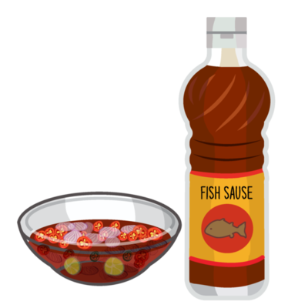
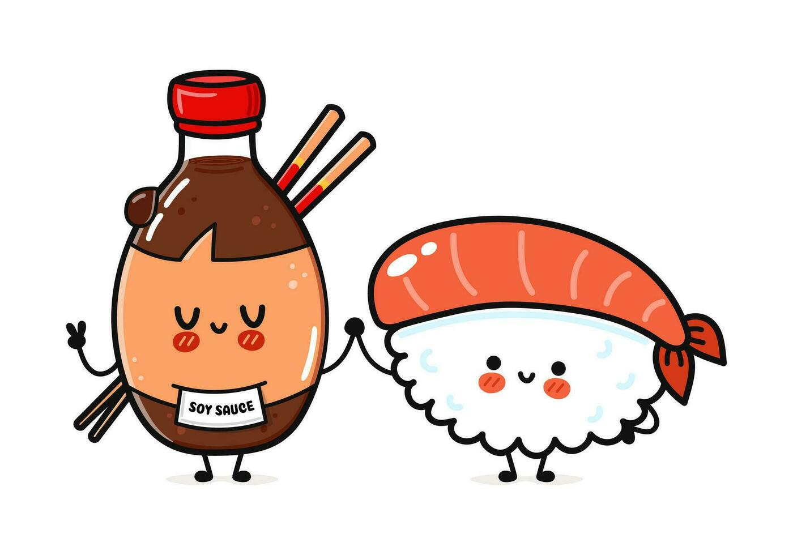
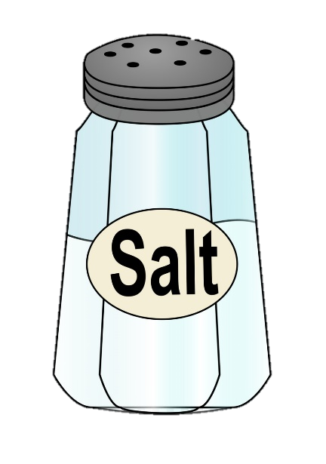
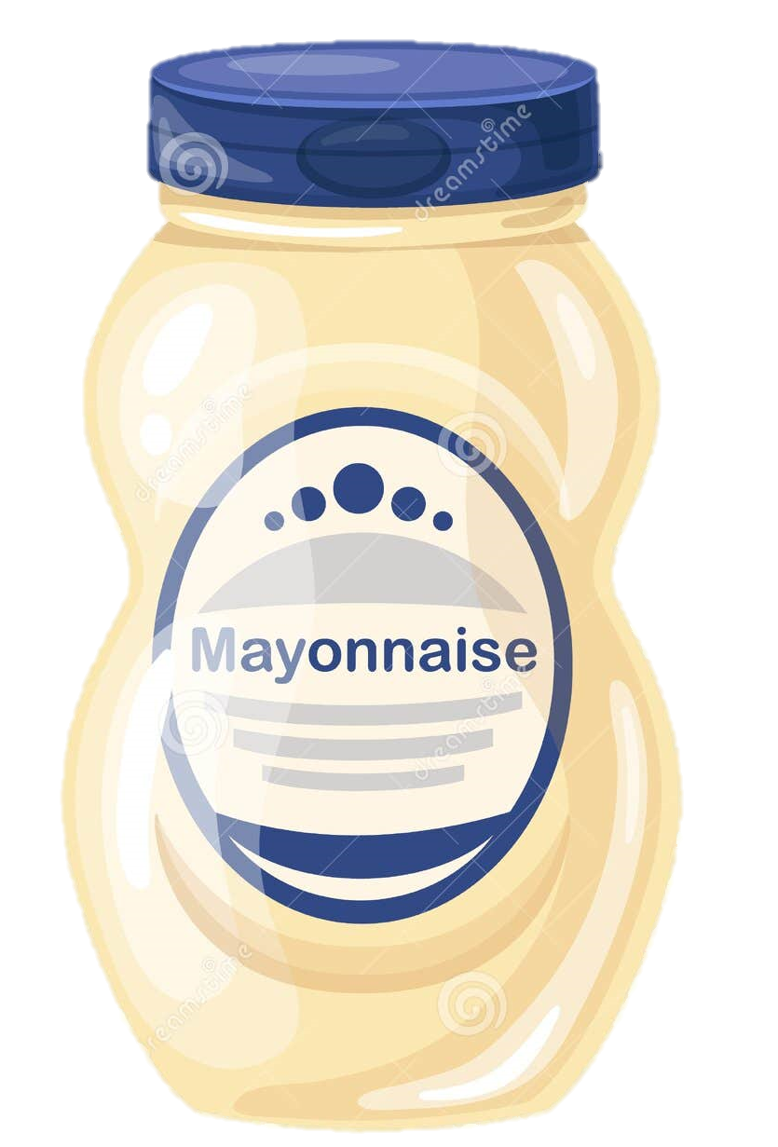
salt
tomato
ketchup
mayonnaise
fish sauce
soya sauce

Slide 28
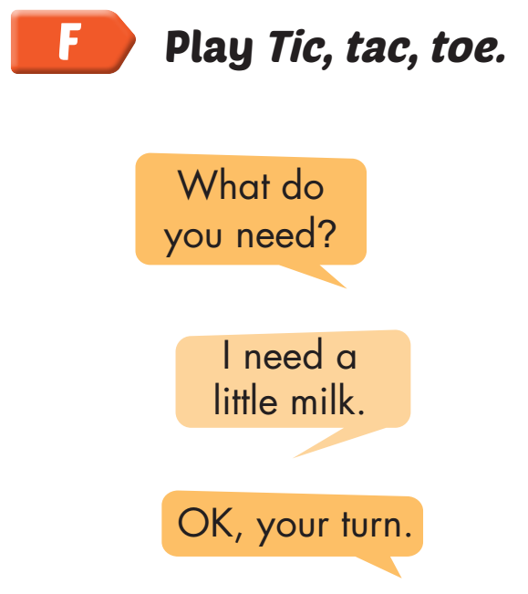
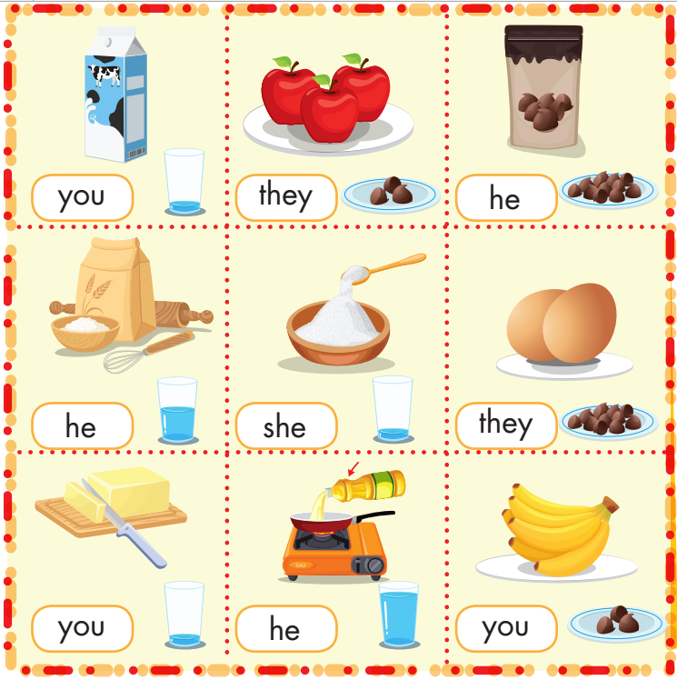

Slide 29




SPACE RACE
Choose One:
Rocket Ship or Alien Ship?

Slide 30

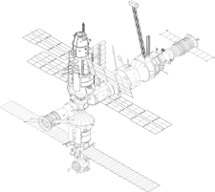









SPACE RACE
GO!
3
2
1
ROCKET SHIP WINS!
ALIEN SHIP
WINS!

Slide 31




SPACE RACE
1
2
3
4
5
6
7
8

Slide 32

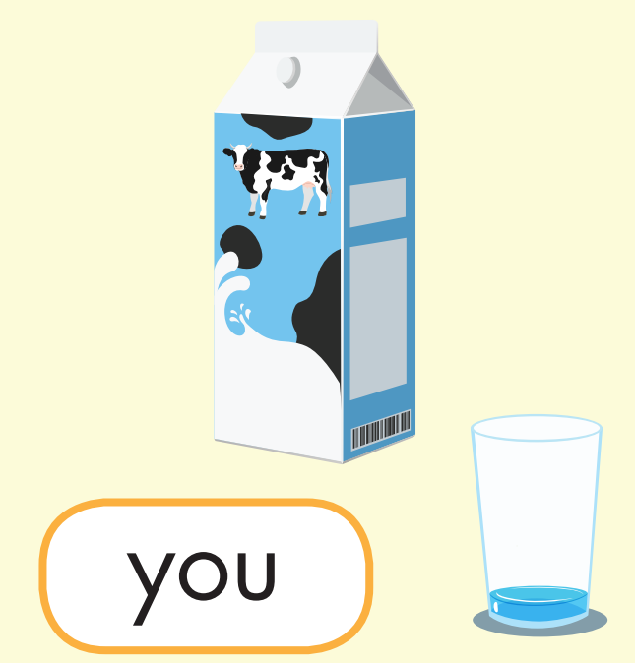

1. What do you need?
I need a little milk.

Slide 33
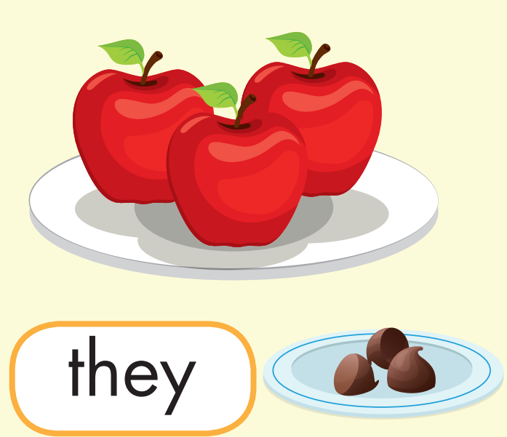
2. What do they need?
They need a few apples.

Slide 34
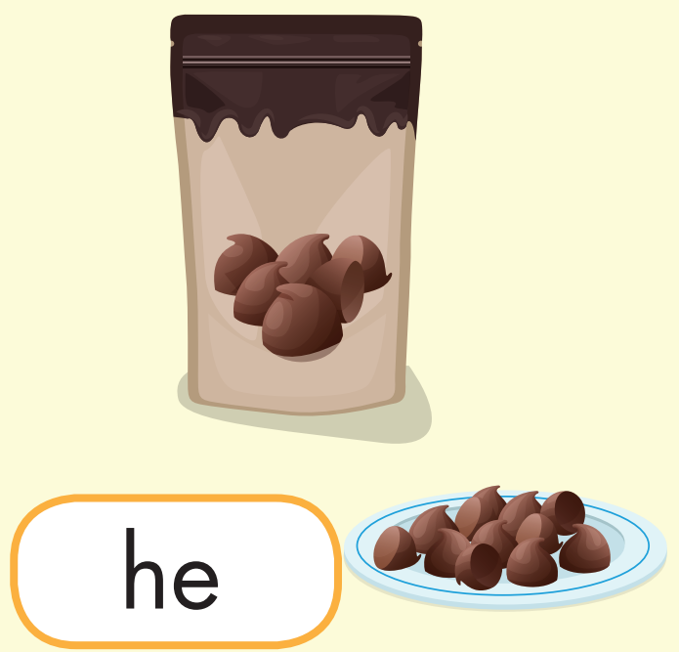
3. What does he need?
He needs a lot of chocolate chips.

Slide 35
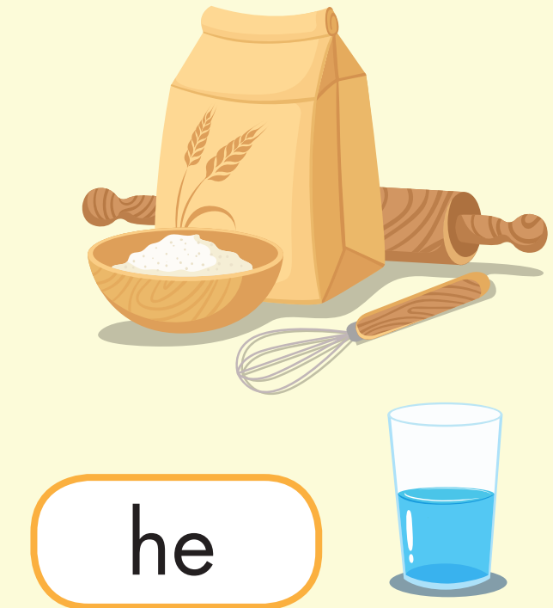
4. What does he need?
He needs some flour.

Slide 36
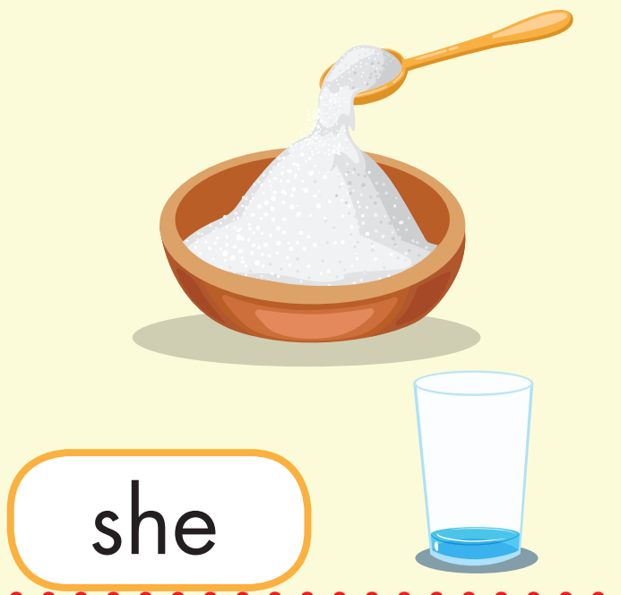
5. What does she need?
She needs a little sugar.

Slide 37
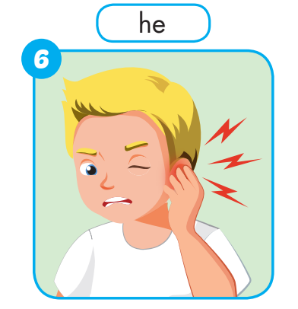
6. What’s wrong?
He has an earache.

Slide 38
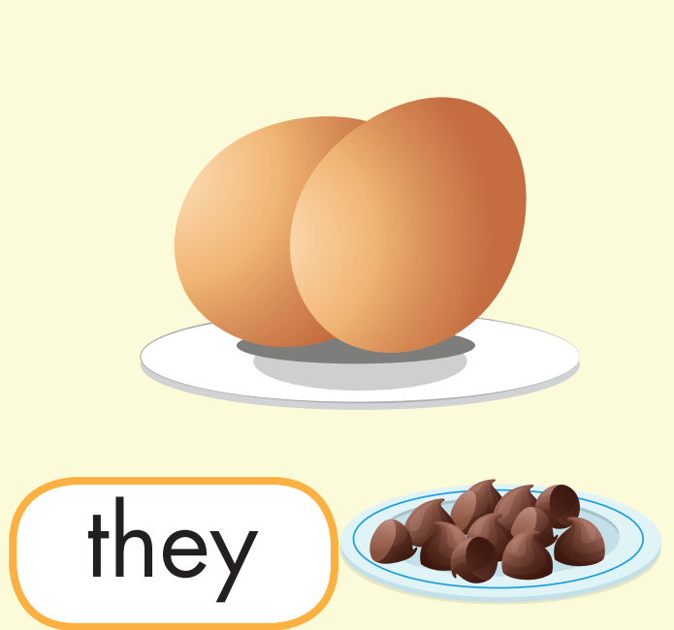
7. What do they need?
They need a lot of eggs.

Slide 39
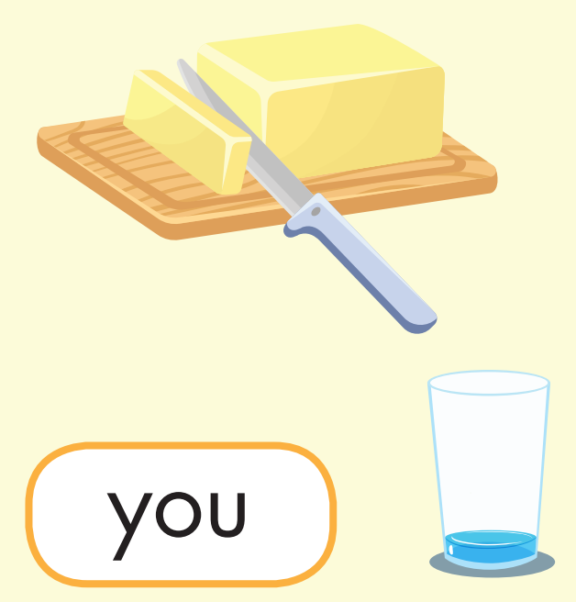
8. What do you need?
I need a little butter.

Slide 40

CONSOLIDATION

Slide 41

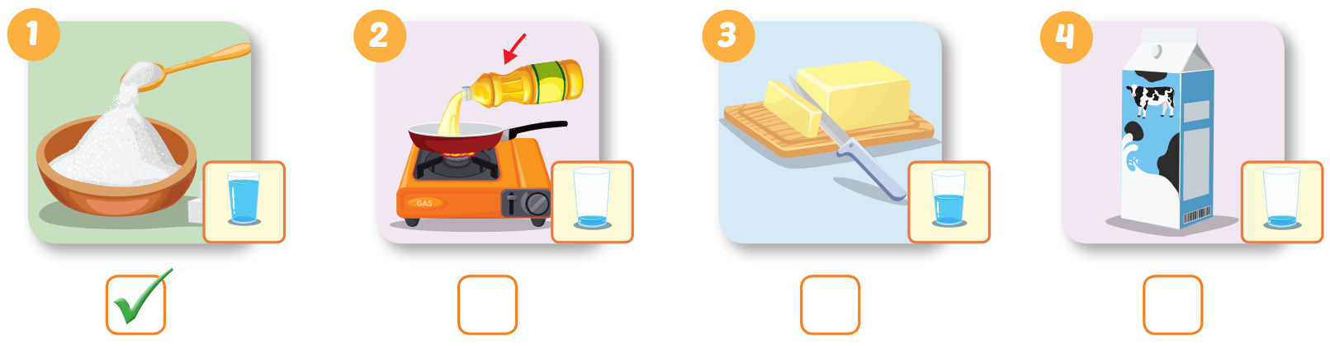


Extra Practice
WB, page 53

Slide 42
Today’s lesson
Vocabularies
sugar, butter, flour, chocolate chips, oil, milk.
Structures/ Sentence patterns
What do you need?
I need a lot of sugar.
What does she need?
She needs a little milk.

Slide 43
Homework
Practice the vocabularies and structure, and make sentences using them.
Do the exercises in Tiếng Anh 5 i-Learn Smart Start WB (page 53).
Do the exercises in Tiếng Anh 5 i-Learn Smart Start Notebook.
Prepare the next lesson (page 81 SB).
Play the consolidation games in Tiếng Anh 5 i-Learn Smart Start DHA App on www.eduhome.com.vn

Slide 44

Enjoy your day!

