Slide 1

Unit 6: FOOD AND DRINKS
Lesson 1.1
Page 78

Slide 2
Objectives
By the end of this lesson, students will be able to recognize vocabulary expressing food and drinks and say what they need to cook something.
Vocabulary: sugar, butter, flour, chocolate chips, oil, milk.
Sentence pattern: I need a little butter.

Slide 3

WARM-UP

Slide 4


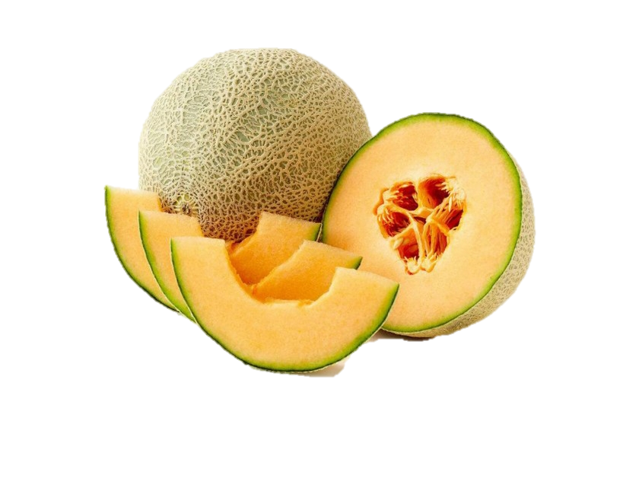
Catch the words
water
a melon
a watermelon

Slide 5



Catch the words
a moon
a cake
a mooncake

Slide 6
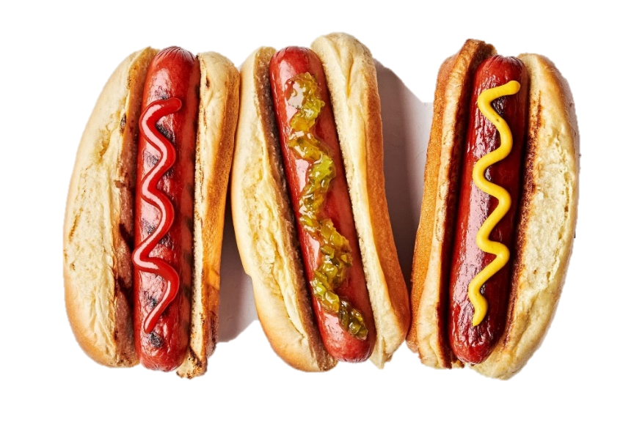


Catch the words
hot
a dog
a hot dog

Slide 7



Catch the words
milk
shake
milkshake

Slide 8
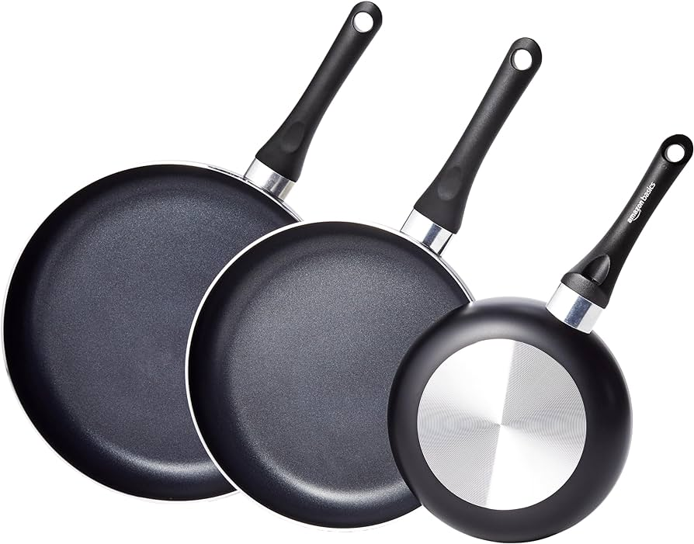
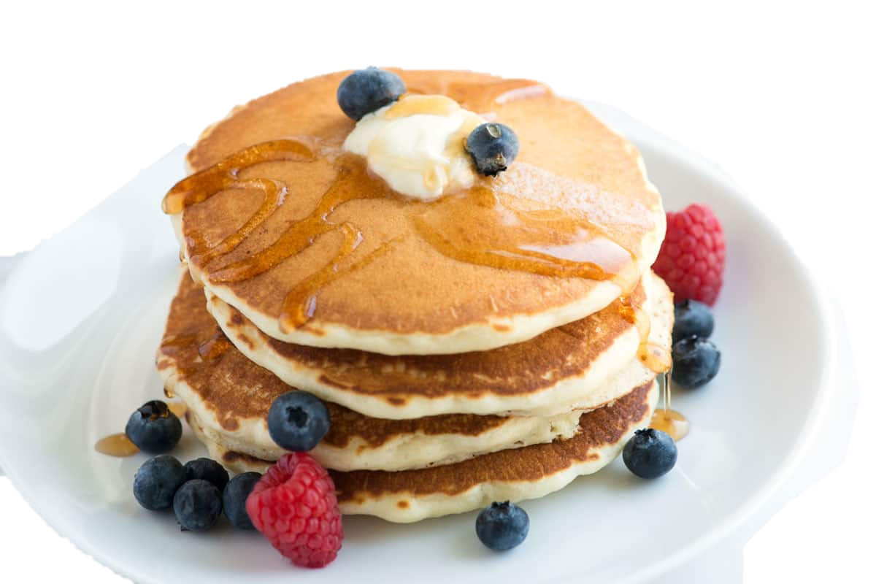
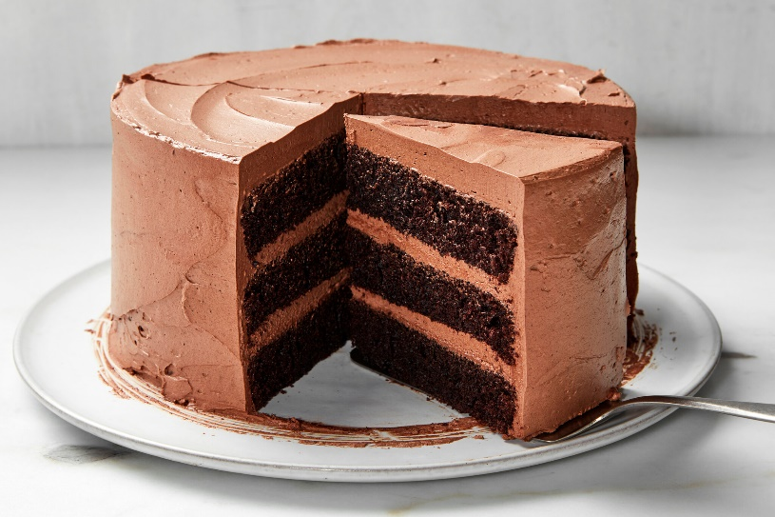
Catch the words
a pan
a cake
a pancake

Slide 9
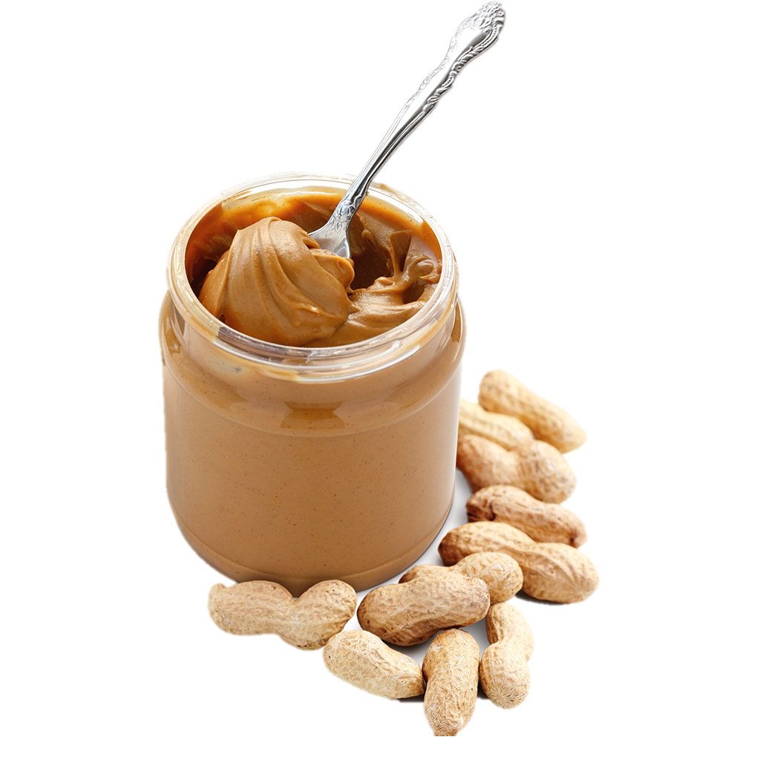
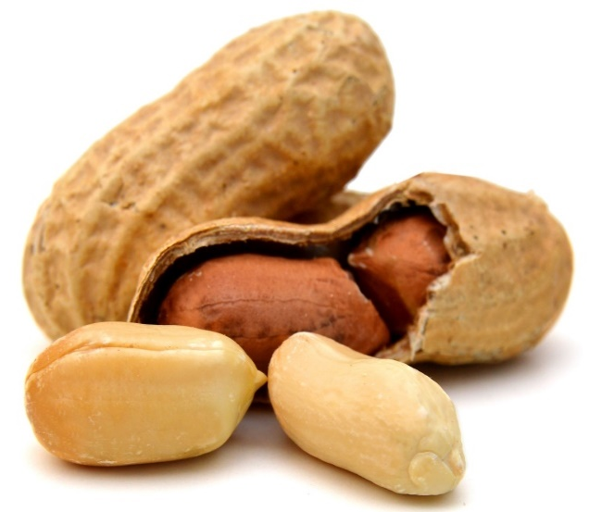
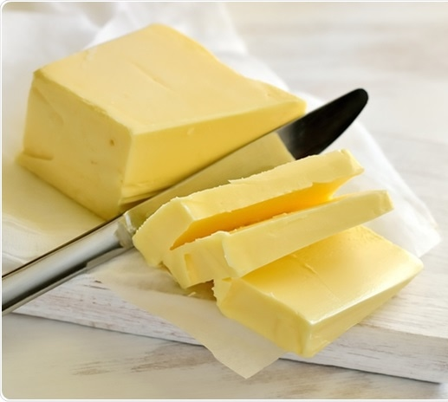
Catch the words
a peanut
butter
peanut butter

Slide 10

New words
sugar, butter, flour, chocolate
chips, oil, milk.

Slide 11

Presentation

Slide 12


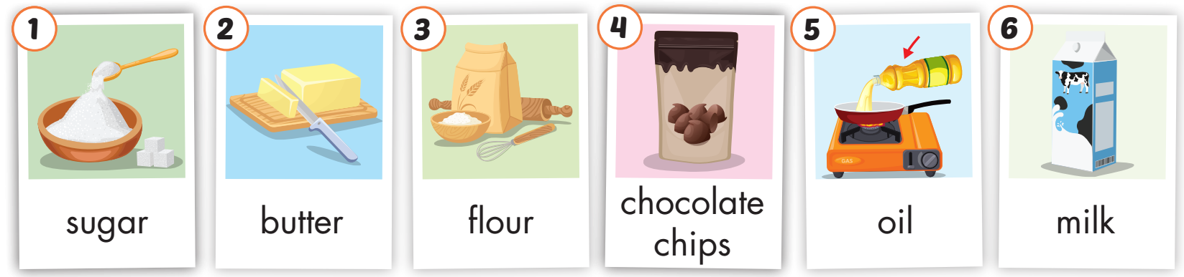
Click on A to hear the sound.
/ˈʃʊɡ.ɚ/
đường
/ˈbʌt̬.ɚ/
bơ
/ˈflaʊ.ɚ/
bột
/ˌtʃɑːk.lət ˈʧɪp/
kẹo viên socola
/ɔɪl/
dầu ăn
/mɪlk/
sữa
Notes:
Click vào hình A. 1. Listen and point. Repeat để cho cả audio full chạy

Slide 13

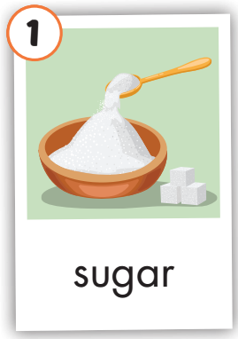
Click on the picture to hear the sound.
sugar
/ˈʃʊɡɚ/
đường

Slide 14
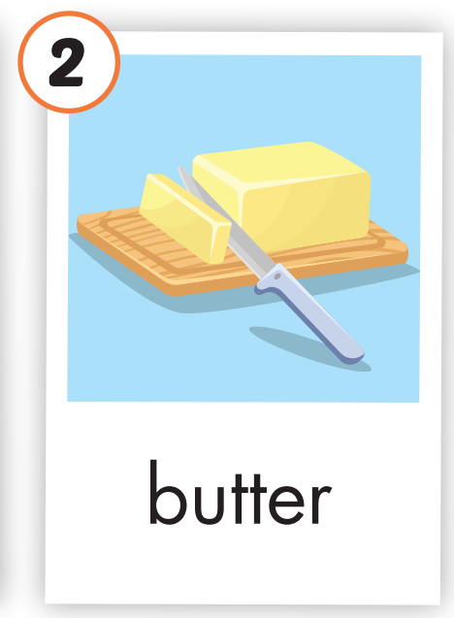
Click on the picture to hear the sound.
butter
/ˈbʌt̬.ɚ/
bơ

Slide 15
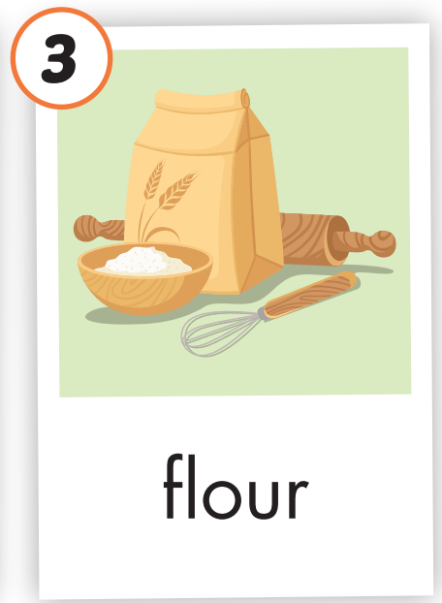
Click on the picture to hear the sound.
flour
/ˈflaʊ.ɚ/
bột

Slide 16
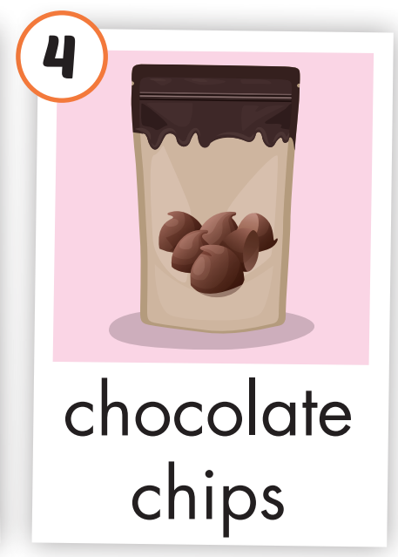
Click on the picture to hear the sound.
chocolate chips
/ˌtʃɑːk.lət ˈʧɪp/
kẹo viên socola

Slide 17
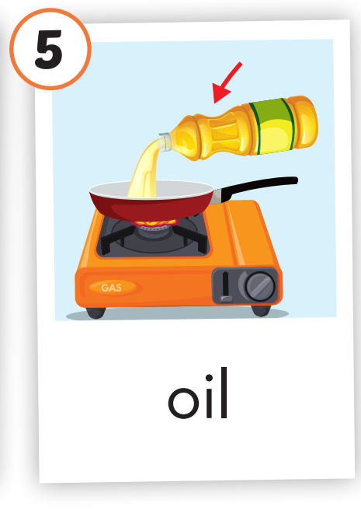
Click on the picture to hear the sound.
oil
/ɔɪl/
dầu ăn

Slide 18
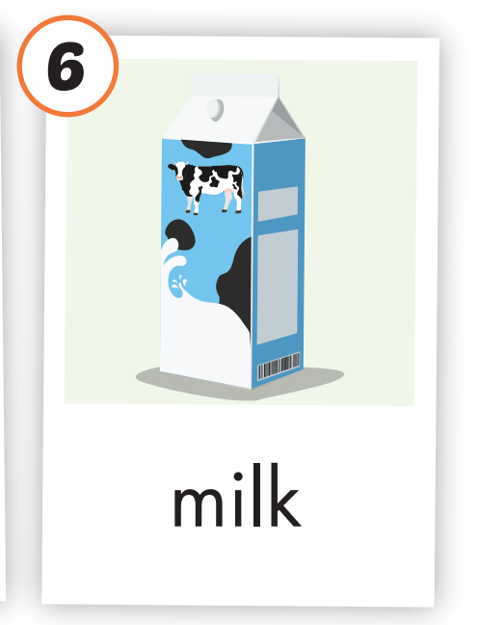
Click on the picture to hear the sound.
milk
/mɪlk/
sữa

Slide 19
Practice

Slide 20

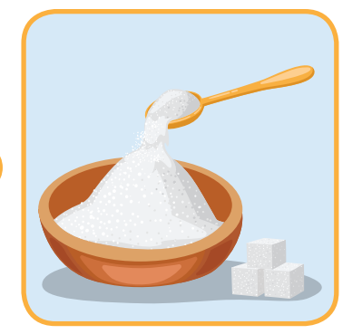


Listen and choose
A
B
C

Slide 21
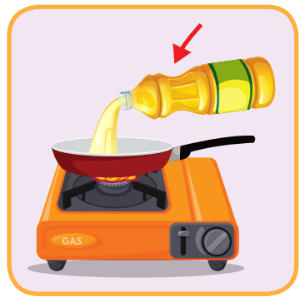
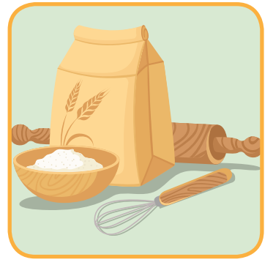

Listen and choose
A
B
C

Slide 22
Listen and choose
A
B
C

Slide 23
Listen and choose
A
B
C

Slide 24
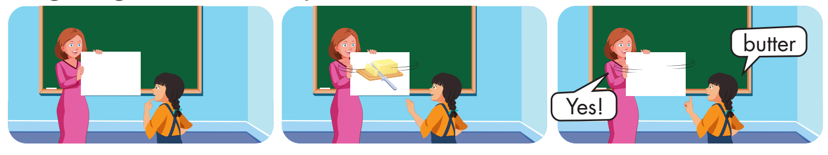

Slide 25
Presentation

Slide 26
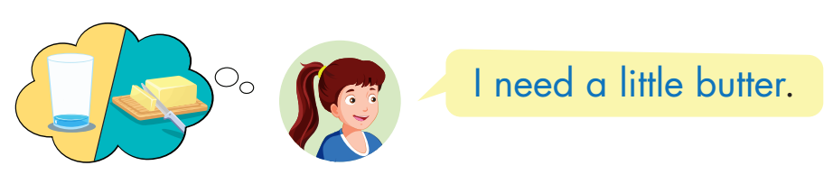
Structure
Click on the picture to hear the sound.

Slide 27

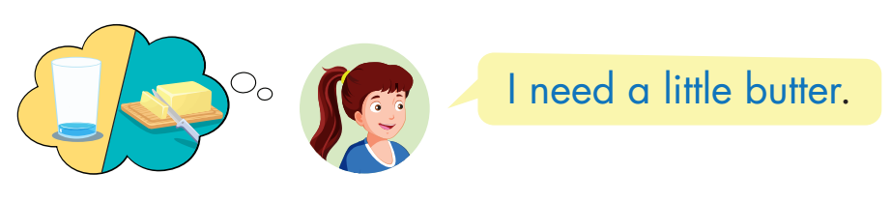
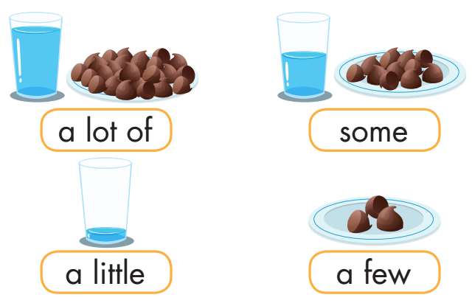
Click on B to hear the sound.

Slide 28
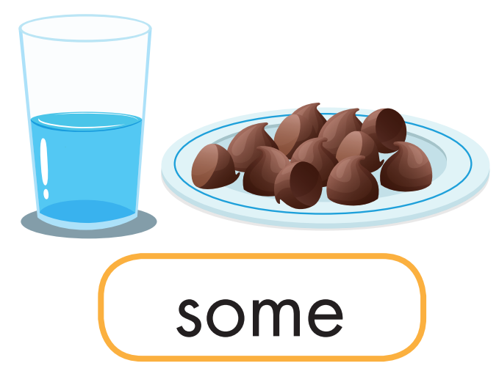
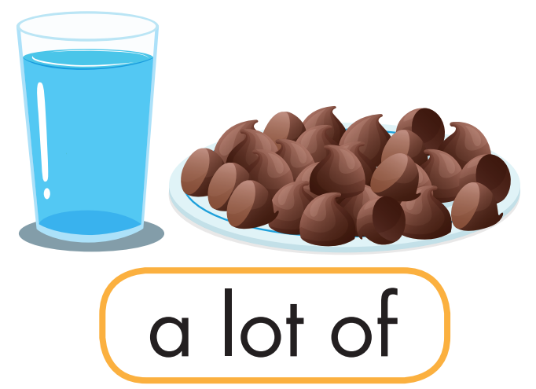
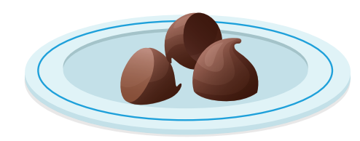


Match.

Slide 29

Practice

Slide 30

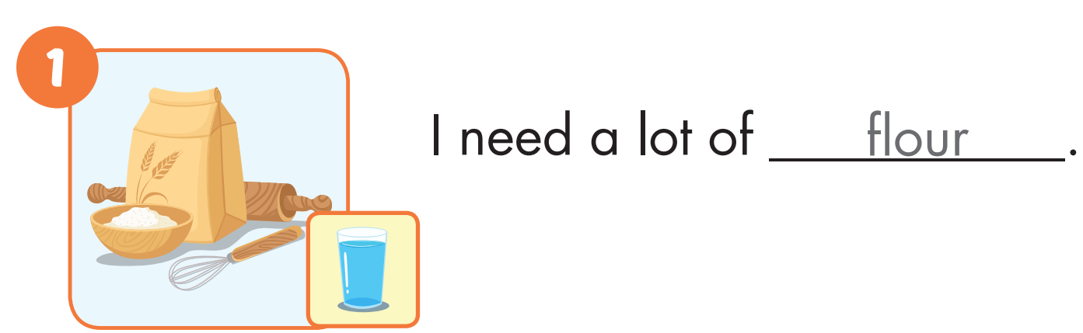

Slide 31
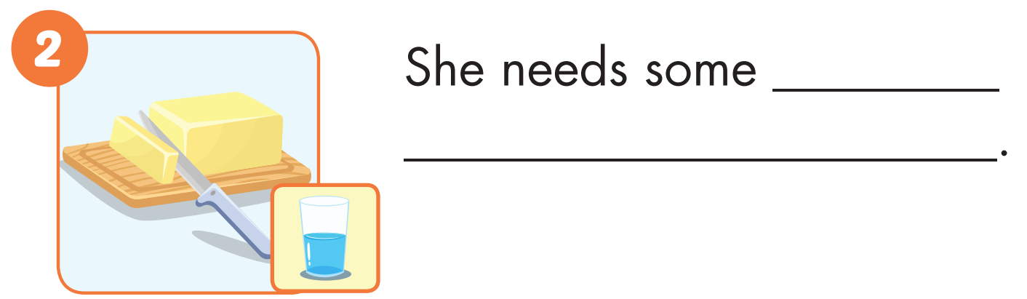
butter

Slide 32
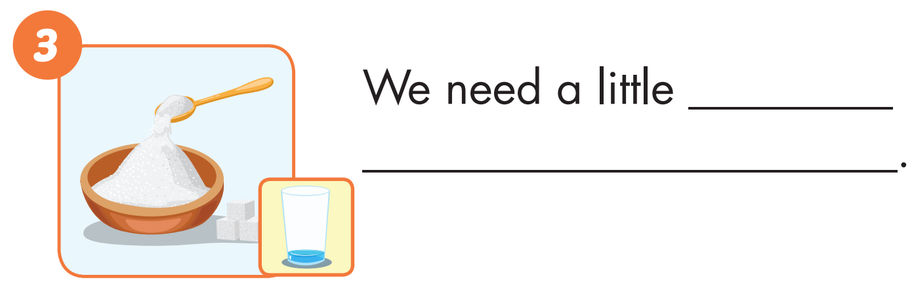
sugar

Slide 33
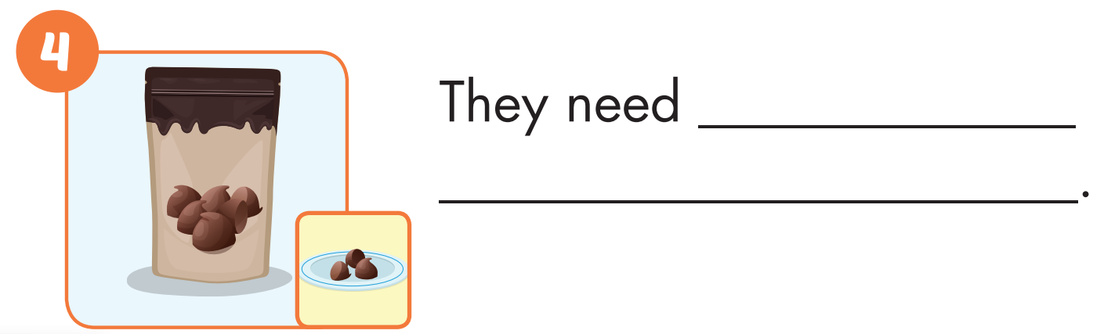
a few
chocolate chips

Slide 34
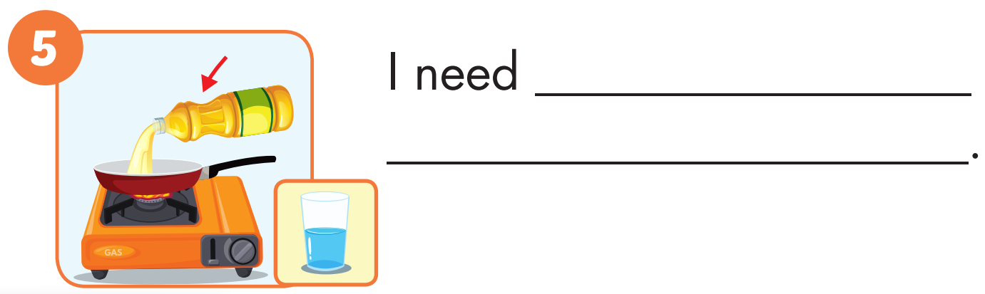
some oil

Slide 35
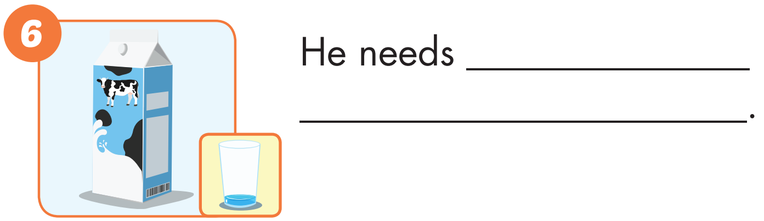
a little milk

Slide 36

Production

Slide 37
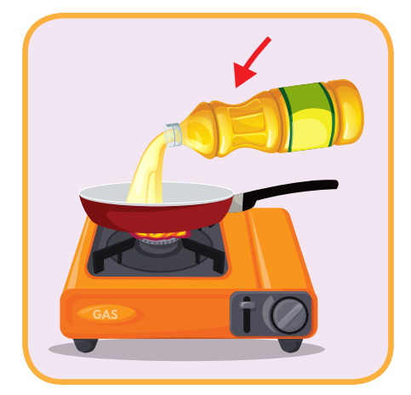
oil
SHOW

Slide 38

milk
SHOW

Slide 39
butter
SHOW

Slide 40
chocolate chips
SHOW

Slide 41
sugar
SHOW

Slide 42
flour
SHOW

Slide 43

CONSOLIDATION

Slide 44

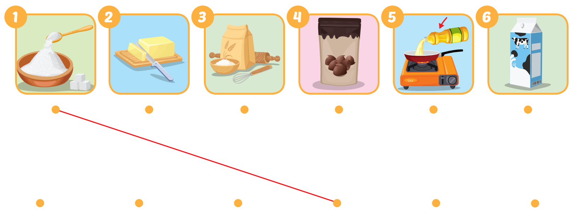
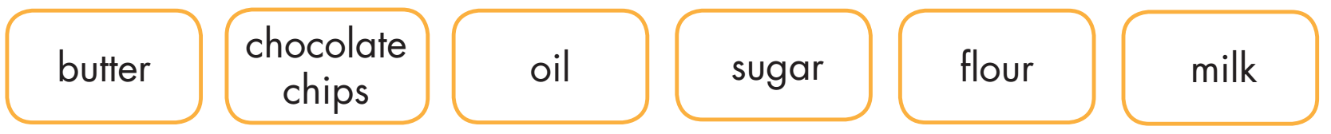
Extra Practice
WB, page 52

Slide 45
Today’s lesson
Vocabularies
sugar, butter, flour, chocolate chips, oil, milk.
Structures/ Sentence patterns
I need a little butter.

Slide 46
Homework
Practice the vocabularies and structure, and make sentences using them.
Do the exercises in Tiếng Anh 5 i-Learn Smart Start WB (page 52).
Do the exercises in Tiếng Anh 5 i-Learn Smart Start Notebook.
Prepare the next lesson (page 79 SB).
Play the consolidation games in Tiếng Anh 5 i-Learn Smart Start DHA App on www.eduhome.com.vn

Slide 47

Enjoy your day!

