Slide 1

Unit 4: Travel
Lesson 4.3
Page 59

Slide 2


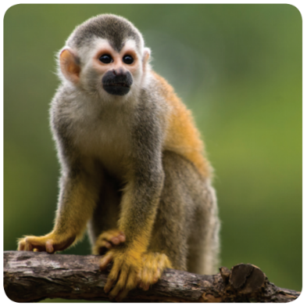

LẮP RÁP TÊN LỬA
PLAY
Monkey

Slide 3



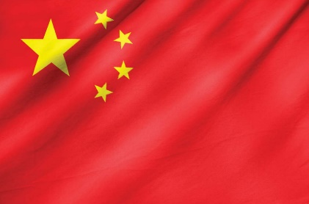



A
B
C
D
China

Slide 4




A
B
C
D
Indonesia

Slide 5

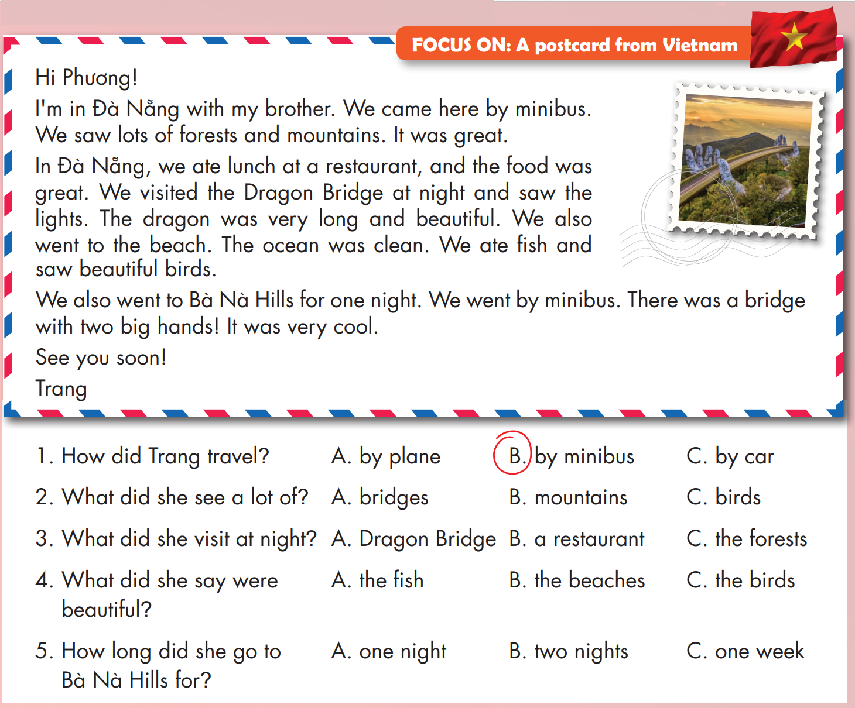

Slide 6
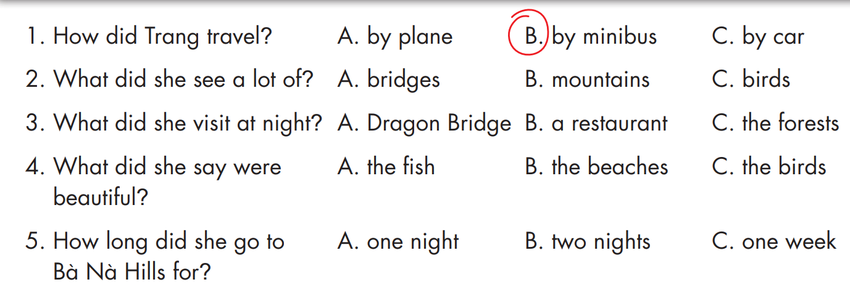


Slide 7
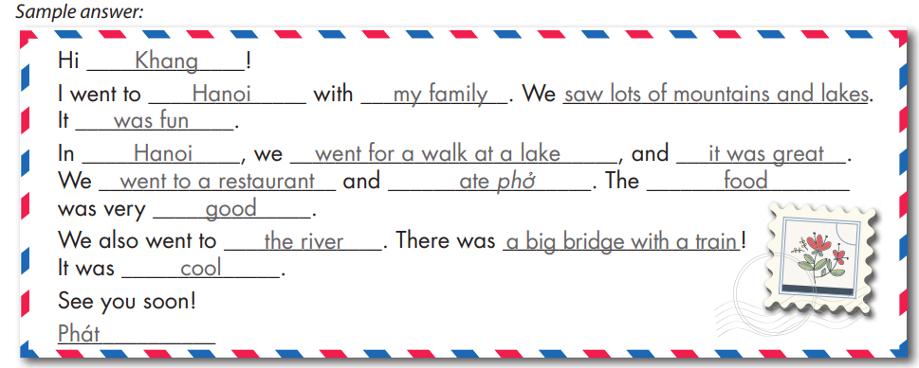
1. What's your friend's name?
2. Where did you go?
3. Who did you go with?
4. What did you do there?

Slide 8
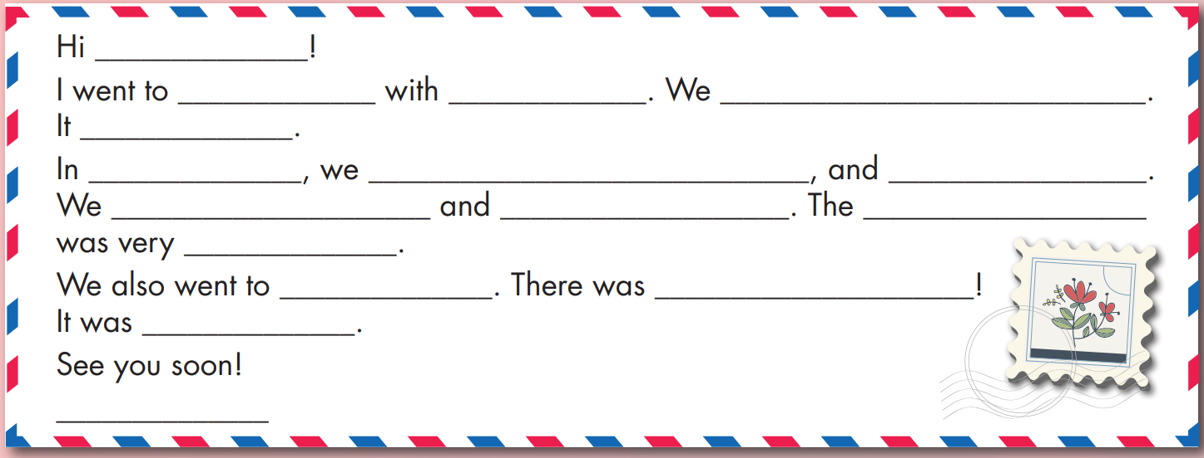

Slide 9

Extra Practice
WB, page 39
1. What's your friend's name?
2. Where did you go?
3. How did you get there?
4. What did you do there?
Sample writing:
Hi Ly!
My family went to Thailand. We went by plane. We went to the beach and swam in the ocean. It was beautiful. We also ate lots of delicious food. I'm having a great time.
See you soon.
My

Slide 10
Homework
Practice the vocabularies and structure, and make sentences using them.
Do the exercises in Tiếng Anh 5 i-Learn Smart Start WB (page 19)
Do the exercises in Tiếng Anh 5 i-Learn Smart Start Notebook (page 25)
Prepare the next lesson (page 32 SB)
Play the consolidation games in Tiếng Anh 5 i-Learn Smart Start DHA App on www.eduhome.com.vn

