Slide 1

Unit 4: Travel
Lesson 4.1
Page 57

Slide 2












> Someone has deleted some words.
> Guess the deleted word within the time limit (12 seconds).

Slide 3



They went by van.
CHECK
Notes:
3

Slide 4


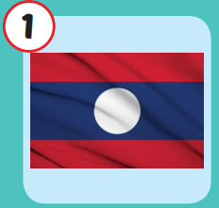
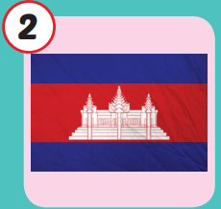
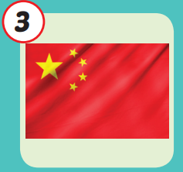
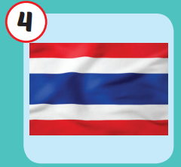
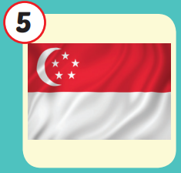
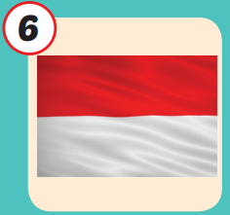






/laʊs/
nước Lào
/kæmˈbəʊdiə/
nước Campuchia
/ˈtʃaɪnə/
nước
Trung Quốc
/ˈtaɪlænd/
nước Thái Lan
/ˈsɪŋəpɔːr/
nước Singapore
/ˌɪndəˈniːʒə/
nước Indonesia
Notes:
Click vào hình A. 1. Listen and point. Repeat để cho cả audio full chạy

Slide 5
Check your memory

Slide 6


Look and choose
LAO
JAPAN
CAMBODIA

Slide 7

Look and choose
LAO
THAILAND
CAMBODIA

Slide 8

Look and choose
CHINA
THAILAND
COMBODIA

Slide 9





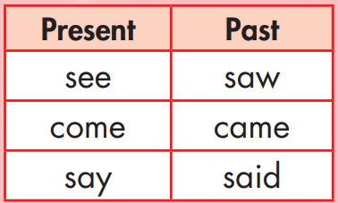
Structure

Slide 10

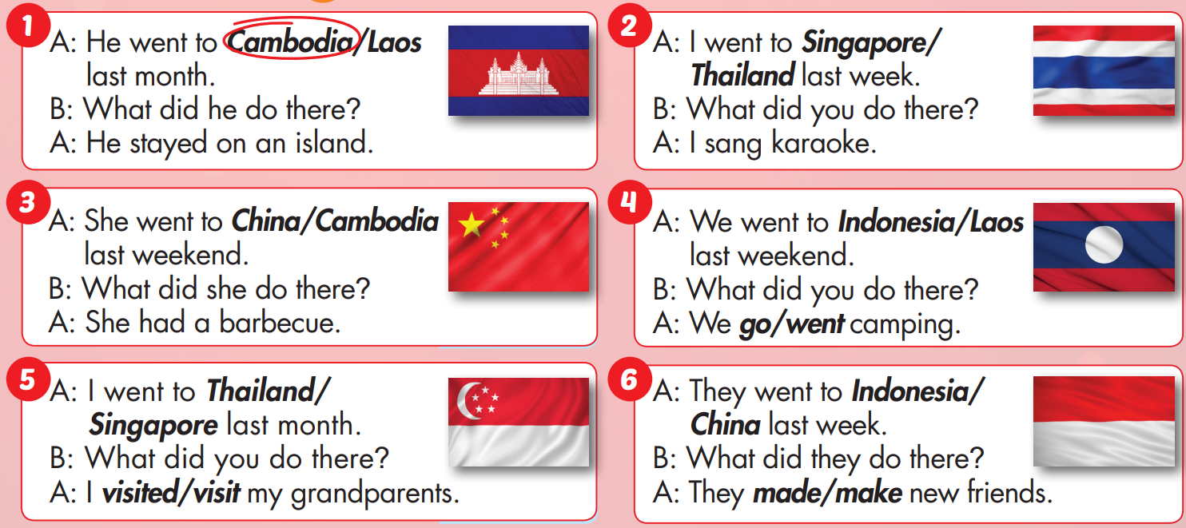


Slide 11

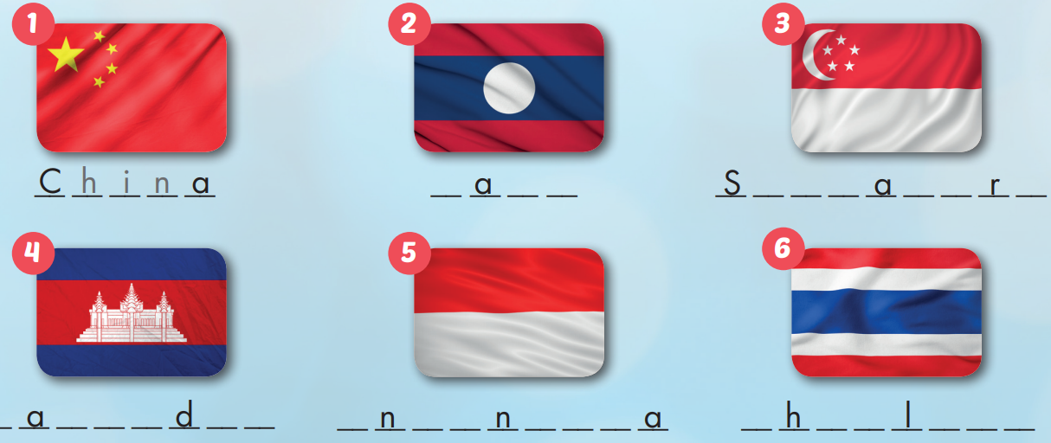
Extra Practice
WB, page 38
L o s
i n g p o e
C m b o i a
I d o e s i
T a i a n d

Slide 12

CONSOLIDATION

Slide 13
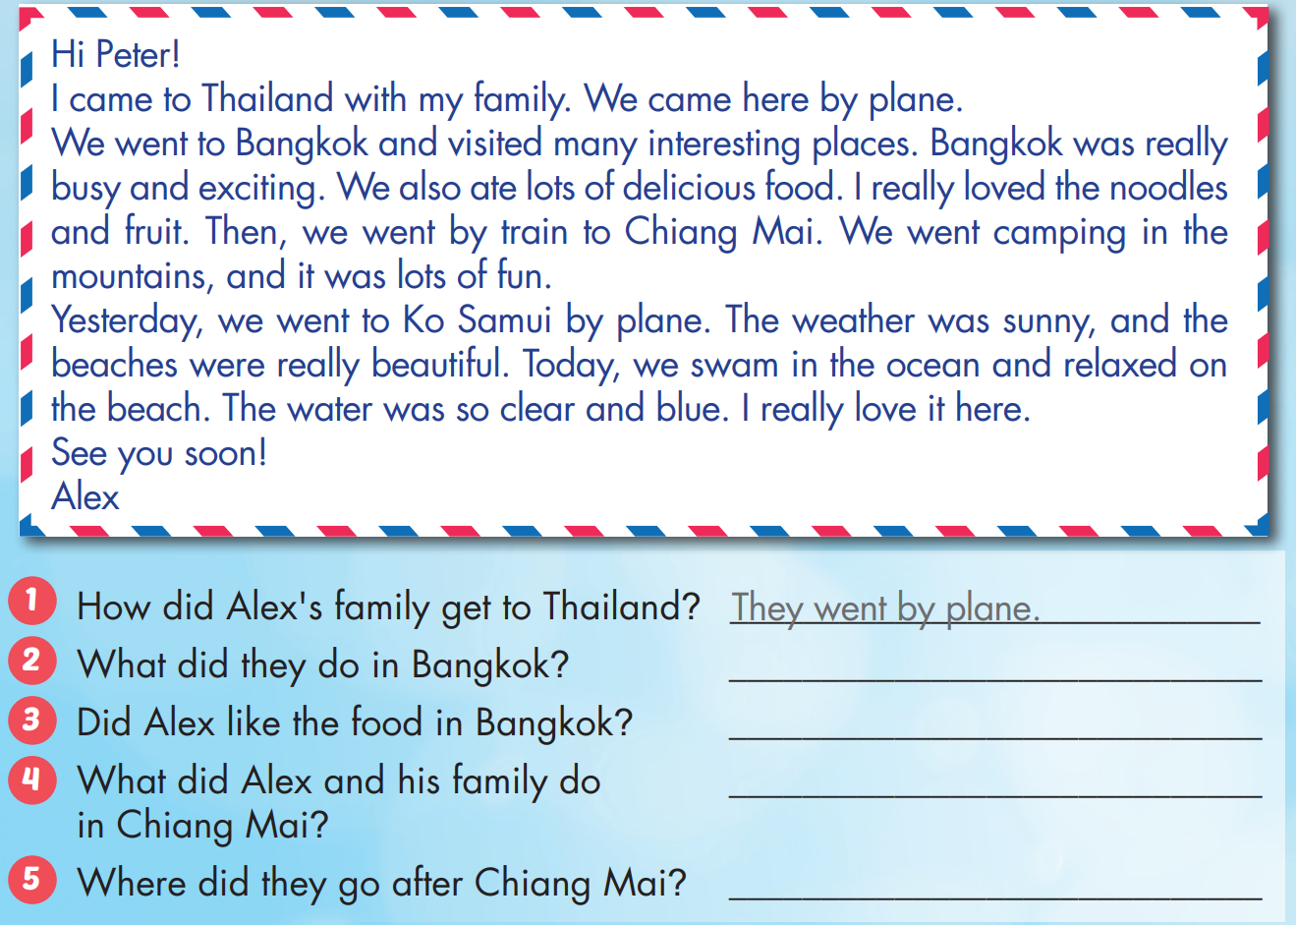
Extra Practice
WB, page 38

Slide 14
Homework
Practice the vocabularies and structure, and make sentences using them.
Do the exercises in Tiếng Anh 5 i-Learn Smart Start WB (page 37)
Do the exercises in Tiếng Anh 5 i-Learn Smart Start Notebook (page 25)
Prepare the next lesson (page 58 SB)
Play the consolidation games in Tiếng Anh 5 i-Learn Smart Start DHA App on www.eduhome.com.vn

