Slide 1

Unit 4: Travel
Lesson 3.2
Page 55

Slide 2
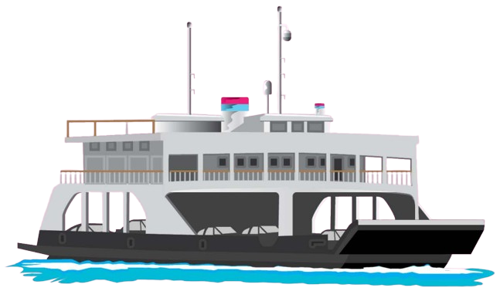
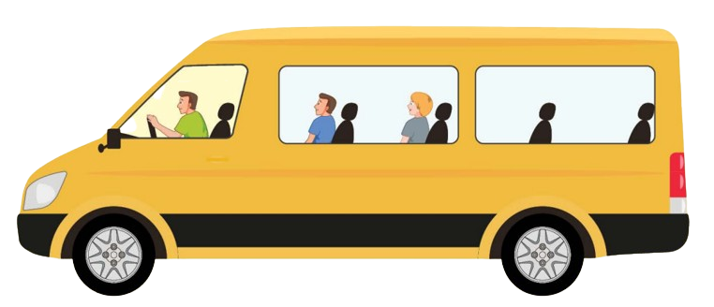




Listen and choose
A
B

Slide 3
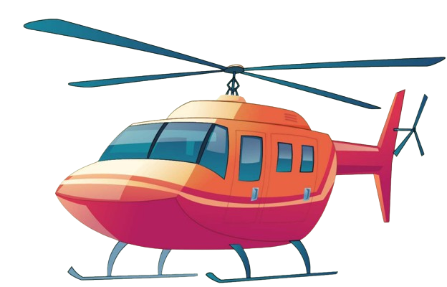
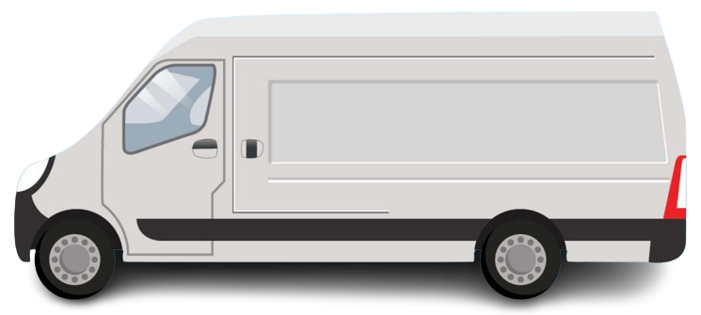
Listen and choose
A
B

Slide 4
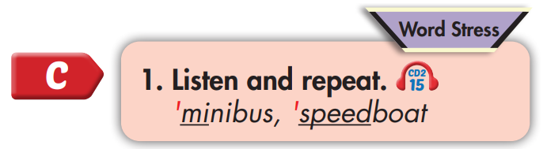
'minibus
'speedboat

Slide 5


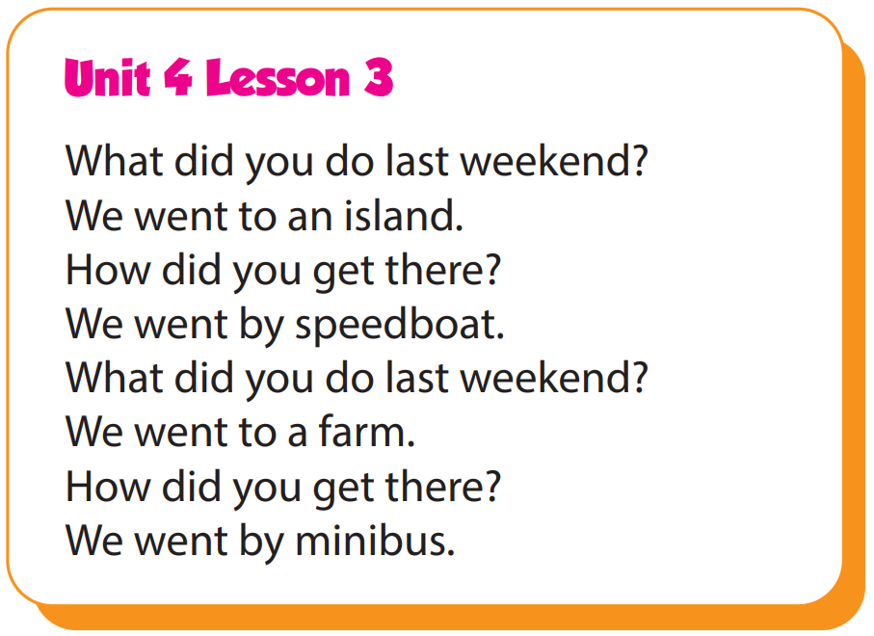

Slide 6
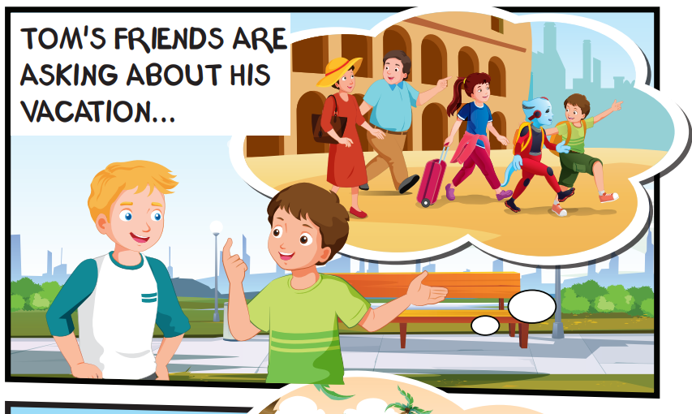
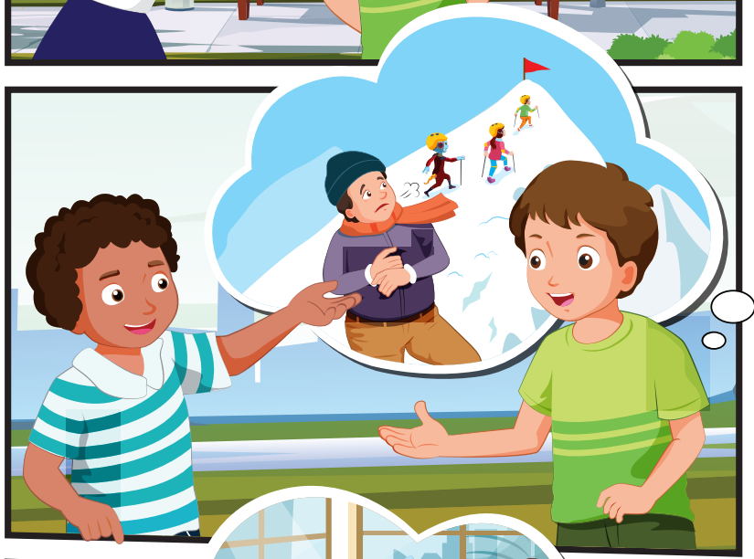
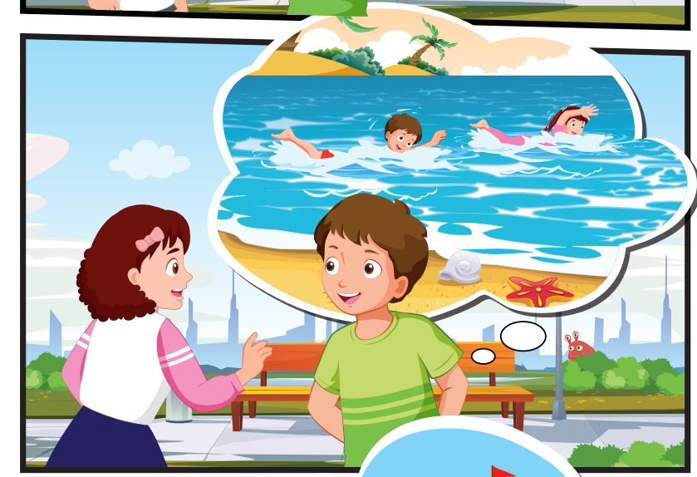
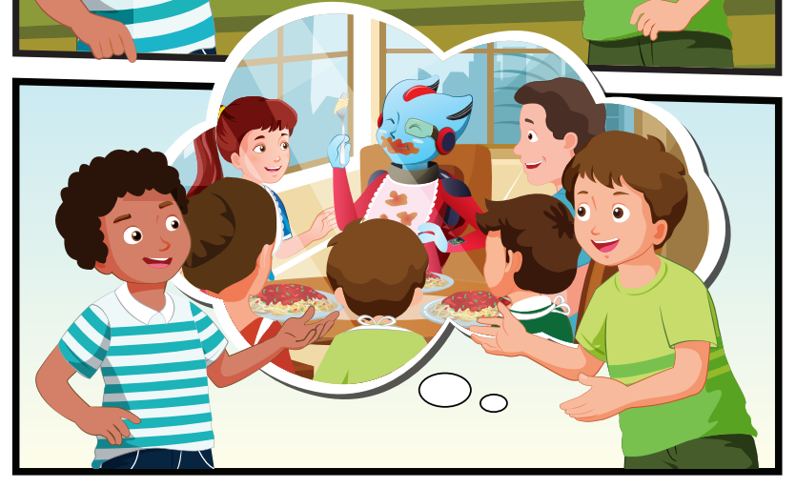
Who can you see?
Tom and his family, Alfie, Nick, Jill, Cody

Slide 7
Where are they?
Tom, Nick, Jill, and Cody are outside

Slide 8
What are they talking about?
Tom's vacation

Slide 9


Slide 10

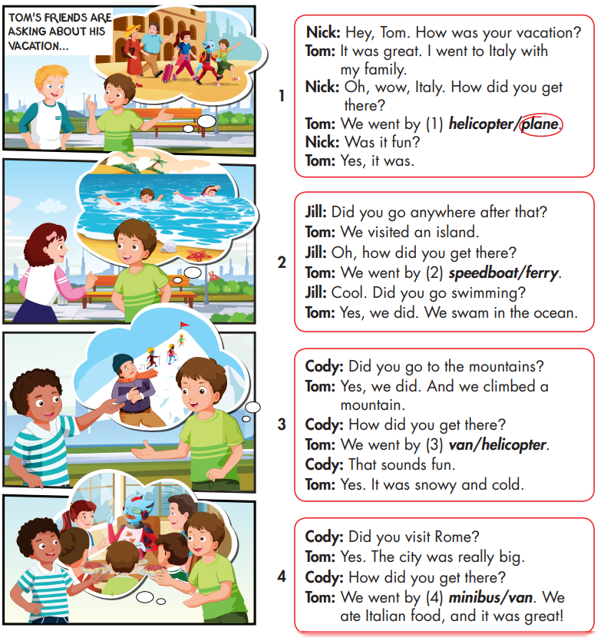

Slide 11



Slide 12
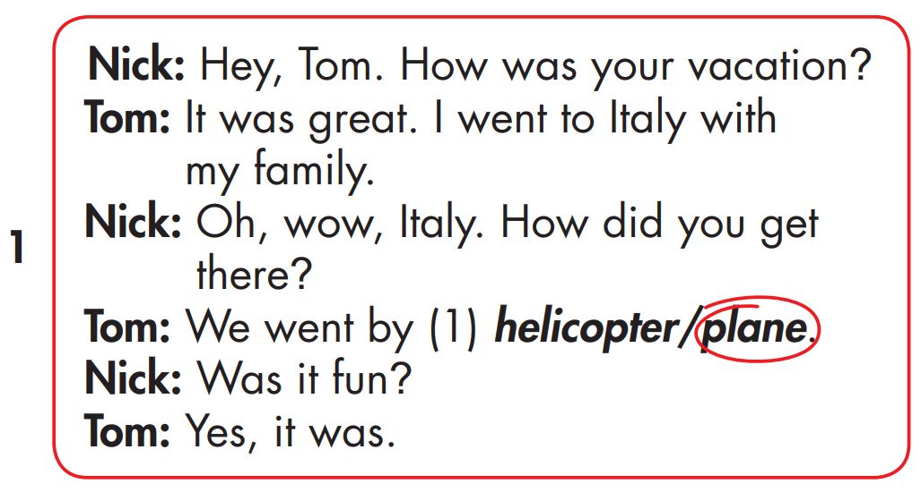
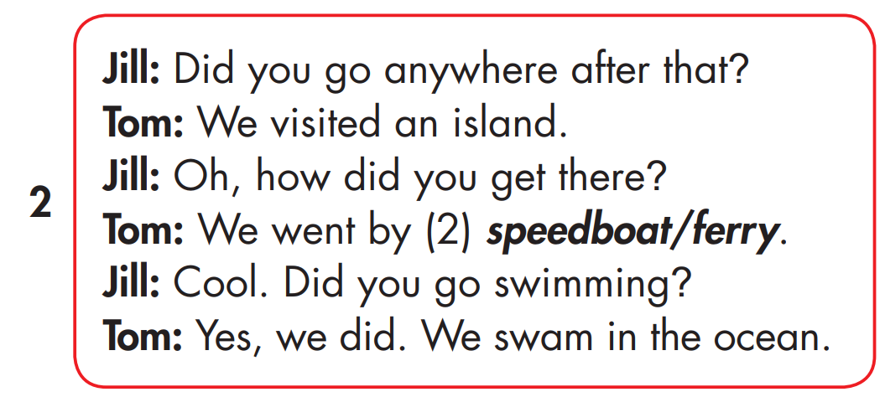

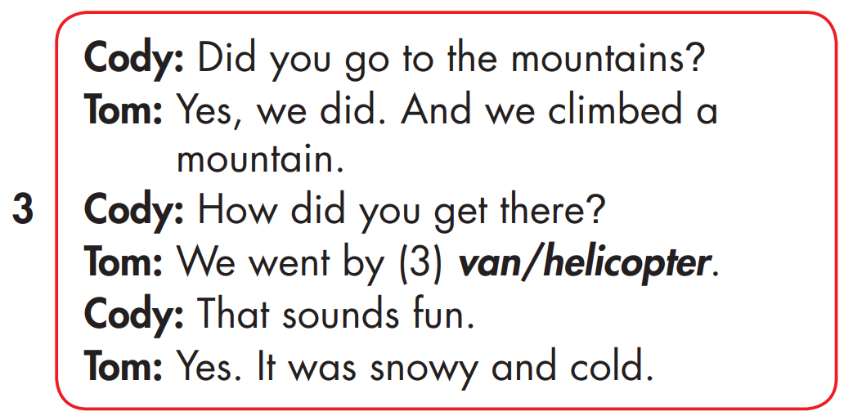
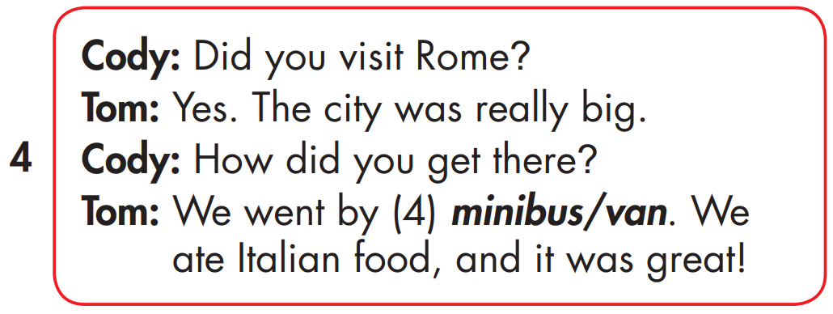
MAKE YOUR OWN STORY

Slide 13

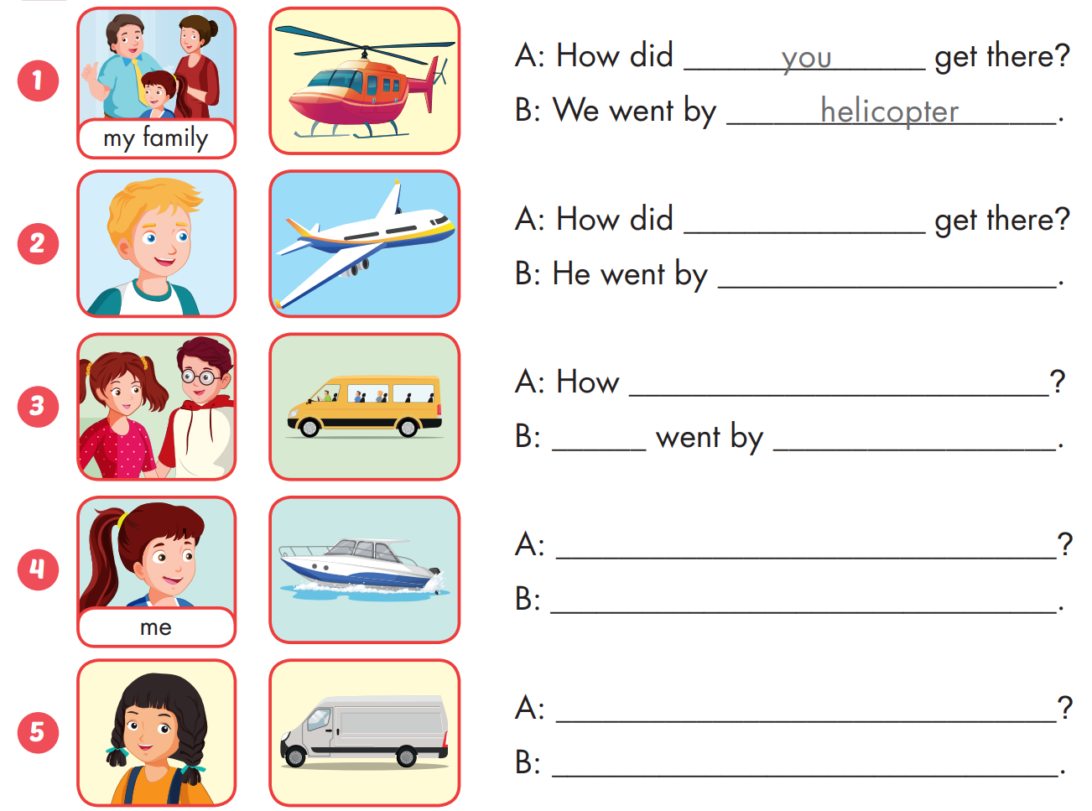
Extra Practice
WB, page 36

Slide 14

Extra Practice
WB, page 36
he
plane

Slide 15
Extra Practice
WB, page 36
did they get there
They
minibus
How did you get there
I went by speedboat.
How did she get there
She went by van

Slide 16
Homework
Practice the vocabularies and structure, and make sentences using them.
Do the exercises in Tiếng Anh 5 i-Learn Smart Start WB (page 35)
Do the exercises in Tiếng Anh 5 i-Learn Smart Start Notebook (page 24)
Prepare the next lesson (page 56 SB)
Play the consolidation games in Tiếng Anh 5 i-Learn Smart Start DHA App on www.eduhome.com.vn

