Slide 1

Unit 4: Travel
Lesson 2.3
Page 53

Slide 2












Travel
Where did he go last month?
He went to Canada.
TIME
IS UP

Slide 3


Travel
Where did she go last week?
She went to France.
TIME
IS UP

Slide 4


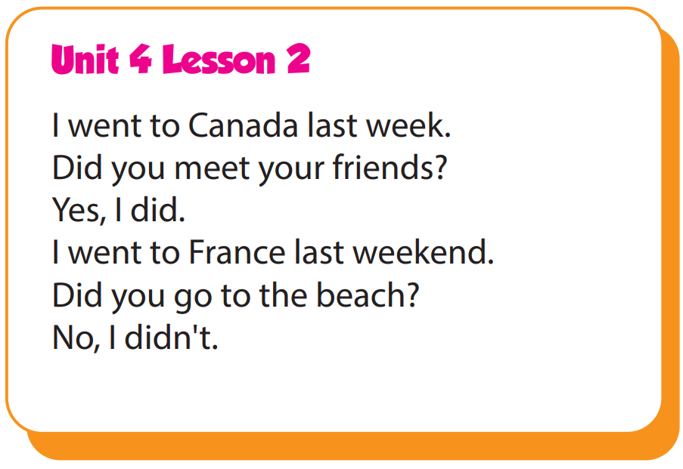

Slide 5

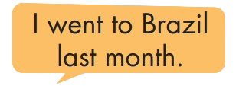
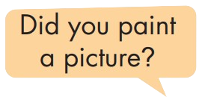
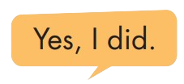
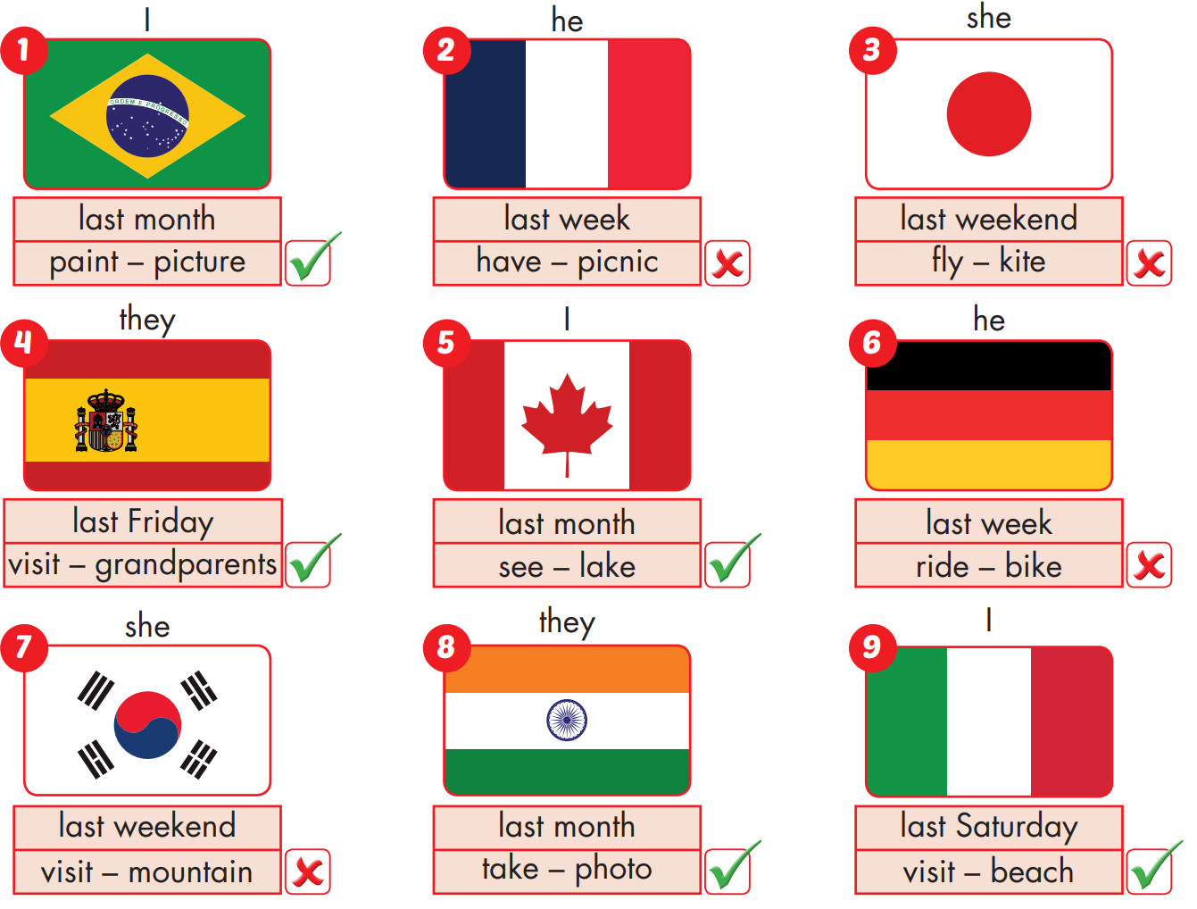

Slide 6
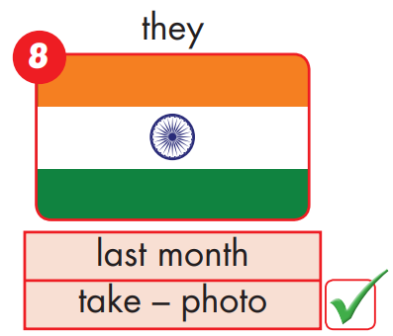
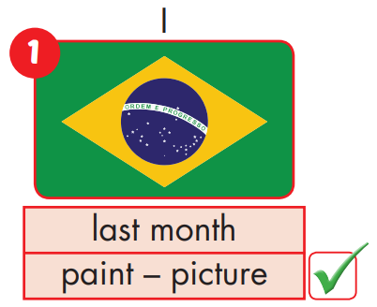
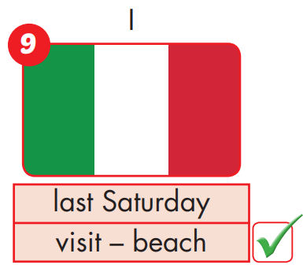
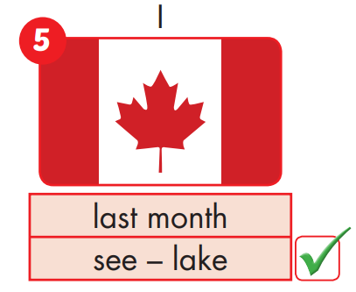
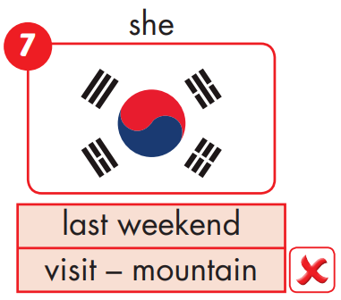

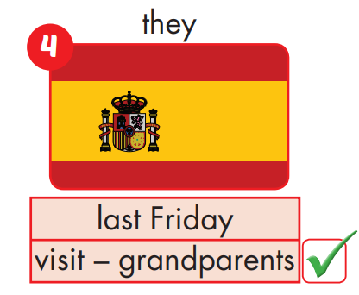
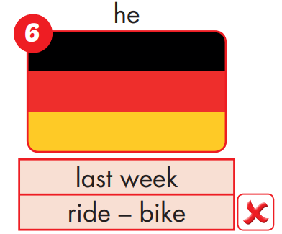
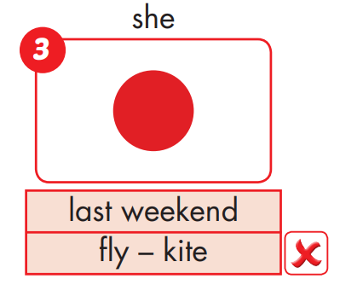
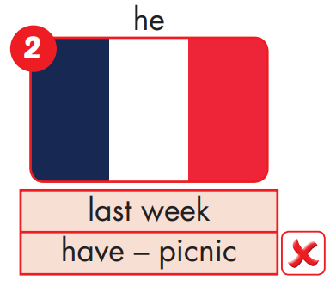

Slide 7
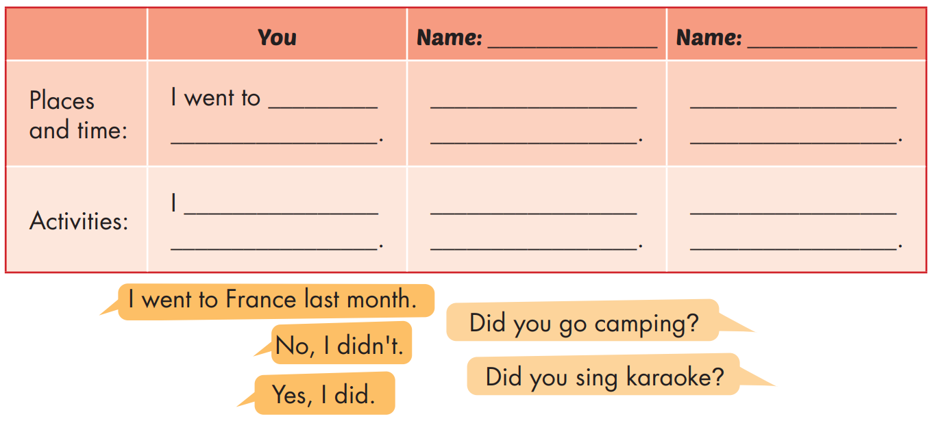
What's your friend's name?
Where did he/she go?
What did he/she do?

Slide 8
Homework
Practice the vocabularies and structure, and make sentences using them.
Do the exercises in Tiếng Anh 5 i-Learn Smart Start WB (page 35)
Do the exercises in Tiếng Anh 5 i-Learn Smart Start Notebook (page 23)
Prepare the next lesson (page 54 SB)
Play the consolidation games in Tiếng Anh 5 i-Learn Smart Start DHA App on www.eduhome.com.vn

