Slide 1

Unit 4: Travel
Lesson 2.1
Page 51

Slide 2
Objectives
By the end of this lesson, students will be able to…
Vocabulary: Pronounce and use the words related to the topic properly: Canada, France, South Korea, Brazil, Germany, Spain
Structure: I went to South Korea last month.
- Did you sing karaoke?
- Yes, I did./No, I didn't.

Slide 3

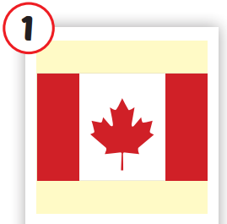
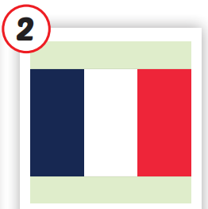
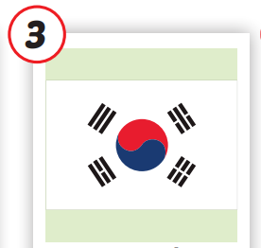
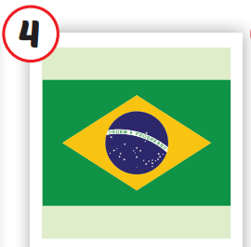
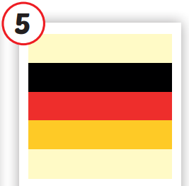
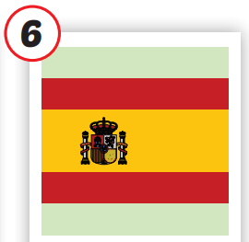







/ˈkænədə/
nước Canada
/fræns/
nước Pháp
/ˌsaʊθ kəˈriːə/
nước Hàn Quốc
/brəˈzɪl/
nước Brazil
/ˈdʒəːrməni/
nước Đức
/speɪn/
nước Tây Ban Nha
Notes:
Click vào hình A. 1. Listen and point. Repeat để cho cả audio full chạy

Slide 4







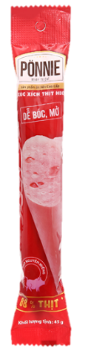


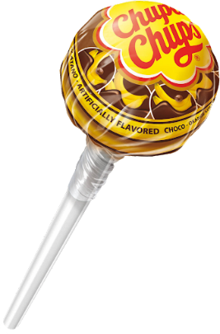




NEXT ROUND
Secrect Presents
Notes:
BÀI GIẢNG PPT SMART START 3 NEW 2022
Author: Thao Nguyen
Điện thoại: 0905917335
Zalo: 0905917335
Fb: https://www.facebook.com/dn.thaonguyen/
Group chia sẻ tài liệu: https://www.facebook.com/groups/220848385841356
******Liên hệ chính chủ để được hỗ trợ nếu bài bị lỗi.

Slide 5
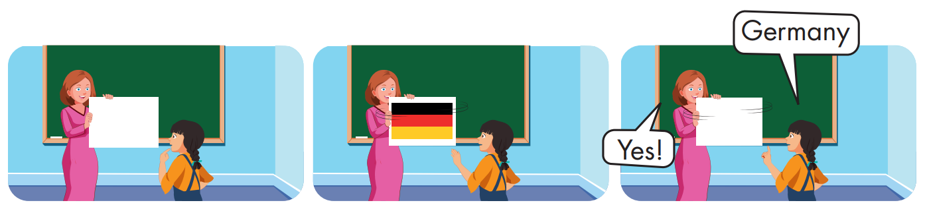

Slide 6
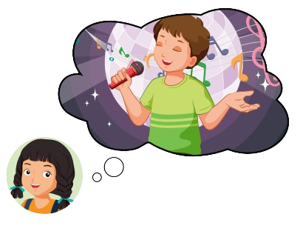




Structure

Slide 7


Slide 8

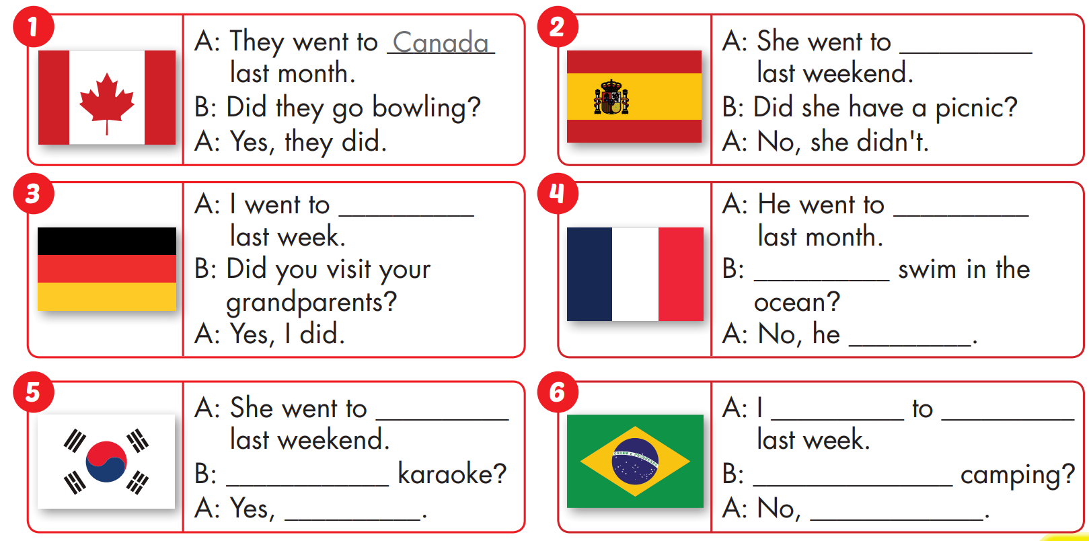
Spain
Germany
France
Did he
didn't
South
Korea
went
Brazil
Did she sing
Did you go
She did
I didn't

Slide 9

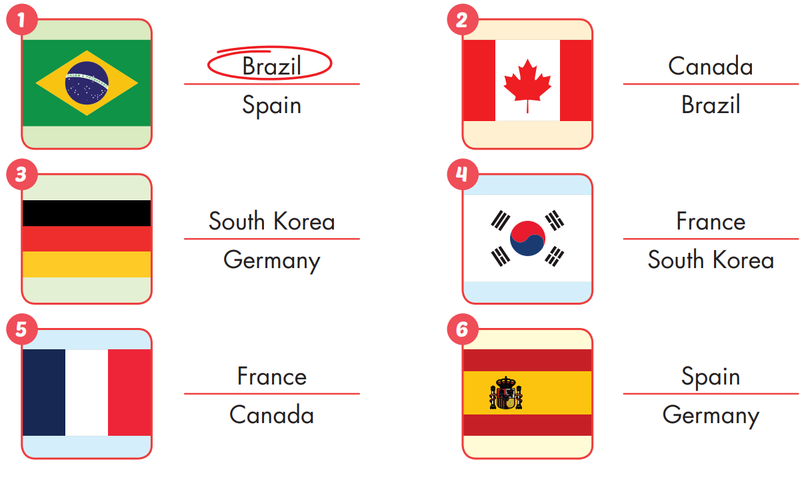

Extra Practice
WB, page 34

Slide 10
Homework
Practice the vocabularies and structure, and make sentences using them.
Do the exercises in Tiếng Anh 5 i-Learn Smart Start WB (page 34)
Do the exercises in Tiếng Anh 5 i-Learn Smart Start Notebook (page 23)
Prepare the next lesson (page 52 SB)
Play the consolidation games in Tiếng Anh 5 i-Learn Smart Start DHA App on www.eduhome.com.vn

