Slide 1





















Unit 0
Alphabet 3
Notes:
Để nguyên trang bìa như này, chỉ thay đổi tên bài trong quá trình làm. Logo của sách Wonderful World

Slide 2






Warm up
Game: What letter is missing ?

Slide 3
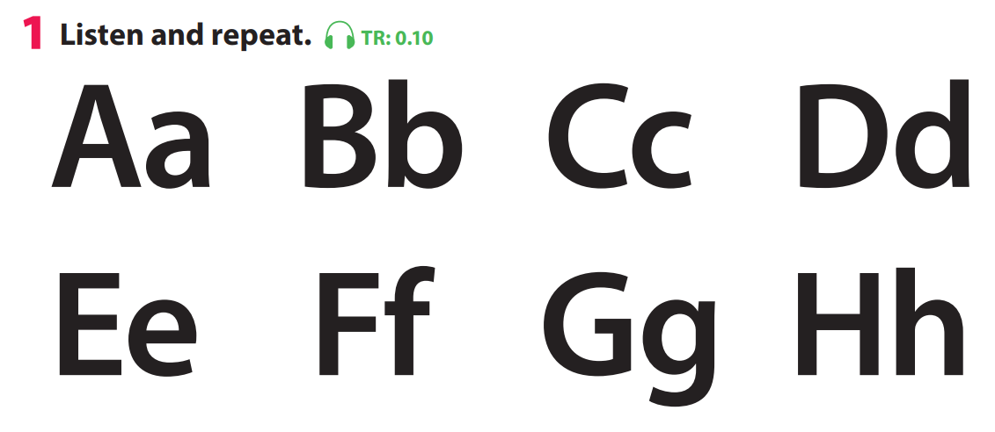
What letter is missing ?

Slide 4
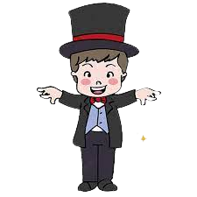

What’s missing?

Slide 5

+3

Slide 6

Let’s say
A
a
B
b
C
c
D
d
E
e
F
f
G
H
h
g
Notes:
Review old lesson
Say the alphabet in order (A-H), from the slowest to the fastest speed, then lead into the lesson: alphabet (I-Q)

Slide 7
Let’s say
I
i
J
K
k
L
l
M
m
j
N
n
P
p
Q
0
o
q
Notes:
Review old lesson
Say the alphabet in order (A-H), from the slowest to the fastest speed, then lead into the lesson: alphabet (I-Q)

Slide 8

Presentation
Task 7: Listen and repeat.

Slide 9

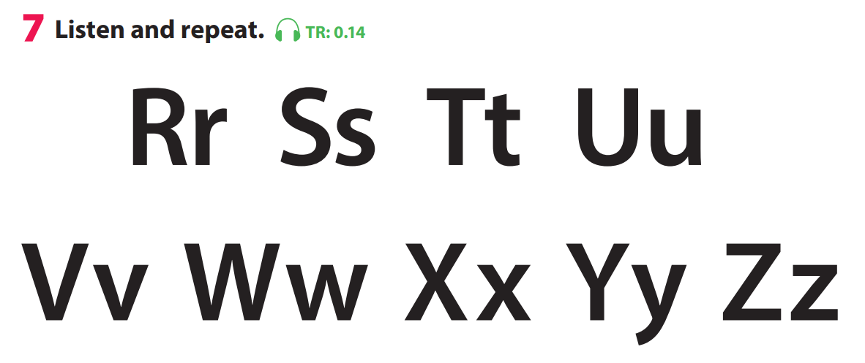

Notes:
GV bấm audio nghe tới đâu click chuột tới đó.

Slide 10

Practice
Task 8: Listen and point. Repeat

Slide 11

Production
Task 9: Ask and answer

Slide 12


How do you spell…?
+5

Slide 13



Good bye.
See you again!

