Slide 1





















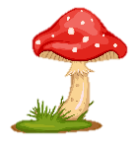

Slide 2



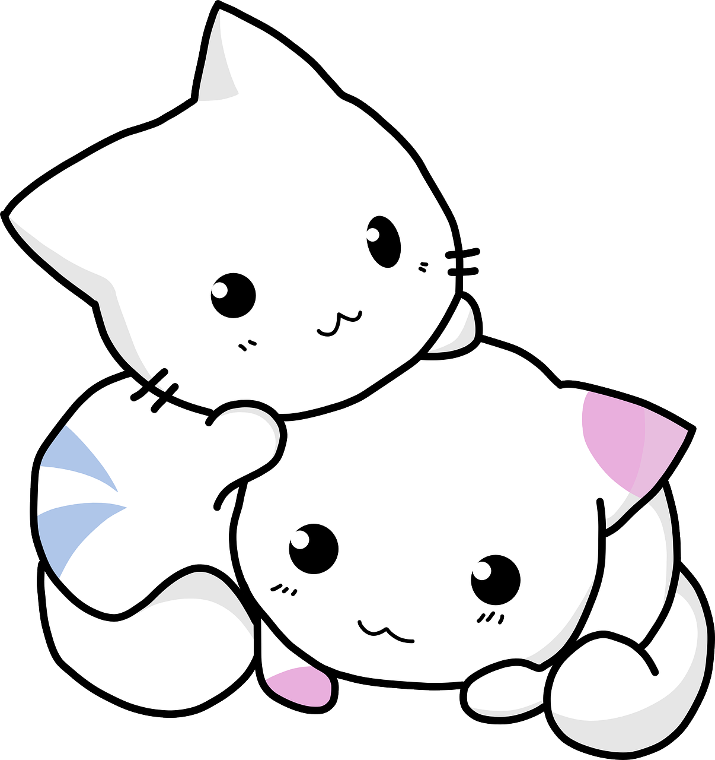
01
Warm up

Slide 3
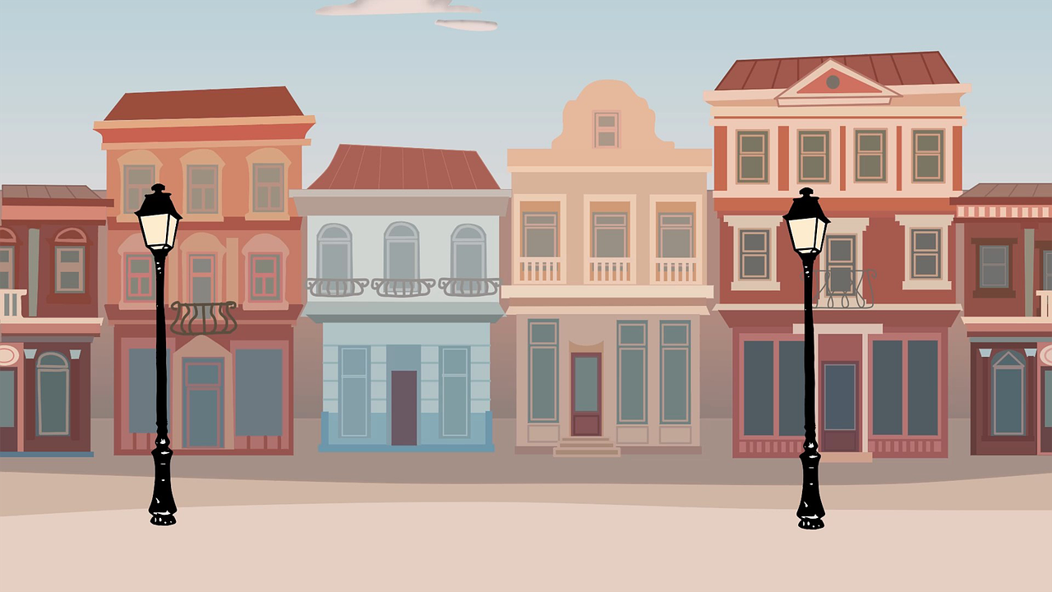
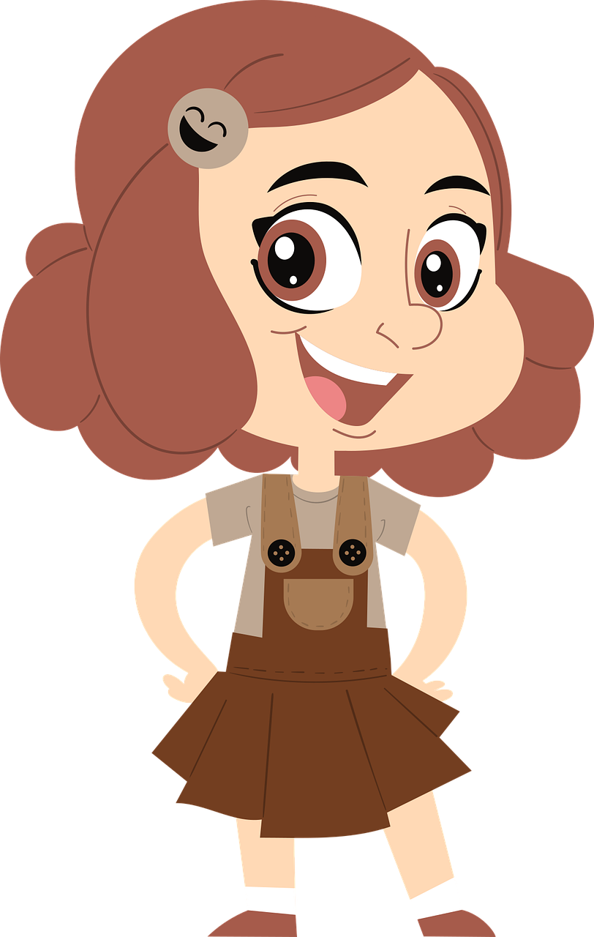
Who is it in a family?
n
_ie_ _
c
e

Slide 4
02
Presentation

Slide 5

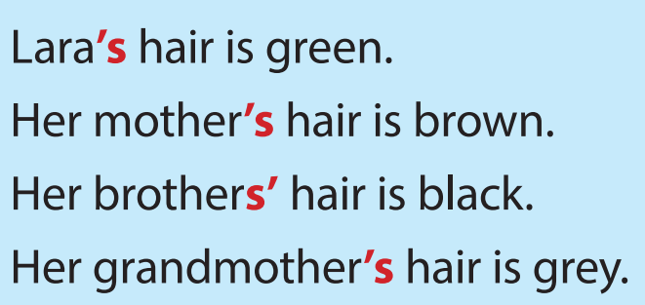


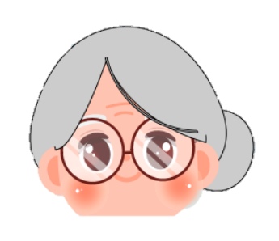
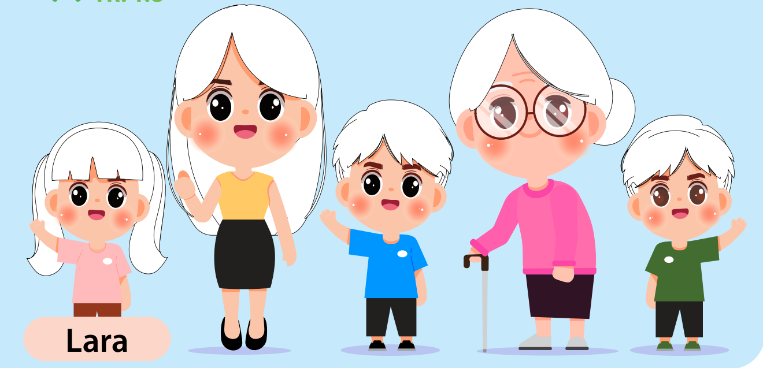




Slide 6
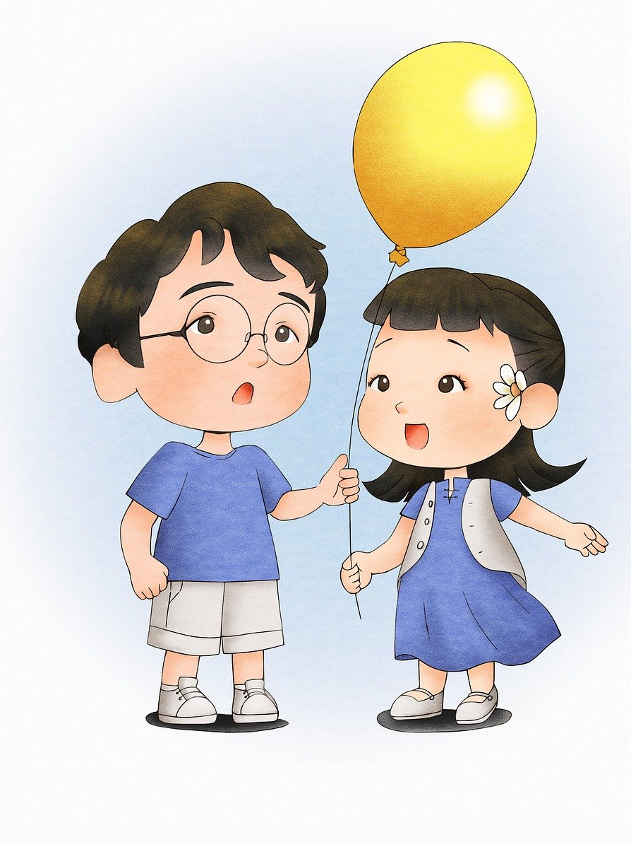
Possessive s’
That yellow balloon belongs to my cousins.
=> My cousins’ balloon is yellow.

Slide 7
`
04
Production

Slide 8
`
05
Wrap-up &
Assessment

