Slide 1





















Unit 0
Greetings
Notes:
Để nguyên trang bìa như này, chỉ thay đổi tên bài trong quá trình làm. Logo của sách Wonderful World

Slide 2


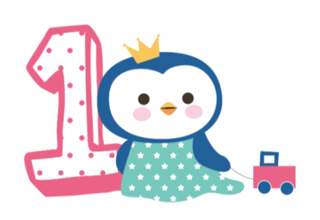



Warm up!

Slide 3
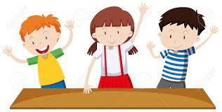



Movement Game: Hip hip hooray
Hands up!
Hands down!
Hip hip hooray
Go to Wonderful World!
Notes:
+ Hands up: raise 2 hands up
+ Hands down: Put to hands down
+ Hip hip hooray (2 times): smack 2 hands on hips then put hands to mouth when saying hooray (2 times)
+ Go to Wonderful World: join 2 hands and make waves then raise both hands up and wave.

Slide 4

Presentation
Task 4 and task 5.

Slide 5
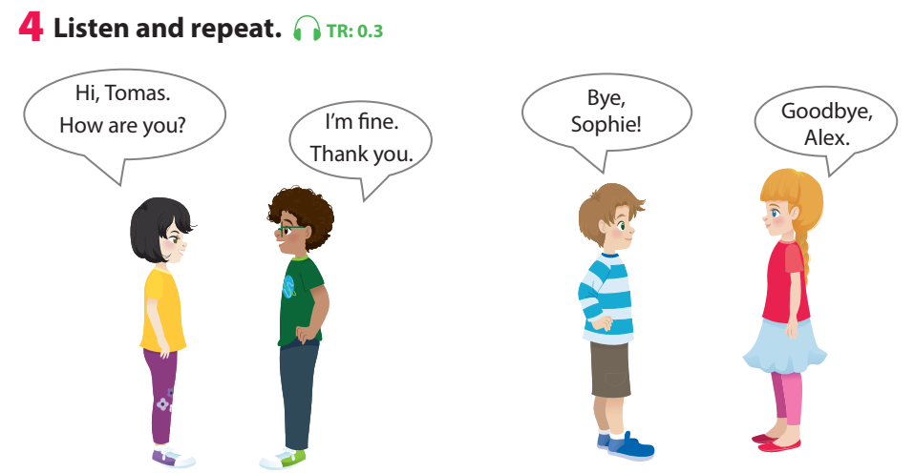

Notes:
Play the track 0.3, ask students to listen and repeat in chorus, group.

Slide 6
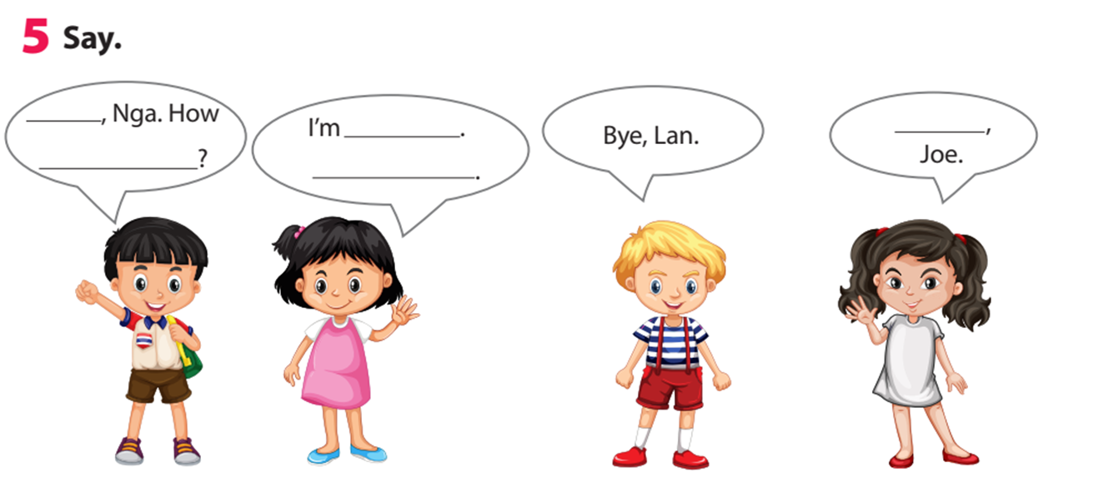
Thank you
Hi
are you
fine
Goodbye
Notes:
Task 5: Say - Ask sts how many friends can they see and their names.
- Have sts look at the bubbles and ask them to complete (spoken).

Slide 7
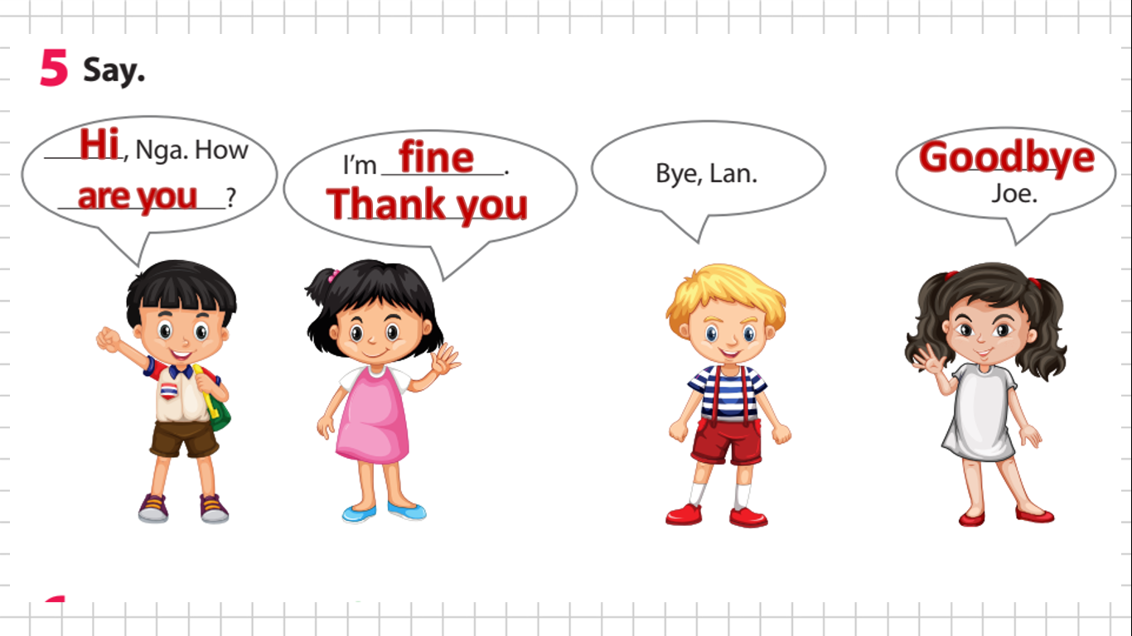
Notes:
- Have sts practice the dialogues in chorus, group, pairs.
- Go over the activity. Ask children to say sentences about different pictures in their classroom, pointing to them.

Slide 8
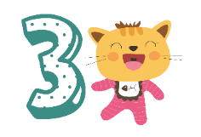
Practice
Task 6: Listen and sing.
Notes:
Task 6: Listen and sing.
-Ask children to look at the picture. Point to the book and ask What’s this? Ask children to predict what the song is about (Good bye friends).
-Play the song all the way through once for children to listen; then play it again as they follow the words in their books.
-Play it again, stopping after each line for children to repeat.
-Play the recording for children to sing along.

Slide 9

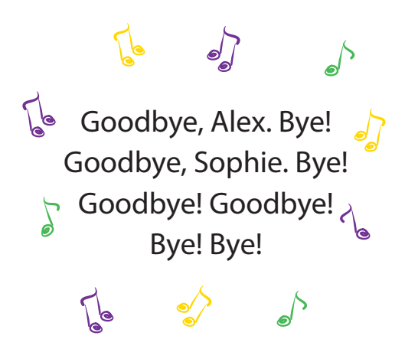
Notes:
Task 6: Listen and sing.
-Ask children to look at the picture. Point to the book and ask What’s this? Ask children to predict what the song is about (Good bye friends).
-Play the song all the way through once for children to listen; then play it again as they follow the words in their books.
-Play it again, stopping after each line for children to repeat.
-Play the recording for children to sing along.

Slide 10
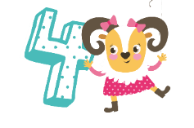
Production
Role play
Notes:
Game: Role play
Situation 1:
A new member of an English club come to the club. Practice the greeting and goodbye.

Slide 11



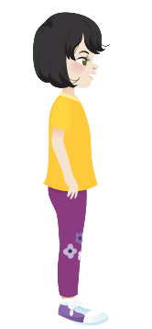
English club
Hi, I’m Anna. Nice to meet you.
Hi, I’m Sophia. Nice to meet you.
Notes:
Game: Role play
Situation 1:
A new member of an English club come to the club. Practice the greeting and goodbye.

Slide 12



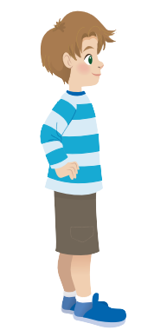

Hi, I’m Tomas. Nice to meet you, too.
Hi, I’m Alex. Nice to meet you.
Notes:
Situation 2:
2 new classmates meet at the school the first time. Practice the greeting and goodbye.
Ask some sts to come to the front to role play for the class.

