Slide 1















Unit 1: My family
and friends
Lesson 1. Task 1 2 3

Slide 2



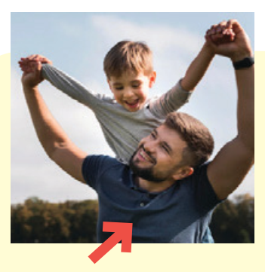
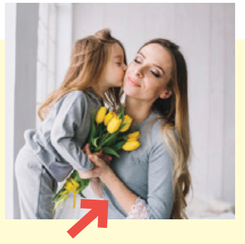
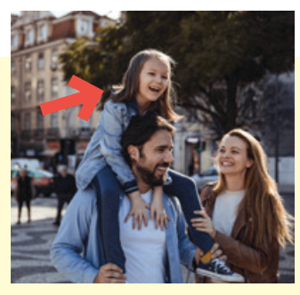


1 Listen and point. Repeat.
father
mother
daughter
son
twins

Slide 3
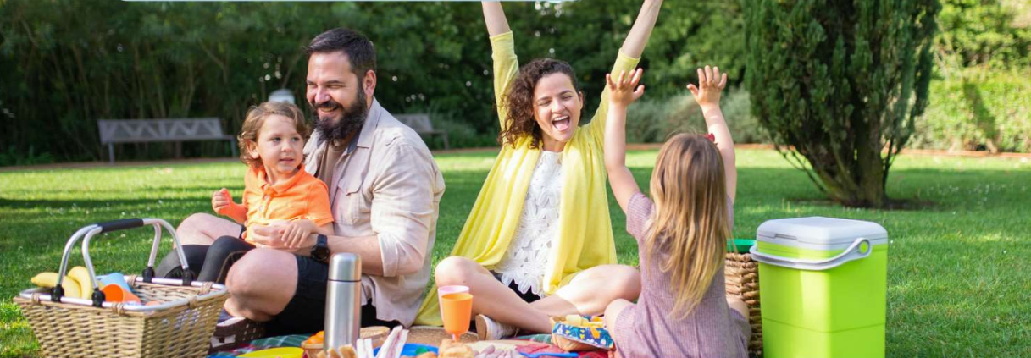


2 Listen and read. Write.
Tom: Look! This is my family.
We’re going on a picnic in the park.
Jack: That’s great! Who is he ?
Tom: He’s my father.
Jack: And who is she ?
Tom: She’s my mother.
Jack: Wow! She’s young.

Slide 4
2. Listen and read. Write.
There are people in the photo:
a mother, a , a son and a daughter.
four/4
father
Notes:
Đề bài và audio đọc khác tiêu đề - KT lại xem bản cập nhập SGK

Slide 5

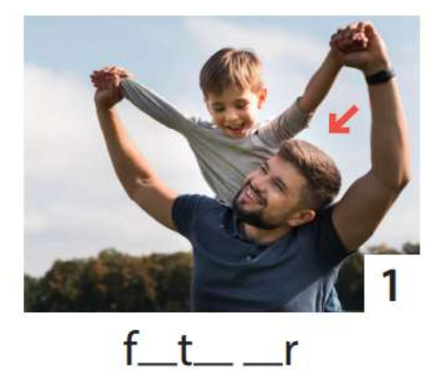
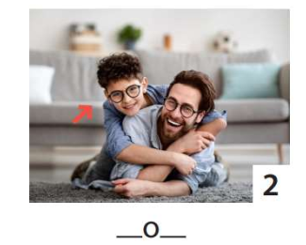
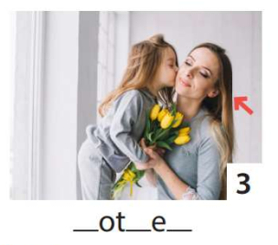
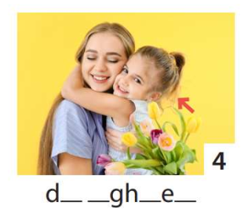
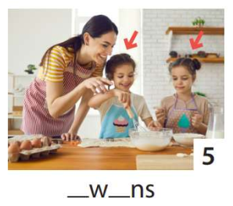
3 Write. Point and say.
1
2
3
4
5
He’s my father.
He’s my son.
She’s my daughter.
She’s my mother.
They’re twins.

Slide 6




Thank you & goodbye!

