Slide 1




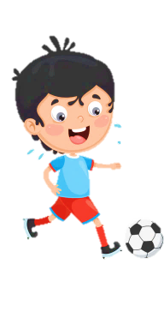











Slide 2
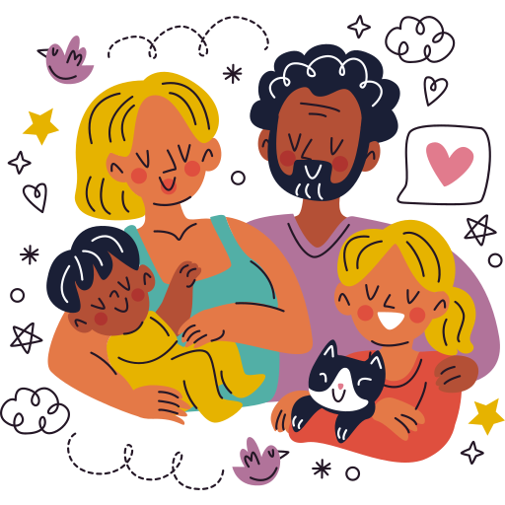
Unit 1:
FAMILY AND FRIENDS
Lesson 3 – Part 4, 5, 6

Slide 3





Table of contents
01
02
Warm - up
Presentation
05
04
Wrap - up &
Assessment
Production
03
Practice

Slide 4




01
Warm up

Slide 5
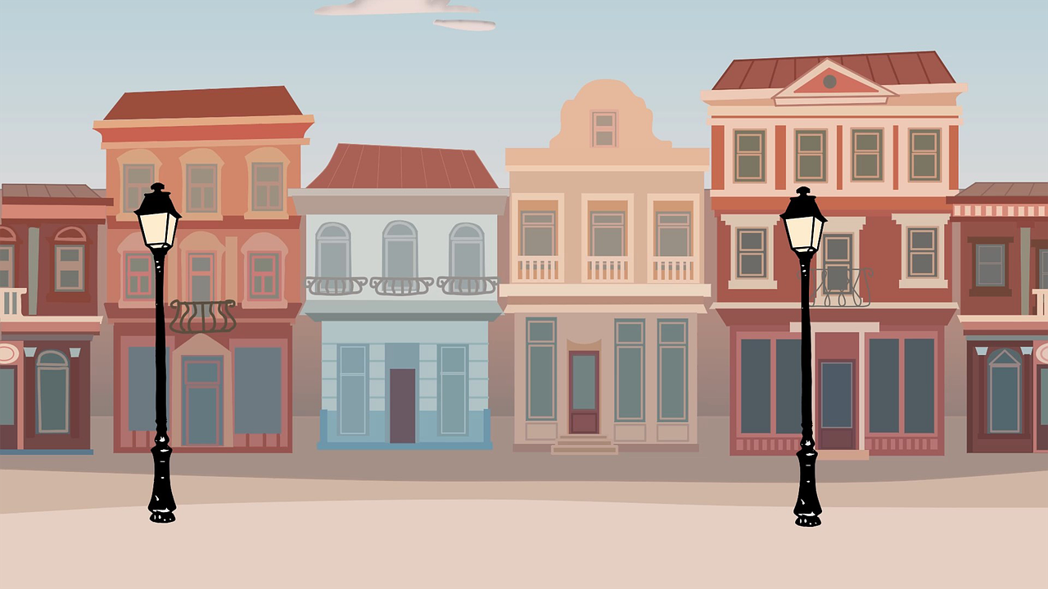
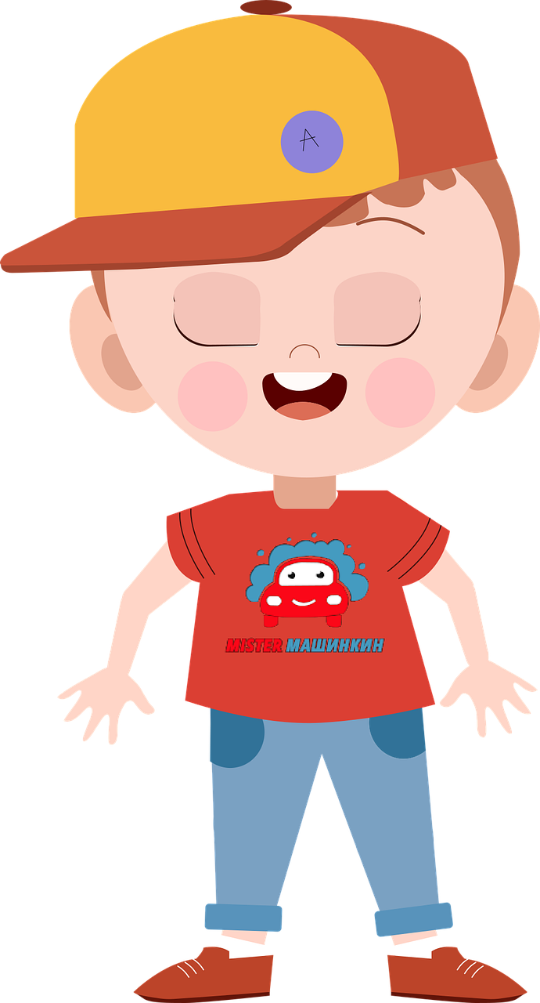
Who is it in a family?
co_s_n
u
i

Slide 6

Who is it in a family?
un_ _ _
c
l
e

Slide 7

Who is it in a family?
n_p_e_
e
h
w

Slide 8
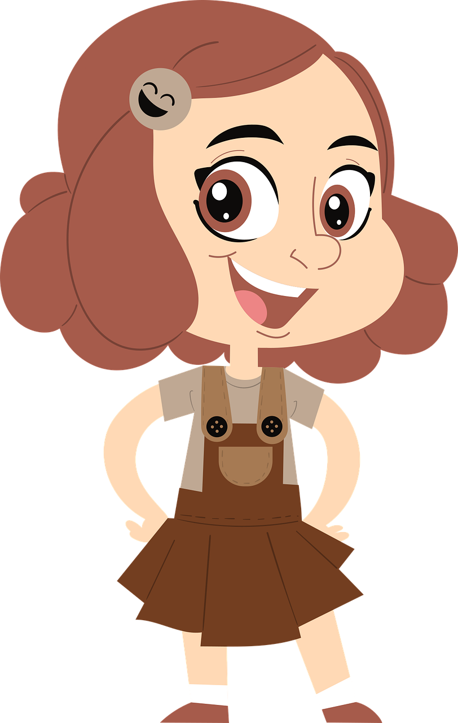
Who is it in a family?
n
_ie_ _
c
e

Slide 9
02
Presentation

Slide 10

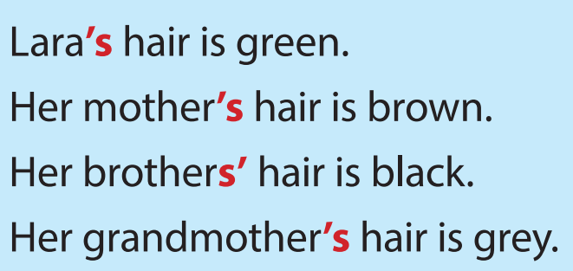

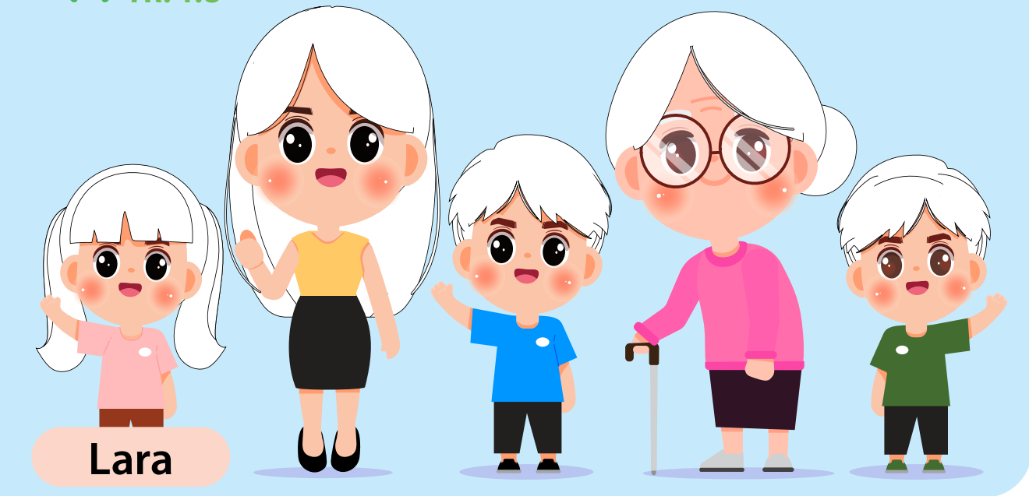

Slide 11

Possessives: ‘s
This camera belongs to my aunt.
=> This is my aunt’s camera.

Slide 12
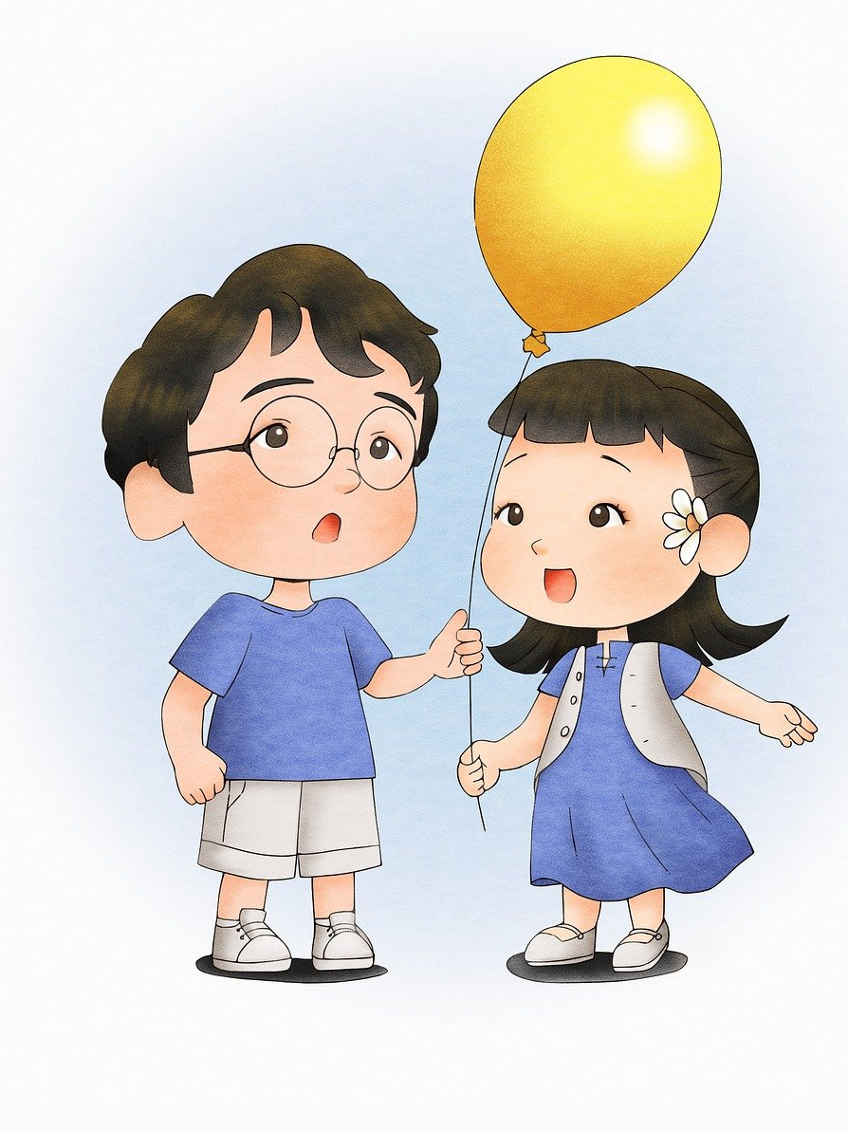
Possessive s’
That yellow balloon belongs to my cousins.
=> My cousins’ balloon is yellow.

Slide 13

Look and say
These red shoes belong to Anna.
=> Anna…. shoes are red.
‘s

Slide 14

Look and say
That red car belongs to my grandpa.
=> That red car is my grandpa….
‘s

Slide 15
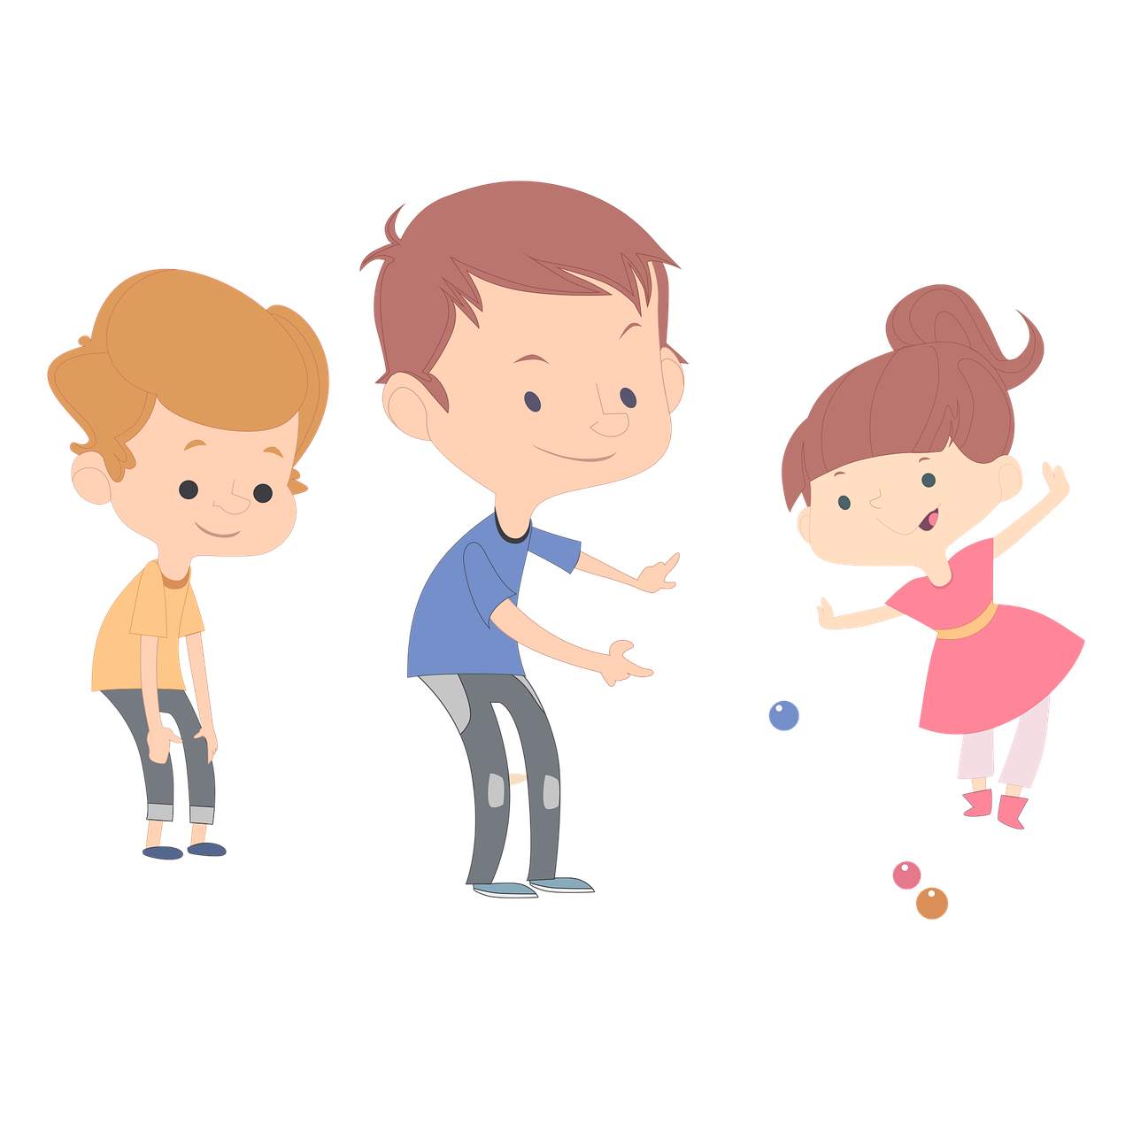
Look and say
The boys have a sister.
She is the boy…. sister.
s’

Slide 16
`
03
Practice

Slide 17
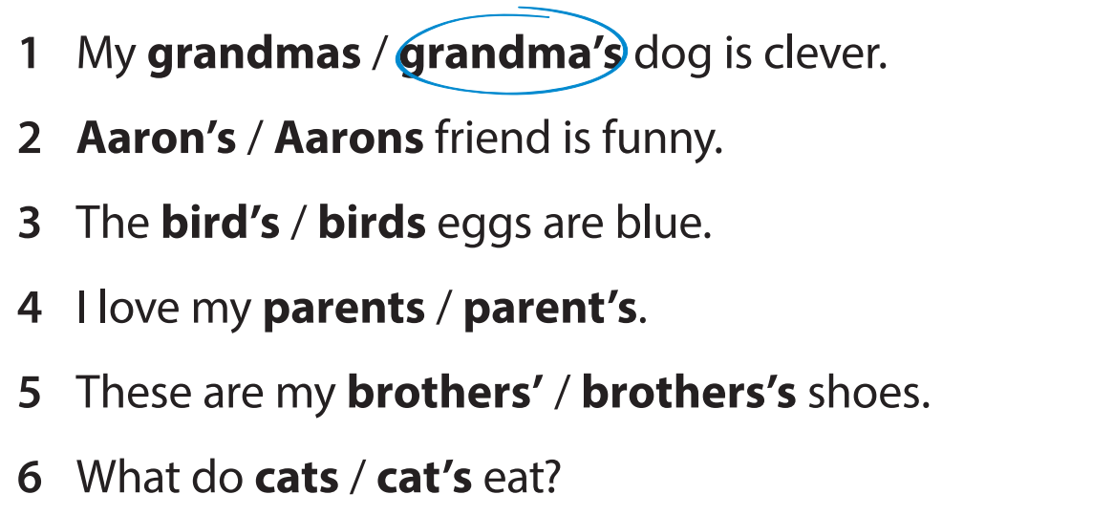


Slide 18
`
04
Production

Slide 19

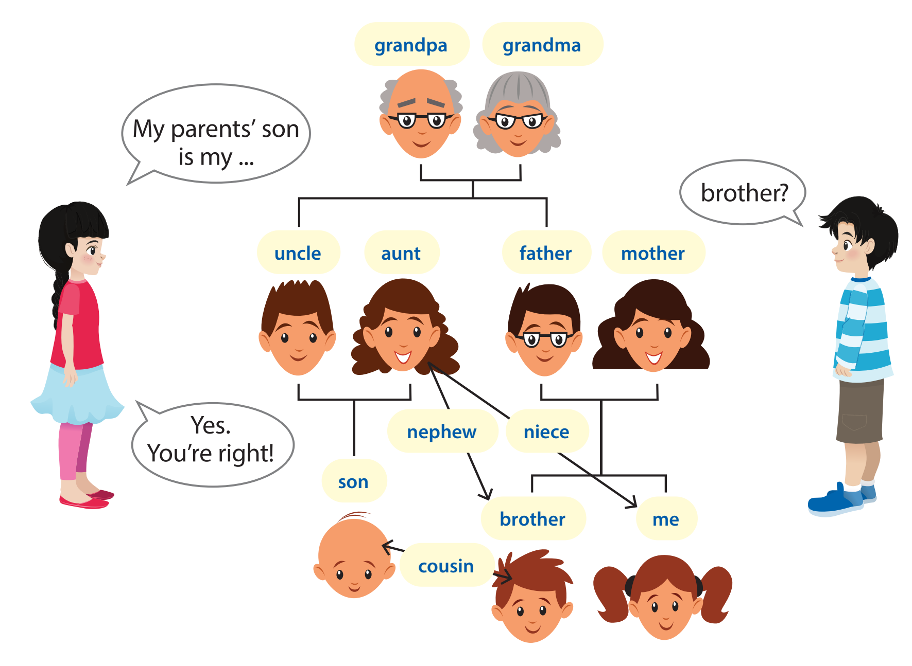
My parents’ son is my ….
brother?
Yes.
You’re right!

Slide 20
`
05
Wrap-up &
Assessment

Slide 21

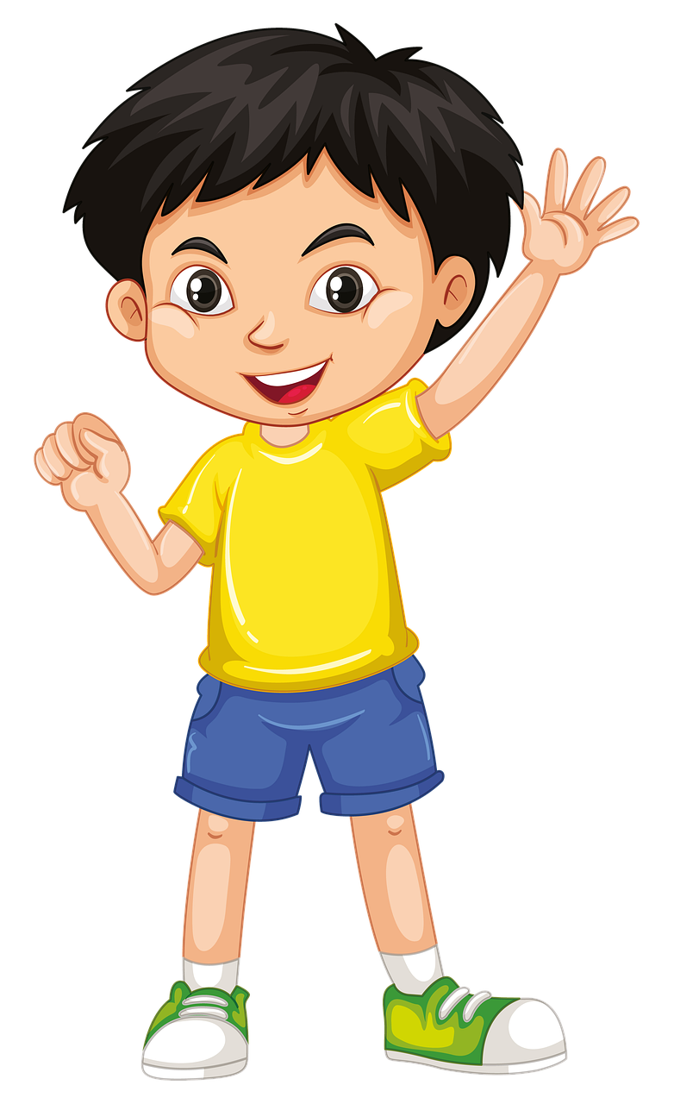
Find the mistake and correct it
John’s shorts is so comfortable.
John’s shorts are so comfortable.

Slide 22
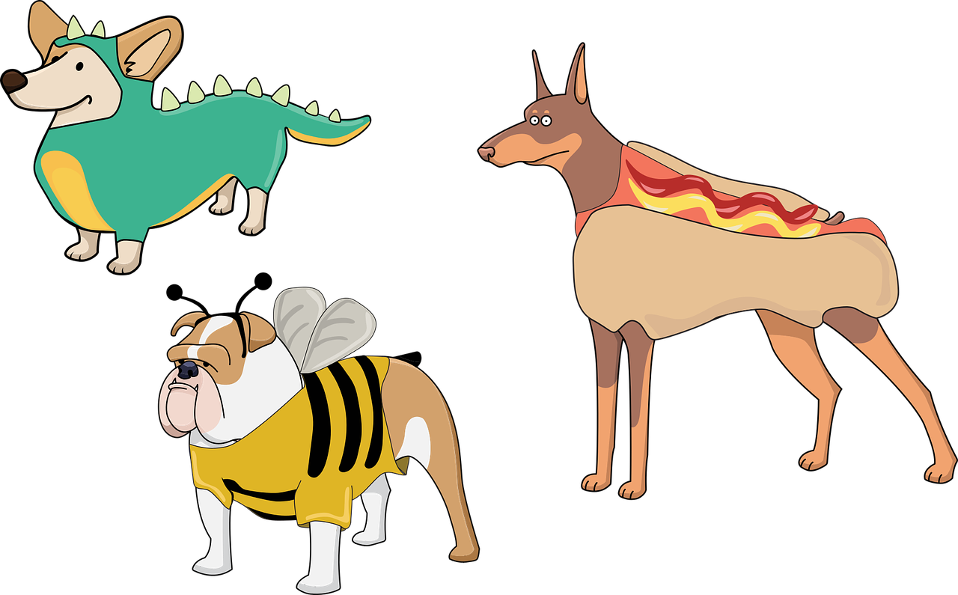

Find the mistake and correct it
Her dogs’s favourite food is meat.
=> Her dogs’ favourite food is meat.

Slide 23

Find the mistake and correct it
My parent’s house is beautiful.
=> My parents’ house is beautiful.

Slide 24


Wrap up
Unit 1: Family and friends
Lesson 3 – Part 4,5,6
What do we learn today?
Grammar: Possessive ‘s, s’
Lara’s hair is green.
Her brothers’ hair is black.

