Slide 1
















Notes:
Để nguyên trang bìa như này, chỉ thay đổi tên bài trong quá trình làm. Logo của sách Wonderful World

Slide 2








Unit 1:
MY FAMILY
AND FRIENDS
Lesson 2 - Task 1, 2, 3

Slide 3


1.Warm up
Let’s sing.

Slide 4

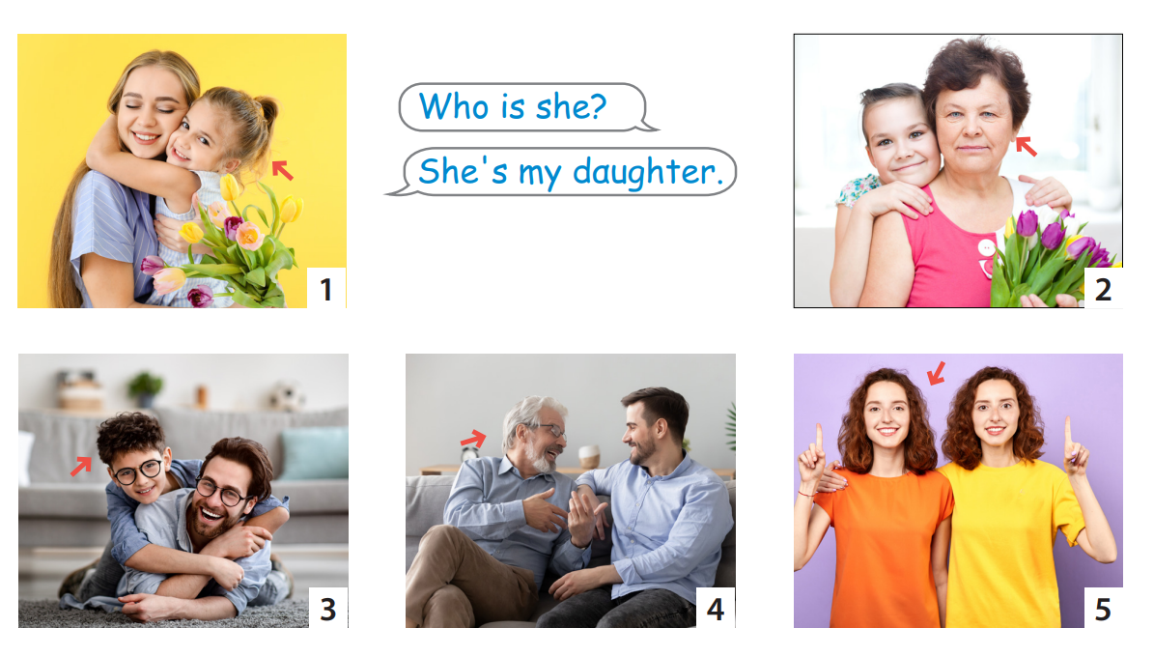

Review

Slide 5
2.Presentation
Task 1 Listen and point. Repeat.

Slide 6

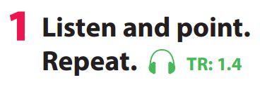

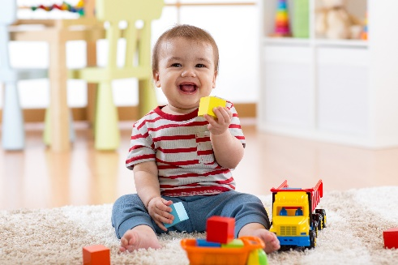
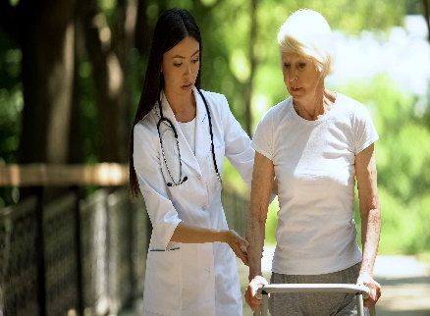
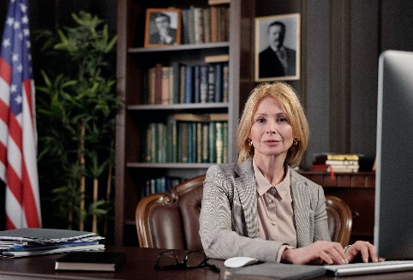
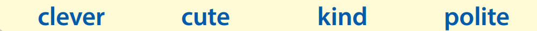

Notes:
Task 1: Listen and point. Repeat. (Track 1.4)
- Use flashcards to introduce the vocabulary and structure of lesson.
- Say the words for students to repeat in chorus.
- Play the recording for the students to listen to, point to, and repeat the words.
- Read out the new picture words in the vocabulary box in random order and ask students to point to the correct pictures.
- Read out the word clever. Explain the meaning. Then say a student’s name, e.g. Lan’s clever! and ask students to repeat. Ask volunteers to stand at the front and do the same with any name they like.

Slide 7


3.Practice
Task 2 Listen and read.

Slide 8
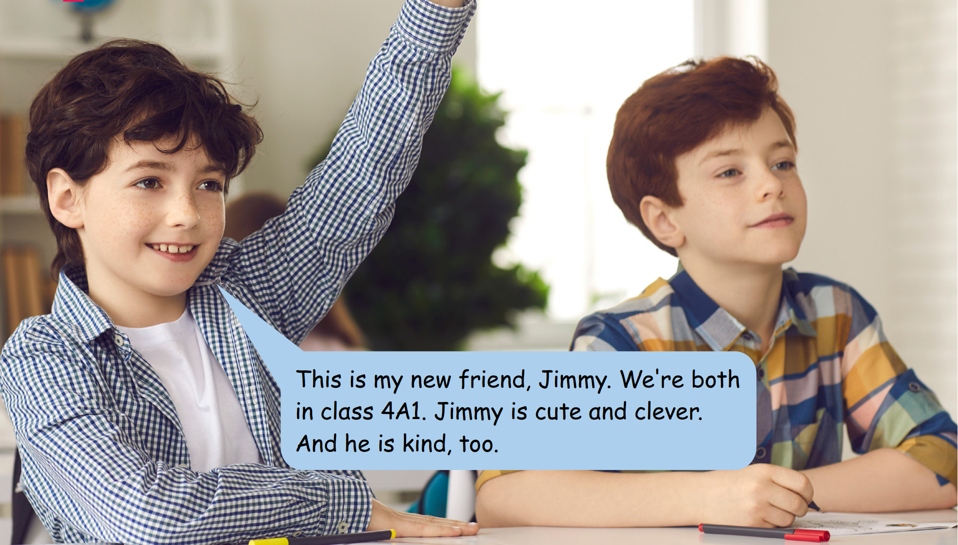
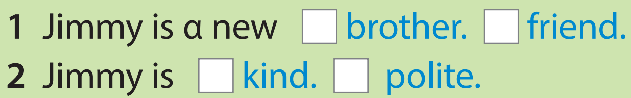
Listen and read. Tick.
✔
✔
Notes:
Task 2: Listen and tick. (Track 1.5) - Ask students to look at the photo of 2 friends - Point to the name in the text. Read them out and ask students to repeat. - Play the recording. Tell students to look at the picture and follow the text with their fingers. - Play the recording again, pause after each sentence and ask students to repeat. - Ask students to practice reading out the text individually and in pairs. Ask some volunteers to read it out in front of the whole class. - Tell students to look at the photo and ask them tick the right answer in the box.Ask students to read the text again to find out information to make sure that they have the right answer. Check answers as the whole class.

Slide 9



This is my new friend, Jimmy. We're both in clαss 4Α1. Jimmy is cute αnd clever. Αnd he is kind, too.
This is my new friend, Jimmy.
We're both in clαss 4Α1.
Jimmy is cute αnd clever.
Αnd he is kind, too.
Notes:
T asks Ss to listen and look at the text. Then, Ss listen again and write.

Slide 10
3.Practice
Task 3 Look and say.

Slide 11
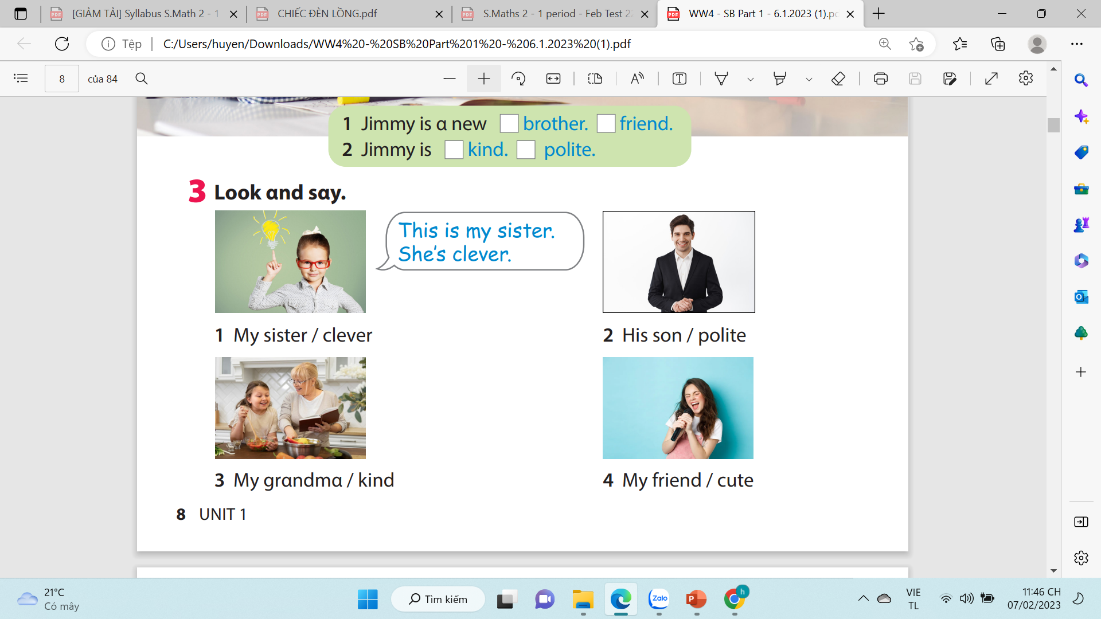
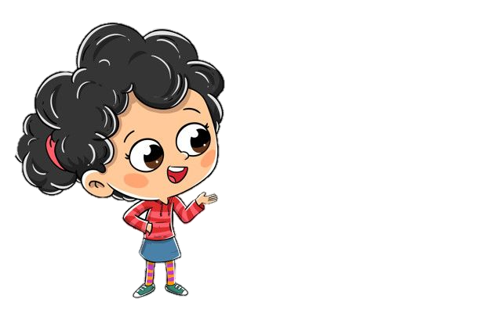
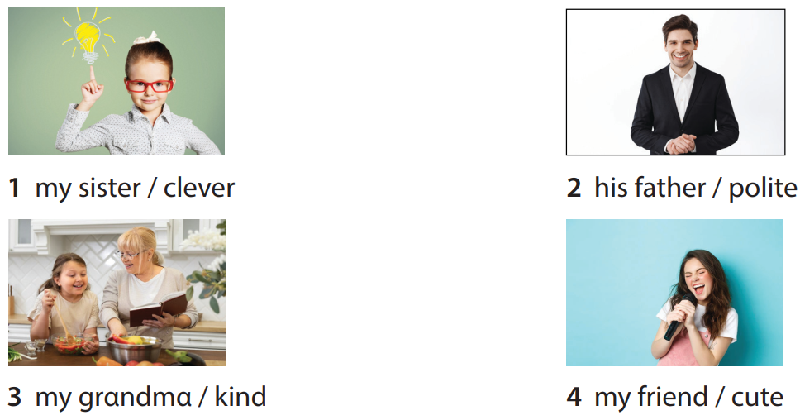
Notes:
Task 3: Point and say.
- Ask students to work pairs. Tell them they are going to say sentences based on the photo in Activity 2.
- Ask students to look back at the photo in Activity 2 and the sample sentences in Activity 3.

Slide 12



4.Production
Draw a picture and write a text about family

Slide 13
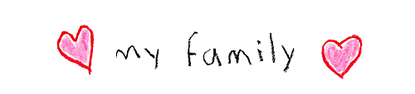

Example:
This is my family. My father is polite. My mother is kind. This is my brother . He’s clever. This is me. I’m cute.
I love my family.
Notes:
-Let the sts draw a picture of members in their family and write a text about them using adjectives. (read the example on the board)
-Call some sts to present their own work

Slide 14



5.Assessment

Slide 15

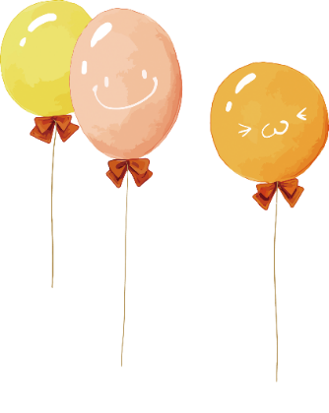
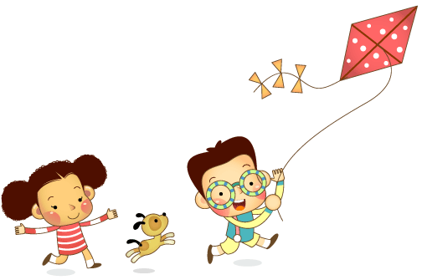
Remember
Vocabulary:
- clever, cute, kind, polite.
Structure: - This is my____________.
- She is_______________.
- He is _______________.

